Slide 1
Chapter 10: Storage and File Structure
Overview of Physical Storage Media
Magnetic Disks
RAID
Tertiary Storage
Storage Access
File Organization
Organization of Records in Files
Data-Dictionary Storage

Slide 2
Classification of Physical Storage Media
Speed with which data can be accessed
Cost per unit of data
Reliability
  data loss on power failure or system crash
  physical failure of the storage device
Can differentiate storage into:
  volatile storage: loses contents when power is switched off
  non-volatile storage:
    Contents persist even when power is switched off.
    Includes secondary and tertiary storage, as well as batter- backed up main-memory.

Slide 3
Physical Storage Media
Cache – fastest and most costly form of storage; volatile; managed by the computer system hardware. Several levels of cache.
Main memory:
  fast access (10s to 100s of nanoseconds; 1 nanosecond = 10^{–9} seconds)
  generally too small (or too expensive) to store the entire database
    capacities of up to a few Gigabytes widely used currently
    Capacities have gone up and per-byte costs have decreased steadily and rapidly (roughly factor of 2 every 2 to 3 years)
  Volatile — contents of main memory are usually lost if a power failure or system crash occurs.

Slide 4
Physical Storage Media (Cont.)
Flash memory
  Data survives power failure
  Data can be written at a location only once, but location can be erased and written to again
    Can support only a limited number (10K – 1M) of write/erase cycles.
    Erasing of memory has to be done to an entire bank of memory
  Reads are almost as fast as main memory (but not quite)
  But writes are slow (few microseconds), erase is slower
  Actual performance depends on file system and details
  Widely used in embedded devices such as digital cameras, phones, and USB keys

Slide 5
Physical Storage Media (Cont.)
Magnetic-disk
  Data is stored on spinning disk, and read/written magnetically
  Primary medium for the long-term storage of data; typically stores entire database.
  Data must be moved from disk to main memory for access, and written back for storage
    Much slower access than main memory (more on this later)
  direct-access – possible to read data on disk in any order, unlike magnetic tape
  Capacities range up to roughly 1.5 TB as of 2009
    Much larger capacity and cost/byte than main memory/flash memory
    Growing constantly and rapidly with technology improvements (factor of 2 to 3 every 2 years)
  Survives power failures and system crashes
    disk failure can destroy data, but is rare

Slide 6
Physical Storage Media (Cont.)
Optical storage
  non-volatile, data is read optically from a spinning disk using a laser
  CD-ROM (640 MB) and DVD (4.7 to 17 GB) most popular forms
  Blu-ray disks: 27 GB to 54 GB
  Write-one, read-many (WORM) optical disks used for archival storage (CD-R, DVD-R, DVD+R)
  Multiple write versions also available (CD-RW, DVD-RW, DVD+RW, and DVD-RAM)
  Reads and writes are slower than with magnetic disk
  Juke-box systems, with large numbers of removable disks, a few drives, and a mechanism for automatic loading/unloading of disks available for storing large volumes of data

Slide 7
Physical Storage Media (Cont.)
Tape storage
  non-volatile, used primarily for backup (to recover from disk failure), and for archival data
  sequential-access – much slower than disk
  very high capacity (40 to 300 GB tapes available)
  tape can be removed from drive ⇒ storage costs much cheaper than disk, but drives are expensive
  Tape jukeboxes available for storing massive amounts of data
    hundreds of terabytes (1 terabyte = 10⁹ bytes) to even multiple petabytes (1 petabyte = 10¹² bytes)

Slide 8
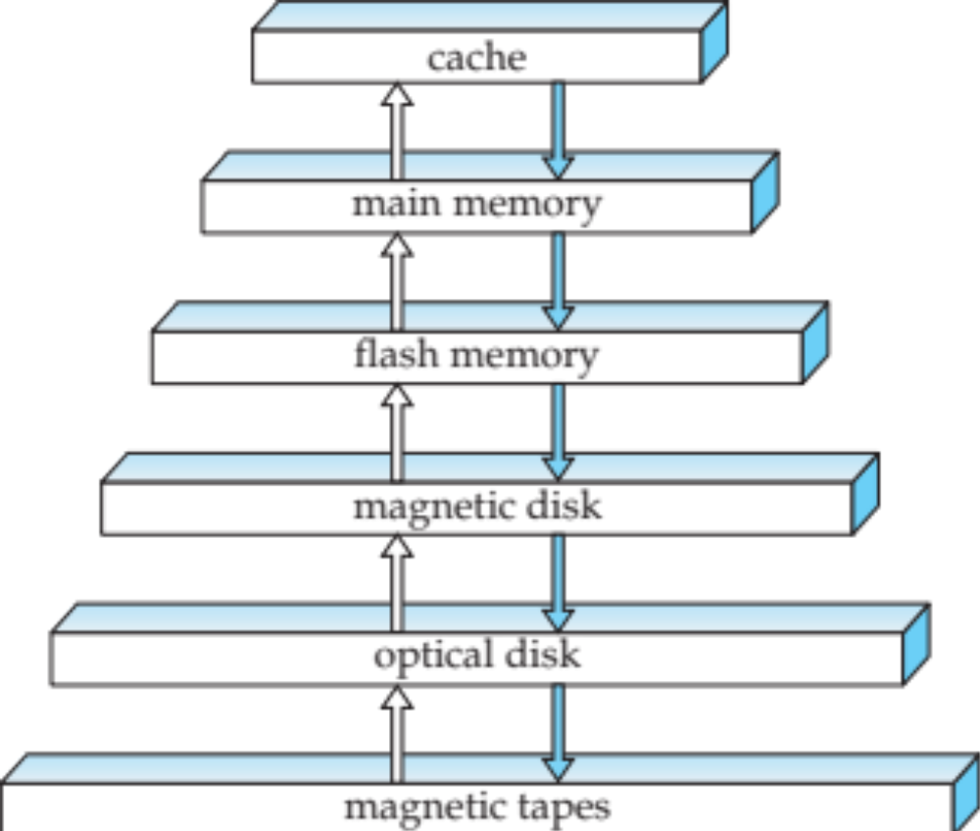
Storage Hierarchy

Slide 9
Storage Hierarchy (Cont.)
primary storage: Fastest media but volatile (cache, main memory).
secondary storage: next level in hierarchy, non-volatile, moderately fast access time
  also called on-line storage
  E.g. flash memory, magnetic disks
tertiary storage: lowest level in hierarchy, non-volatile, slow access time
  also called off-line storage
  E.g. magnetic tape, optical storage
Another issue: remote storage, clouds, etc.

Slide 10
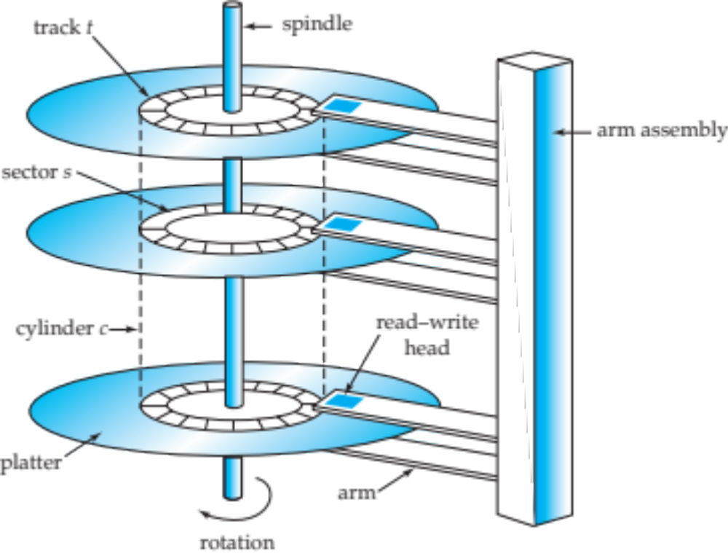
Magnetic Hard Disk Mechanism
NOTE: Diagram is schematic, and simplifies the structure of actual disk drives

Slide 11
Magnetic Disks
Read-write head
  Positioned very close to the platter surface (almost touching it)
  Reads or writes magnetically encoded information.
Surface of platter divided into circular tracks
  Over 50K-100K tracks per platter on typical hard disks
Each track is divided into sectors.
  A sector is the smallest unit of data that can be read or written.
  Sector size typically 512 bytes
  Typical sectors per track: 500 to 1000 (on inner tracks) to 1000 to 2000 (on outer tracks)
To read/write a sector
  disk arm swings to position head on right track
  platter spins continually; data is read/written as sector passes under head
Head-disk assemblies
  multiple disk platters on a single spindle (1 to 5 usually)
  one head per platter, mounted on a common arm.
Cylinder i consists of i^{th} track of all the platters

Slide 12
Magnetic Disks (Cont.)
Earlier generation disks were susceptible to head-crashes
  Surface of earlier generation disks had metal-oxide coatings which would disintegrate on head crash and damage all data on disk
  Current generation disks are less susceptible to such disastrous failures, although individual sectors may get corrupted
Disk controller – interfaces between the computer system and the disk drive hardware.
  accepts high-level commands to read or write a sector
  initiates actions such as moving the disk arm to the right track and actually reading or writing the data
  Computes and attaches checksums to each sector to verify that data is read back correctly
    If data is corrupted, with very high probability stored checksum won’t match recomputed checksum
  Ensures successful writing by reading back sector after writing it
  Performs remapping of bad sectors

Slide 13

Disk Subsystem
Multiple disks connected to a computer system through a controller
  Controllers functionality (checksum, bad sector remapping) often carried out by individual disks; reduces load on controller
Disk interface standards families
  ATA (AT adaptor) range of standards
  SATA (Serial ATA)
  SCSI (Small Computer System Interconnect) range of standards
  SAS (Serial Attached SCSI)
  Several variants of each standard (different speeds and capabilities)
Notes:
----- Meeting Notes (3/27/12 20:25) -----

Slide 14
Performance Measures of Disks
Access time – the time it takes from when a read or write request is issued to when data transfer begins. Consists of:
  Seek time – time it takes to reposition the arm over the correct track.
    Average seek time is 1/2 the worst case seek time.
      Would be 1/3 if all tracks had the same number of sectors, and we ignore the time to start and stop arm movement
    4 to 10 milliseconds on typical disks
  Rotational latency – time it takes for the sector to be accessed to appear under the head.
    Average latency is 1/2 of the worst case latency.
    4 to 11 milliseconds on typical disks (5400 to 15000 r.p.m.)
Data-transfer rate – the rate at which data can be retrieved from or stored to the disk.
  25 to 100 MB per second max rate, lower for inner tracks
  Multiple disks may share a controller, so rate that controller can handle is also important
    E.g. SATA: 150 MB/sec, SATA-II 3Gb (300 MB/sec)
    Ultra 320 SCSI: 320 MB/s, SAS (3 to 6 Gb/sec)
    Fiber Channel (FC2Gb or 4Gb): 256 to 512 MB/s

Slide 15
Performance Measures (Cont.)
Mean time to failure (MTTF) – the average time the disk is expected to run continuously without any failure.
  Typically 3 to 5 years
  Probability of failure of new disks is quite low, corresponding to a
  “theoretical MTTF” of 500,000 to 1,200,000 hours for a new disk
    E.g., an MTTF of 1,200,000 hours for a new disk means that given 1000 relatively new disks, on an average one will fail every 1200 hours
  MTTF decreases as disk ages
Disk Subsystem
Disks usually connected directly to computer system
In Storage Area Networks (SAN), a large number of disks are connected by a high-speed network to a number of servers
In Network Attached Storage (NAS) networked storage provides a file system interface using networked file system protocol, instead of providing a disk system interface

Slide 16
Optimization of Disk-Block Access
Block – a contiguous sequence of sectors from a single track
  data is transferred between disk and main memory in blocks
  sizes range from 512 bytes to several kilobytes
    Smaller blocks: more transfers from disk
    Larger blocks: more space wasted due to partially filled blocks
    Typical block sizes today range from 4 to 16 kilobytes
Disk-arm-scheduling algorithms order pending accesses to tracks so that disk arm movement is minimized
  elevator algorithm
File organization – optimize block access time by organizing the blocks to correspond to how data will be accessed
  E.g. Store related information on the same or nearby cylinders.
  Files may get fragmented over time
    Sequential access to fragmented file means increased arm movement
  Some systems have utilities to defragment the file system, in order to speed up file access

Slide 17
Optimization of Disk Block Access (Cont.)
Nonvolatile write buffers speed up disk writes by writing blocks to a non-volatile RAM buffer immediately
  Non-volatile RAM: battery backed up RAM or flash memory
    Even if power fails, the data is safe and will be written to disk when power returns
  Controller then writes to disk whenever the disk has no other requests or request has been pending for some time
  Database operations that require data to be safely stored before continuing can continue without waiting for data to be written to disk
  Writes can be reordered to minimize disk arm movement
Log disk – a disk devoted to writing a sequential log of block updates
  Used exactly like nonvolatile RAM
    Write to log disk is very fast since no seeks are required
    No need for special hardware (NV-RAM)
File systems typically reorder writes to disk to improve performance
  Journaling file systems write data in safe order to NV-RAM or log disk
  Reordering without journaling: risk of corruption of file system data

Slide 18
RAID
RAID: Redundant Arrays of Independent Disks
  disk organization techniques that manage a large numbers of disks, providing a view of a single disk of
    high capacity and high speed by using multiple disks in parallel,
    high reliability by storing data redundantly, so that data can be recovered even if a disk fails
The chance that some disk out of a set of N disks will fail is much higher than the chance that a specific single disk will fail.
  E.g., a system with 100 disks, each with MTTF of 100,000 hours (approx. 11 years), will have a system MTTF of 1000 hours (approx. 41 days)
  Techniques for using redundancy to avoid data loss are critical with large numbers of disks
Originally a cost-effective alternative to large, expensive disks
  I in RAID originally stood for ``inexpensive’’ (now “independent”)
  Today RAIDs are used for their higher reliability and bandwidth.

Slide 19
Improvement of Reliability via Redundancy
Redundancy – store extra information that can be used to rebuild information lost in a disk failure
E.g., Mirroring (or shadowing)
  Duplicate every disk. Logical disk consists of two physical disks.
  Every write is carried out on both disks
    Reads can take place from either disk
  If one disk in a pair fails, data still available in the other
    Data loss would occur only if a disk fails, and its mirror disk also fails before the system is repaired
      Probability of combined event is very small
        Except for dependent failure modes such as fire or building collapse or electrical power surges
Mean time to data loss depends on mean time to failure,
and mean time to repair
  E.g. MTTF of 100,000 hours, mean time to repair of 10 hours gives mean time to data loss of 500*10⁶ hours (or 57,000 years) for a mirrored pair of disks (ignoring dependent failure modes)

Slide 20
Improvement in Performance via Parallelism
Two main goals of parallelism in a disk system:
  1. Load balance multiple small accesses to increase throughput
  2. Parallelize large accesses to reduce response time.
Improve transfer rate by striping data across multiple disks.
Bit-level striping – split the bits of each byte across multiple disks
  In an array of eight disks, write bit i of each byte to disk i.
  Each access can read data at eight times the rate of a single disk.
  But seek/access time worse than for a single disk
    Bit level striping is not used much any more
Block-level striping – block i of a file goes to disk (i mod n) + 1
  Requests for different blocks can run in parallel if the blocks reside on different disks
  A request for a long sequence of blocks can utilize all disks in parallel

Slide 21

RAID Levels
Schemes to provide redundancy at lower cost by using disk striping combined with parity bits
  Different RAID organizations, or RAID levels, have differing cost, performance and reliability characteristics
RAID Level 0: Block striping; non-redundant.
  Used in high-performance applications where data loss is not critical.
RAID Level 1: Mirrored disks with block striping
  Offers best write performance.
  Popular for applications such as storing log files in a database system.

Slide 22
RAID Levels (Cont.)
RAID Level 2: Memory-Style Error-Correcting-Codes (ECC) with bit striping.
RAID Level 3: Bit-Interleaved Parity
  a single parity bit is enough for error correction, not just detection, since we know which disk has failed
    When writing data, corresponding parity bits must also be computed and written to a parity bit disk
    To recover data in a damaged disk, compute XOR of bits from other disks (including parity bit disk)

Slide 23
RAID Levels (Cont.)
RAID Level 3 (Cont.)
  Faster data transfer than with a single disk, but fewer I/Os per second since every disk has to participate in every I/O.
  Subsumes Level 2 (provides all its benefits, at lower cost).
RAID Level 4: Block-Interleaved Parity; uses block-level striping, and keeps a parity block on a separate disk for corresponding blocks from N other disks.
  When writing data block, corresponding block of parity bits must also be computed and written to parity disk
  To find value of a damaged block, compute XOR of bits from corresponding blocks (including parity block) from other disks.

Slide 24
RAID Levels (Cont.)
RAID Level 4 (Cont.)
  Provides higher I/O rates for independent block reads than Level 3
    block read goes to a single disk, so blocks stored on different disks can be read in parallel
  Provides high transfer rates for reads of multiple blocks than no-striping
  Before writing a block, parity data must be computed
    Can be done by using old parity block, old value of current block and new value of current block (2 block reads + 2 block writes)
    Or by recomputing the parity value using the new values of blocks corresponding to the parity block
      More efficient for writing large amounts of data sequentially
  Parity block becomes a bottleneck for independent block writes since every block write also writes to parity disk

Slide 25
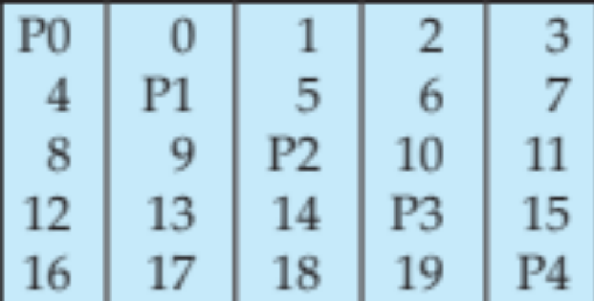
RAID Levels (Cont.)
RAID Level 5: Block-Interleaved Distributed Parity; partitions data and parity among all N + 1 disks, rather than storing data in N disks and parity in 1 disk.
  E.g., with 5 disks, parity block for nth set of blocks is stored on disk (n mod 5) + 1, with the data blocks stored on the other 4 disks.

Slide 26
RAID Levels (Cont.)
RAID Level 5 (Cont.)
  Higher I/O rates than Level 4.
    Block writes occur in parallel if the blocks and their parity blocks are on different disks.
  Subsumes Level 4: provides same benefits, but avoids bottleneck of parity disk.
RAID Level 6: P+Q Redundancy scheme; similar to Level 5, but stores extra redundant information to guard against multiple disk failures.
  Better reliability than Level 5 at a higher cost; not used as widely.

Slide 27
Choice of RAID Level
Factors in choosing RAID level
  Monetary cost
  Performance: Number of I/O operations per second, and bandwidth during normal operation
  Performance during failure
  Performance during rebuild of failed disk
    Including time taken to rebuild failed disk
RAID 0 is used only when data safety is not important
  E.g. data can be recovered quickly from other sources
Level 2 and 4 never used since they are subsumed by 3 and 5
Level 3 is not used anymore since bit-striping forces single block reads to access all disks, wasting disk arm movement, which block striping (level 5) avoids
Level 6 is rarely used since levels 1 and 5 offer adequate safety for most applications (but maybe becoming more important)

Slide 28
Hardware Issues
Software RAID: RAID implementations done entirely in software, with no special hardware support
Hardware RAID: RAID implementations with special hardware
  Use non-volatile RAM to record writes that are being executed
  Beware: power failure during write can result in corrupted disk
    E.g. failure after writing one block but before writing the second in a mirrored system
    Such corrupted data must be detected when power is restored
      Recovery from corruption is similar to recovery from failed disk
      NV-RAM helps to efficiently detected potentially corrupted blocks
        Otherwise all blocks of disk must be read and compared with mirror/parity block

Slide 29
Hardware Issues (Cont.)
Latent failures: data successfully written earlier gets damaged
Data scrubbing:
  continually scan for latent failures, and recover from copy/parity
Hot swapping: replacement of disk while system is running, without power down
  Supported by some hardware RAID systems,
  reduces time to recovery, and improves availability greatly
Many systems maintain spare disks which are kept online, and used as replacements for failed disks immediately on detection of failure
  Reduces time to recovery greatly
Many hardware RAID systems ensure that a single point of failure will not stop the functioning of the system by using
  Redundant power supplies with battery backup
  Multiple controllers and multiple interconnections to guard against controller/interconnection failures

Slide 30
Next Topic: How are Tables Stored on Disk?
The database is stored as a collection of files.
In fact, each table is stored in one or more files, where each file consists of multiple 4KB or 16KB pages (blocks).
E.g., 1GB relation = 50 files of 20MB each: file1, file2, file3, ..
Simple solution: each page has 20 rows of size 200 bytes:
But this is too naive:
  How about insertions and deletions?
  How about sorted tables?
  How about variable-length rows?
Need to use more complicated schemes
Compare to memory allocation (but on disk)
row 1
row 2
row 3
row 4
row 5

Slide 31
Next Topic: How are Tables Stored on Disk?
The database is stored as a collection of files.
In fact, each table is stored in one or more files, where each file consists of multiple 4KB or 16KB pages (blocks).
E.g., 1GB relation = 50 files of 20MB each: file1, file2, file3, ..
Simple solution: each page has 20 rows of size 200 bytes:
But this is too naive:
  How about insertions and deletions?
  How about sorted tables?
  How about variable-length rows?
Need to use more complicated schemes
Compare to memory allocation (but on disk)
row 1
row 2
row 3
row 4
row 5

Slide 32
File Organization
The database is stored as a collection of files. Each file is a sequence of records. A record is a sequence of fields.
One approach:
  assume record size is fixed
  each file has records of one particular type only
  different files are used for different relations
  This case is easiest to implement; will consider variable length records later.

Slide 33
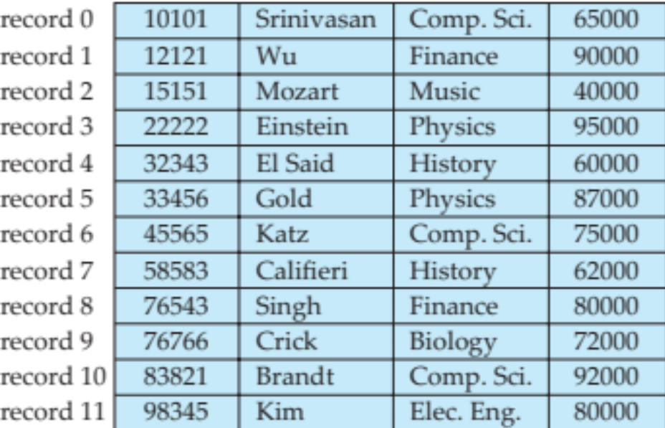
Fixed-Length Records
Simple approach:
  Store record i starting from byte n ∗ (i – 1), where n is the size of each record.
  Record access is simple but records may cross blocks
    Modification: do not allow records to cross block boundaries
Deletion of record i:
alternatives:
  move records i + 1, . . ., n
  to i, . . . , n – 1
  move record n to i
  do not move records, but
  link all free records on a
  free list

Slide 34
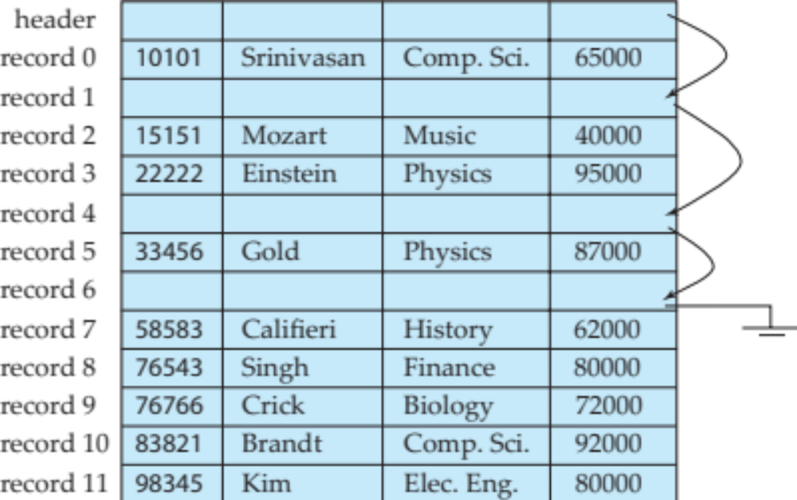
Free Lists
Store the address of the first deleted record in the file header.
Use this first record to store the address of the second deleted record, and so on
Can think of these stored addresses as pointers since they “point” to the location of a record.
More space efficient representation: reuse space for normal attributes of free records to store pointers. (No pointers stored in in-use records.)

Slide 35
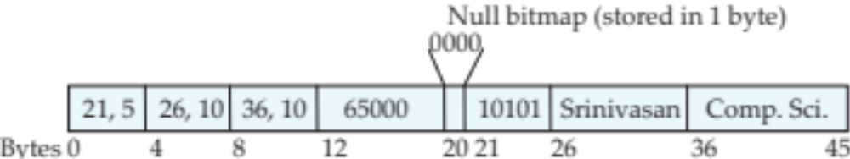
Variable-Length Records
Variable-length records arise in database systems in several ways:
  Storage of multiple record types in a file.
  Record types that allow variable lengths for one or more fields such as strings (varchar)
  Record types that allow repeating fields (used in some older data models).
Attributes are stored in order
Variable length attributes represented by fixed size (offset, length), with actual data stored after all fixed length attributes
Null values represented by null-value bitmap

Slide 36
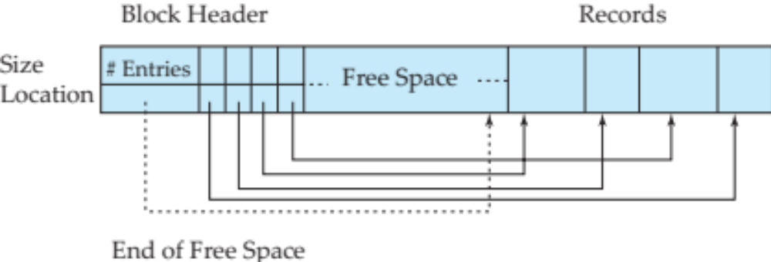
Variable-Length Records: Slotted Page Structure
Slotted page header contains:
  number of record entries
  end of free space in the block
  location and size of each record
Records can be moved around within a page to keep them contiguous with no empty space between them; entry in the header must be updated.
Pointers should not point directly to record — instead they should point to the entry for the record in header.

Slide 37
Organization of Records in Files
Heap – a record can be placed anywhere in the file where there is space
Sequential – store records in sequential order, based on the value of the search key of each record
Hashing – a hash function computed on some attribute of each record; the result specifies in which block of the file the record should be placed
Records of each relation may be stored in a separate file. In a multitable clustering file organization records of several different relations can be stored in the same file
  Motivation: store related records on the same block to minimize I/O

Slide 38
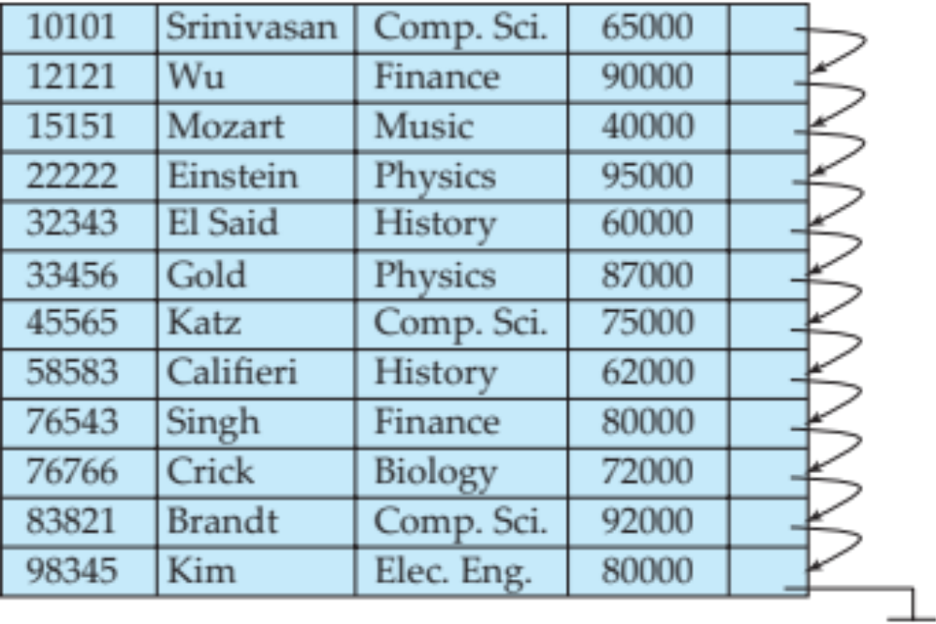
Sequential File Organization
Suitable for applications that require sequential processing of the entire file
The records in the file are ordered by a search-key

Slide 39
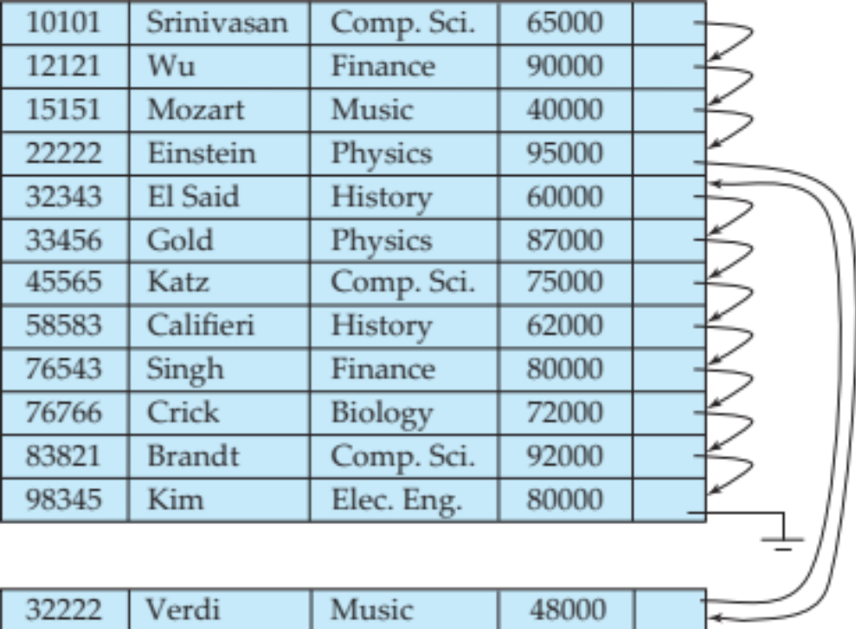
Sequential File Organization (Cont.)
Deletion – use pointer chains
Insertion –locate the position where the record is to be inserted
  if there is free space insert there
  if no free space, insert the record in an overflow block
  In either case, pointer chain must be updated
Need to reorganize the file
from time to time to restore
sequential order

Slide 40


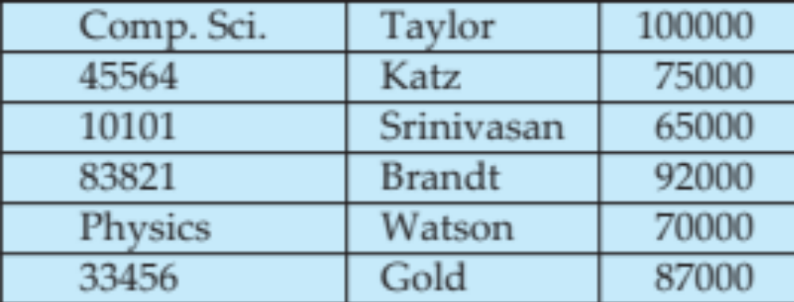
Multitable Clustering File Organization
Store several relations in one file using a multitable clustering file organization
department
instructor
multitable clustering
of department and
instructor

Slide 41
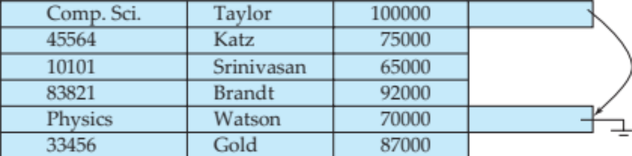
Multitable Clustering File Organization (cont.)
good for queries involving department instructor, and for queries involving one single department and its instructors
bad for queries involving only department
results in variable size records
Can add pointer chains to link records of a particular relation

Slide 42
Data Dictionary Storage
The Data dictionary (also called system catalog) stores metadata; that is, data about data, such as
Information about relations
  names of relations
  names, types and lengths of attributes of each relation
  names and definitions of views
  integrity constraints
User and accounting information, including passwords
Statistical and descriptive data
  number of tuples in each relation
Physical file organization information
  How relation is stored (sequential/hash/…)
  Physical location of relation
Information about indices (Chapter 11)

Slide 43
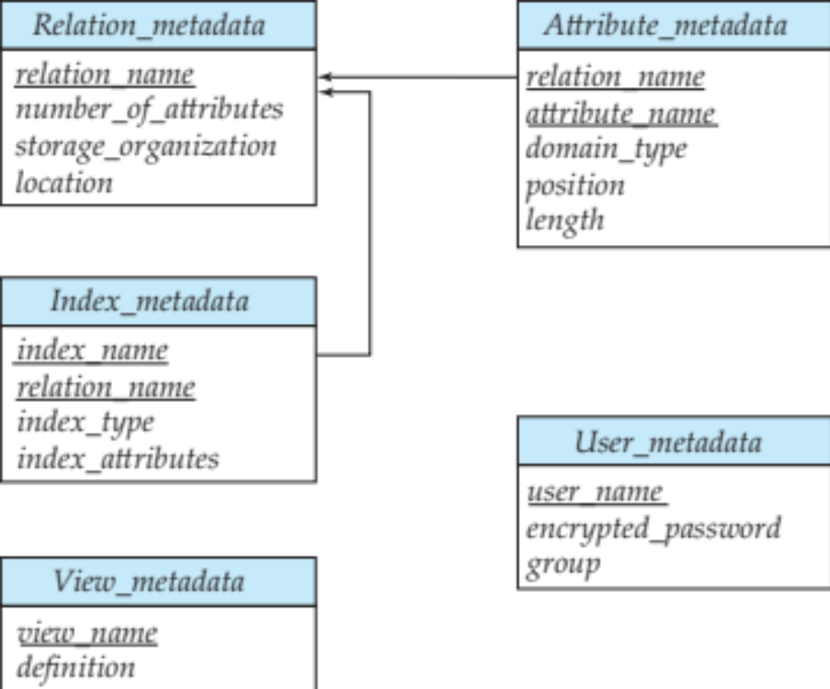
Relational Representation of System Metadata
Relational representation on disk
Specialized data structures designed for efficient access, in memory

Slide 44
Storage Access
A database file is partitioned into fixed-length storage units called blocks. Blocks are units of both storage allocation and data transfer.
Database system seeks to minimize the number of block transfers between the disk and memory. We can reduce the number of disk accesses by keeping as many blocks as possible in main memory.
Buffer – portion of main memory available to store copies of disk blocks.
Buffer manager – subsystem responsible for allocating buffer space in main memory.

Slide 45
Buffer Manager
Programs call on the buffer manager when they need a block from disk.
  If the block is already in the buffer, buffer manager returns the address of the block in main memory
  If the block is not in the buffer, the buffer manager
    Allocates space in the buffer for the block
      Replacing (throwing out) some other block, if required, to make space for the new block.
      Replaced block written back to disk only if it was modified since the most recent time that it was written to/fetched from the disk.
    Reads the block from the disk to the buffer, and returns the address of the block in main memory to requester.

Slide 46
Buffer-Replacement Policies
Most operating systems replace the block least recently used (LRU strategy)
Idea behind LRU – use past pattern of block references as a predictor of future references
Queries have well-defined access patterns (such as sequential scans), and a database system can use the information in a user’s query to predict future references
  LRU can be a bad strategy for certain access patterns involving repeated scans of data
    For example: when computing the join of 2 relations r and s by a nested loops
    for each tuple tr of r do
    for each tuple ts of s do
    if the tuples tr and ts match …
  Mixed strategy with hints on replacement strategy provided
  by the query optimizer is preferable

Slide 47
Buffer-Replacement Policies (Cont.)
Pinned block – memory block that is not allowed to be written back to disk.
Toss-immediate strategy – frees the space occupied by a block as soon as the final tuple of that block has been processed
Most recently used (MRU) strategy – system must pin the block currently being processed. After the final tuple of that block has been processed, the block is unpinned, and it becomes the most recently used block.
Buffer manager can use statistical information regarding the probability that a request will reference a particular relation
  E.g., the data dictionary is frequently accessed. Heuristic: keep data-dictionary blocks in main memory buffer
Buffer managers also support forced output of blocks for the purpose of recovery (more in Chapter 16)

