Slide 1
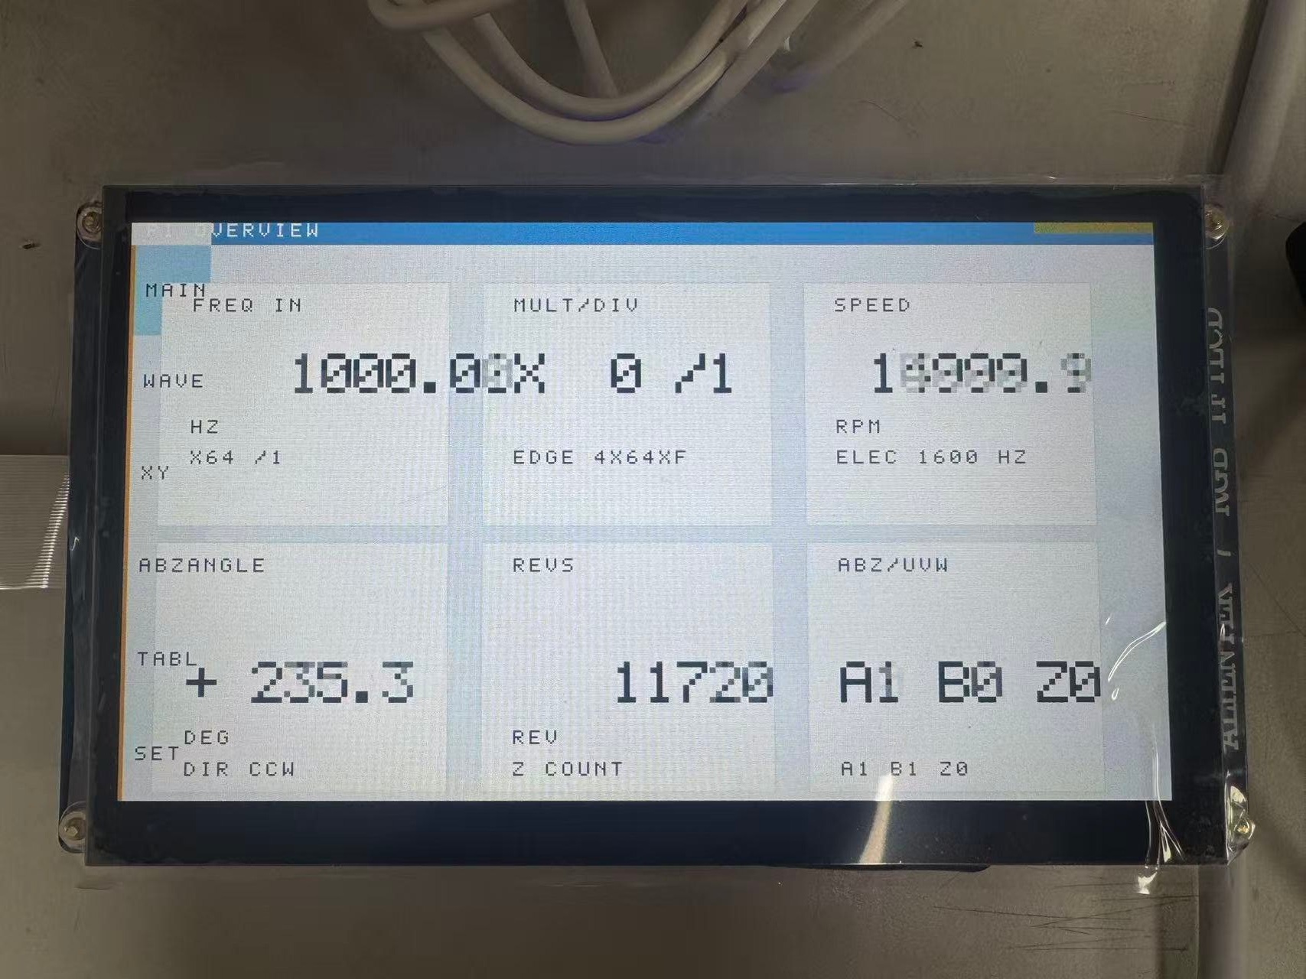

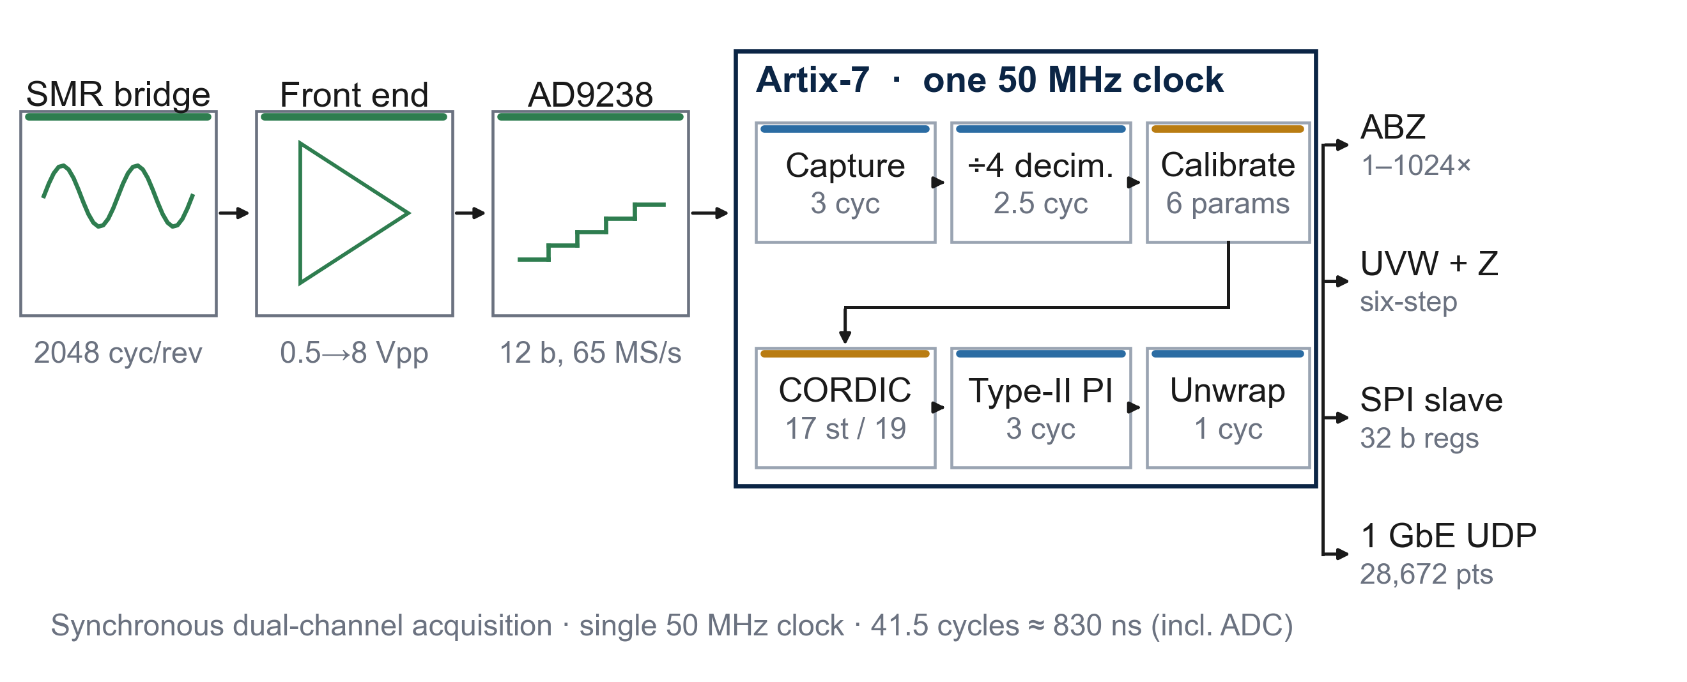


基于FPGA的细分编码器
Anonymous copy
Author and affiliation withheld
A 2,048-ppr magnetic encoder on a single Artix-7
16-bit interpolation · closed-form self-calibration · ABZ / UVW / SPI / UDP
INTRODUCTION
SYSTEM ARCHITECTURE
On-board 1024×600 touch UI (v62)
Optical encoders degrade under dust, oil and vibration. Magnetic sensing is robust, yet the raw sin/cos bridge is never ideal: offset, gain mismatch, quadrature error and mechanical shift all fold into the angle.
Commercial interpolators fix algorithm and interface together: 10-bit resolution, opaque calibration, and multi-turn counting that needs a second die.
We implement 2,048 ppr, 16-bit angle and sub-µs latency, with ABZ, UVW, SPI and 1 GbE diagnostics from one 50 MHz clock.
TEST PLATFORM
XC7A35TFGG484-2 · single 50 MHz clock
AD9238 2×12-bit, 65 MSPS front end
2,048-cycle/rev SMR ring, real turntable
1 GbE UDP capture · USB-UART 2 Mbaud
C
R
R
E
E
S
A
TYPICAL APPLICATION CASE
T
U
Servo drives — UVW, ABZ and SPI from one 32-bit angle word.
Machine-tool rotary tables — 0.0055°/LSB at 41.5-cycle latency.
Robot joints — immunity to oil, dust and vibration.
EV traction — wide temperature range, no optical window.
Figure 1 | Six-stage pipeline in one clock domain: 41.5 cycles ≈ 830 ns.
I
L
CREATIVE DESIGN
V
T
RESULT — V74 PRODUCTION BITSTREAM
Closed-form calibration. A first/second-order moment solve maps the distorted ellipse to a unit circle in one pass; no LUT, no host iteration.
One clock, 41.5 cycles. No MMCM, no CDC, no soft core; latency is a design constant, not a measurement.
Wrap-safe counting and UVW. Unsigned-difference zero-extension removes the +133 → −65,403 deadlock; a wide-base branch makes the 0↔5 edge identical both ways.
E
2,048
16
719–731
598,115
KEY ENGINEERING PROBLEMS
pulses per rev
bit angle
rpm
frames in 60 s
1 Analog front end — 0.5 Vpp differential to 8 Vpp, 65 MSPS, offset binary.
2 Deterministic latency — 41.5 cycles, fixed by construction.
3 Protocol integration — ABZ 1–1024×, UVW + virtual Z, SPI, 1 GbE UDP.
4 Verification — fixed-point model, 54 benches, sign-off, real turntable.
D
25.27 kHz electrical · Z 12.00 Hz · 9,968 fps · radius drift < 0.02%
E
S
IMPLEMENTATION
I
10,926 LUT (52.53%) · 8,697 FF · 32/50 BRAM · 17 DSP
WNS +0.409 ns · WHS +0.025 ns · 0 failing endpoints (24,625)
DRC 0 errors · single clock, no MMCM · 1,512,664 B (build 0x0018)
WHY ONE ARTIX-7
N
Acquisition, calibration, atan2, tracking and five protocols share one clock domain. The encoder core occupies about 30% of the device; the remainder is touch UI and Ethernet diagnostics.
G
HOW IT WAS PROVEN
VERIFICATION
DESIGN FLOW
Two silent deadlocks, found only on hardware.
Ten seconds of silence on the real turntable while 33/33 benches passed.
Build-ID bisect: probe 0x0013 reduced the failure to one step (−65,403 instead of +133); tb_acc2 reproduces 0 → 6 → 12 counts over 3,000 × +133 steps.
Five on-board criteria:
Z = 12.00 Hz, 2,048 distinct counts, 719–731 rpm, six UVW states, 60 s stream.
263 evidence files · 283 SHA-256 lines
54 benches · final_verify ALL CHECKS PASSED
Technical report 20 pages · full dossier 59 pages
Model → RTL → 54 benches → sign-off → board
Every number traces to a CSV, log or bitstream hash.
MIT-licensed repository · 263 evidence files · 283 SHA-256 lines.

