Slide 1
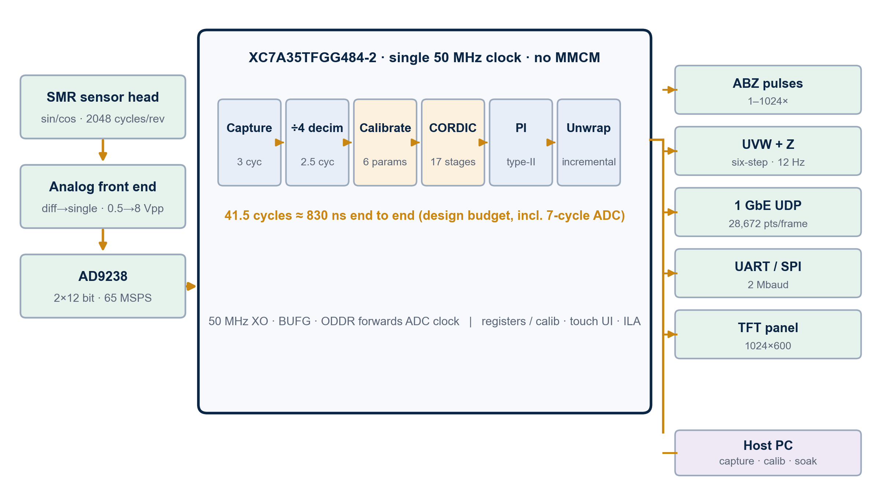
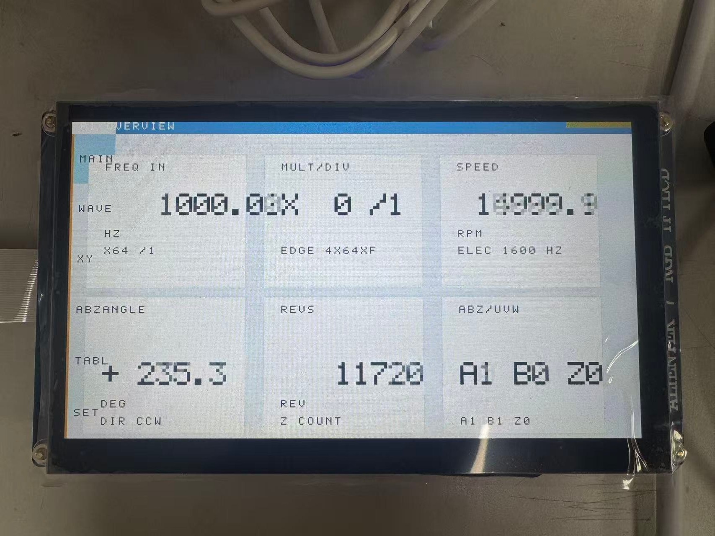
A 2,048-ppr Magnetic Encoder on One Artix-7
Anonymous submission — author and affiliation withheld.
AMD
基于FPGA的细分编码器 · 16-bit on-chip interpolation, closed-form self-calibration, ABZ / UVW / SPI / UDP
INTRODUCTION
SYSTEM ARCHITECTURE — ONE CLOCK DOMAIN, 41.5-CYCLE LATENCY
Optical encoders lose accuracy in dust, oil and vibration. Magnetic sensing is rugged, but the raw sin/cos bridge is never ideal: offset, gain mismatch, quadrature error and residual shift all fold into the angle.
Commercial interpolation ASICs fix both the algorithm and the interface, yet multi-turn Multi-turn counting needs a second chip and the calibration recipe stays opaque. This work puts the whole chain — acquisition, calibration, atan2, tracking and five output protocols — into one Artix-7.
Goal: 2,048 ppr, 16-bit angle, sub-µs latency, ABZ / UVW / SPI / UDP / UART from a single 50 MHz clock domain.
Key technical issues
• Analog front end: 0.5 Vpp differential to 8 Vpp, 65 MSPS, offset binary.
• Real-time: deterministic 41.5-cycle pipeline, no MMCM, no CDC.
• Protocols: ABZ 1–1024×, UVW + virtual Z, SPI slave, 1 GbE UDP.
• Validation: fixed-point model, 57 benches, build sign-off, real turntable.
Single 50 MHz clock
No MMCM/PLL. The ADC clock is forwarded by ODDR, so capture, DSP and outputs share one edge.
Fixed latency
41.5 cycles ≈ 830 ns from sample to angle — a speed loop can be tuned without online delay identification.
Five protocols, one image
ABZ, UVW+Z, SPI, 1 GbE UDP and UART are generated from the same 32-bit angle, speed and status word.
CREATIVE DESIGN
RESULT — V90 PRODUCTION BITSTREAM, REAL TURNTABLE
ON-BOARD UI & TEST PLATFORM
1 Closed-form six-parameter calibration
One first/second-order moment solve maps the distorted ellipse to a unit circle. No LUT, no host iteration; the six coefficients are readable over UART.
2 Single clock, 41.5 cycles
Zero CDC and zero IP: latency is a design constant, not a measurement. Peak sample rate is traded for determinism, which is what an encoder needs.
3 Wrap-safe counting and UVW
Unsigned-difference zero-extension removed a +133 → −65,403 sign-extension deadlock; a wide-base branch makes the 0↔5 sector identical forward and reverse.
2,048
16 bit
457–459
597,886
pulses / rev
2,048 distinct counts
angle resolution
0.0055°/LSB
rpm, real turntable
Z = 7.62–7.65 Hz
frames / 60 s
9,964.8 fps
Resources: 10,978 LUT (52.78%) · 8,724 FF · 32/50 BRAM · 17 DSP
Timing: WNS +0.199 ns · WHS +0.017 ns · 0 failing endpoints (24,691)
On hardware: UVW six states uniform, 293 commutations/s; 60 s stream, radius drift < 0.02%
1024×600 touch UI (v62 demo bitstream)
XC7A35T · AD9238 2×12 bit · 50 MHz single clock
Copyright 2026 · 2026 9th National College Student Embedded Chip & System Design Competition · FPGA Innovation Track · AMD Track · Independent Topic (Junior Group) · XC7A35TFGG484-2

