Slide 1
FastFabric: Scaling Hyperledger Fabric to 20,000 Transactions per Second
Christian Gorenflo, Stephen Lee, Lukasz Golab, Srinivasan Keshav
University of Waterloo

Slide 2
Background & Intro
Permissioned blockchains are becoming popular in many areas such as cryptocurrencies, supply-chains, insurance, and others
Permissioned blockchains special emphasis on transactions throughput.
Hyperledger Fabric 1.2 since it is reported to be the fastest available
open-source permissioned blockchain

Slide 3
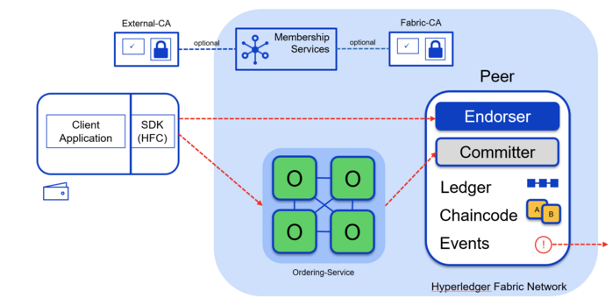
Fabric 1.2

Slide 4
Contribution
Separating metadata from data
Only transfer transaction IDs to decide the transaction order
Parallelism and caching:
Parallelism policy validation & syntactic verification
Caching unmarshaled blocks at the comitters
memory hierarchy for fast data access:
Replacing the world state database with a memory hash table
Deferring storage of blocks to a write-optimized storage cluster
Resource separation:
Separate commiter and endorser to different hardware

Slide 5
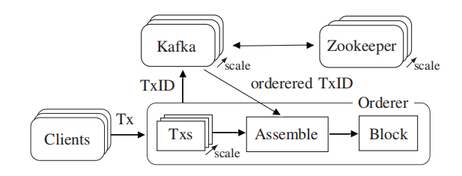
Orderer improvement
Separate transaction header from payload
Message pipelining

Slide 6
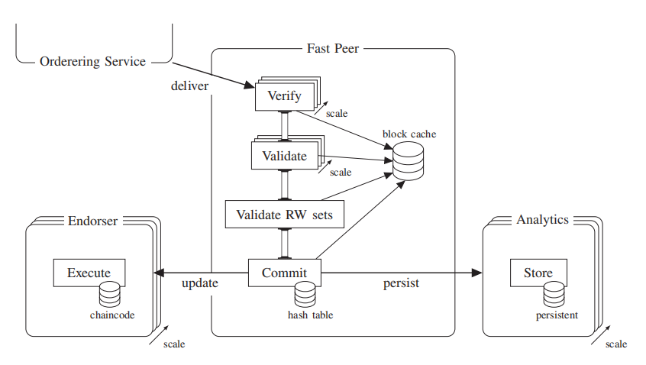
Peer improvement
Replacing the world state database with a memory hash table
Defer store blocks and world state hash table using a store cluster
Separate commit and endorse
Parallelize validation
Cache unmarshaled blocks

Slide 7
Evaluation setup
15 local servers connected by a 1 Gbit/s switch
2 × Intel ® Xeon ® CPU E5-2620 v2 2.10GHz
64GB RAM
Baseline
LevelDB as the peer state database
Orderer stores block in-memory rather than disk
Run entire Fabric 1.2 system rather than docker container
Every transactions is non-conflicting and valid
Default endorsement policy (single endorser signature)

Slide 8
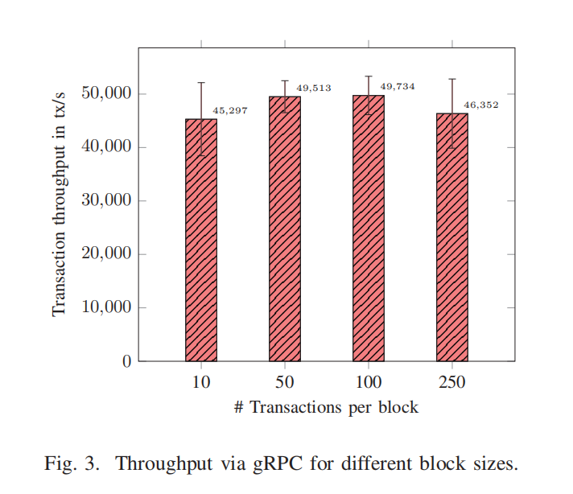
Block transfer via gRPC

Slide 9
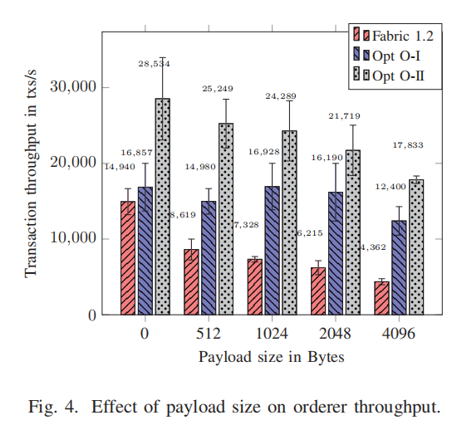
Orderer throughput
Opt O-Ⅰ:
Only Tx ID is published to Kafka
Opt O-II:
Parallel processing of Tx from clients

Slide 10
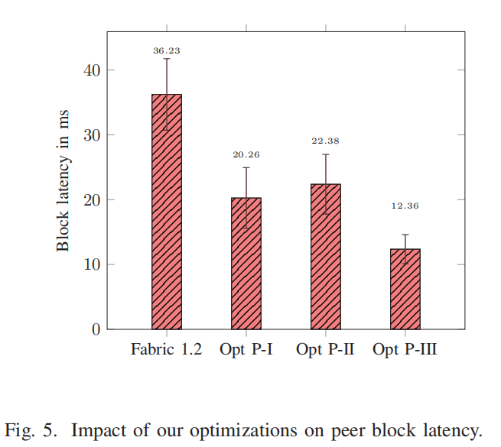
Peer experiments
Opt O-Ⅰ:
LevelDB replaced by in-memory hash table
Opt O-II:
Validation and commitment parallelized;
Separate storage and endorse
Opt O-III:
Opt O-I & Opt O-II
Cache unmarshaled blocks for pipeline

Slide 11
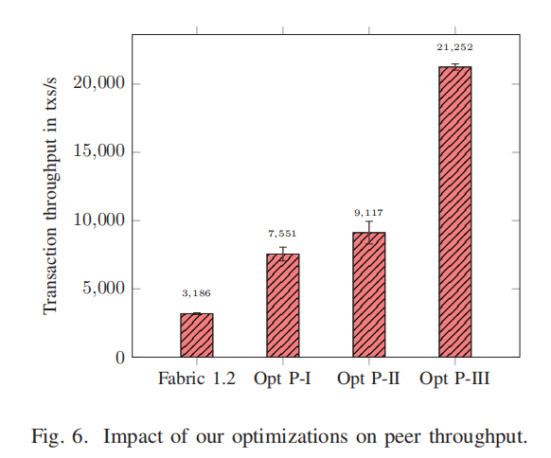
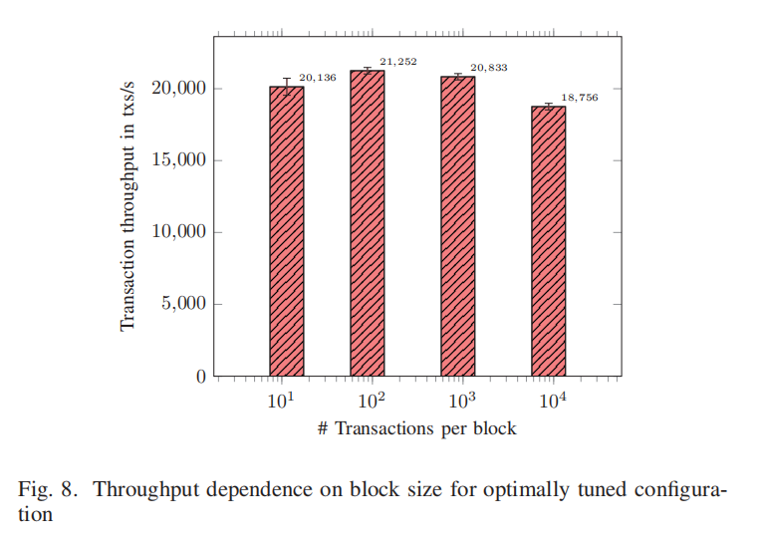
Peer experiments

Slide 12
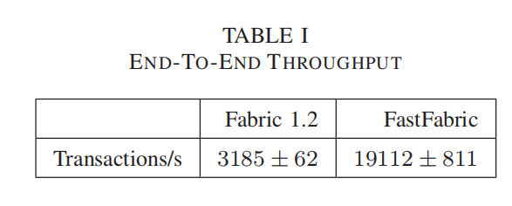
End-to-end throughput

Slide 13
Contribution
Separating metadata from data
Only transfer transaction IDs to decide the transaction order
Parallelism and caching:
Parallelism policy validation & syntactic verification
Caching unmarshaled blocks at the comitters
memory hierarchy for fast data access:
Replacing the world state database with a memory hash table
Deferring storage of blocks to a write-optimized storage cluster
Resource separation:
Separate commiter and endorser to different hardware

Slide 14
Thanks

