Slide 1
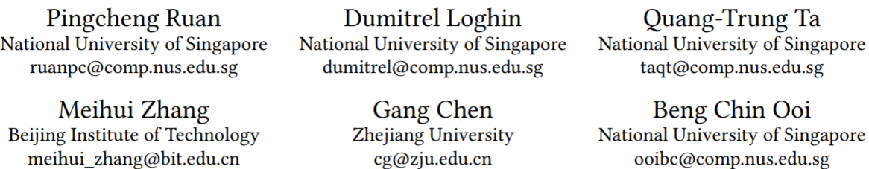
A Transactional Perspective on Execute-order-validate Blockchains

Slide 2
Overview
Goal
Apply Database techniques onto EOV and optimize on execution layer
Contribution
Analyze the resemblance between EOV and OCC(optimistic concurrency control)
Propose a theorem to identify transaction can never be reordered for serializability and design algorithms to early filter out such transactions, with the serializability guarantee for the remaining after reordering.
Implement and evaluation

Slide 3
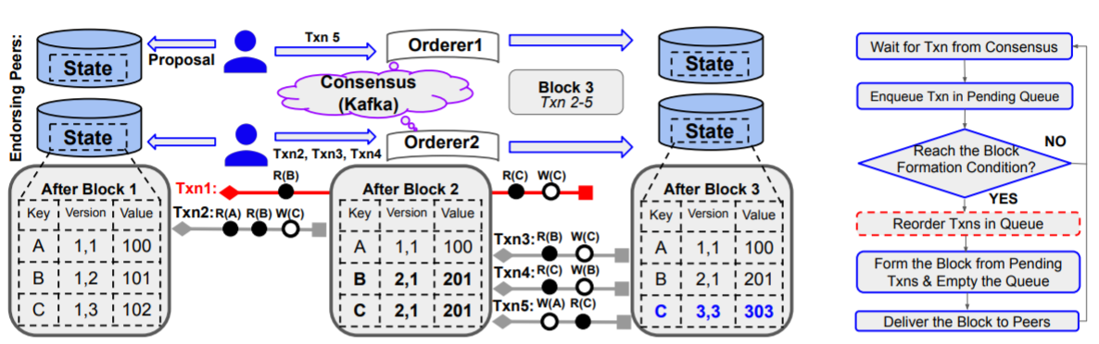
Background: EOV(execute-order-validate)

Slide 4
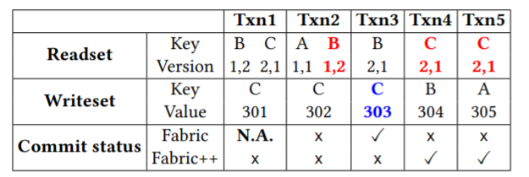
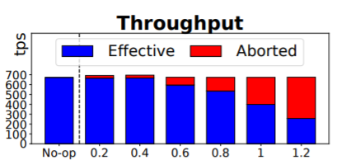
Background: EOV(execute-order-validate)

Slide 5
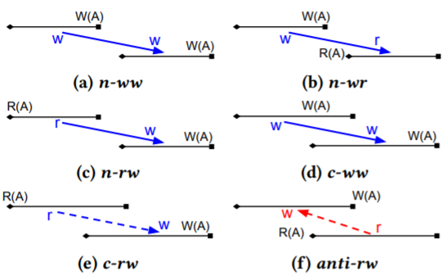
Background: OCC(optimistic concurrency control)
Snapshot
Start Timestamp
End Timestamp
Accessed Records

Slide 6
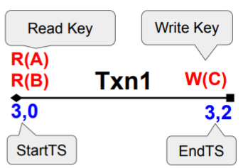
Resemblance
Snapshot -> block sequence number (M+1,0)
Start Timestamp -> StartTs(a sequence number of snapshot)
End Timestamp -> EndTs(its sequence number in block)
Accessed records -> read/write sets

Slide 7
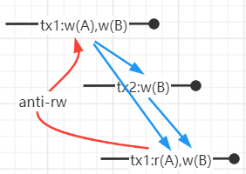
Serializability
Strong Serializability: Serializable & sequence ordered by end timestamp
A schedule of transactions without anti-rw achieves Strong Serializability.

Slide 8
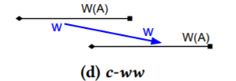
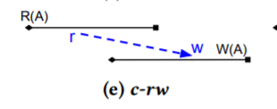
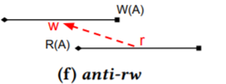
Reorderability
In blockchains, reordering can only happen between concurrent transactions.
A transaction does not change its concurrency relationship with respect to others after reordering.

Slide 9
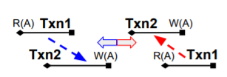

Reorderability
Lemma1: Switching c-rw and anti-rw transactions order will keep their dependency order.
Lemma2: Switching c-ww transactions order will change their dependency order.

Slide 10
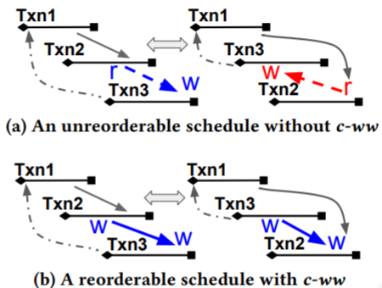
Reorderability
Thm: A transaction schedule cannot be reordered to be serializable if there exists a cycle with no c-ww dependencies involving pending transactions.

Slide 11
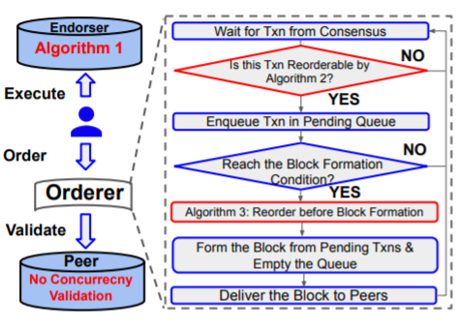
Fine-grained Concurrency Control
Simulate txns with snapshot consistency
For a new transaction T
Compute T’s dependency except c-ww among P based on G, b, readkeys, writekeys;
If a cycle, abort. Otherwise update the dependency into G and add into P.
Form a block
Topologically sort P with respect to G
Recover c-ww conflict from the order P into G

Slide 12
Security Analysis
Safety
liveness

Slide 13
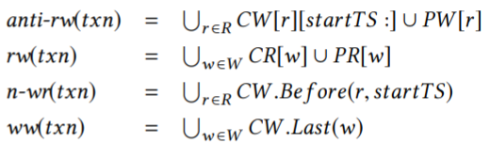
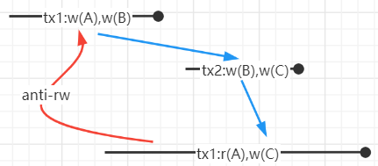
Implementation: Dependency Resolution
LevelDB: CommittedWriteTxns (CW) and CommittedReadTxns (CR), example: {A_3_2: Txn1}
In-memory: PendingWriteTxns(PW) and PendingReadTxns(PR)

Slide 14
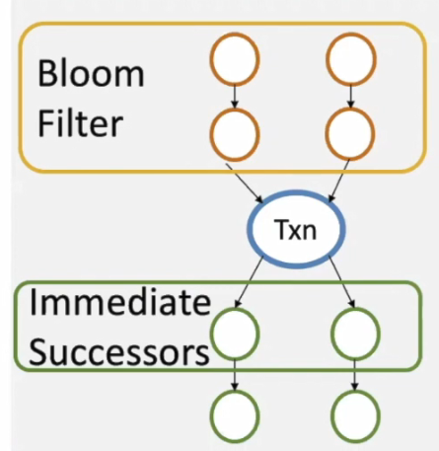
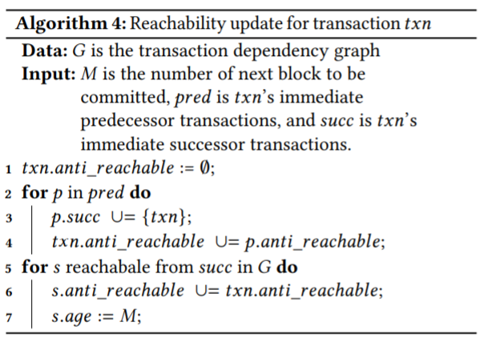
Implementation: Cycle Detection

Slide 15
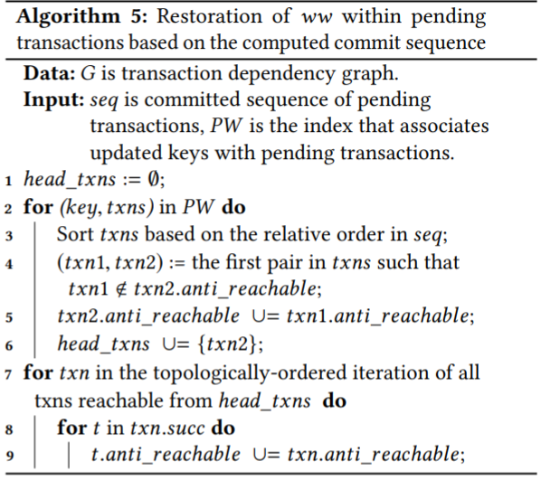
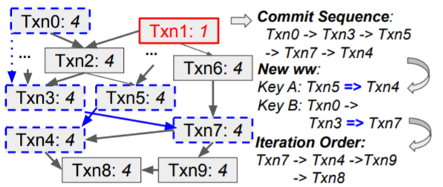
Implementation: Dependency Restoration

Slide 16
Implementation: Pruning
Set a snapshot threshold H=M-max_span
Define the age of a transaction

Slide 17
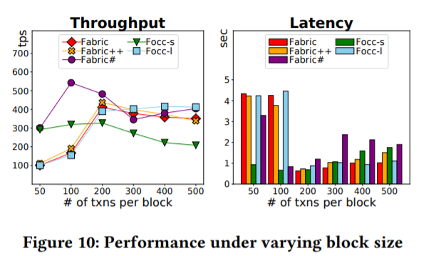
Experiments

Slide 18
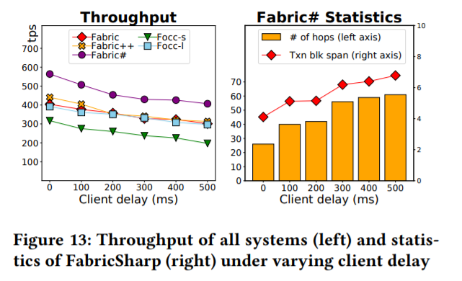
Experiments

Slide 19
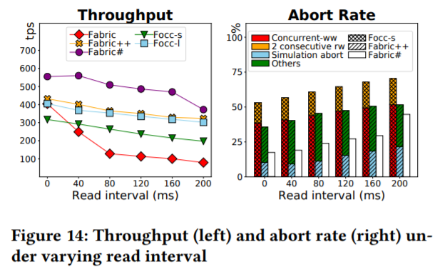
Experiments

