Slide 1



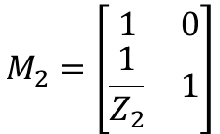




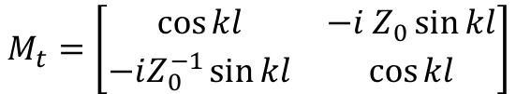





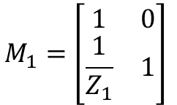




$$ω_{1}=\frac{1}{\sqrt{L_{1}C_{1}} }$$
$$ω_{2}=\frac{1}{\sqrt{L_{2}C_{2}} }$$
$$R_{1}$$
$$R_{2}$$
Port 1
$$L_{1}$$
$$Z_{0}, k$$
$$L_{2}$$
Port 2
$$β=\frac{R_{1}}{2 L_{1} }$$
$$α =\frac{R_{2}}{{2 L}_{2} }$$
$$C_{1}$$
$$C_{2}$$
$$κ_{ext1}=\frac{Z_{o}}{4 L_{1}}$$
$$κ_{ext2}=\frac{Z_{o}}{4 L_{2}}$$
$$l$$
Transmission (ABCD) matrices
$Z_{1}=R_{1}−iωL_{1}−\frac{1}{iωC_{1}} =−i\frac{L_{1}}{ω}\left( {ω^{2}−ω}_{1}^{2}+2iωβ\right)$
$$M_{1}=\left[\begin{matrix}1 & 0 \\ \frac{1}{Z_{1}} & 1\end{matrix}\right]$$
$Z_{2}=R_{2}−iωL_{2}−\frac{1}{iωC_{2}} =−i\frac{L_{2}}{ω}\left(ω^{2} −ω_{2}^{2}+2iωα\right)$
$$M_{t}=\left[\begin{matrix}\cos{kl} & −i Z_{0}\sin{kl} \\ −iZ_{0}^{−1}\sin{kl} & \cos{kl}\end{matrix}\right]$$
$$M=M_{1}⋅M_{t}⋅M_{2}=\left[\begin{matrix}A & B \\ C & D\end{matrix}\right]$$
$$M_{2}=\left[\begin{matrix}1 & 0 \\ \frac{1}{Z_{2}} & 1\end{matrix}\right]$$
$$S_{21}=\frac{2}{A+B/Z_{0}+CZ_{0}+D}$$

Slide 2

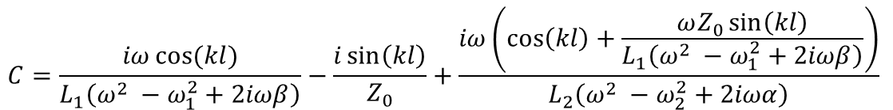
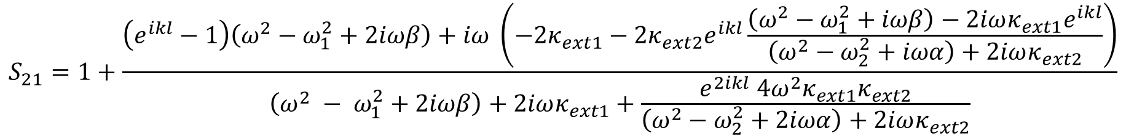




$$R_{1}$$
$$R_{2}$$
Port 1
$$L_{1}$$
$$Z_{0}, k$$
$$L_{2}$$
Port 2
$$C_{1}$$
$$C_{2}$$
$$l$$
$$A=\cos{(kl)}+\frac{ωZ_{0}\sin{(kl)}}{L_{2} \left(ω^{2} −ω_{2}^{2}+2iωα\right)}$$
$$B=−iZ_{0}\sin{(kl)}$$
$$C=\frac{iω\cos{(kl)}}{L_{1}\left(ω^{2} −ω_{1}^{2}+2iωβ\right)}−\frac{i\sin\left(kl\right)}{Z_{0}}+\frac{iω\left(\cos\left(kl\right)+\frac{ωZ_{0}\sin\left(kl\right)}{L_{1}\left(ω^{2} −ω_{1}^{2}+2iωβ\right)}\right)}{L_{2}\left(ω^{2} −ω_{2}^{2}+2iωα\right)}$$
$$D=\cos{(kl)}+\frac{ωZ_{0}\sin{(kl)}}{L_{1} \left(ω^{2} −ω_{1}^{2}+2iωβ\right)}$$
negligible
精确解：
negligible
Driving force act on the second oscillator
$$κ_{ext1}≫κ_{ext2}$$
$$≈1$$
$$S_{21}=1+\frac{\left(e^{ikl}−1\right)\left(ω^{2}−ω_{1}^{2}+2iωβ\right)+iω \left(−{2κ}_{ext1}−2κ_{ext2}e^{ikl}\frac{\left(ω^{2}−ω_{1}^{2}+iωβ\right)−2iωκ_{ext1}e^{ikl}}{\left(ω^{2}−ω_{2}^{2}+iωα\right)+2iωκ_{ext2}}\right)}{\left(ω^{2} − ω_{1}^{2}+2iωβ\right)+2iωκ_{ext1}+\frac{e^{2ikl} 4ω^{2}κ_{ext1}κ_{ext2}}{\left(ω^{2}−ω_{2}^{2}+2iωα\right)+2iωκ_{ext2}}}$$

Slide 3
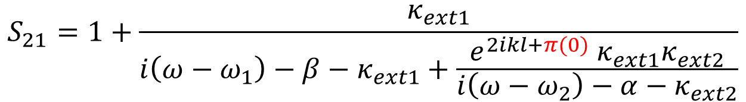
$$R_{1}$$
$$R_{2}$$
Port 1
$$L_{1}$$
$$Z_{0}, k$$
$$L_{2}$$
Port 2
$$C_{1}$$
$$C_{2}$$
$$l$$
近似解：
$$S_{21}=1+\frac{κ_{ext1}}{i\left(ω−ω_{1}\right)−β−κ_{ext1}+\frac{e^{2ikl+π(0)} κ_{ext1}κ_{ext2}}{i\left(ω−ω_{2}\right)−α−κ_{ext2}}}$$
→ Same as we derived from quantum model, this also explains the interference of coherent and dissipative coupling.
Different phase generates the nonreciprocity, this may relate to different local curl field.

Slide 4



$$M_{1}$$
$$M_{t}$$
$$M_{2}$$
$$R_{1}$$
$$R_{2}$$
Port 1
$$L_{1}$$
$$Z_{0}, k$$
$$L_{2}$$
Port 2
$$C_{1}$$
$$C_{2}$$
$$l$$

Slide 5

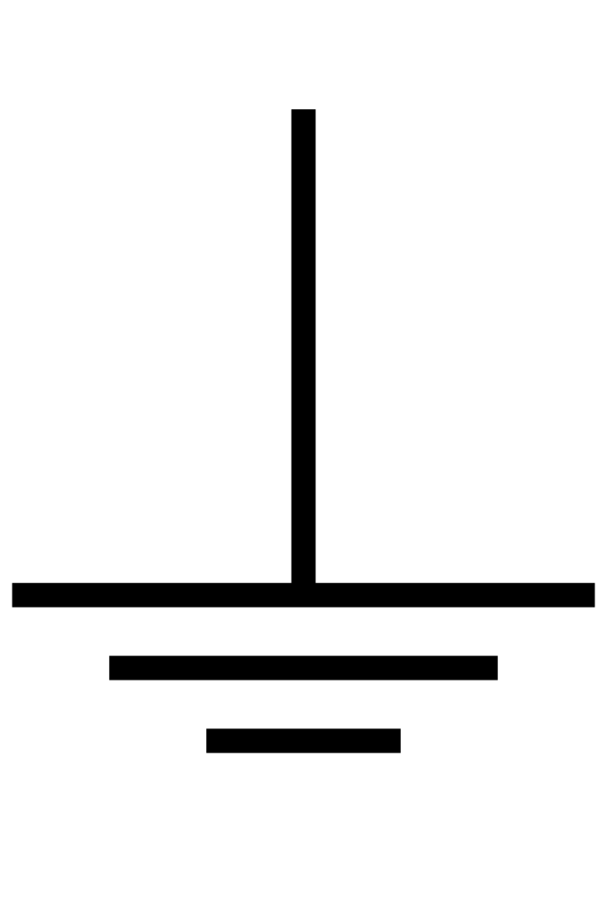


O₁
O₂
$$R_{1}$$
M₁₂
$$R_{2}$$
$$L_{1}$$
$$L_{2}$$
$$C_{1}$$
M₂₁
$$C_{2}$$

