Slide 1
Time domain analysis of coupled system using numerical method
Yutong Zhao
March 26th

Slide 2

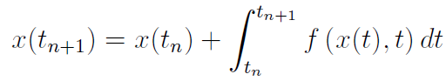
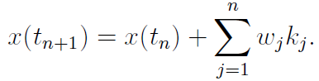
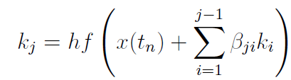
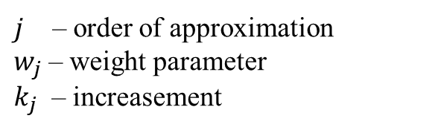

Runge-Kutta methods： Numerical solution of Ordinary Differential equations (ODE)
All ODE can be rearranged in the form:
$$\dot{x}\left(t\right)=f\left(x\left(t\right),x\right)$$
With initial condition:
We take a stepsize $h=t_{n+1}−t_{n}$ , where $t_{n}$ is the current system state and $t_{n+1}$ is the system of after one time interval.
Exact solution
Numerical solution
based on the slope of the jth order of the interval
$j$ – order of approximation
$w_{j}$ – weight parameter
$k_{j}$ – increasement

Slide 3



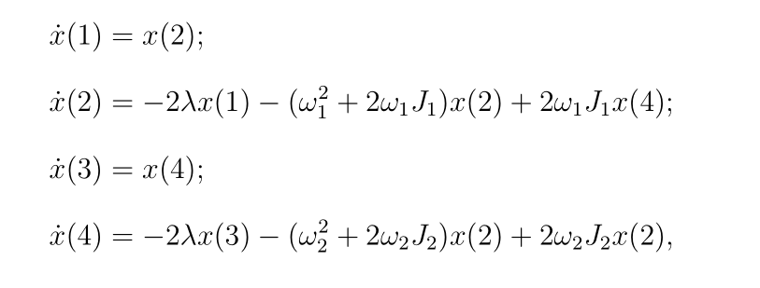





Runge-Kutta methods: Properties and example
We have weight parameter
local truncation error - the error caused by one iteration step
global truncation error - the cumulative error caused by many iteration step
Equation of motion for coherent coupling --- Mechanical system: spring coupled pendulums
$$ω_{1}=10 Hz$$
$$ω_{2}=9 −11 Hz$$
$$Δω_{1}=0.01 Hz$$
$$Δω_{2}=0.01 Hz$$
$$J=0.05 Hz$$

Slide 4
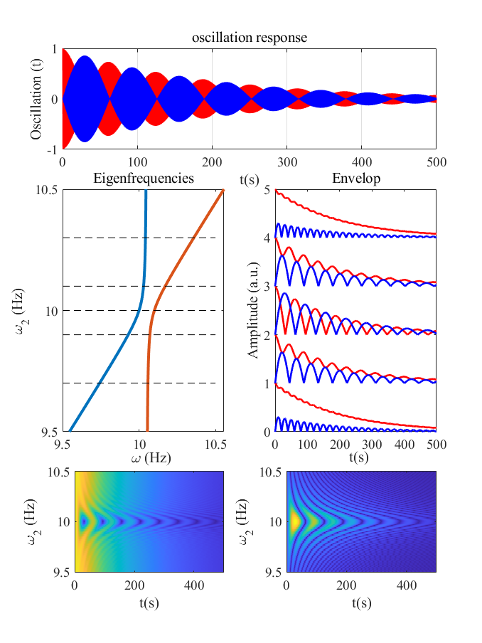
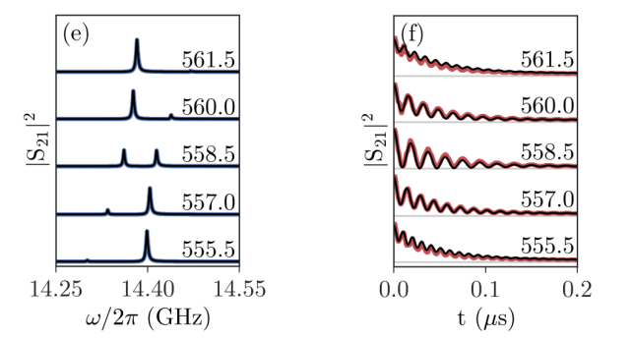
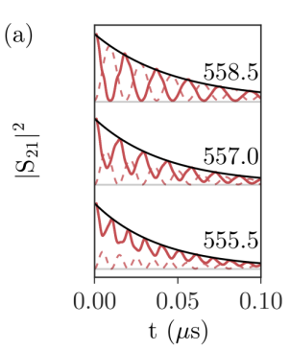
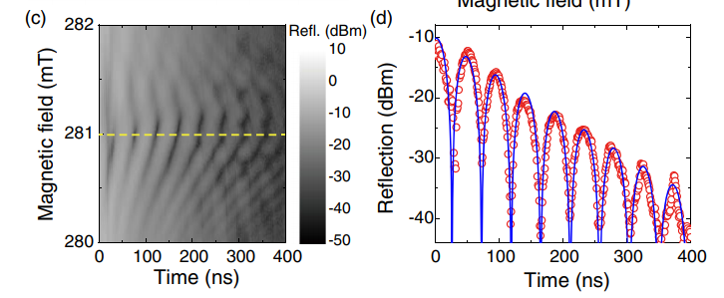
Match, Christophe, et al. "Transient response of the cavity magnon-polariton." Physical Review B 99.13 (2019): 134445.
O₁
O₂
Zhang, Xufeng, et al. "Strongly coupled magnons and cavity microwave photons." Physical review letters 113.15 (2014): 156401.

Slide 5
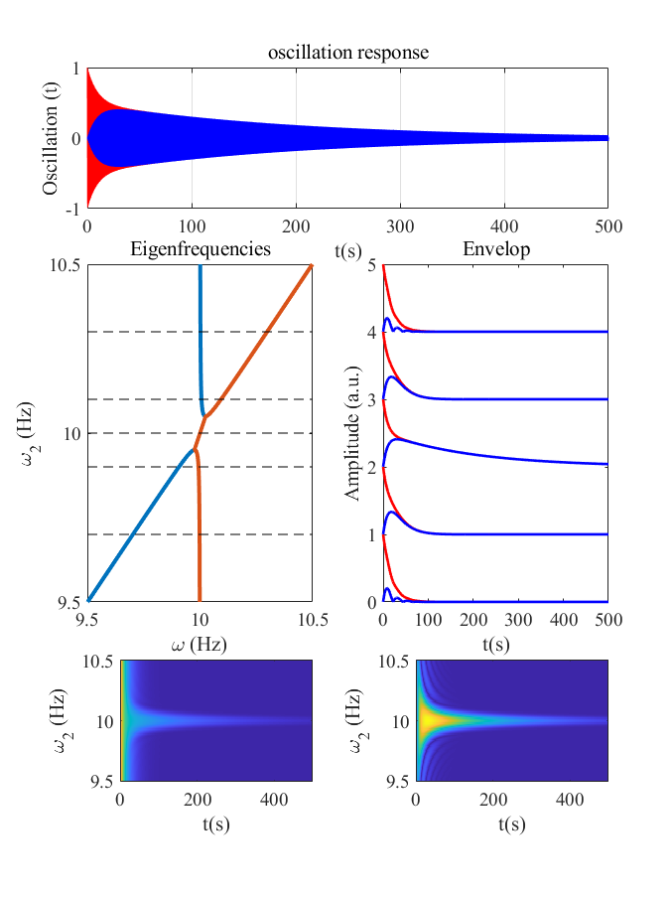
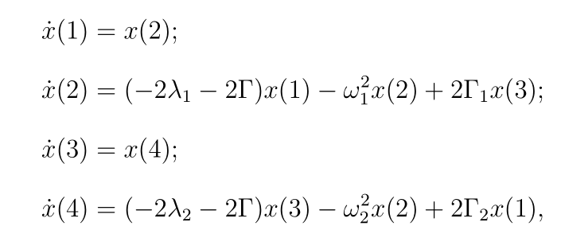
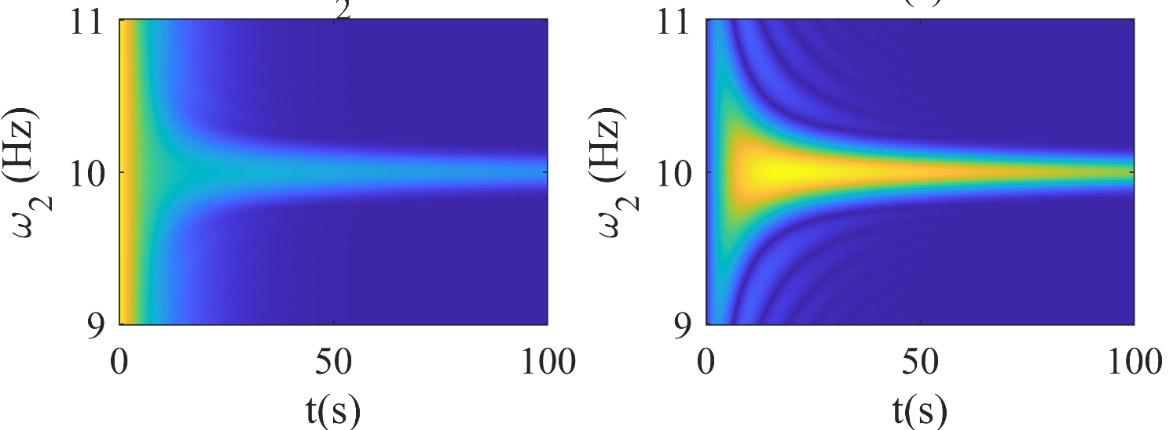





Equation of motion for dissipative coupling
$$ω_{1}=10 Hz$$
$$ω_{2}=9 −11 Hz$$
$$Δω_{1}=0.1 Hz$$
$$Δω_{2}=0.1 Hz$$
$$Γ=0.1 Hz$$
O₁
O₂

Slide 6
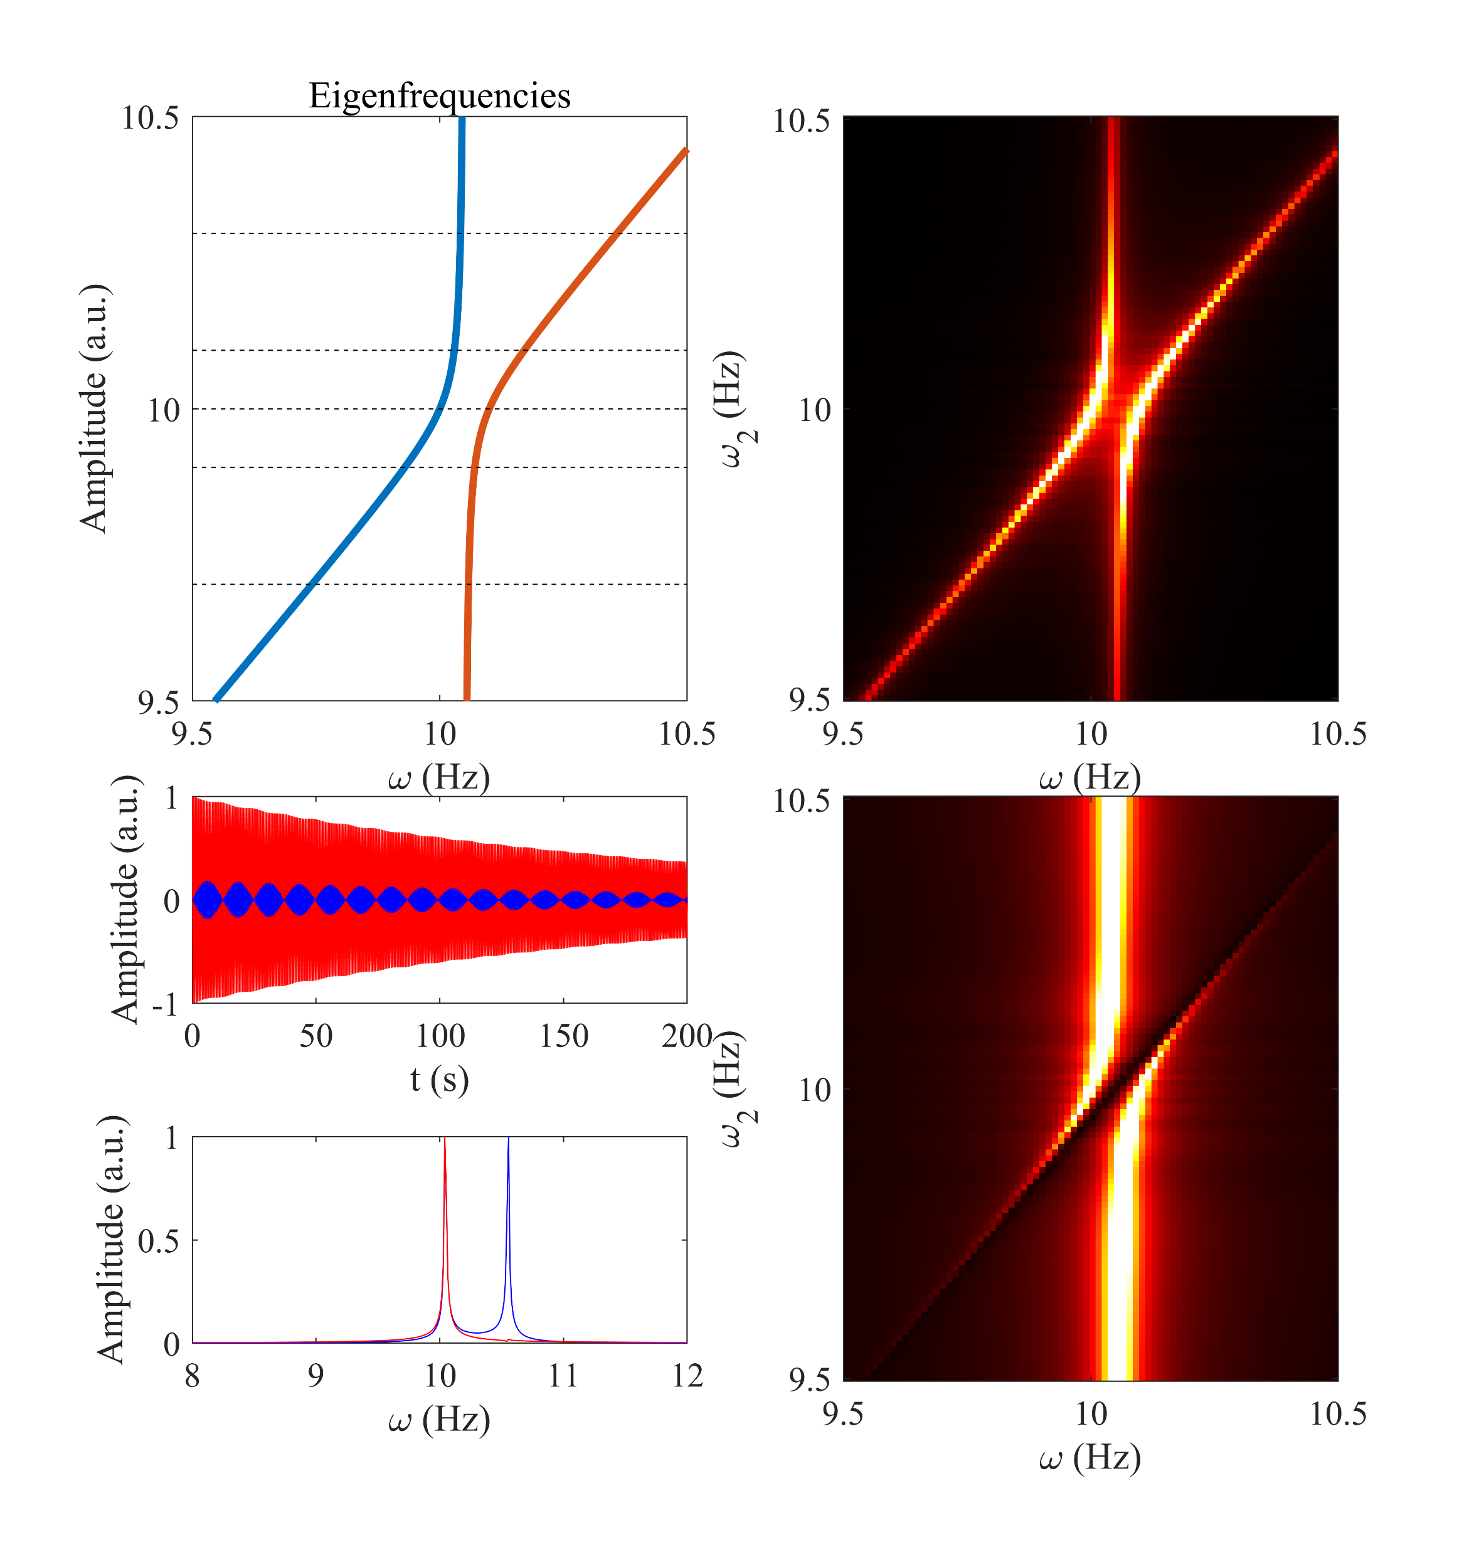
FFT of magnon signal
magnon
Time domain
cavity
Freq. domain
FFT of cavity signal

Slide 7
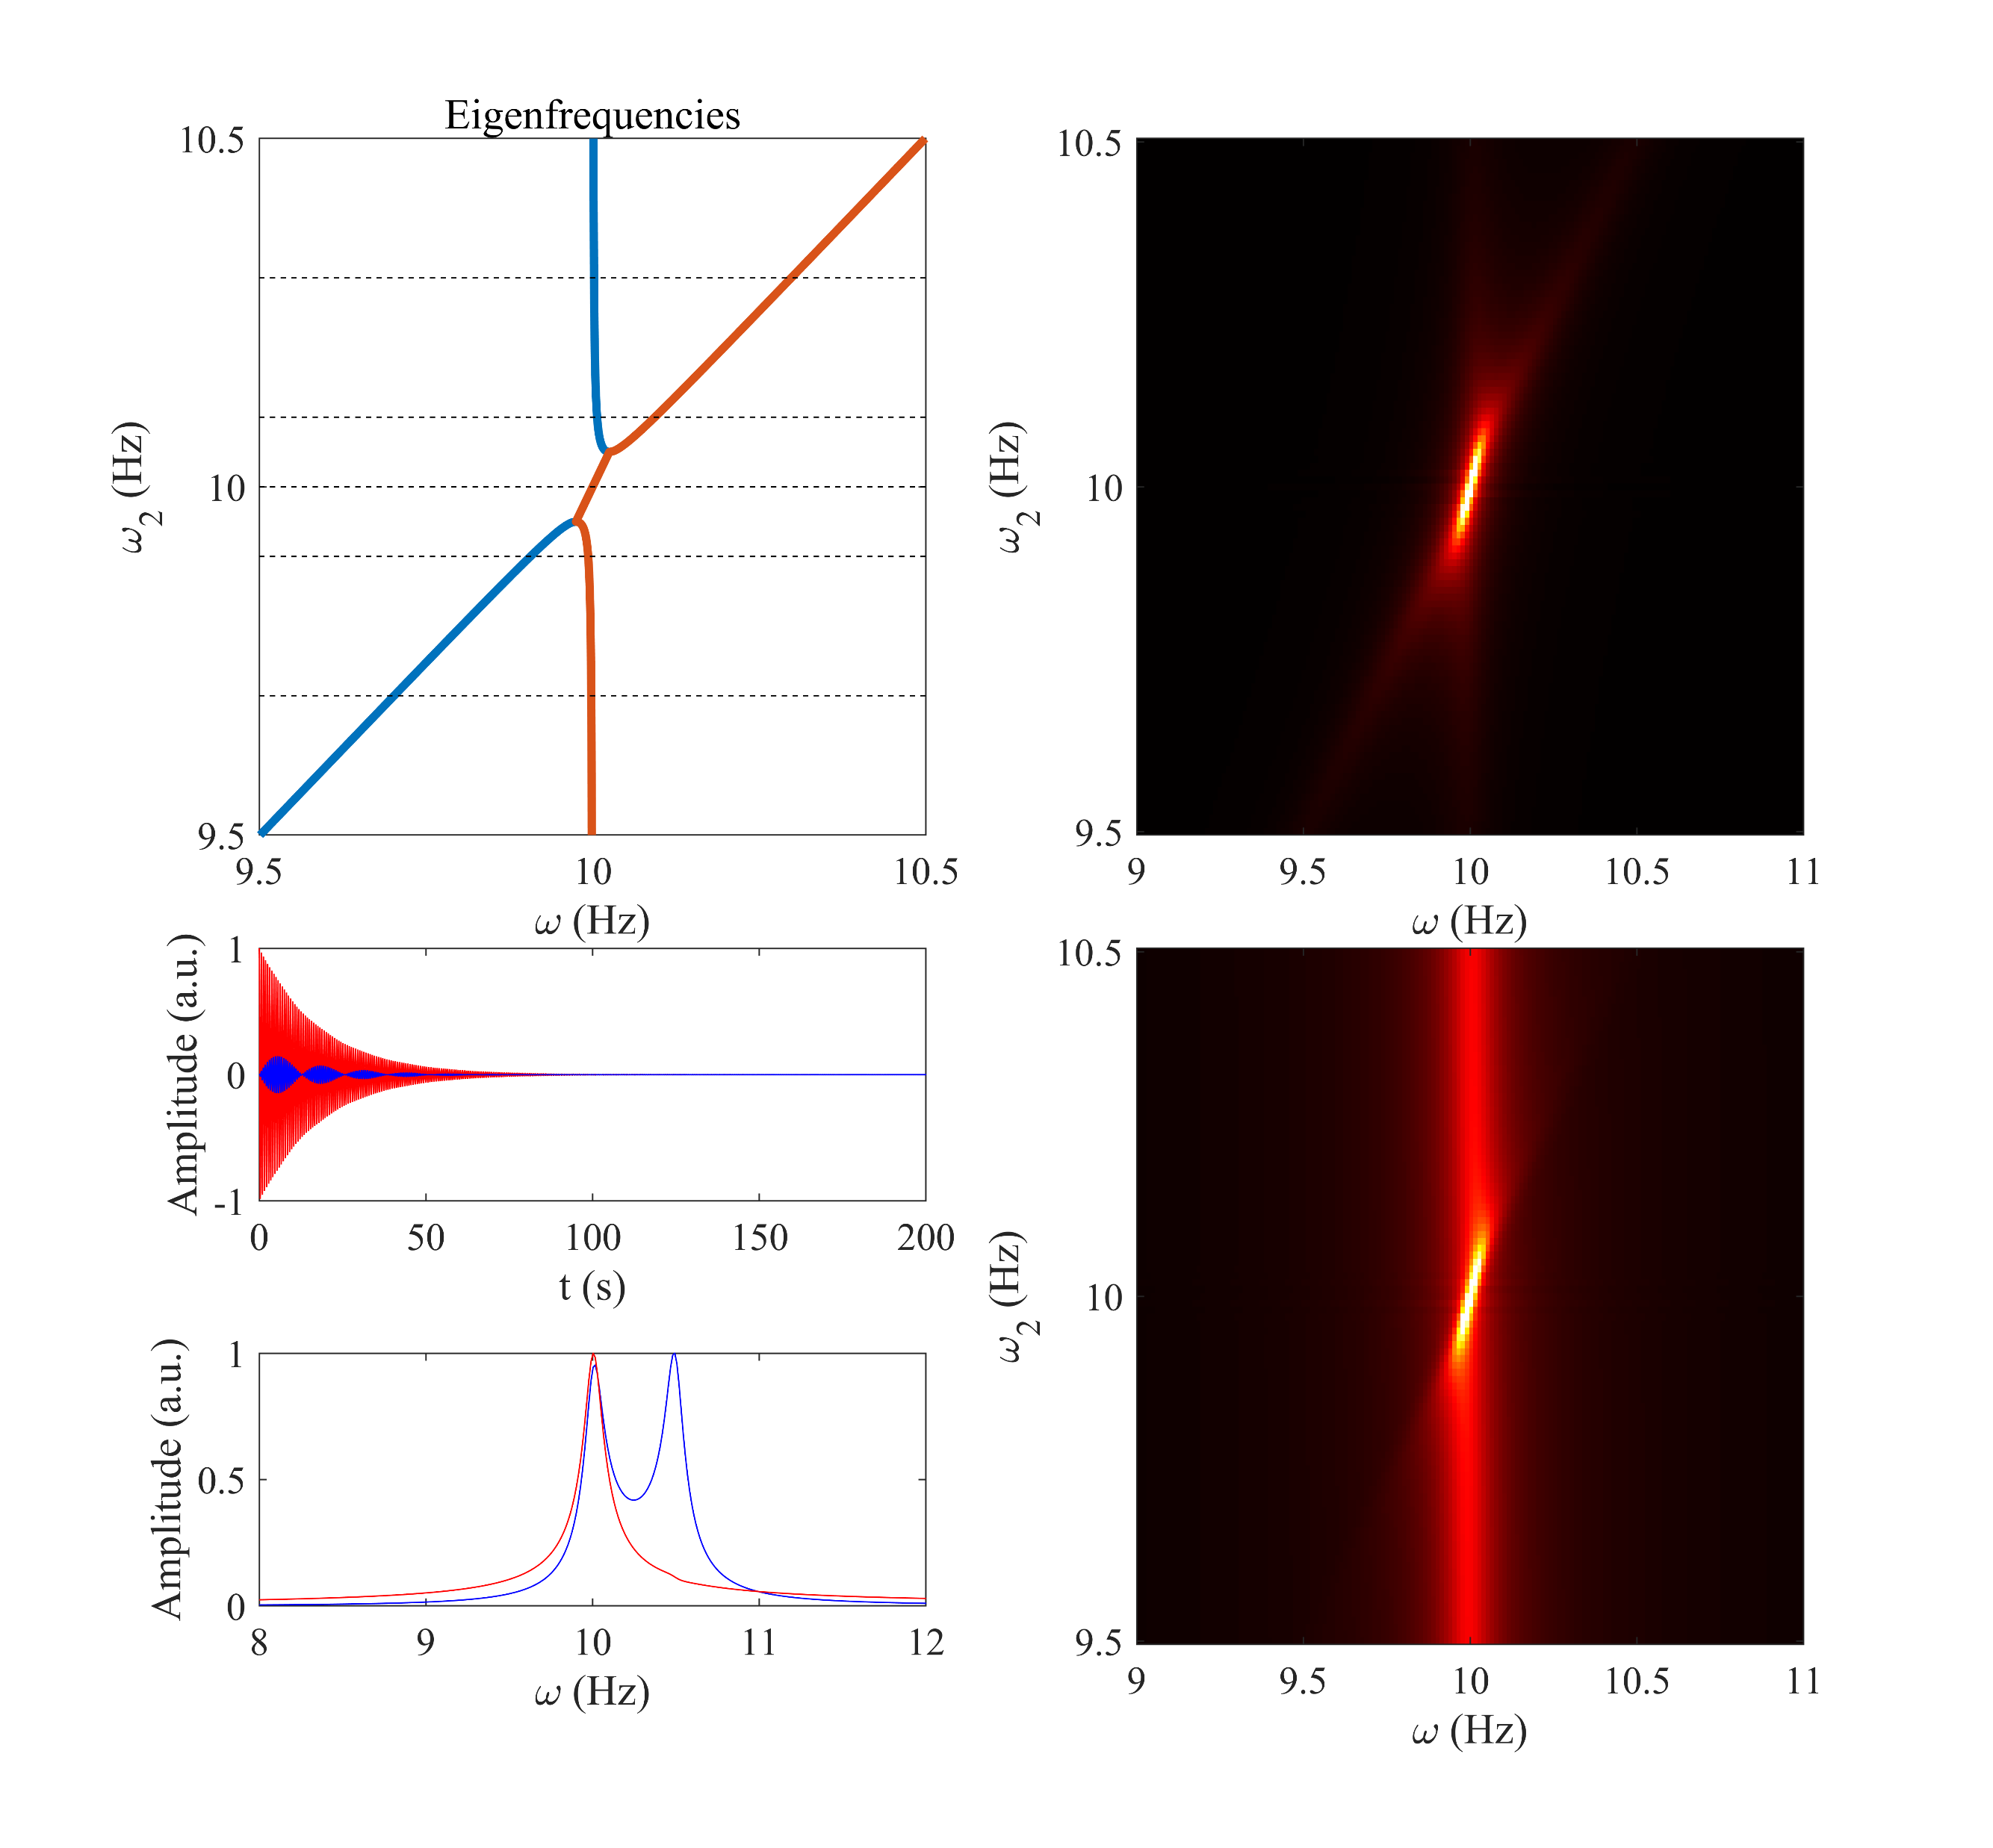
Magnon
FFT signal
Time domain
Cavity
FFT signal
Freq. domain

Slide 8
Summary
Better understand on coherent coupling, especially on the magnon perspective.
Provide preliminary knowledge on dissipative coupling, and provide time domain signal for both cavity and magnon.
Future work:
Build the model for dissipative coupling for electromagnetic systems.

