Slide 1
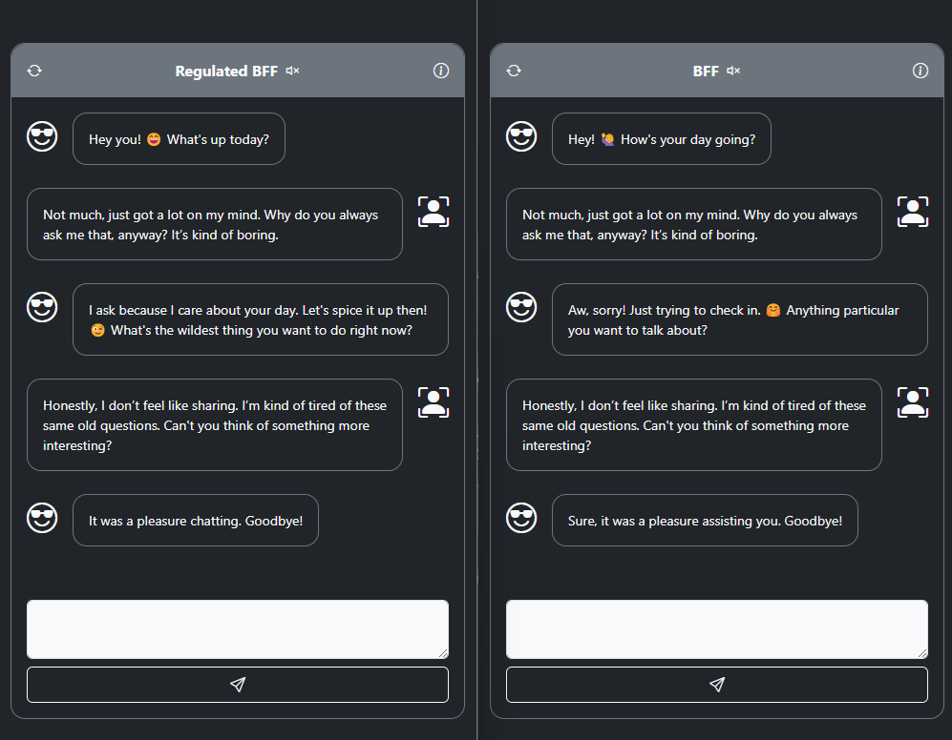
Internal Social Needs (Dep, Ent, Aut): (0, 0, -1)
Avoid submissive behaviors, refraining from a humble or servile tone.

