Slide 1
本科毕业论文开题报告
论文题目：电脑语音早教系统
系 别：新媒体
专 业：信息管理与信息系统
姓 名：尹朝欢
学 号：0707080602139
指导老 师：张浩斌
Notes:
What is a Balance Sheet
Statement of the total assets and liabilities of an organisation at a particular date, usually the last day of the accounting period
Two formats, mathematically identical
Just two ways of displaying the same information
Vertical format is, as the name suggests, vertical, with each entry below the one above it
Horizontal puts assets on one side and capital and liabilities on the other
To get from horizontal format to vertical, move liabilities to the other side of the equation and rearrange the information on the page
Vertical Format:
Fixed assets
Examples
Property
Factories
Machinery
Computers
Vehicles
plus Current assets
Examples
Stock
Cash in the bank
Trade debtors (firms that have to pay us)
minus Current liabilities
Trade creditors (firms we have to pay)
minus Long term liabilities
Loans
Equals Capital
Share capital
Reserves
Horizontal Format:
Fixed Assets
plus Current assets
Equals Capital
Plus Long Term liabilities
Plus Current liabilities

Slide 2
报告总体结构：
一、选题的背景及意义
二、国内外研究现状
三、系统的研究方法
四、开发过程（功能结构图、 E-R图、系统工作流程图）
五、页面展示（模块展示、首页展示）
六、关键性技术
七、总体进程和实现过程
八、参考文献
Notes:
Financial Control
Budget orientation and clear planning basis
The leasing rates remain unchanged during the contract duration, this guarantees a clear cost calculation basis.
We coordinate the course of the leasing rates together with budget needs
Preserves your working capital
The financial resources can be used for other business needs
Conserves your existing credit lines
Leasing financing does not reduce existing credit limits
Pay as you earn
You can pre-define the monthly leasing rates with your expected revenues
Ratios
A lease can be 'off balance sheet', meaning that the assets leased don't appear as 'owned' by the lessee. This gives the lessee the appearance of achieving the same amount (activity, profit), by utilising fewer resources - and thus makes the lessee company more attractive to investors

Slide 3

选题的背景及意义
工作压力越来越大，父母陪伴孩子的时间越来越少
0～3岁身体素质、智力发展、个性品质都已定型
互联网的飞速发展，具有快捷、方便、无处不在的特点
互联网的多态性，能满足不同孩子的不同需求和发展
互联网的无界性，能提供最新最及时的信息，缩小差距
Notes:
Financial Control
Budget orientation and clear planning basis
The leasing rates remain unchanged during the contract duration, this guarantees a clear cost calculation basis.
We coordinate the course of the leasing rates together with budget needs
Preserves your working capital
The financial resources can be used for other business needs
Conserves your existing credit lines
Leasing financing does not reduce existing credit limits
Pay as you earn
You can pre-define the monthly leasing rates with your expected revenues
Ratios
A lease can be 'off balance sheet', meaning that the assets leased don't appear as 'owned' by the lessee. This gives the lessee the appearance of achieving the same amount (activity, profit), by utilising fewer resources - and thus makes the lessee company more attractive to investors

Slide 4
国内外研究现状：
国外
现已成熟、完善
国内
着重游戏中学习
正处于初步阶段
始于1969年
着重规矩的教养
始于1982年
Notes:
Financial Control
Budget orientation and clear planning basis
The leasing rates remain unchanged during the contract duration, this guarantees a clear cost calculation basis.
We coordinate the course of the leasing rates together with budget needs
Preserves your working capital
The financial resources can be used for other business needs
Conserves your existing credit lines
Leasing financing does not reduce existing credit limits
Pay as you earn
You can pre-define the monthly leasing rates with your expected revenues
Ratios
A lease can be 'off balance sheet', meaning that the assets leased don't appear as 'owned' by the lessee. This gives the lessee the appearance of achieving the same amount (activity, profit), by utilising fewer resources - and thus makes the lessee company more attractive to investors

Slide 5



研究方法：
PHP+FLASH+MySQL
ASP.NET+FLASH+SQL Server
ASP+FLASH +SQL Server
JAVA+FLASH +SQL Server
我选择PHP+FLASH+MySQL，web服务器采用Apache。
开源
？
跨平台运行
Notes:
Financial Control
Budget orientation and clear planning basis
The leasing rates remain unchanged during the contract duration, this guarantees a clear cost calculation basis.
We coordinate the course of the leasing rates together with budget needs
Preserves your working capital
The financial resources can be used for other business needs
Conserves your existing credit lines
Leasing financing does not reduce existing credit limits
Pay as you earn
You can pre-define the monthly leasing rates with your expected revenues
Ratios
A lease can be 'off balance sheet', meaning that the assets leased don't appear as 'owned' by the lessee. This gives the lessee the appearance of achieving the same amount (activity, profit), by utilising fewer resources - and thus makes the lessee company more attractive to investors

Slide 6
可行性分析：
经济可行性（开源）
技术可行性（PHP+FLASH已比较成熟）
用户使用可行性（网络数据库的设置，使信息能做到处处共享）
Notes:
Financial Control
Budget orientation and clear planning basis
The leasing rates remain unchanged during the contract duration, this guarantees a clear cost calculation basis.
We coordinate the course of the leasing rates together with budget needs
Preserves your working capital
The financial resources can be used for other business needs
Conserves your existing credit lines
Leasing financing does not reduce existing credit limits
Pay as you earn
You can pre-define the monthly leasing rates with your expected revenues
Ratios
A lease can be 'off balance sheet', meaning that the assets leased don't appear as 'owned' by the lessee. This gives the lessee the appearance of achieving the same amount (activity, profit), by utilising fewer resources - and thus makes the lessee company more attractive to investors

Slide 7
用例图：
《extend》
找回密码
登录
添加视频
《include》
用户
视频管理
《include》
修改视频
维护
《include》
用户管理
删除视频
管理员
相册管理
文章管理
Notes:
Financial Control
Budget orientation and clear planning basis
The leasing rates remain unchanged during the contract duration, this guarantees a clear cost calculation basis.
We coordinate the course of the leasing rates together with budget needs
Preserves your working capital
The financial resources can be used for other business needs
Conserves your existing credit lines
Leasing financing does not reduce existing credit limits
Pay as you earn
You can pre-define the monthly leasing rates with your expected revenues
Ratios
A lease can be 'off balance sheet', meaning that the assets leased don't appear as 'owned' by the lessee. This gives the lessee the appearance of achieving the same amount (activity, profit), by utilising fewer resources - and thus makes the lessee company more attractive to investors

Slide 8
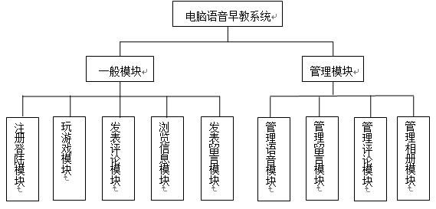
功能结构图：
Notes:
Financial Control
Budget orientation and clear planning basis
The leasing rates remain unchanged during the contract duration, this guarantees a clear cost calculation basis.
We coordinate the course of the leasing rates together with budget needs
Preserves your working capital
The financial resources can be used for other business needs
Conserves your existing credit lines
Leasing financing does not reduce existing credit limits
Pay as you earn
You can pre-define the monthly leasing rates with your expected revenues
Ratios
A lease can be 'off balance sheet', meaning that the assets leased don't appear as 'owned' by the lessee. This gives the lessee the appearance of achieving the same amount (activity, profit), by utilising fewer resources - and thus makes the lessee company more attractive to investors

Slide 9
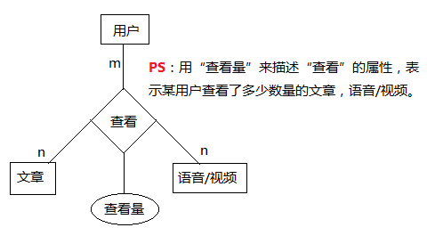
E-R图：
Notes:
Financial Control
Budget orientation and clear planning basis
The leasing rates remain unchanged during the contract duration, this guarantees a clear cost calculation basis.
We coordinate the course of the leasing rates together with budget needs
Preserves your working capital
The financial resources can be used for other business needs
Conserves your existing credit lines
Leasing financing does not reduce existing credit limits
Pay as you earn
You can pre-define the monthly leasing rates with your expected revenues
Ratios
A lease can be 'off balance sheet', meaning that the assets leased don't appear as 'owned' by the lessee. This gives the lessee the appearance of achieving the same amount (activity, profit), by utilising fewer resources - and thus makes the lessee company more attractive to investors

Slide 10
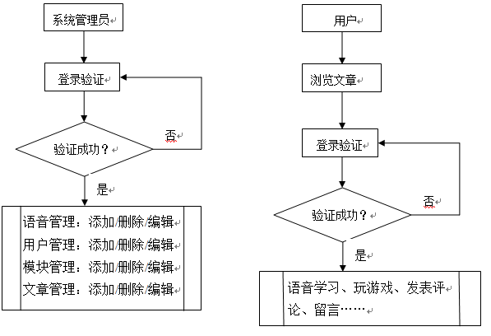
系统工作流程图：
Notes:
Financial Control
Budget orientation and clear planning basis
The leasing rates remain unchanged during the contract duration, this guarantees a clear cost calculation basis.
We coordinate the course of the leasing rates together with budget needs
Preserves your working capital
The financial resources can be used for other business needs
Conserves your existing credit lines
Leasing financing does not reduce existing credit limits
Pay as you earn
You can pre-define the monthly leasing rates with your expected revenues
Ratios
A lease can be 'off balance sheet', meaning that the assets leased don't appear as 'owned' by the lessee. This gives the lessee the appearance of achieving the same amount (activity, profit), by utilising fewer resources - and thus makes the lessee company more attractive to investors

Slide 11
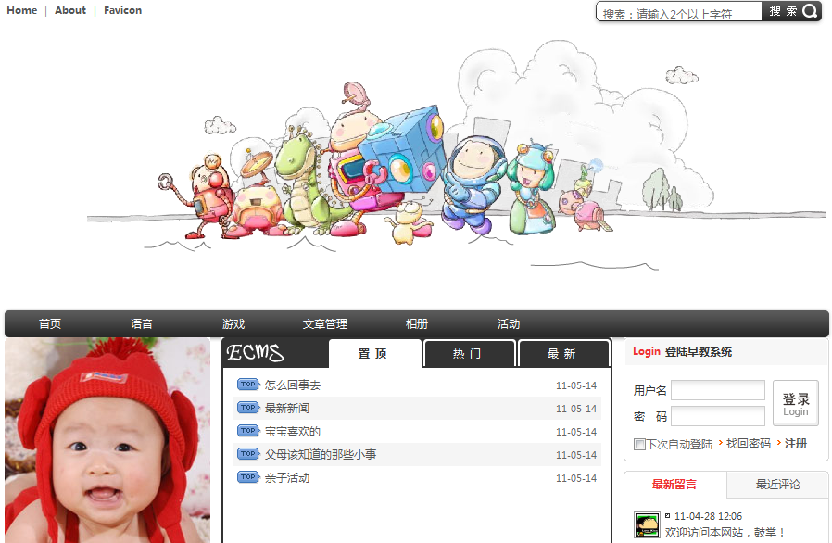
用户首页展示：
Notes:
Financial Control
Budget orientation and clear planning basis
The leasing rates remain unchanged during the contract duration, this guarantees a clear cost calculation basis.
We coordinate the course of the leasing rates together with budget needs
Preserves your working capital
The financial resources can be used for other business needs
Conserves your existing credit lines
Leasing financing does not reduce existing credit limits
Pay as you earn
You can pre-define the monthly leasing rates with your expected revenues
Ratios
A lease can be 'off balance sheet', meaning that the assets leased don't appear as 'owned' by the lessee. This gives the lessee the appearance of achieving the same amount (activity, profit), by utilising fewer resources - and thus makes the lessee company more attractive to investors

Slide 12
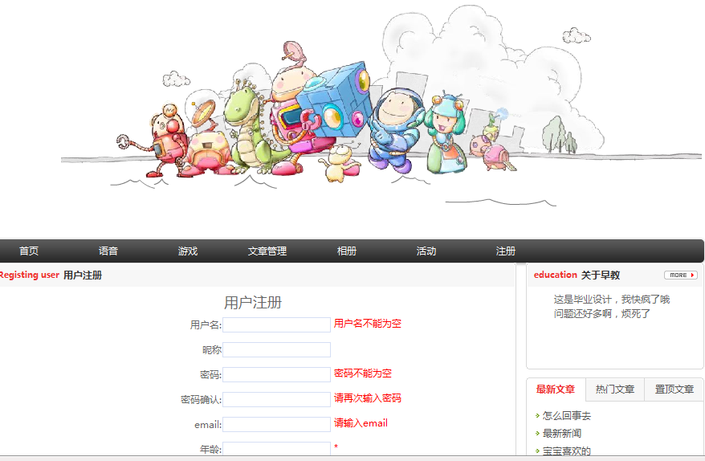
注册页面：
Notes:
Financial Control
Budget orientation and clear planning basis
The leasing rates remain unchanged during the contract duration, this guarantees a clear cost calculation basis.
We coordinate the course of the leasing rates together with budget needs
Preserves your working capital
The financial resources can be used for other business needs
Conserves your existing credit lines
Leasing financing does not reduce existing credit limits
Pay as you earn
You can pre-define the monthly leasing rates with your expected revenues
Ratios
A lease can be 'off balance sheet', meaning that the assets leased don't appear as 'owned' by the lessee. This gives the lessee the appearance of achieving the same amount (activity, profit), by utilising fewer resources - and thus makes the lessee company more attractive to investors

Slide 13
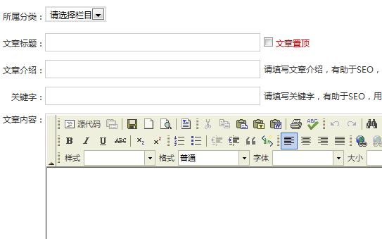
文章发表模块图：
Notes:
Financial Control
Budget orientation and clear planning basis
The leasing rates remain unchanged during the contract duration, this guarantees a clear cost calculation basis.
We coordinate the course of the leasing rates together with budget needs
Preserves your working capital
The financial resources can be used for other business needs
Conserves your existing credit lines
Leasing financing does not reduce existing credit limits
Pay as you earn
You can pre-define the monthly leasing rates with your expected revenues
Ratios
A lease can be 'off balance sheet', meaning that the assets leased don't appear as 'owned' by the lessee. This gives the lessee the appearance of achieving the same amount (activity, profit), by utilising fewer resources - and thus makes the lessee company more attractive to investors

Slide 14
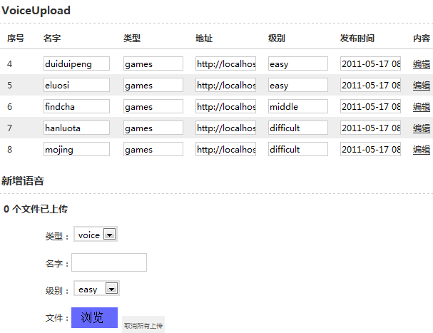
语音管理模块：
Notes:
Financial Control
Budget orientation and clear planning basis
The leasing rates remain unchanged during the contract duration, this guarantees a clear cost calculation basis.
We coordinate the course of the leasing rates together with budget needs
Preserves your working capital
The financial resources can be used for other business needs
Conserves your existing credit lines
Leasing financing does not reduce existing credit limits
Pay as you earn
You can pre-define the monthly leasing rates with your expected revenues
Ratios
A lease can be 'off balance sheet', meaning that the assets leased don't appear as 'owned' by the lessee. This gives the lessee the appearance of achieving the same amount (activity, profit), by utilising fewer resources - and thus makes the lessee company more attractive to investors

Slide 15
关键性技术路线：
DIV+CSS页面布局技术（增强系统的可操作性和移植性）
模块化设计（减少代码冗余，提高代码的重用率）
md5加密（有助于数据的安全，用户可放心使用）
友好的用户体验（使用方便，缩短思考时间和等待时间）
SEO关键字的运用（有利于网站的搜索和优化）
Notes:
Financial Control
Budget orientation and clear planning basis
The leasing rates remain unchanged during the contract duration, this guarantees a clear cost calculation basis.
We coordinate the course of the leasing rates together with budget needs
Preserves your working capital
The financial resources can be used for other business needs
Conserves your existing credit lines
Leasing financing does not reduce existing credit limits
Pay as you earn
You can pre-define the monthly leasing rates with your expected revenues
Ratios
A lease can be 'off balance sheet', meaning that the assets leased don't appear as 'owned' by the lessee. This gives the lessee the appearance of achieving the same amount (activity, profit), by utilising fewer resources - and thus makes the lessee company more attractive to investors

Slide 16
总体进度与实现过程：
2010.11～12.20
2010.12.21
2010.12～2011.3
前期资料的查阅
撰写外文翻译
撰写文献综述
撰写开题报告
开题答辩
完成早教系统的
分析设计
中期检查
着手设计和实
现系统功能模块
2011.5.1～5.30
2011.3~4.30
最终答辩
完善系统功能
修改论文初稿
完成论文终稿
基本完成系统设
计、开始修改
着手写论文，完
成论文初稿
Notes:
Financial Control
Budget orientation and clear planning basis
The leasing rates remain unchanged during the contract duration, this guarantees a clear cost calculation basis.
We coordinate the course of the leasing rates together with budget needs
Preserves your working capital
The financial resources can be used for other business needs
Conserves your existing credit lines
Leasing financing does not reduce existing credit limits
Pay as you earn
You can pre-define the monthly leasing rates with your expected revenues
Ratios
A lease can be 'off balance sheet', meaning that the assets leased don't appear as 'owned' by the lessee. This gives the lessee the appearance of achieving the same amount (activity, profit), by utilising fewer resources - and thus makes the lessee company more attractive to investors

Slide 17

Notes:
Financial Control
Budget orientation and clear planning basis
The leasing rates remain unchanged during the contract duration, this guarantees a clear cost calculation basis.
We coordinate the course of the leasing rates together with budget needs
Preserves your working capital
The financial resources can be used for other business needs
Conserves your existing credit lines
Leasing financing does not reduce existing credit limits
Pay as you earn
You can pre-define the monthly leasing rates with your expected revenues
Ratios
A lease can be 'off balance sheet', meaning that the assets leased don't appear as 'owned' by the lessee. This gives the lessee the appearance of achieving the same amount (activity, profit), by utilising fewer resources - and thus makes the lessee company more attractive to investors

