Slide 1
Analyzing Rocket Launch Data & Predicting Mission Success
Data Science Capstone Project
July 2025

Slide 2
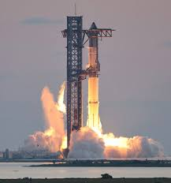
Executive Summary
The project analyzes historical rocket launch data to support mission planning and business decision-making.
Launch outcomes were predicted based on features such as payload mass, orbit type, and launch site.
Web scraping, API calls, and SQL queries were used to collect and process SpaceX launch records.
Machine learning models were built to predict 1st stage booster landing success with up to 83.3% accuracy.
These predictions can help improve bidding strategies, cost estimation, and operational efficiency in launch services.

Slide 3
Introduction
Objective: Understand launch success patterns and predict future outcomes.
Tools: Python, Pandas, SQL, Plotly, Folium, Dash
This report has been prepared as part of the Applied Data Science Capstone course.

Slide 4
Data Collection Methodology
• Used APIs (SpaceX, yfinance) and web scraping (BeautifulSoup).
• Gathered launch site, payload mass, and mission outcome data.
• Combined financial and launch datasets for analysis.

Slide 5
Data Wrangling Methodology
Collected SpaceX launch data via API and web scraping (requests, BeautifulSoup)
Extracted stock data with yfinance (e.g., Tesla, competitors)
Stored and structured data using Pandas DataFrames
Checked shape, types, and missing values for validation
Cleaned and merged datasets, standardized formats for analysis

Slide 6
EDA & Visual Analytics Methods
Analyzed key variables: payload mass, orbit type, landing outcome, and flight number
Used matplotlib, seaborn, and plotly.express for static and interactive plots
Created scatter plots, box plots, and correlation heatmaps to detect trends and outliers
Built interactive dashboards using Plotly Dash for dynamic filtering and insights
Identified relationships between payload, orbit, and landing success probability

Slide 7
Predictive Analysis Methodology
Selected Logistic Regression, Support Vector Machine, Decision Tree, and KNN for classification modeling
Split data into training and test sets; used stratified sampling for class balance
Applied GridSearchCV for hyperparameter tuning and model optimization
Evaluated models using accuracy, precision, recall, and F1-score
Chose the best-performing model to predict landing success based on mission features (e.g., payload mass, orbit, flight number)

Slide 8
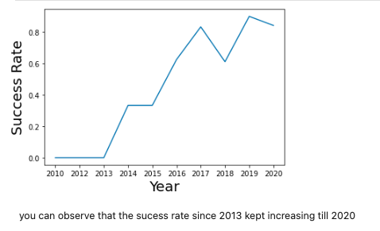
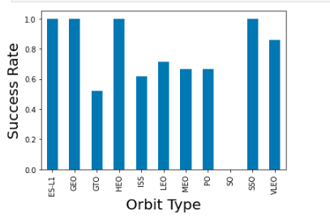
EDA

Slide 9
EDA with SQL
Tools Used:
SQL queries via Jupyter notebook using ibm_db and sql magic
Data visualization with matplotlib and seaborn
Key SQL Insights:
Most frequent launch sites identified using GROUP BY + COUNT(*)
Average payload mass computed across orbit types
Success rate trends analyzed over years and by orbit category
Correlation between orbit type and landing success visualized using bar charts
Visual Findings:
🛰️ Orbit Types: HEO and SSO showed highest success rates
📈 Yearly Trends: Steady increase in landing success rate since 2013, peaking in 2019

Slide 10
Interactive Map with Folium
Purpose: Visualize SpaceX launch sites and success outcomes on an interactive map
Tools Used:
Folium for rendering Leaflet.js-based maps
Pandas for data handling
HTML popups and color-coded markers for interactivity
Map Features:
📍 Launch Sites marked with circle markers
✅ Success Outcomes represented by color (e.g., green for success, red for failure)
📌 Popups display site name and number of successful launches
Insights Gained:
Enabled spatial comparison between frequently used sites
Highlighted geographic distribution of successful landings

Slide 11
Interactive Dashboard with Plotly Dash
Objective: Build an interactive web-based dashboard to explore SpaceX launch data dynamically
Tools Used:
Dash by Plotly for the web framework
Plotly for interactive visualizations
Pandas for data processing
Dashboard Features:
Dropdown menu to filter by Launch Site
Pie chart showing Success Rate by Site
Scatter plot displaying Payload vs. Launch Outcome
Interactive updates triggered by user input

Slide 12
Predictive Analysis (Classification)
Goal: Predict whether a SpaceX Falcon 9 first stage landing is successful based on mission features
Models Tested:
Logistic Regression
Support Vector Machine (SVM)
Decision Tree Classifier
K-Nearest Neighbors (KNN)
Key Features Used:
Payload Mass
Orbit Type
Launch Site
Flight Number
Boosters Version Category
Model Evaluation Metrics:
Accuracy: Highest with Decision Tree (~83%)
Confusion Matrix and F1-Score used for balanced evaluation
Cross-validation ensured robustness of results

Slide 13
Conclusion
This project demonstrated a full data science workflow: from data collection and wrangling to EDA, modeling, and dashboarding
Developed a machine learning model capable of predicting SpaceX landing success with >83% accuracy
Created interactive visual tools (Folium map & Plotly Dash) to enhance stakeholder engagement
Extracted insights using SQL and Python-based EDA to inform modeling decisions
Provided actionable recommendations for SpaceY to optimize bidding and improve mission planning

