Slide 1
Chapter 8 Homework
Prof. Junbeom Hur
TA. Hyundo Yoon
TA. Hodong Kim
Korea University

Slide 2
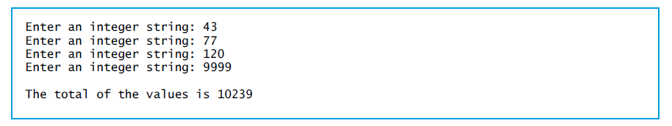
Problem 1
Write a program that takes four strings representing integers (-9999~99999) and prints total.
The program should convert each string to a corresponding integer value and print the total of the converted values.
You may use the ‘atoi’ function in ‘stdlib.h’.

Slide 3
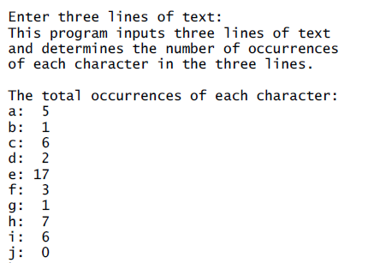
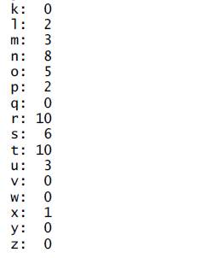
Problem 2
Write a program that takes a 3-line text and print the occurrence of each alphabet letter in the text.
(max length of a line: 80)
Count uppercase and lowercase letters as the same alphabet letter.
Use the ‘tolower’ or ‘toupper’ function in ‘ctype.h’.
Store the occurrences in an array and prints it out.
Use the ‘strchr’ function in ‘string.h’.

Slide 4
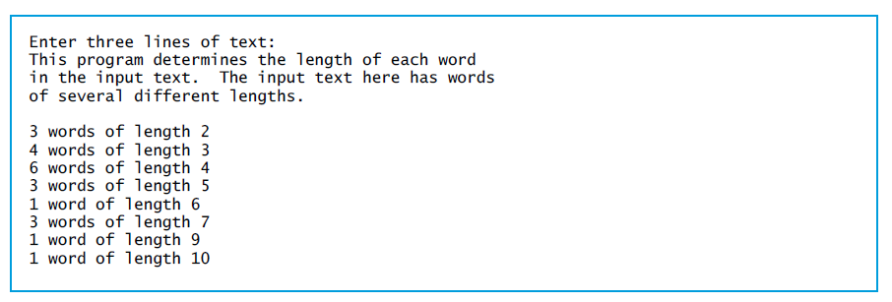
Problem 3
Write a program that takes three lines (max length: 80) of text input and prints the occurrence of the word lengths (1-letter words, 2-letter words, 3-letter words, … 19-letter words).
Use ‘strtok’ and ‘strlen’ functions in ‘string.h’.

Slide 5
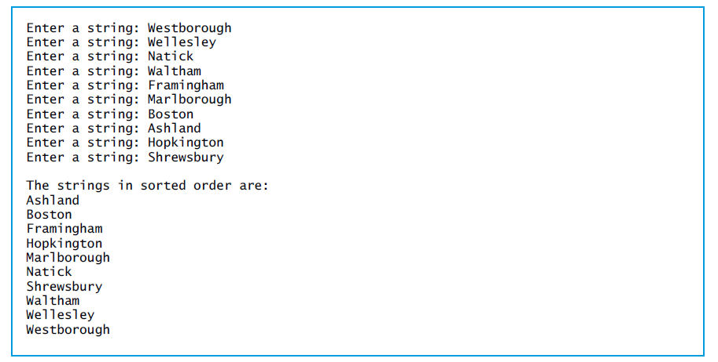
Problem 4
Write a program that takes 10 strings (max length: 50) and prints the strings in alphabetized order.
Use ‘bubble sort’ algorithm (increasing order).
Use ‘strcpy( )’ and ‘strcmp( )’ functions in ‘string.h’.

Slide 6
Problem 5
Write a program using ‘encryptor’ and ‘decryptor’ functions:
‘encryptor’ function
Parameters:
A char type 2-dimiension array storing predefined words
A char type array used to store the output string (size of each row of the arrays: 10)
Behaviors:
Randomly selects one of the predefined words (plaintexts) from the first parameter
Encrypts the selected word by adding a random integer value between 1~19 (key) to each word (output is called ‘ciphertext)
(‘\0’ is not a letter)
Ex) When the selected word is ‘ab…u’ and the random positive integer value is 3,
Writes the ciphertext on the second parameter
Prints the selected word, the key, and the ciphertext
 | [0] | [1] | … | [8] | [9]
char | ‘a’ | ‘b’ | … | ‘u’ | ‘\0’
ascii | 97 | 98 | … | 117
 | [0] | [1] | … | [8] | [9]
char | ‘b’ | ‘e’ | … | ‘x’ | ‘\0’
ascii | 100 | 101 | … | 120
+3

Slide 7
Problem 5
‘decryptor’ function
Parameters:
A 2-dimension char type array storing predefined word
A char type array which contains the ciphertext
Behaviors:
Figures out the key and the plaintext which were selected by encryptor
Make a guess about the key (1~19)
Make a guess about its plaintext by subtracting guessing key from the ciphertext
Probe if there is a matching word in the first parameter with the guessing plaintext
If there is a match, the original Key and Plaintext are found
* Repeats until recovering the original key and plaintext
Prints the key, and the plaintext which are recovered by the decryptor function.

Slide 8
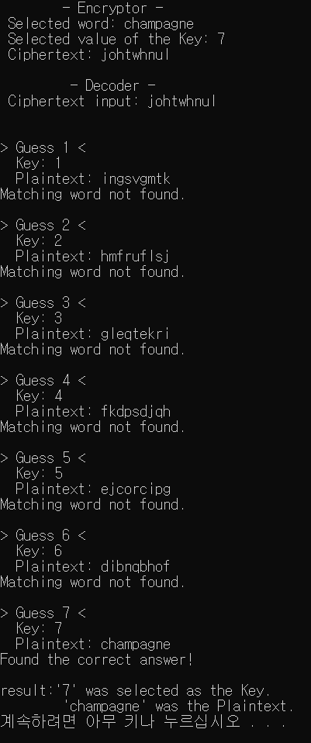
Problem 5
The main function of your program executes each function (encryptor and decryptor) only once
The predefined words
craftbeer, metallica, whitewine, champagne, bourgogne, sandiego, lafayette, pinotnoir, sauvignon, dondiablo
You may use the ‘strcmp’, and ‘strcpy’ functions in the ‘stdlib.h’.

Slide 9
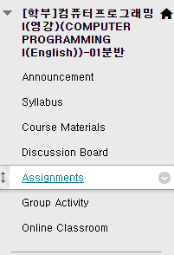
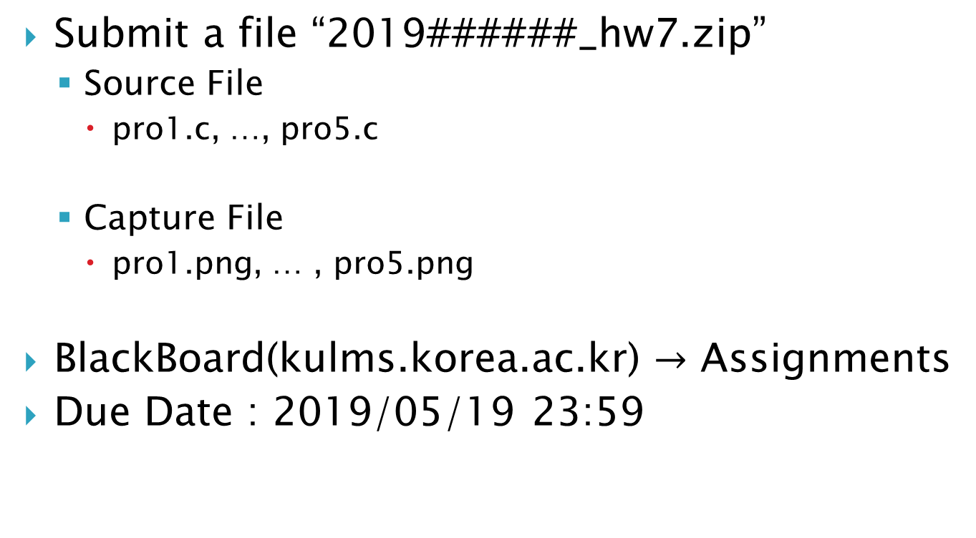
Homework-7
Submit a file “2019######_hw7.zip”
Source File
pro1.c, …, pro5.c
Capture File
pro1.png, … , pro5.png
BlackBoard(kulms.korea.ac.kr) $→$ Assignments
Due Date : 2019/05/19 23:59

