Slide 1
Chapter 11 Homework
Prof. Junbeom Hur
TA. Hyundo Yoon
TA. Hodong Kim
Korea University

Slide 2

Exercise 1
Write a program that takes two text files: toRead.txt and toWrite.txt
Copy the contents of the first text file (toRead.txt) into the second text file (toWrite.txt), but delete empty line
Put your toRead.txt file at your project repository
Hello my name is Cha Cha.
I live in Seoul, Korea.
I love you so much.
toRead.txt
Hello my name is Cha Cha.
I live in Seoul, Korea.
I love you so much.
toWrite.txt

Slide 3
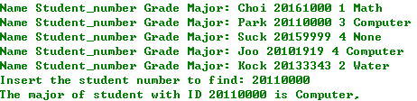
Exercise 2
Write a program that takes 5 students’ information (that is name, student ID, grade, and major), and writes them into ‘student_file.txt’
After that, the program takes a student number, and searches for the corresponding major in the ‘student_file.txt’, and displays it on the screen

Slide 4
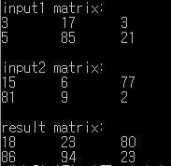
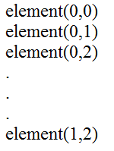

Exercise 3
Write a program that reads (2x3)-matrix from the ‘input1.txt’ and ‘input2.txt’, and writes the summation of given two matrices in ‘result.txt’.
input.txt
result.txt

Slide 5

Exercise 4
Write a program that reads texts from the file ‘test.txt’ and prints the number of occurrences of the target word (that is, the second argument) in the file (together with the whole word numbers)
Example) test.txt
President Donald Trump will not meet North Korean leader Kim Jong Un next month, he announced in a letter to Kim released by the White House Thursday morning, scrapping plans for what would have been a historic diplomatic summit.
He said during an appearance from the Roosevelt Room the decision amounted to a "tremendous setback" and warned North Korea that the US military is ready to act should Pyongyang take any "foolish and reckless" action.
"Our military, which is by far the most powerful anywhere in the world that has been greatly enhanced recently as we all know, is ready as necessary," he said.
But he left open the door to renewing the diplomatic thaw which had preceded the anticipated talks.
"If and when Kim Jong Un chooses to engage in constructive dialogue and actions, I am waiting," he said.
In his letter, which the administration said was dispatched through established communication channels to North Korea, Trump wrote with chagrin the summit was off.

Slide 6
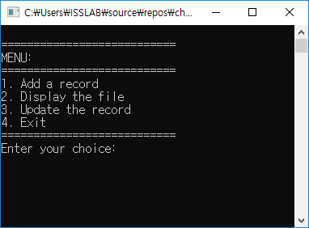
Problem 5
Write a program that manages the Employee list
Use employee structure
There are 4 options for menu
Add a record
Display the file (txt file)
Update the record
Exit
Struct employee {
int employee_id;
char *name;
};

Slide 7
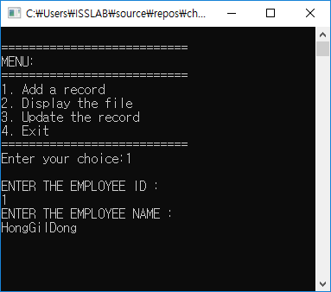
Problem 5
Option 1: Add a record
When you add a record for the first time, program creates a txt file and write the employee ID and name in that txt file
From the second addition, the input information is appended to the same txt file that you have created
Return to main menu after adding a record

Slide 8
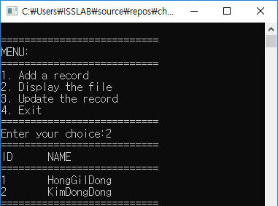
Problem 5
Option 2: Display the File
Program reads the txt file and lists the employee’s ID and name as shown in the right figure
Pressing any button will allow the user to go back to main menu

Slide 9
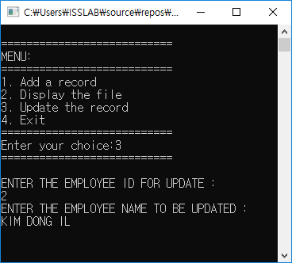
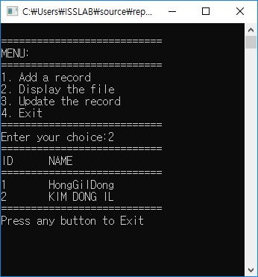
Problem 5
Option 3: Update the Record
Program searches for the employee ID, and updates the name of the employee
Return to main menu after entering a record
When you Display the file (option 2), the updated name should be shown in the list

Slide 10
Problem 5
Option 4: Exit
Phe program ends

Slide 11
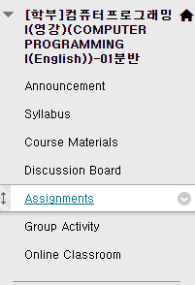
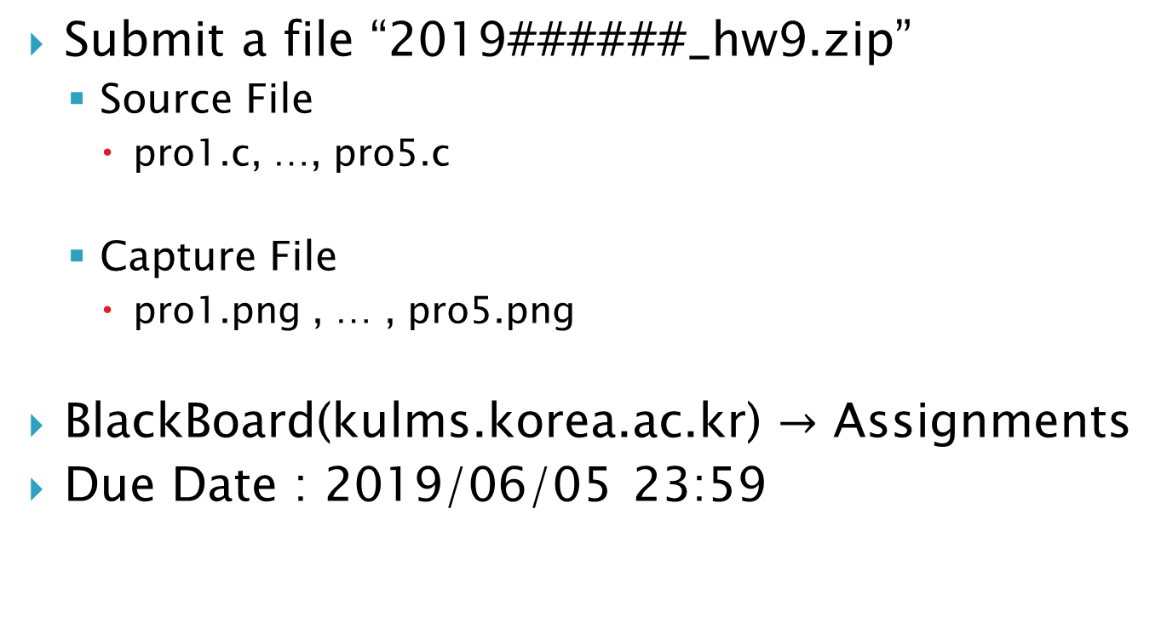
Homework-9
Submit a file “2019######_hw9.zip”
Source File
pro1.c, …, pro5.c
Capture File
pro1.png , … , pro5.png
BlackBoard(kulms.korea.ac.kr) $→$ Assignments
Due Date : 2019/06/05 23:59

