Slide 1
Chapter 12 Homework
Prof. Junbeom Hur
TA. Hyundo Yoon
TA. Hodong Kim
Korea University

Slide 2
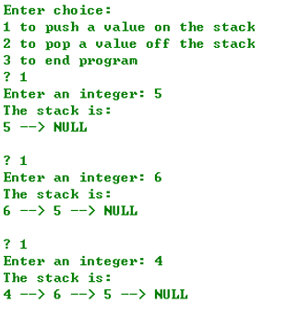
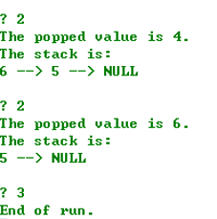
Problem 1
Write a primary functions of stack: push() and pop()
push(): create a new node and places it on top of stack
pop(): remove a node from the top of stack, free the memory that was allocated to the popped node and return the popped value
There is a sample code in next slide and blackboard.

Slide 3
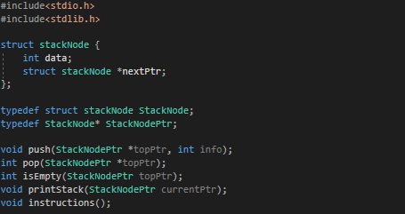
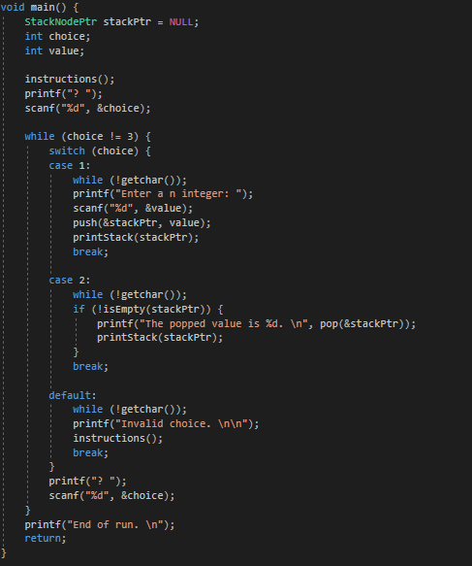
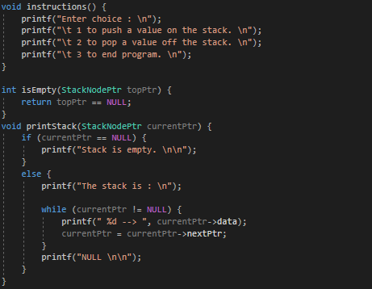
Problem 1
) implement two functions

Slide 4
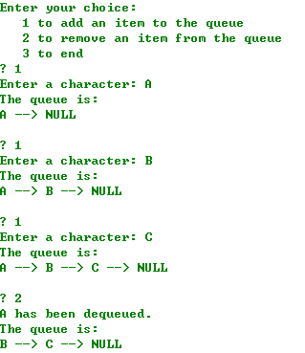
Problem 2
Write a primary functions of queue: enqueue() and dequeue()
enqueue(): insert node at the tail of the queue
dequeue(): remove the node from head of the queue and free the memory that was allocated to the dequeued node
There is a sample code in next slide and blackboard.

Slide 5
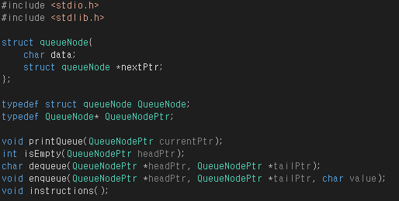
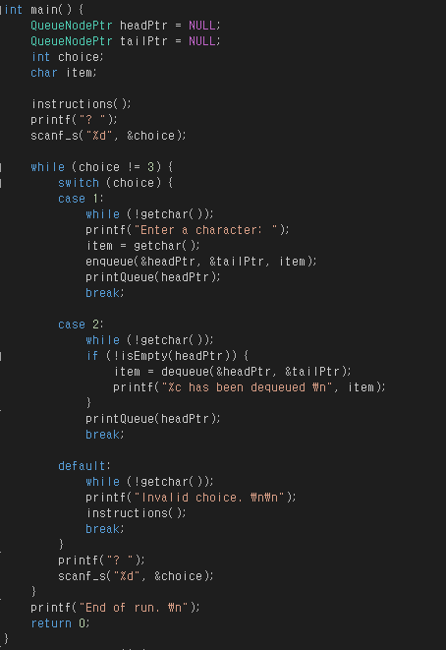
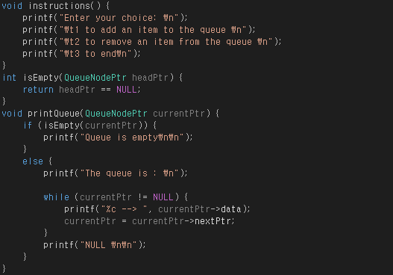
Problem 2

Slide 6
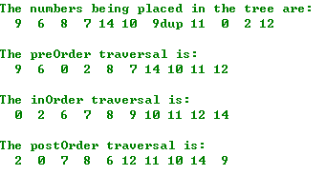
Problem 3
Write a program that generates 10 random numbers (range : 0~14) and inserts each in the binary search tree
Duplicate values should be discarded
Four traverse and insertion functions should be implemented:
inOrder(), preOrder(), postOrder(), insertNode()
There is a sample code in next slide and blackboard

Slide 7
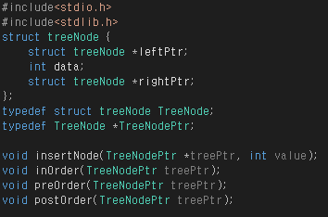
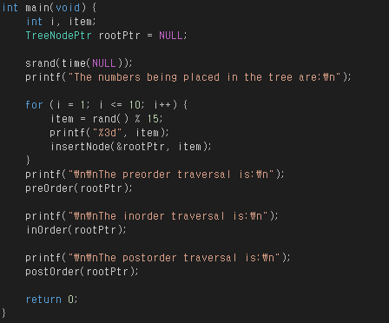
Problem 3

Slide 8
Problem 4
Write a program that reads 2 text files, and merge them in an alphabetically increasing order
You must use a linked list in the program
Each text file contains 10 words
Read each text file, and insert each word into a singly linked list (input linked list)
Insert the word before reading next one
Merge the two linked lists (output linked list)
Print each input linked lists before merging
Output linked list must be sorted in alphabetically increasing order
Sorting should be done only at the time of word insertion to output linked list
There must be no duplicate words in the output linked list
Print the output linked list
Write the output linked list as a text file

Slide 9
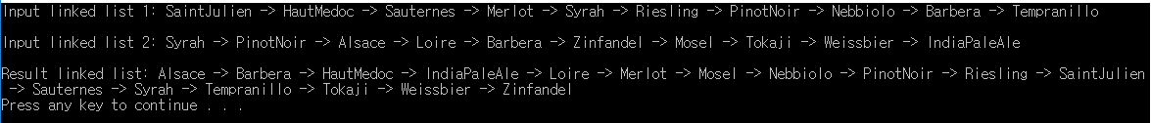
Problem 4
Following functions must be implemented in your source code
Inserting a node
Deleting a node
Printing a linked list
Ex)
output.txt
Alsace
Barbera
HautMedoc
IndiaPaleAle
Loire
Merlot
Mosel
Nebbiolo
PinotNoir
Riesling
SaintJulien
Sauternes
Syrah
Tempranillo
Tokaji
Weissbier
Zinfandel
input1.txt
input2.txt
SaintJulien
HautMedoc
Sauternes
Merlot
Syrah
Riesling
PinotNoir
Nebbiolo
Barbera
Tempranillo
Syrah
PinotNoir
Alsace
Loire
Barbera
Zinfandel
Mosel
Tokaji
Weissbier
IndiaPaleAle

Slide 10
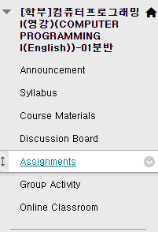
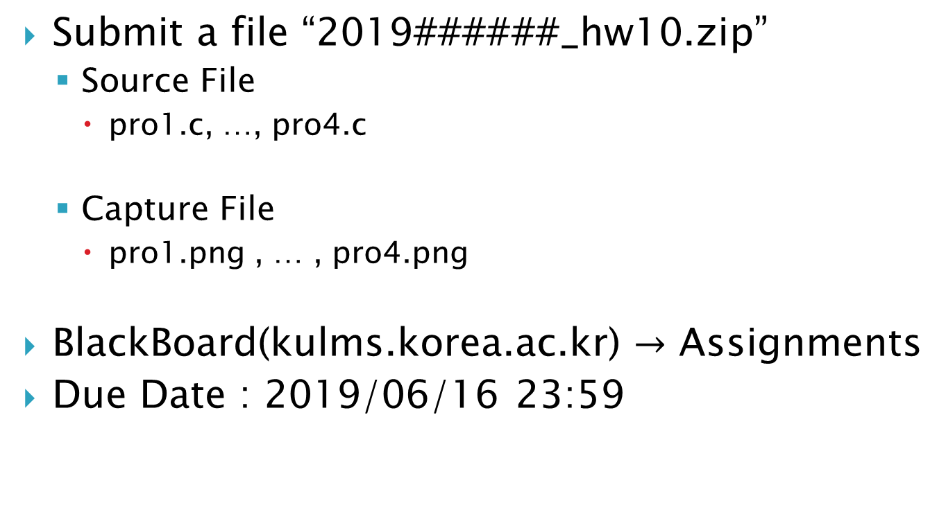
Homework-10
Submit a file “2019######_hw10.zip”
Source File
pro1.c, …, pro4.c
Capture File
pro1.png , … , pro4.png
BlackBoard(kulms.korea.ac.kr) $→$ Assignments
Due Date : 2019/06/16 23:59

