Slide 1
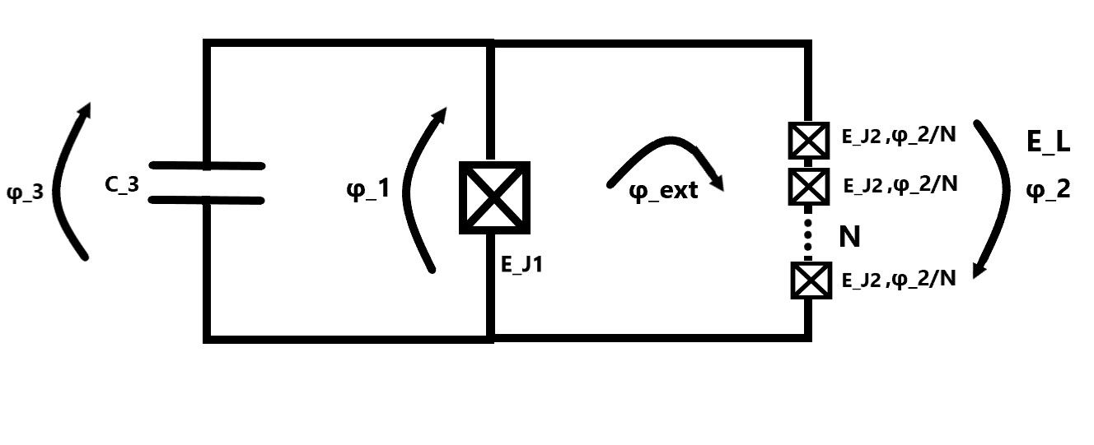
Fluxonium
2023-08-02 Group meeting
Amalie T. J. Paulsen

Slide 2
Milling
Milling recipe I used:
Folder: Gatemon_Guys -> milling test -> 2 min with 150nm Al

Slide 3
Milling

Slide 4
Milling

Slide 5
Milling

Slide 6
Milling

