Slide 1
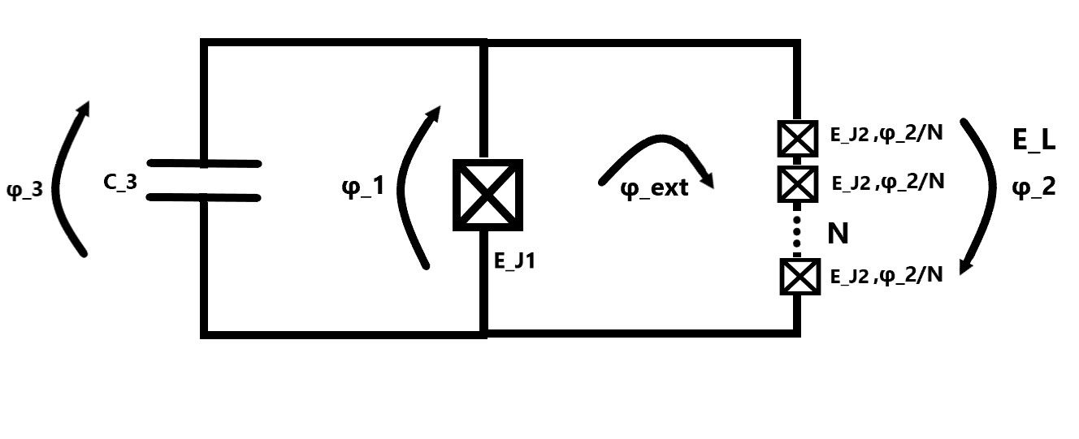
Fluxonium
2023-08-02 Group meeting
Amalie T. J. Paulsen
Notes:
Put side-number on pages

Slide 2
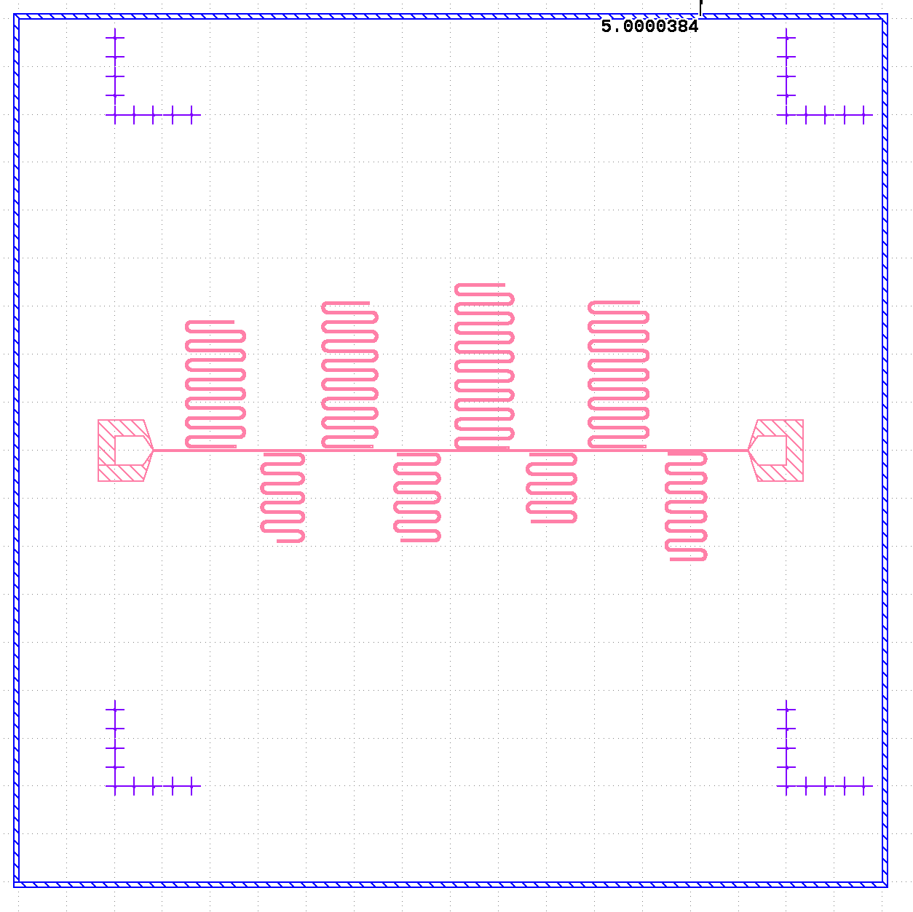
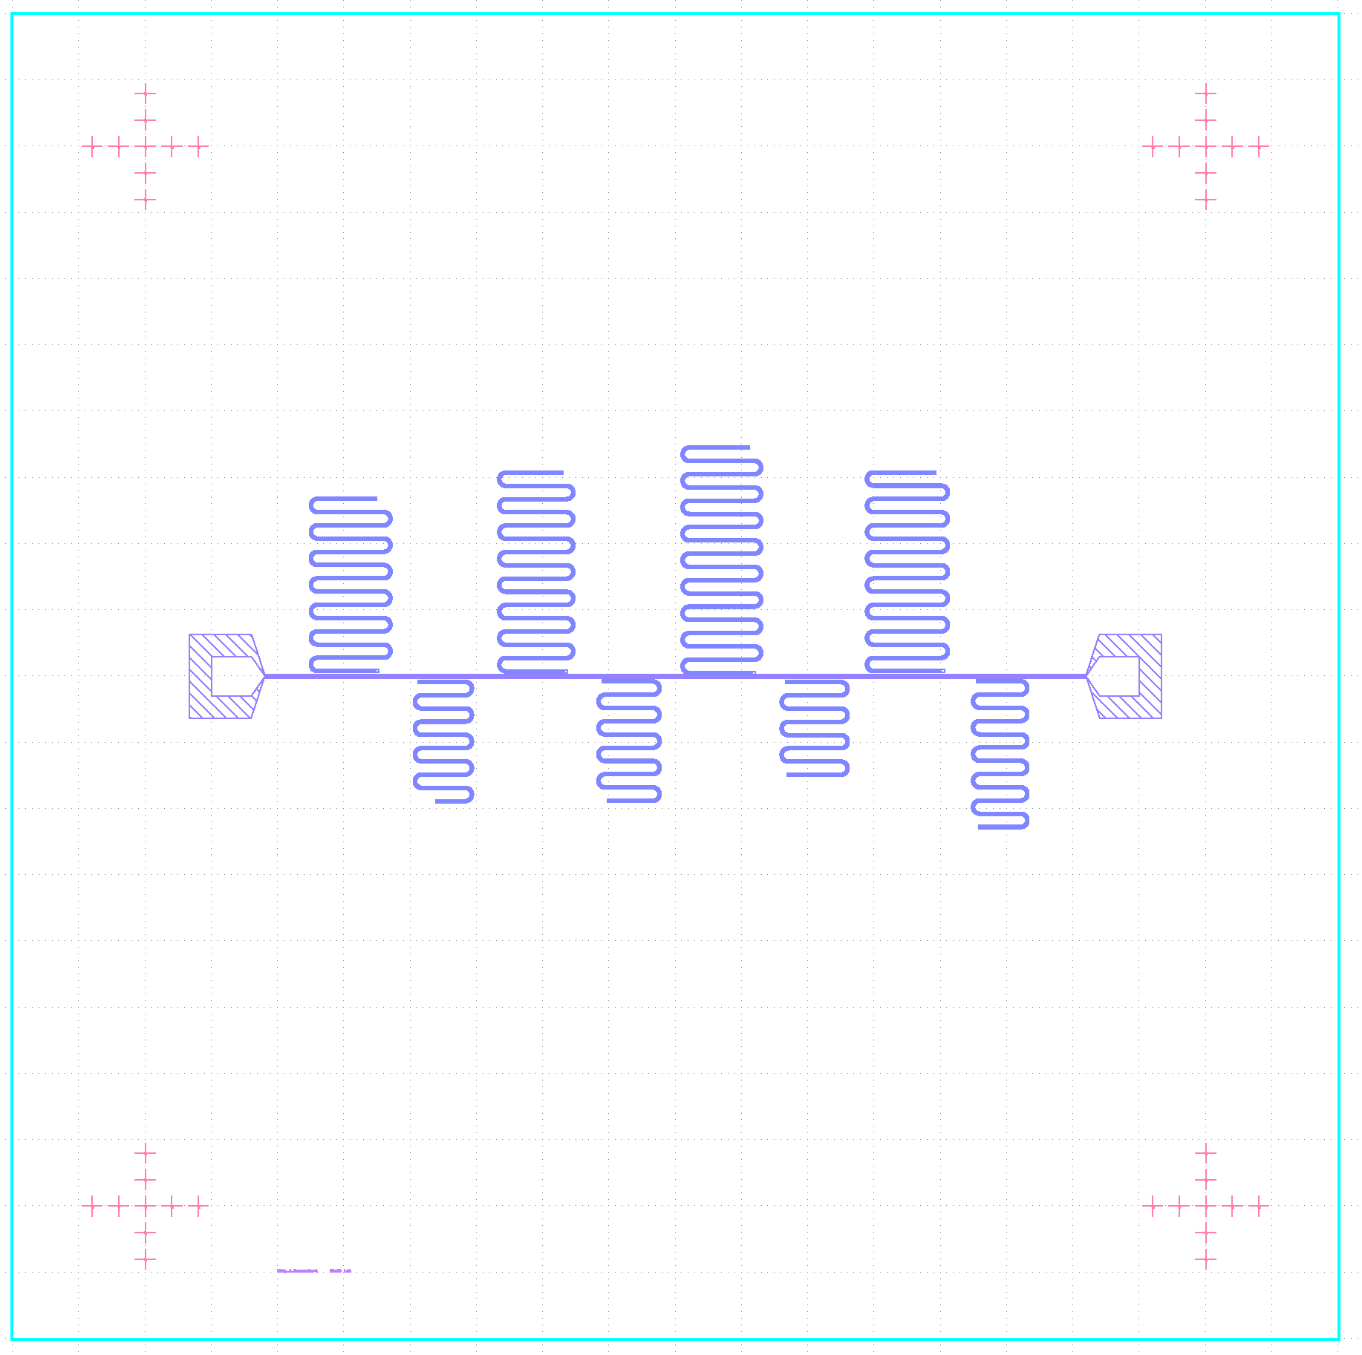
Copy of Davids design
Notes:
Put the 2 designs on top of each other in Klayout + simulated the resonators in Ansys

Slide 3
From fabrication of Davids resonators
Res number simulation | 1 | 2 | 3 | 4 | 5 | 6 | 7 | 8
Res number design | 3 | 8 | 4 | 6 | 2 | 5 | 1 | 7
Target fr (GHz)
Ansys fr (GHz) | 5.23143 | 5.50788 | 5.74643 | 5.96252 | 6.24387 | 6.48330 | 6.70832 | 6.96051
Measured fr (GHz) | 5.2355 | 5.47297 | 5.7722 | 5.957276 | Dead | 6.44288 | 6.71689 | 6.91824

Slide 4
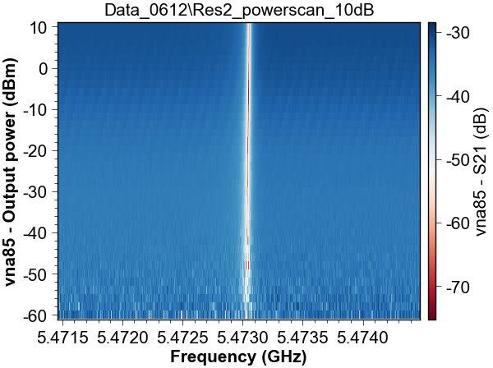
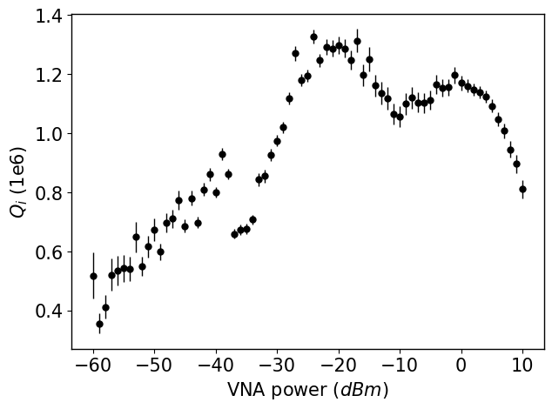
Q_i

Slide 5
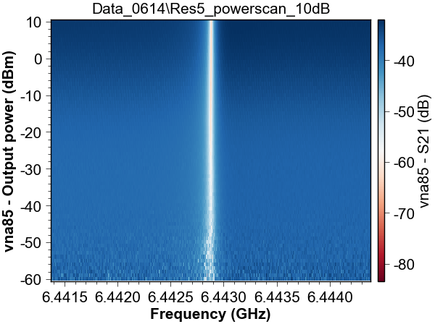
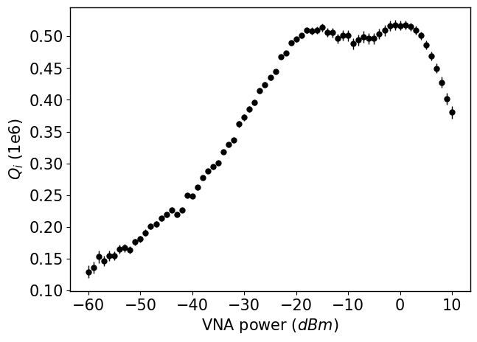
Q_i

Slide 6
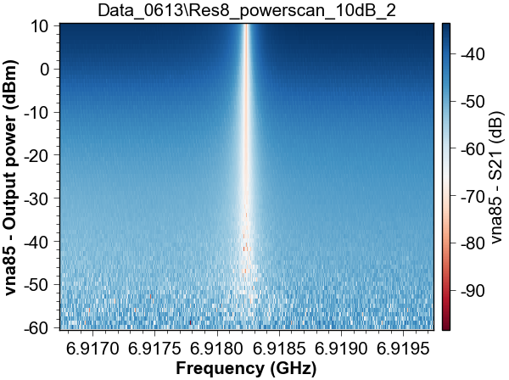
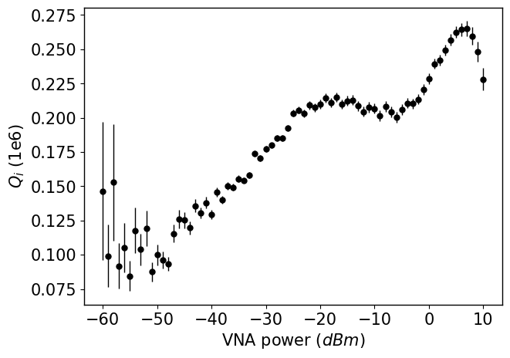
Q_i

Slide 7
Simulations in Ansys and using Besidin calculator
Res number | 1 | 2 | 3 | 4 | 5 | 6 | 7 | 8
Ansys without feedline (GHz) (100nm Al) - David | 6.70832 | 6.24387 | 5.23143 | 5.74643 | 6.48330 | 5.96252 | 6.96051 | 5.50788
Ansys without feedline(GHz) (200nm Al) - David | 6.74544
Ansys without feedline (GHz) (100nm Al) - Amalie | 6.74866 | 6.25708 | 5.24219 | 5.72611 |  | 5.96808
Ansys without feedline (GHz) (100nm Al) - Amalie, second attempt | 6.730 | 6.21595
Passes: | 10 | 10 | 10 | 10 | 10 | 10 | 10 | 10
Maximum deltage freq. | 0.1% | 0.1% | 0.1% | 0.1% | 0.1% | 0.1% | 0.1% | 0.1%
Which gives a length of resonator of (um):
Besidin (GHz) calculator of frequency
Amalie distance from feedline | 18 | 16 | 4 | 17 | 19 | 16 | 20,5 | 14,5
Amalie calculation of the length(um): | 8918 | 9631 | 11466 | 10470 | 4624 | 5016.3 | 4304 | 5471
Amalie length which is capacitively coupled | 440 | 440 | 475 | 510 | 217 | 339.3 | 398 | 310
Besidin (GHz) (amalie calculations of length) | 6.61173 From <https://smm.misis.ru/CPW-resonator-coupling/> | 6.12261 From <https://smm.misis.ru/CPW-resonator-coupling/> | 5.14213 From <https://smm.misis.ru/CPW-resonator-coupling/> | 5.63169 From <https://smm.misis.ru/CPW-resonator-coupling/> | 6.37606 From <https://smm.misis.ru/CPW-resonator-coupling/> | 5.87486 From <https://smm.misis.ru/CPW-resonator-coupling/> | 6.84405 From <https://smm.misis.ru/CPW-resonator-coupling/> | 5.38772 From <https://smm.misis.ru/CPW-resonator-coupling/>

Slide 8
Plans
Fabrication using Al in Plassys
Objective: to know more about the quality of the Plassys-Al.
To be more familiar with fabrication, designing in gdspy, ansys etc.
Make a scrip to calculate the Qi

