Slide 1
Quantum learning theory – Masterclass
21-25 August

Slide 2
Lower bounds and upper bounds.
Quek: Information-theoretic lower bounds for learning
Tomography (classical algorithm) scales exponentially with system size for a given precision.
Huang: discuss quantum advantage over classical.
In the past there have only been proven quadratically advantage of a quantum computer.
He proves exponential advantage when simulating properties of a quantum system (observables).
Takeaway: Quantum systems simulate quantum systems exponentially better than a classical computer on some tasks.
Lecturers:
Jonas Helsen
Hsin-Yuan Huang
Yihui Quek
Ingo Roth
Ronald de Wolf
Laura Mancinska
Tim Möbus
Notes:
Yihui Quek: information-theoretic lower bounds for learning.
(knowing the boundaries of what can be done on a QC) –
The tomography had a lower bound where the number of measurements for a given precision scales exponentially with the system size
- Meaning you can use tomography (using a classical algorithm) on a small system = few qubits, but not if we go to bigger systems. Because you need to do an experiment and look at the outcome on a quantum computer and read it out, then handle the data on a classical computer in order to learn the quantum state.
Huang also discuss that quantum computers advantage over the classical. So far there have only been proven quadratically advantage of a quantum computer. He proves that a quantum computer can learn from exponentially fewer experiments than those required in conventional experiments on a classical computer. But it depends of course on the task (in this case it is learning a property of a quantum system (observable )).
(He even did an experiment). A bit unsure
For a classical computer to learn a quantum state, you need to do experiments and look at the outcome, process the information and that takes exponentially more time than a quantum computer, because a quantum computer can do it efficiently.
Instead of doing tomography on a classical computer, you want to use a quantum system (ex. Quantum sensors) and get the information directly in quantum-computer memories where it can be processed.
- Quantum systems simulate quantum systems better than a classical computer.

Slide 3
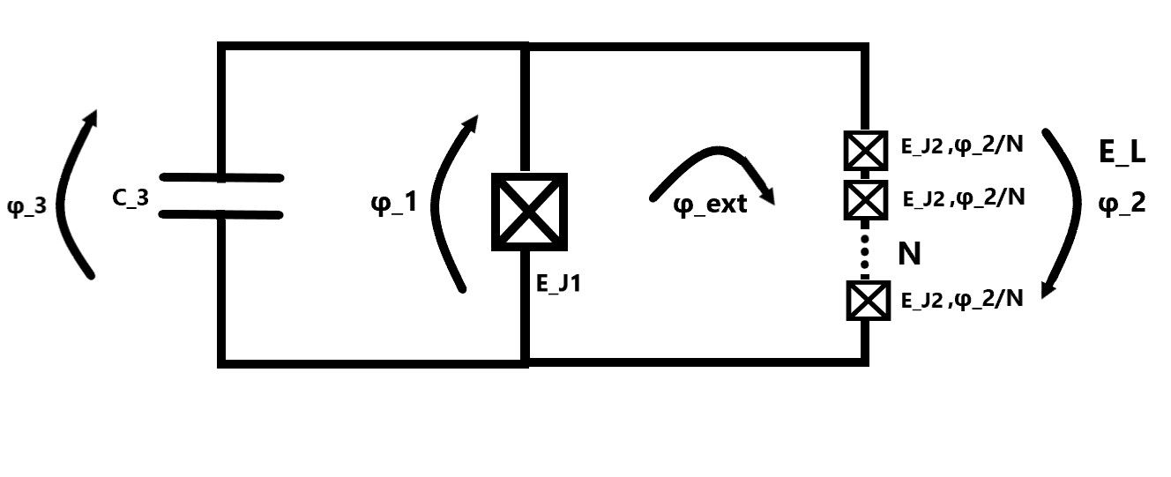
Fluxonium
2023-08-02 Group meeting
Amalie T. J. Paulsen

Slide 4
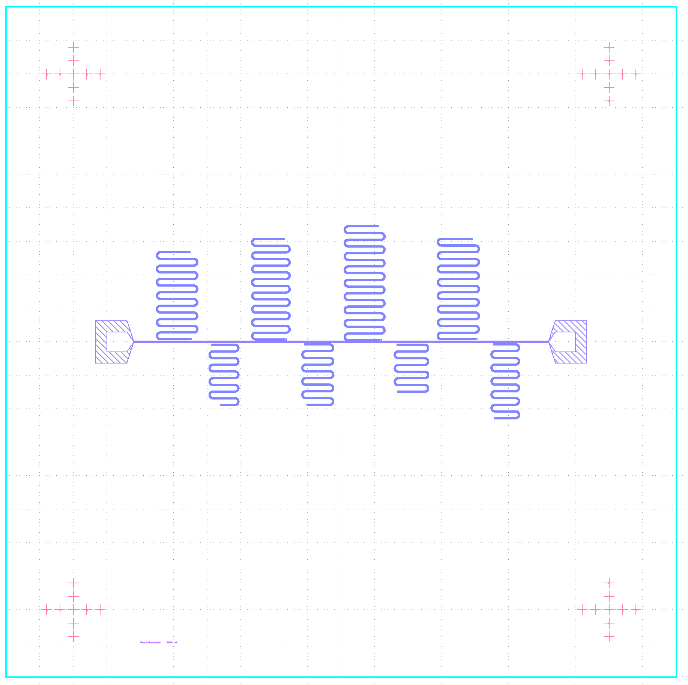
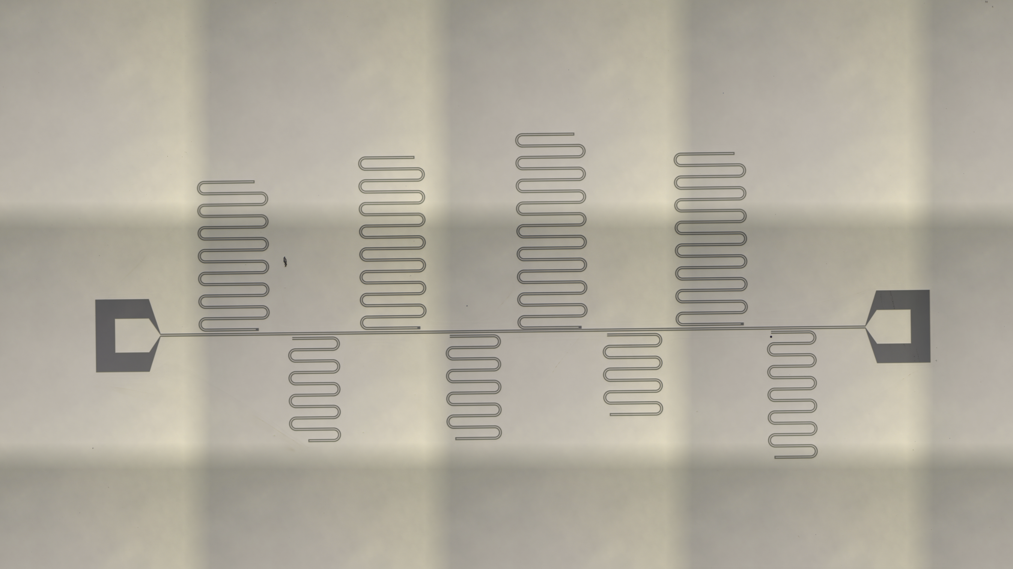
Chip_5_Resonator5 - Overview

Slide 5
Chip_5_Resonator5 - Measurements

