Slide 1
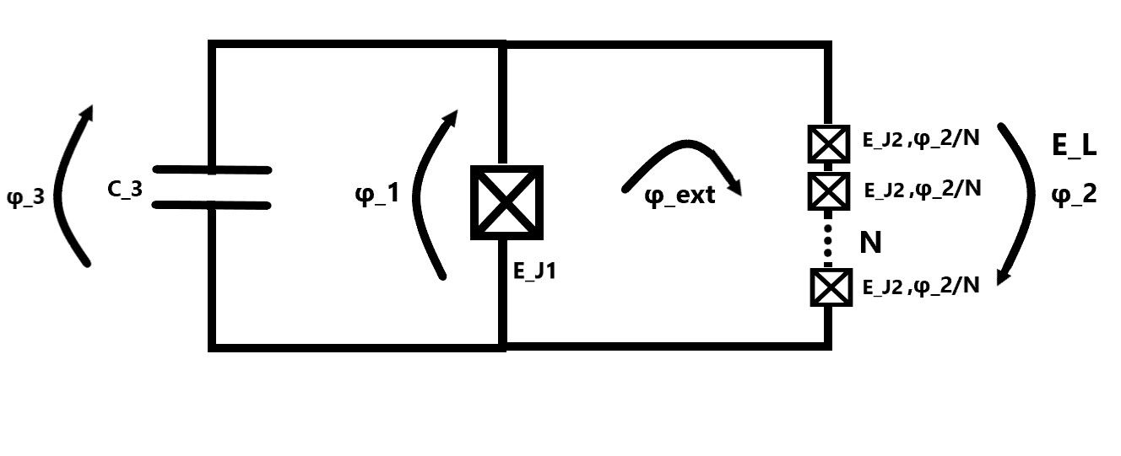
Fluxonium
2023-08-02 Group meeting
Amalie T. J. Paulsen

Slide 2
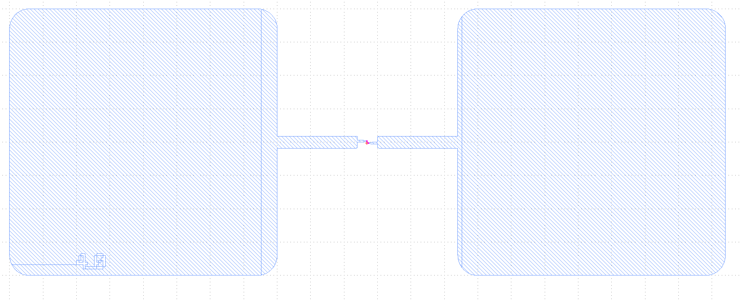
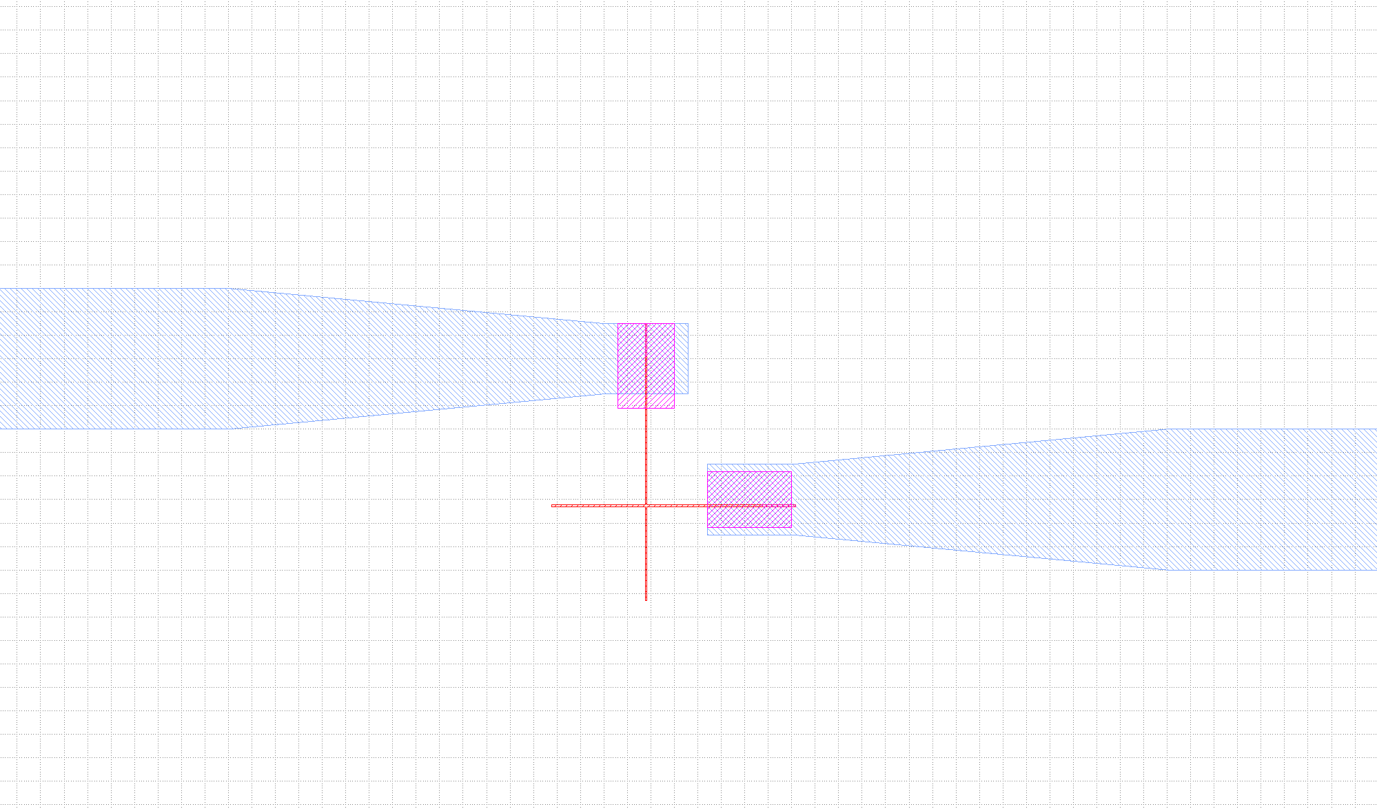
Josephson junctions (JJ)
Design of JJ
Varying width of JJ (100-360nm) 20 nm inbetween
Fabricated in 3 steps
Base layer
JJ layer
Patches layer

Slide 3
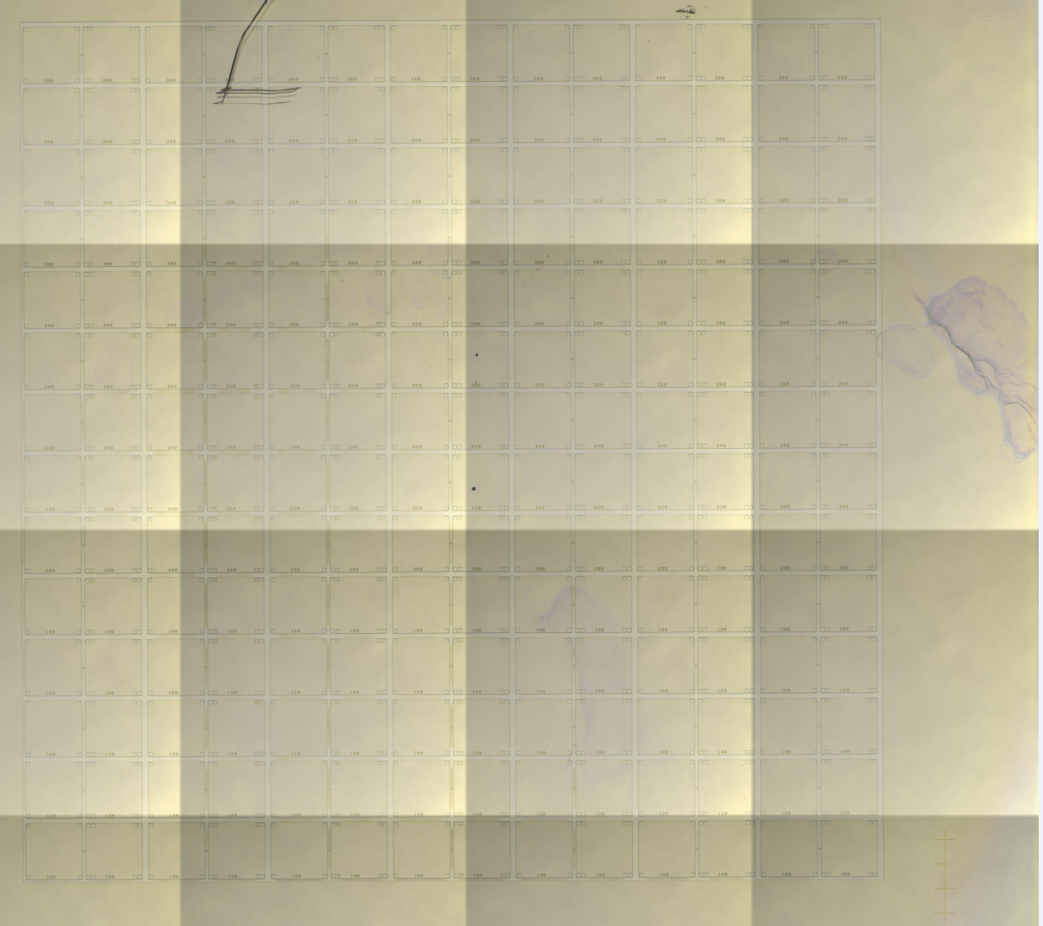
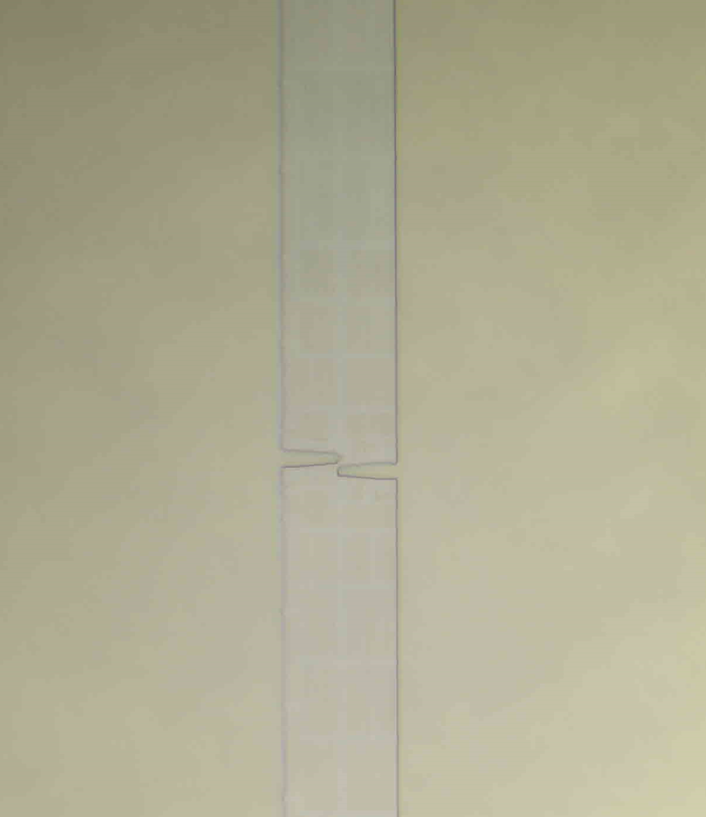
Chip_8_JJ2 dose test of JJ in Quantech
Base layer
Post develop

Slide 4
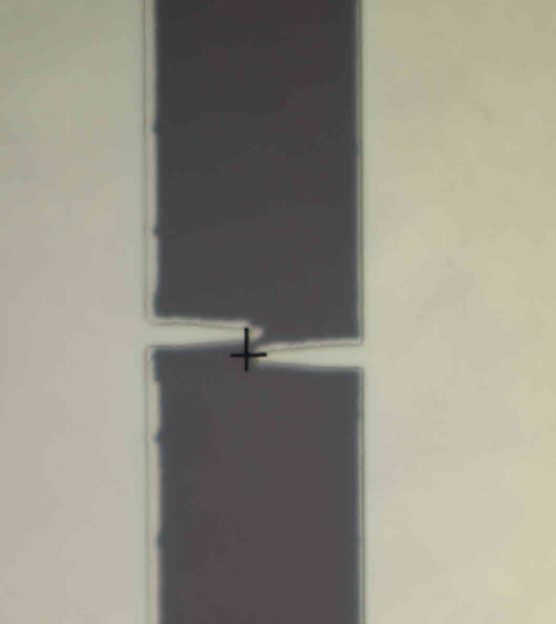

Chip_8_JJ2 dose test of JJ in Quantech
JJ layer
Post develop
Double angle evaporation in Plassys
Chalmers paper:

Slide 5
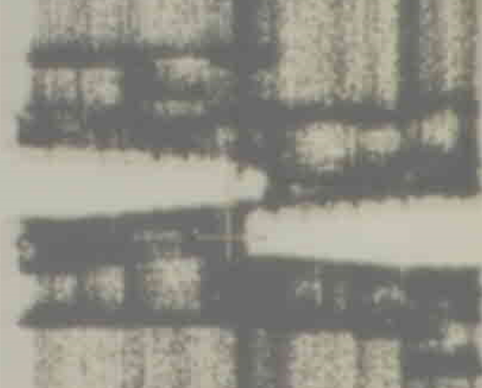
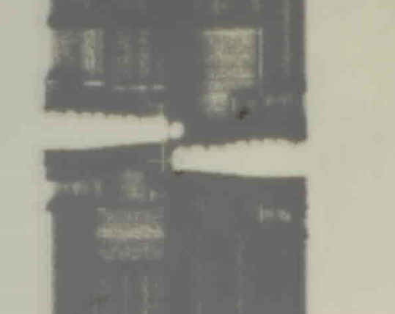
Chip_8_JJ2 dose test of JJ in Quantech
100nm – 2 different doses
1045
1190

Slide 6
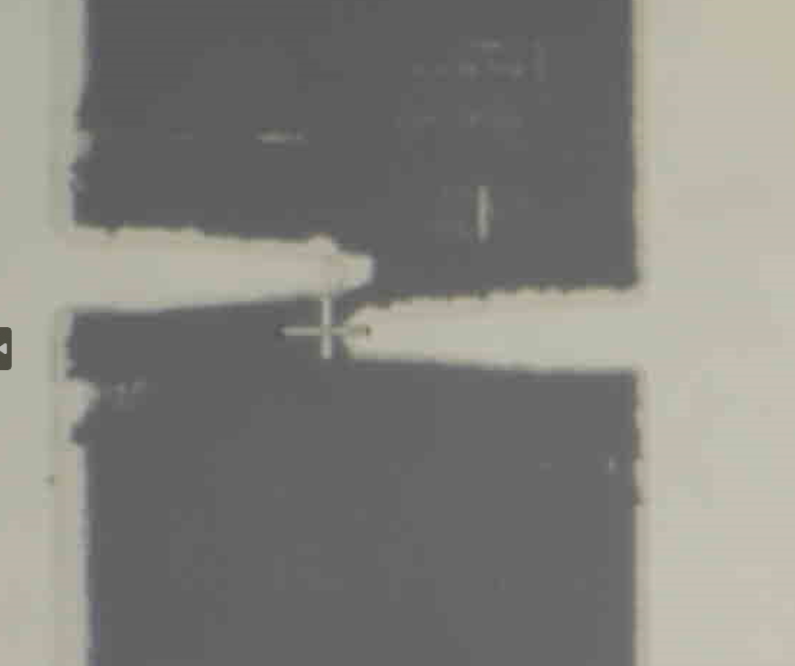
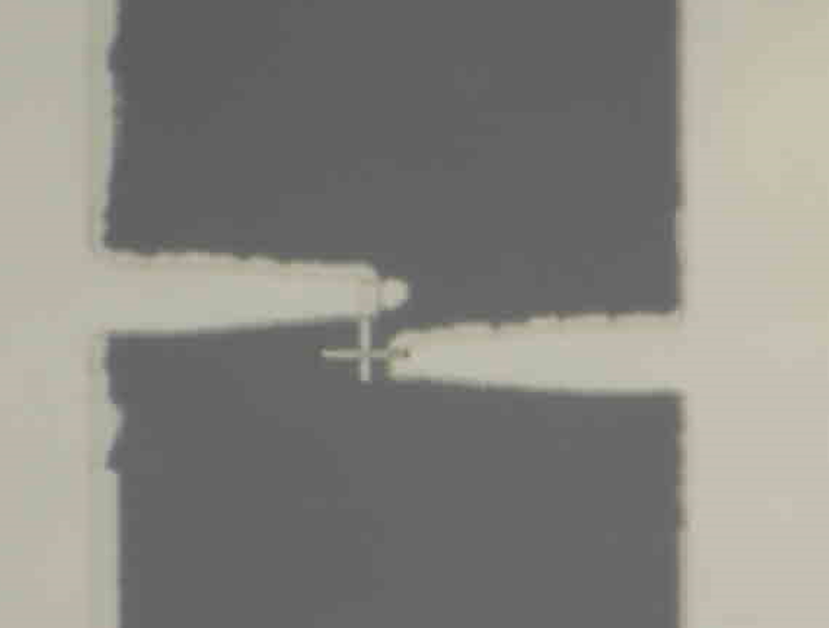
Chip_8_JJ2 dose test of JJ in Quantech
360nm – 2 different doses
1045
1190

Slide 7
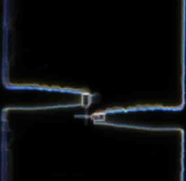
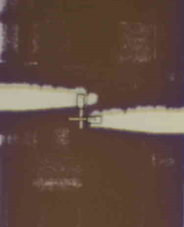
Chip_8_JJ2 dose test of JJ in Quantech
Patches layer
Post develop
Milling, Al evaporation and oxygen capping in Plassys
- Problems with the Plassys..
360nm JJ, DF and BF

Slide 8
Chip_8_JJ2 dose test of JJ in Quantech
Next step on Chip_8_JJ2
Before there were no junctions, now we have junctions down to 100nm
And a good dose around 1045-1190
Problems with Plassys..
Next step
Finish the patches
2 probe measurements (to see if they are working even though the base layer was bad
SEM -> decide on a final dose
Test limits of the recipe by making arrays of JJ and small junctions

Slide 9
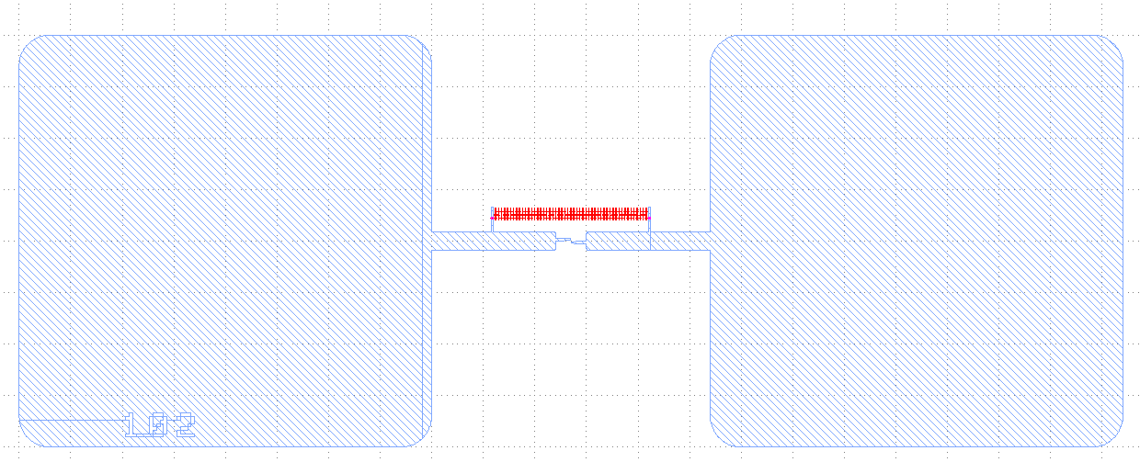
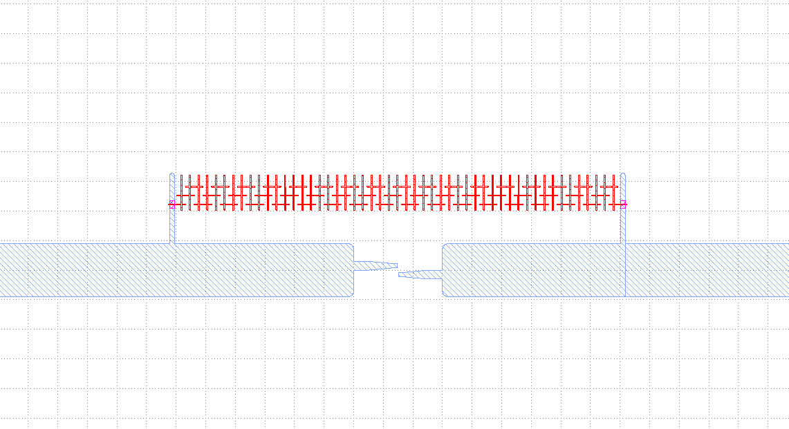
Josephson junctions (JJ) and array of JJ (array_JJ)
Design of JJ
Varying width of JJ (40-400nm) 40 nm inbetween
Design of JJ
Varying width of JJ (40-400nm)
Design of array_JJ
Varying # JJ in array (30-150) 420nm junctions

Slide 10
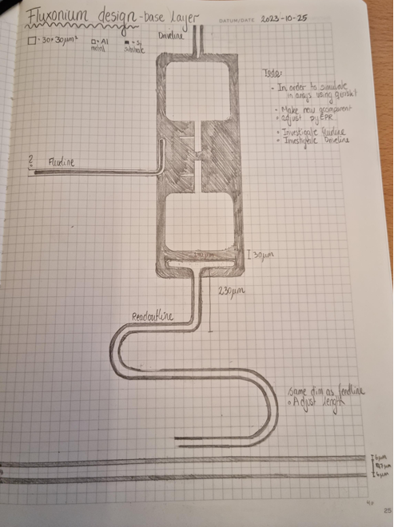
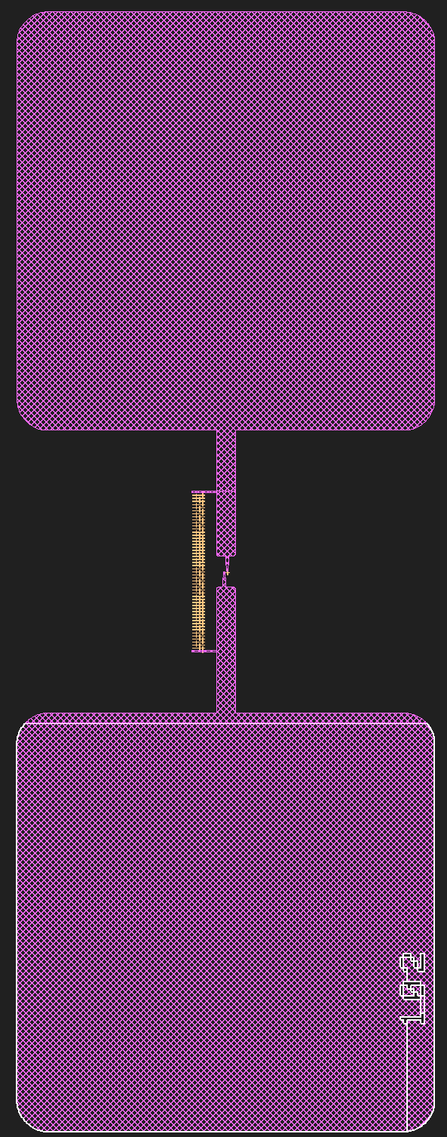

Fluxonium/Transmon
First draft:

Slide 11
Fluxonium/Transmon
Next step Fluxonium/Transmon
Continue reading experimental papers on Fluxonium to get good parameters of E_J, E_C and E_L and if the flux
Simulate capacitance in Ansys (maybe using Qiskit metal)
Help from Shikhar and Ksenia

Slide 12
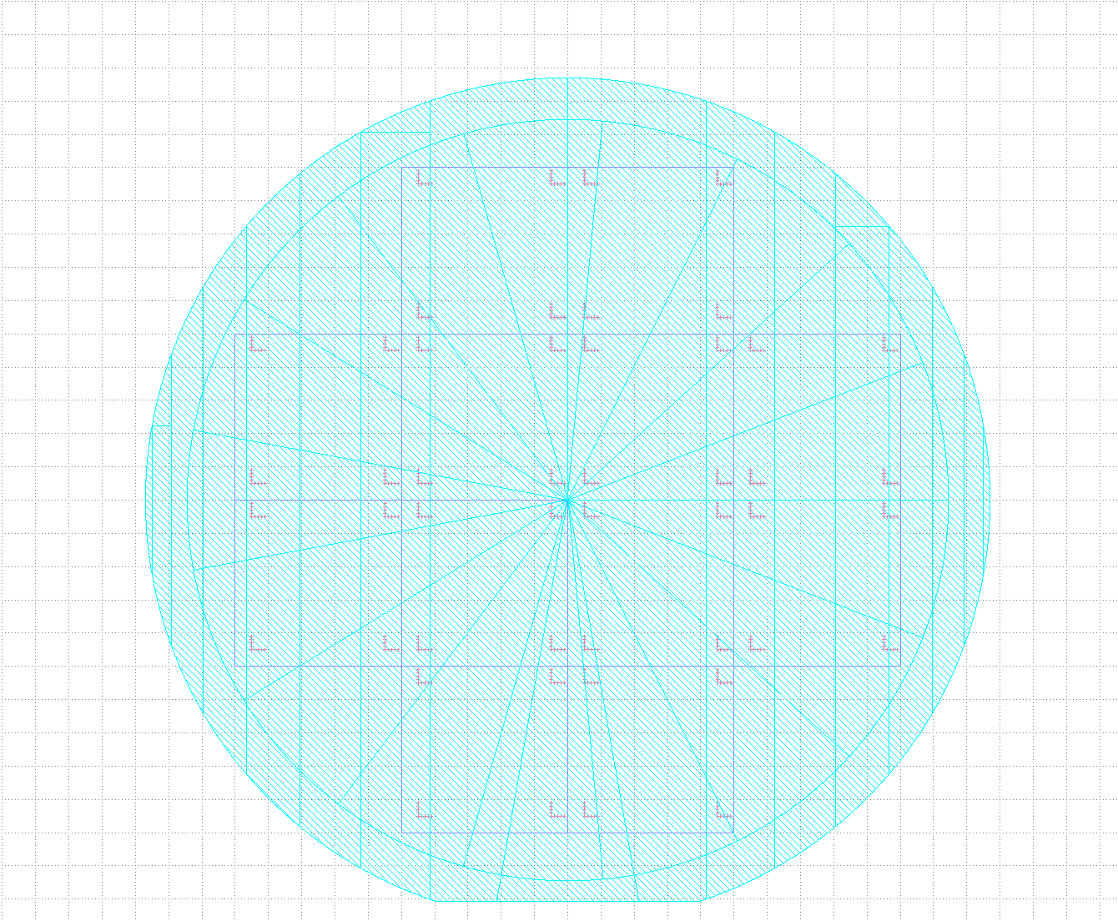
Wafer_Al300nm
Design

Slide 13
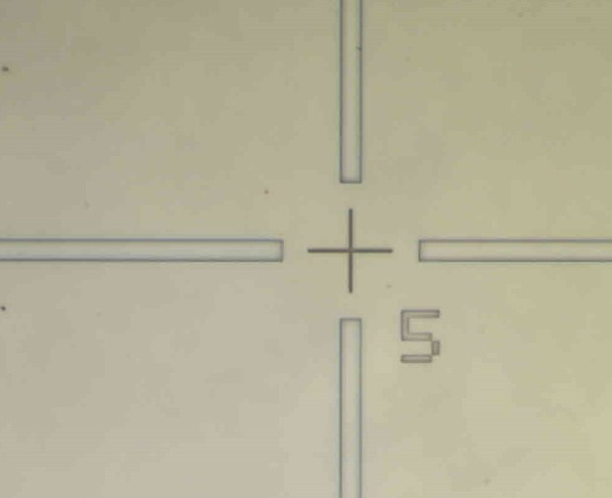
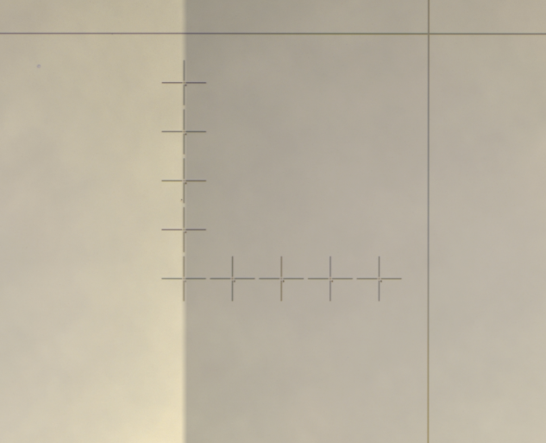
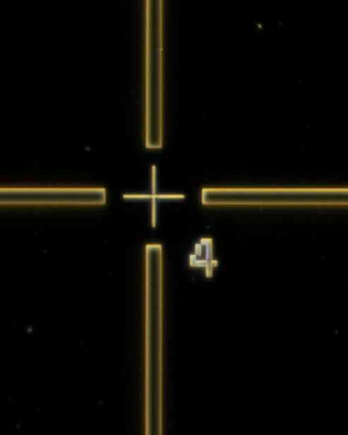
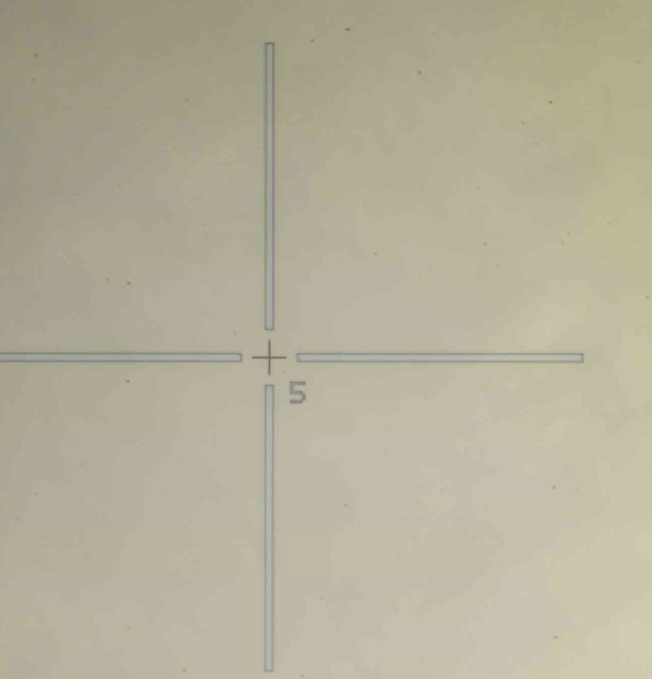
Wafer_Al300nm
Post development

Slide 14
Wafer_Al300nm
Next step on wafer
Help from cleanroom to dice
Find out the approx etch rate (maybe using the borders)

