Slide 1
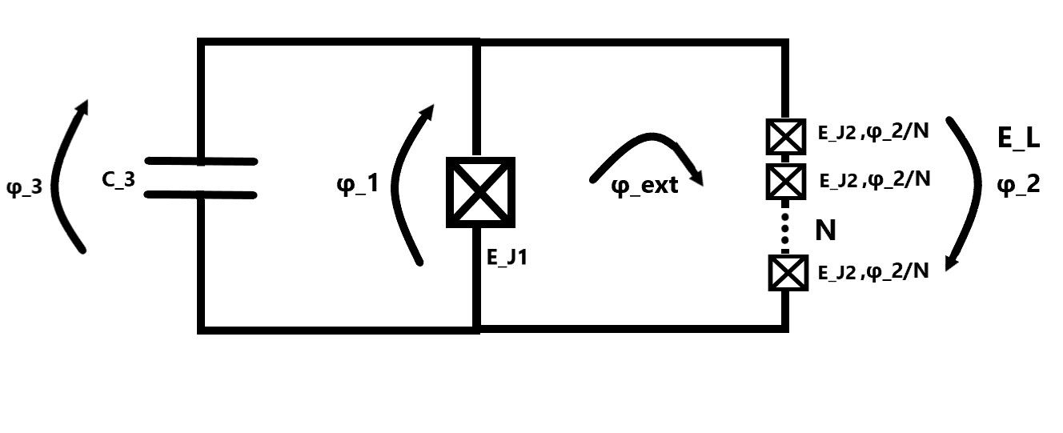
Fluxonium
2023-08-02 Group meeting
Amalie T. J. Paulsen

Slide 2
Introduction slide
2nd year Master student of the quantum physics track
Starting my master thesis 20th of august which is 1year
Goal of master thesis is to design, simulate, and fabricate 1 fluxonium qubit (type of superconducting qubit).
Warm up project with Morten beforehand to get introduced to it all.
Workflow:
Look at resonators
Look at JJ
Look at Transmon
Look at fluxonium

