Slide 1
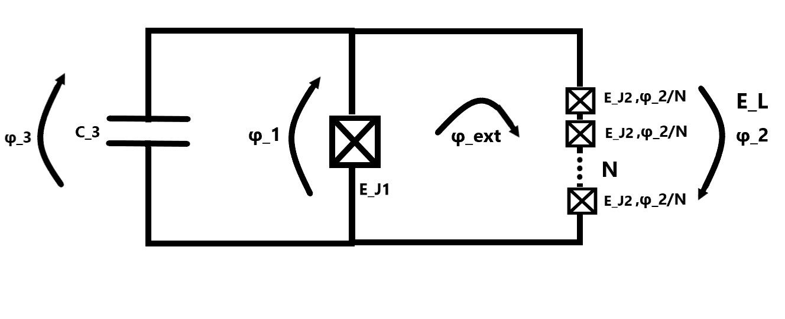
Fluxonium
2023-08-02 Group meeting
Amalie T. J. Paulsen

