Slide 1
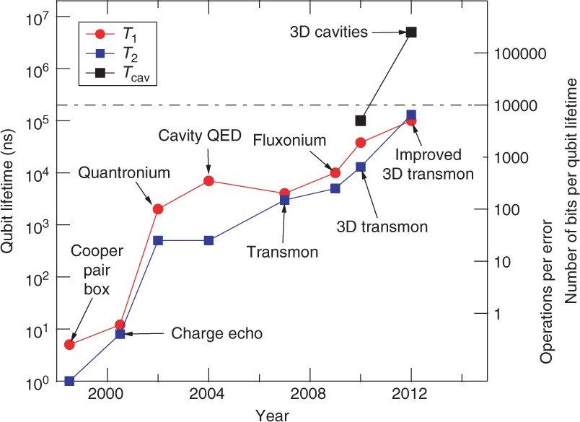

Fig. 3.1 “Schoelkopf’s law” plot illustrating the exponential growth for superconducting (charge-) qubit coherence ...
Notes:
Fig. 3.1 “Schoelkopf’s law” plot illustrating the exponential growth for superconducting (charge-) qubit coherence times. Recent experiments [18] with the “fluxonium” qubit design have achieved T1 times exceeding 1 ms.
Unless provided in the caption above, the following copyright applies to the content of this slide:

