Slide 1
Zether
Privacy in a Smart Contract World

Slide 2
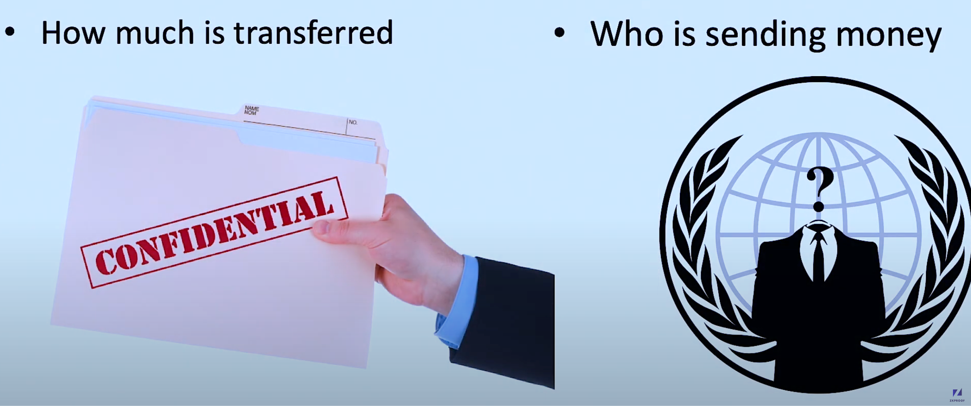
Confidentiality vs. Anonymity

Slide 3
Key Featues
Confidential Transactions
Compatibility with Smart Contract
Zero-knowledge Proofs
Account-Based Model
Decentralized and Non-Custodial

Slide 4
Anonymous Zether detailed
Uses ElGamal Encryption for hiding balances on chain
Uses ∑-Bullets for zero knowledge proofs of correct arithmetic operations in transactions
Confidentiality
Uses encrypted states maintained onchain for token operations
onchain state updates are possible due to encryption being homomorphic
Anonymity
Sender and receiver identities are hidden by using an anonymity set, where only two are the real sender & receiver, adding “noise” to the list
The “noise” are encrypted “0” that can not be told apart from the real transfer value

Slide 5
Calculate Balance in Encrypted Format
g is a special number that is publicly known
x is the secret key of the sender
The public key is calculated by g^{x}, let’s call it y
For the balance value b, the encrypted value is g^{b} * y^{r}, where r is a random number generated for the transaction and publicly shared
Given g^{b} * y^{r}, b can only be recovered if you have the secret key
g^{b} * y^{r} = g^{b} * (g^{x})^{r} = g^{(b + x * r)}

Slide 6
Update Balances in Encrypted Format
Alice wants to send 100 zether to Bob
Bob’s balance is b, public key is y, it’s encrypted as g^{b} * y^{r1}
The transfer value is encrypted as g¹⁰⁰ * y^{r2}
The smart contract performs the following to “add” the transfer value to the balance
(g^{b} * y^{r1}) * (g¹⁰⁰ * y^{r2})
Bob can later on recover the updated balance using his secret key x, and the publicly known random numbers r1 and r2.
(g^{b} * y^{r1}) * (g¹⁰⁰ * y^{r2}) = g^{(b + 100)} * y^{(r1 + r2)}

Slide 7
How Zether works
Deposit: Users deposit their token into Zether-compatible smart contract. These tokens are converted into Zether tokens, which are confidential and can be used within the Zether system.
Confidential Transactions: Users can send Zether tokens to each other. The transaction amounts are encrypted, and zero-knowledge proofs are used to validate the transactions without revealing any details to third parties.
Withdrawal: Users can withdraw their Zether tokens back into regular tokens, converting them out of the Zether system and back into the standard token echosystem.

Slide 8
Account Creation
Generate an ECC Key Pair
The public key will be used as the account identifier
The private key will be used to sign transactions and generate zero-knowledge proofs
Register in Zether Smart Contract
Verify the challenge and init the pending cash.

Slide 9
Deposit
bTransfer is plaintext
verify the y is registered in zether
update the pending transfer in zether
transfer the erc20 from the sender to zether smart contract
no zkp prove need

Slide 10
Transfer
need a larger group of users with public keys for anonymous
generate n chipertexts C₁, …, C_{n} under keys y₁, … , y_{n} repectively.
zk-proof
the ciphertexxts are well-formed
one of them encrypts b*, one of them encrypts -b*, rest encrypt 0
b* is positive
remaining balance in y_{i} is also positive; and
the correct nonce is declared
no real token transfer, only update pending

Slide 11
Withdraw
bTransfer is plaintext
transfer the erc20 from the zether smart contract to sender
zk-proof to verify the user know the secret key of y and the amount b is not changed.

Slide 12
Limitation
Anonymity Group
Performance and Scalability
Usability
Interperability
Regulatory and Compliance Issues
Cryptographic Assumptions:
Limitations in Expressive Power
Size of Proofs and Transactions
Notes:
Yes, Zether, like any cryptographic system and privacy protocol, has certain limitations and challenges. Here are some of the key limitations of Zether:
Key Limitations of Zether
Performance and Scalability:
Transaction Throughput: Zether transactions are more computationally intensive than regular Ethereum transactions due to the use of zero-knowledge proofs (zk-SNARKs). This can lead to slower transaction throughput.
Gas Costs: The verification of zk-SNARKs requires significant computational resources, which translates to higher gas costs on the Ethereum network. This can make transactions expensive, especially during times of high network congestion.
Trusted Setup:
Setup Phase: Zether relies on zk-SNARKs, which typically require a trusted setup phase to generate public parameters. If the trusted setup is compromised, the security of the entire system can be jeopardized. Although there are advancements like zk-STARKs that do not require a trusted setup, Zether's current implementation is based on zk-SNARKs.
Usability:
Complexity: The use of advanced cryptographic techniques makes Zether more complex to implement and understand compared to traditional financial systems. Users and developers need to have a good grasp of cryptographic concepts.
User Experience: Interacting with privacy-preserving systems like Zether can be more complex for end-users, especially those not familiar with cryptographic protocols. Generating and managing zk-SNARK proofs can be cumbersome.
Interoperability:
Integration with Other Systems: Integrating Zether with other decentralized applications (dApps) or smart contracts that do not support privacy-preserving features can be challenging. This limits the seamless interaction with other Ethereum-based projects.
Regulatory and Compliance Issues:
Anonymity Concerns: While privacy is a major advantage of Zether, it also raises concerns about regulatory compliance. Anonymity can be exploited for illicit activities such as money laundering or terrorism financing. Balancing privacy with regulatory requirements is a significant challenge.
Transparency vs. Privacy: Finding the right balance between transparency (for regulatory compliance) and privacy (for user protection) is complex and may require additional mechanisms.
Cryptographic Assumptions:
Security Assumptions: The security of Zether relies on the strength of the underlying cryptographic assumptions, such as the hardness of certain mathematical problems. Advances in quantum computing or new cryptographic attacks could potentially weaken these assumptions.
Limitations in Expressive Power:
Simple Payment System: Zether is designed primarily for confidential payments and may not support more complex financial instruments or smart contract interactions natively. Extending its functionality beyond simple payments requires additional work and innovation.
Size of Proofs and Transactions:
Proof Size: Although zk-SNARKs are succinct, the size of the proofs and the associated data can still be relatively large compared to non-privacy-preserving transactions. This can impact storage and bandwidth requirements.

