Slide 1
ENGL/ DIHU 155
Reading, Writing, and Making with Technology in the Humanities
Week 5 Tutorial
Zhehao Sun
Contact: zhehao.sun@ubc.ca

Slide 2
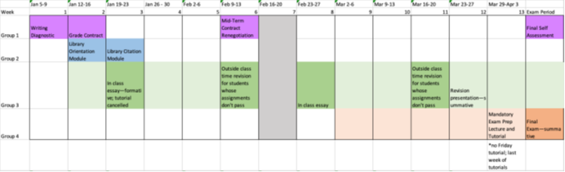
Reminder
Essay Revisions must be completed in-person Tuesday or Wednesday of next week
  February 10th and 11th from 10:00 am – 12:00 pm
Grade Contract renegotiation due week 6 8
You must rewrite this even if you are maintaining your current grade contract
  You can change your grade beforehand – this can lead to lighter revisions on your essay
  To renegotiate your grade early, reach out to myself and Dr. Murphy via canvas messenger.
  Engagement assignments week 6

Slide 3
Reminder
Readings for Next Week
Okorafor, Nnedi. The Book of Phoenix. (Read Second half by lecture.)
They Say I Say Chapters 8 and 9 (Tying it all together)

Slide 4
Reminder
Week 5 Reading
Okorafor, Nnedi. The Book of Phoenix. (Read first half by lecture.)
Jorge Luis Borges, “The Library of Babel.” 1941

Slide 5
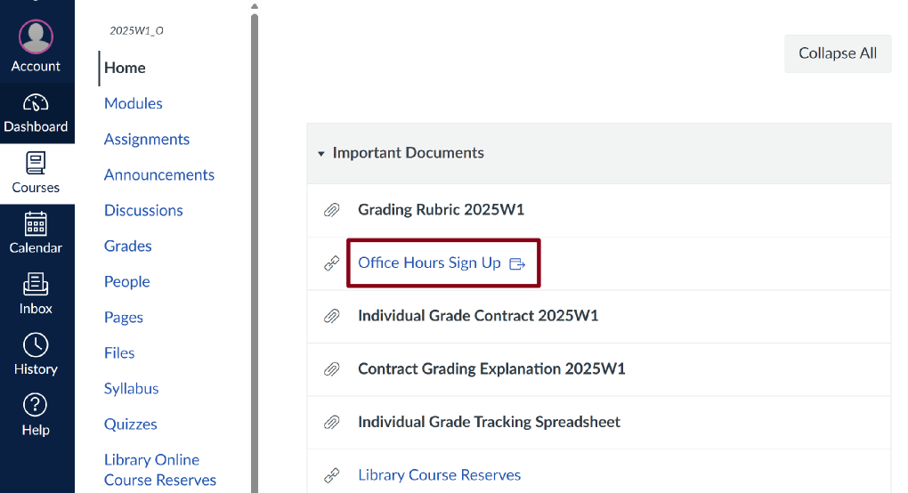
Reminder
Office Hours
Sign Up Sheet
Fridays 10:00 – 12:00

Slide 6
10 Minutes Writing Prompts:
The Book of Phoenix & The Library of Babel
The Book of Phoenix
What themes have you identified in the book so far?
Identify the antagonists and protagonists in The Book of Phoenix and discuss their relationship
The Book of Phoenix is described as a Sci-Fi. Are there any other genres that you believe it could fall under, and why? If not, why not?
The Library of Babel
What themes have you identified in the story?
Can you think of any related stories or important cultural context for this work?
What is the setting? (Past or future? Physical design of the library) and what is the setting’s significance to the story or themes?
Notes:
-10 minute writing prompt
Phoenix Themes – confinement/freedom, self-identity, liberation, evolution, Storytelling (this is a story within a story), and technology
Babel Main ideas – the universe is ultimately unknowable; some understanding spurs on the desire to find out more; Related to the ‘Tower of Babel’ story from the Bible wherein god splits humans into different places and gives them different languages so that they stop trying to work together to create things that rival god.
Babel Themes: Seeking; Belief vs. Disbelief; Religious conflict; Geometric ‘perfection’; Meaning vs. meaninglessness; structure of knowledge (we must know one thing before we can know another); limits to human conception

Slide 7
What is a ‘theme’ in literature?
A theme is a universal idea, lesson, or message explored throughout a work of literature. One key characteristic of literary themes is their universality, which is to say that themes are ideas that not only apply to the specific characters and events of a book or play, but also express broader truths about human experience that readers can apply to their own lives.
For example, John Steinbeck’s The Grapes of Wrath (about a family of tenant farmers who are displaced from their land in Oklahoma) is a book whose themes might be said to include the inhumanity of capitalism, as well as the vitality and necessity of family and friendship.
“Theme” LitCharts, 30 January 2026,
https://www.litcharts.com/literary-devices-and-terms/theme

Slide 8
Some additional key details about theme:
All works of literature have themes. The same work can have multiple themes, and many different works explore the same or similar themes.
Themes are sometimes divided into thematic concepts and thematic statements. A work's thematic concept is the broader topic it touches upon (love, forgiveness, pain, etc.) while its thematic statement is what the work says about that topic. For example, the thematic concept of a romance novel might be love, and, depending on what happens in the story, its thematic statement might be that "Love is blind," or that "You can't buy love."
Themes are almost never stated explicitly. Oftentimes you can identify a work's themes by looking for a repeating symbol, motif, or phrase that appears again and again throughout a story, since it often signals a recurring concept or idea.
“Theme” LitCharts, 30 January 2026,
https://www.litcharts.com/literary-devices-and-terms/theme

Slide 9
‘Think – Pair – Share’ Activity – The Book of Phoenix
We are going to read a passage from The Book of Phoenix
On your own, you are going to write out your first impressions about this passage – themes or anything else literary worth noting
You are going to create a small evidence chart (as per the Acheson reading)

Slide 10
“One must stop time to listen to a story. The storyteller starts it again.
She starts it in her own place, in her own moment, in her own point of view. As long as you listen, she is in charge of your destiny. You and the storyteller share everything, even your existence.
Listen…
I started picking up the local accent. I could never fit in, so that wasn’t the reason. I just liked the sound of it. I missed my love Saeed, my friend Mmuo, the other Tower 7 prisoners who weren’t so nice to me. Speaking like the Ghanaians reminded me of them all. Plus, after all that had happened, it felt good to be different from what I had been, yet the same. That which was me would never change. That which was me could survive death. Over and over.
I was Phoenix.”

Slide 11
Evidence chart and first impressions from Acheson’s Examples
Third Version of My Chart: Adding Evidence About Social Context
 | MATERIAL REALITY | MARRIAGE | SENSUOUSNESS | EMOTION
Poem | “the plums” 2 “the icebox” 4 “breakfast” 8 “that” 3, “which” 5 (deictics) | Title “I/me,” “you” “icebox” 4, “breakfast” 8 (domesticity) “you were probably saving” 6–7 | “I have eaten” 1 “delicious” 10 “sweet” 11 “cold” 12 | Title “I/me,” “you” “Forgive me” 9
Reference Works | Dictionary: Anglo-Saxon words | Biography: Williams’s marriage | Dictionary: plum | Edition: “Reply”
Social and Historical Contexts | Women’s work labour intensive Food an important part of women’s lives | Nuclear family | Intimacy in marriage | Wife isolated
FIRST IMPRESSIONS, REVIEWED
My first impressions, from my close reading of the poem, were as follows:
“This Is Just To Say” is about sensual, moral, and interpersonal experience in the material, everyday world.
“This Is Just To Say” is about relationships between people and about how these relationships are shaped by use of language.
“This Is Just To Say” is about poetry and how it is different or the same as everyday acts of communication.
Notes:
Write this out, talk to your neighbour (groups of 2 or 3) and then we will discuss our findings as a class

Slide 12
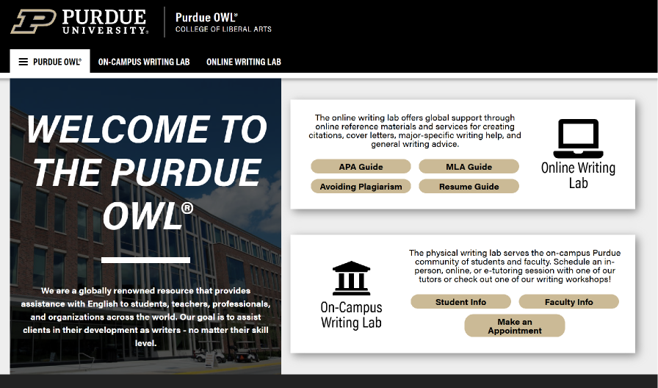
Citation Guide Resource​
Purdue OWL
Notes:
(Purdue OWL) is widely regarded as one of the most authoritative and practical academic writing resources available.

