Slide 1
ENGL/ DIHU 155
Reading, Writing, and Making with Technology in the Humanities
Week 6 Tutorial
Zhehao Sun
Contact: zhehao.sun@ubc.ca

Slide 2
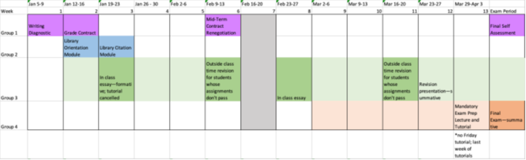
Reminder
Essay 2 is the Monday after Reading Wee. (February 23rd, Week 8)
Grade Contract Renegotiations is due February 23rd.
You must rewrite this even if you are maintaining your current grade contract
You can change your grade beforehand – this can lead to lighter revisions on your essay
No tutorial on Week 8.

Slide 3
Reminder
Week 6 Reading
Okorafor, Nnedi. The Book of Phoenix. (Read Second half by lecture.)
They Say I Say Chapters 8 and 9

Slide 4
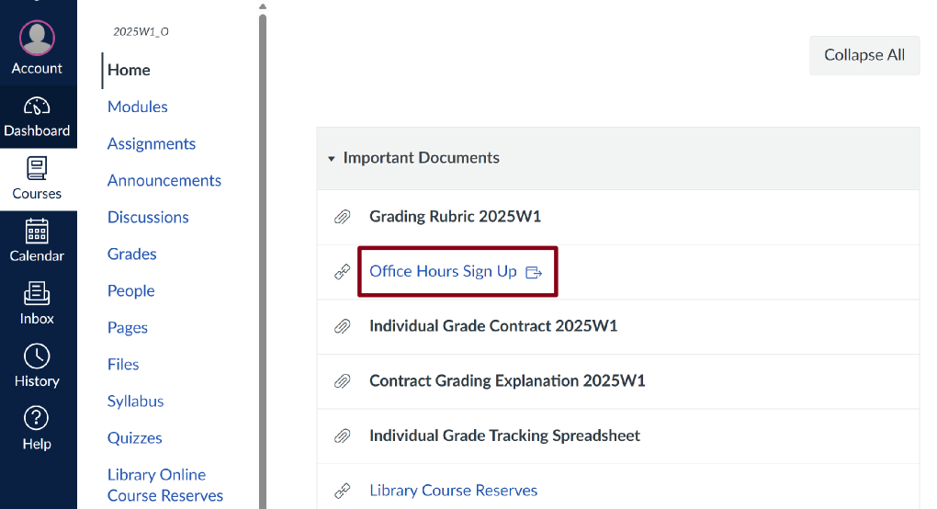
Reminder
Office Hours
Sign Up Sheet
Fridays 10:00 – 12:00

Slide 5
Review – Last week we looked at themes
In literary analysis
In The Book of Phoenix

Slide 6
What is a ‘theme’ in literature?
A theme is a universal idea, lesson, or message explored throughout a work of literature. One key characteristic of literary themes is their universality, which is to say that themes are ideas that not only apply to the specific characters and events of a book or play, but also express broader truths about human experience that readers can apply to their own lives.
For example, John Steinbeck’s The Grapes of Wrath (about a family of tenant farmers who are displaced from their land in Oklahoma) is a book whose themes might be said to include the inhumanity of capitalism, as well as the vitality and necessity of family and friendship.
“Theme” LitCharts, 30 January 2026,
https://www.litcharts.com/literary-devices-and-terms/theme

Slide 7
“One must stop time to listen to a story. The storyteller starts it again.
She starts it in her own place, in her own moment, in her own point of view. As long as you listen, she is in charge of your destiny. You and the storyteller share everything, even your existence.
Listen…
I started picking up the local accent. I could never fit in, so that wasn’t the reason. I just liked the sound of it. I missed my love Saeed, my friend Mmuo, the other Tower 7 prisoners who weren’t so nice to me. Speaking like the Ghanaians reminded me of them all. Plus, after all that had happened, it felt good to be different from what I had been, yet the same. That which was me would never change. That which was me could survive death. Over and over.
I was Phoenix.”
Themes | Identity | Death + Rebirth | Storytelling
Quotes | “Plus, after all that had happened, it felt good to be different from what I had been, yet the same.” | “That which was me could survive death. Over and over.“ “I was Phoenix.” | You and the storyteller share everything, even your existence.
Context | Self discovery, figuring out who she is from life outside the tower, rather than from just her life from the inside | - Literal parallel to death/ human condition, which humanizes her - Human condition, she is taking about resilience and overcoming hardship | Relationship between you and the storyteller linking both.

Slide 8
Essay 2
Permitted resources:
Up to 2 print dictionaries, including translation, phonetic, and other dictionaries.
1 single sided, handwritten Evidence Chart with summary sentences.
Computer with a Respondus lockdown browser.
Print resources provided by the professor, including proof reading checklists and printed out primary texts (where appropriate).
Choose 1 of the texts listed to analyze in response to the below prompt.
Prompt: What is the relationship of speculation to technology in literary texts?
Options:
“The Library of Babel,” Jorge Luis Borges
The Book of Phoenix, Nnedi Okorafor
Write an essay that consists of:
An introduction with a strong, argumentative thesis, clear roadmap, and “so what” statement.
~3 critical paragraphs with claims/sub-topic sentences that undertake your analysis.
  The structure of the paragraph should use a topic sentence, evidence-analysis pairs, and statement of significance as we learned in class.
  Statements of significance in the essay should say why the paragraph is important for your argument.
  Well framed use of primary evidence and analysis.
A 4-5 sentence conclusion that expands from your essay’s argument to broader significance within the themes of the course.
Essays should be no more than 1000 words.

Slide 9
Three Argumentative Body Paragraphs
Remember – each paragraph should contain one clear argument, relating to one theme (row) in your evidence chart.
• 1 strong and accurate topic sentence/claim for your paragraph.
• 4-5 well-written, observant sentences.
• Within those 4-5 sentences, you should include:
• At least 1 well-chosen, framed, and grammatically integrated quotation.
• Discussion or explanation of that quotation that is at least as long as the quotation.
• 1 final sentence that expands on the summary or indicates its implications for your thesis. *This is not the same thing a “connector” sentence that you may have learned in high school.
These are not ‘They Say’ / ‘I Say’ / ‘Expansion’ paragraphs. Each paragraph should represent a single theme or row in your evidence chart. Each is an argumentative paragraph that bridges clearly back to your thesis.
Notes:
These are not ‘They Say’ / ‘I Say’ / ‘Expansion’ paragraphs. Each paragraph should represent a single theme or row in your evidence chart. Each is an argumentative paragraph that bridges clearly back to your thesis.

Slide 10
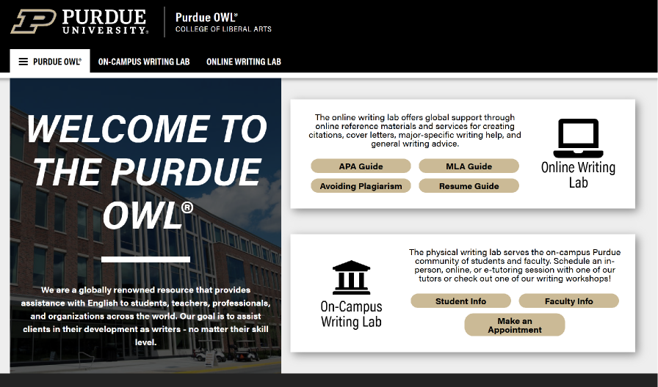
Citation Guide Resource​
Purdue OWL
Notes:
(Purdue OWL) is widely regarded as one of the most authoritative and practical academic writing resources available.

Slide 11
10 Minutes Writing Prompt
They Say/I Say Chapters 8 & 9:
  What is the significance of using transitions within writing?
  How does the ‘so what’ concept work when studying literature?
    Who might find literary analysis important?
    Does the ‘so what’ concept apply at all? Why or why not?
The Book of Phoenix:
  What new themes have you discovered in Book of Phoenix?
  How have the themes from last class shown up within the plot?
  Where does ‘story’ come up within The Book of Phoenix?
    Narrative framing (a story within a story); Cultural stories/mythology

Slide 12
Using your evidence chart from last week, write a thesis and so what statements using the following templates:
Thesis Template: “In this essay, I will argue that [BLANK] “
So What Template: “This argument is significant because [So What Statement].

Slide 13
Themes | Otherness | Storytelling | Death/Rebirth
Quotes | ‘I could never fit in, so that wasn't the reason.” “It felt good to be different from what I had been, yet the same That which was me would never change.” | “You and the storyteller share everything, even your existence” “One must stop time to listen to a story.” | “That which was me could survive death. Over and over” “The storyteller starts it again.”
Context | That one will struggle to change to be included, and will feel excluded. Racism in the real world and the struggle for those who are different | Storytelling has always been a major important aspect to humanity guiding people, the transference of knowledge and culture. This could be seen especially in indigenous cultures with oral traditions where story is converted to a deeper lesson. | Phoenix died and was reborn. Phoenix’s name is a symbol of rebirth and renewal. Symbolizes transformation, the destruction of the old world was needed in order for a new and more futuristic world.

Slide 14
Evidence chart and first impressions from Acheson’s Examples
Third Version of My Chart: Adding Evidence About Social Context
 | MATERIAL REALITY | MARRIAGE | SENSUOUSNESS | EMOTION
Poem | “the plums” 2 “the icebox” 4 “breakfast” 8 “that” 3, “which” 5 (deictics) | Title “I/me,” “you” “icebox” 4, “breakfast” 8 (domesticity) “you were probably saving” 6–7 | “I have eaten” 1 “delicious” 10 “sweet” 11 “cold” 12 | Title “I/me,” “you” “Forgive me” 9
Reference Works | Dictionary: Anglo-Saxon words | Biography: Williams’s marriage | Dictionary: plum | Edition: “Reply”
Social and Historical Contexts | Women’s work labour intensive Food an important part of women’s lives | Nuclear family | Intimacy in marriage | Wife isolated
FIRST IMPRESSIONS, REVIEWED
My first impressions, from my close reading of the poem, were as follows:
“This Is Just To Say” is about sensual, moral, and interpersonal experience in the material, everyday world.
“This Is Just To Say” is about relationships between people and about how these relationships are shaped by use of language.
“This Is Just To Say” is about poetry and how it is different or the same as everyday acts of communication.
Notes:
Write this out, talk to your neighbour (groups of 2 or 3) and then we will discuss our findings as a class

Slide 15
Important Notes
Next week is reading week! No readings, but please do prepare for the in-class essay if you are writing it
Grade contract Renegotiation due on February 23rd
In-Class Essay on the 23rd (If you are with C contract, skip this class)
No tutorial on Week 8. I will still be posting questions for the readings that week.

Slide 16
Introductions – what’s the deal?
Thesis Template: “In this essay, I will argue that [BLANK] “
Roadmap Template: “To demonstrate this, first I will {paragraph 1]. Then I will [paragraph 2], followed by [paragraph 3].
So What Template: “This argument is significant because [So What Statement].

