Slide 1
ENGL/ DIHU 155
Reading, Writing, and Making with Technology in the Humanities
Week 2 Tutorial
Zhehao Sun
Contact: zhehao.sun@ubc.ca

Slide 2
Reminder
Due Next Monday:
Week 3 Engagement Assignment
No Tutorial/ Discussion Session Next Week

Slide 3
Reminder
For Next Monday In-Class Essay
Readings
Nicholson Reading: Baker, Nicholson. "The Charms of Wikipedia." The New York review of books, Volume 55, 03/2008. (Find on UBCO Library catalogue)
Snow Reading: Snow, C.P. "The Rede Lecture." The Two Cultures. 1959. Download Snow, C.P. "The Rede Lecture." The Two Cultures. 1959.
In library catalogue, you can also find the Snow essay at call number AZ361

Slide 4
Reminder
Readings for Week 4 (January 26th)
McLuhan, Marshall. Selections from "The Medium is the Message." From Understanding Media: The Extensions of Man. On Canvas Download On Canvas.
  Read pg 1-10 + pg 15.
Marx, Leo. Selections from "'Technology': The Emergence of a Hazardous Concept." Social Research. Vol. 64, no. 3. (available through UBCO Library)
  Read pg. 965-980
Acheson, Katherine O. Writing Essays About Literature (chapter 7 & 8 available on canvas)

Slide 5
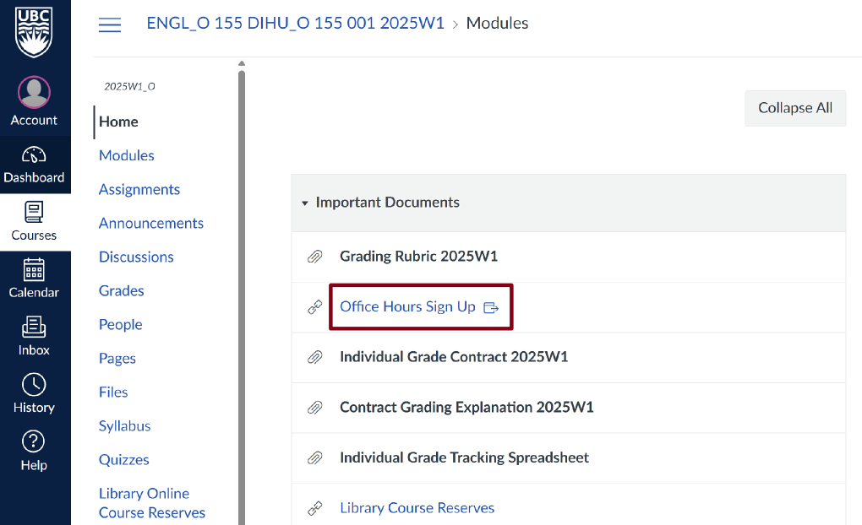
Reminder
Office Hours
Sign Up Sheet
Fridays 10:00 – 12:00

Slide 6
Writing Prompts
Playboi Farti
What views about AI were expressed in this podcast, and by whom?
Who do you agree with, and why?
Who do you disagree with, and why?
How do the themes in this podcast relate to something you have either personally experienced, or learned about in another course?
Notes:
We are going to talk about paragraph structure:
Let me start with the basic requirements for an effective paragraph.
A paragraph should be around 200 to 300 words, which should be no more than two-thirds of a typed page.
Each paragraph presents one clear idea with evidence and analysis.
A well-written paragraph is that it can stand alone as a piece of writing while also fitting seamlessly with other paragraphs around it.

Slide 7
You have unlimited time to complete this assignment.
A-Grade Contracts: A-grade contracts agree to complete 2 full essays, both A and B, 1on each reading provided. You will therefore do 1 assignment on the Baker essay andanother on the Snow essay.
- B- and C-Grade Contracts: You agree to complete 1 full essay, either A or B. You will choose between the Baker and Snow essays. Ensure you complete all identifying information at the top of the exam booklet.
Essay 1
Assignment Description
Permitted resources:
Up to 2 print dictionaries, including translation, phonetic, and other dictionaries.
1 single sided, hand written Evidence Chart with summary sentences.
Computer with a Respondus lockdown browser.
Print resources provided by the professor, including proof reading checklists and printed out primary texts (where appropriate).
Assignment Requirements, All Grade Contracts
Each essay should include:
An introduction with a strong, argumentative thesis, clear roadmap, and “so what”statement.
All of your paragraphs will need to use:
The paragraph structure we have learned in class;
The lessons and templates from TS/ISA Works Cited:
Use what you have learned in the Library Citation Module to include a Works Cited in MLA citation style.

Slide 8
Thesis Statement and Introduction:
You will put together an original, argumentative thesis statement that emerges from the evidence that you engage with in the body paragraphs. Your roadmap should match the big takeaways of each paragraph in your essay.
Notes:
We are going to talk about paragraph structure:
Let me start with the basic requirements for an effective paragraph.
A paragraph should be around 200 to 300 words, which should be no more than two-thirds of a typed page.
Each paragraph presents one clear idea with evidence and analysis.
A well-written paragraph is that it can stand alone as a piece of writing while also fitting seamlessly with other paragraphs around it.

Slide 9
Part 1: They Say
Write 1 “They Say” paragraph of ~250 words. All of your evidence in your paragraph should come directly from the essays.
Baker: Summarize the debate between “inclusionist” and “deletionist” Wikipedia editors.You should talk about their practical disagreements but also try to bring out differences in theirideas about larger questions such as what encyclopedias are for, what kinds of information arevaluable, and what the Internet ought to be like.
Snow: Summarize what Snow says about the relationship between the Industrial Revolution andthe division of the Two Cultures.
Notes:
We are going to talk about paragraph structure:
Let me start with the basic requirements for an effective paragraph.
A paragraph should be around 200 to 300 words, which should be no more than two-thirds of a typed page.
Each paragraph presents one clear idea with evidence and analysis.
A well-written paragraph is that it can stand alone as a piece of writing while also fitting seamlessly with other paragraphs around it.

Slide 10
Part 2: I Say
Draw on Chapter 4 of They Say/I Say to write an “I Say” paragraph of ~250 words.
You should take a position in relation to the summary that you provided in Part 1. Perhaps you agree withone or other side of a debate, maybe you’re somewhere in the middle, or maybe you take issue with the underlying assumptions of what “they” say. Aim to say something contentious and specific. (Remember: contentiousness means saying things someone might reasonably disagree with, not making people mad.)
This paragraph is the most closely related to your thesis statement for the essay as a whole. As the authors of They Say/I Say indicate, even agreement in academic writing must be agreement with a difference. If you’re somewhere in the middle, a statement like“both sides have valid points” is too wishy-washy! Take a specific position.
Notes:
We are going to talk about paragraph structure:
Let me start with the basic requirements for an effective paragraph.
A paragraph should be around 200 to 300 words, which should be no more than two-thirds of a typed page.
Each paragraph presents one clear idea with evidence and analysis.
A well-written paragraph is that it can stand alone as a piece of writing while also fitting seamlessly with other paragraphs around it.

Slide 11
Part 3: Expansion
Write a third paragraph of ~250 words that expands your thinking to a question or idea that is related but not directly obvious.
This paragraph will be most closely related to the “So What” statement in your introduction. You could, for example, talk about attention, the transformationof old genres in digital culture, the ways cultures privilege one or another form of information,the relationship between information and power, misinformation and authority, “neutrality” as arhetorical strategy, the place of human intelligence in digital culture that is increasingly algorithmic, or the potential for new technology to counteract systemic inequities (ableism, racism, sexism, etc.) or reinforce them. These are simply ideas, not prompts—it’s up to you to develop a suitable idea in this paragraph that supports your thesis! Signal clearly the way that your expansion is related to the ideas in Part 1 and Part 2: how did you get here? What is the bridge? Your own thinking should be front and center.
Notes:
We are going to talk about paragraph structure:
Let me start with the basic requirements for an effective paragraph.
A paragraph should be around 200 to 300 words, which should be no more than two-thirds of a typed page.
Each paragraph presents one clear idea with evidence and analysis.
A well-written paragraph is that it can stand alone as a piece of writing while also fitting seamlessly with other paragraphs around it.

Slide 12
What do you say in your thesis?
I am arguing X
Based on the reasoning Y
e.g. “Sole and Despotic Dominion” cannot be considered a short story because, even though it has a conflict, it lacks other narrative elements like exposition, rising action, climax, etc.
A reader should be able to predict what you will be discussing in your essay just by reading the thesis statement.

Slide 13
Paragraph Structure for Analytic Writing Assignment
1 strong and accurate topic sentence/claim for your paragraph.
4-5 well-written, observant sentences.
Within those 4-5 sentences, you should include:
At least 1 well-chosen, framed, and grammatically integrated quotation.
Discussion or explanation of that quotation that is at least as long as the quotation.
1 final sentence that expands on the summary or indicates its implications. *This is not the same thing a “connector” sentence that you may have learned in high school.
Notes:
All of your paragraphs will need:

Slide 14
What is a paragraph?
200-300 words (think: no more than 2/3 of a typed page)
A logical unit that presents a well-defined idea with evidence and analysis
Stand-alone or as part of a progression of ideas
In an essay or any other extended piece of writing, a paragraph is at once self-contained and in relationship to the paragraphs around it.
A relationship might be opposition, continuation, expansion…

Slide 15
Paragraph Structure​
In academic writing (especially as you’re learning to write),
paragraphs have a rigid and predictable structure: ​
Topic Sentence​
Evidence-Analysis Pairs​ (Here is where you use your quoting skills from They Say/I Say​)
So-What Sentence
Notes:
Paragraphs have a rigid and predictable structure. This structure consists of three essential components that work together to create a compelling argument:

Slide 16
Topic Sentence​
A brief statement that describes, in specific terms, the claim that will be demonstrated in the paragraph. ​
Stand-alone: The primary idea, often like a mini-argument. ​
In an essay or larger piece of writing: A sub-claim to the main argument or thesis.
Notes:
First, you need a strong topic sentence or claim.
This sentence states what you will demonstrate in this paragraph.
Think of it as a mini-argument that expresses clearly what you're trying to say.
Your topic sentence must link back to your overall thesis because it functions as a subclaim to your main argument.
Since it can be called as "claim." So, it needs to take a position. Which means something that you want to say and you're able to defend that.
If you're rereading a paragraph, w ha t you've written and it seems unclear, the first thing to check is whether your topic sentence is clear enough.

Slide 17
“Topic sentence” may sounds a misleading term. You may call it a “claim.” ​
A topic sentence/claim needs to take a position. ​
Even in summary writing, all writing has a position or goal. ​
Topic sentences/claims do not simply say that a paragraph has a subject, but signals what you want to say about that subject. ​
​
WHAT/HOW not THAT
Topic Sentence vs. Claim​
Notes:
First, you need a strong topic sentence or claim.
This sentence states what you will demonstrate in this paragraph.
Think of it as a mini-argument that expresses clearly what you're trying to say.
Your topic sentence must link back to your overall thesis because it functions as a subclaim to your main argument.
Since it can be called as "claim." So, it needs to take a position. Which means something that you want to say and you're able to defend that.
If you're rereading a paragraph, w ha t you've written and it seems unclear, the first thing to check is whether your topic sentence is clear enough.

Slide 18
*Evidence and Analysis always go together.*​
Evidence: Aspects of text (especially literary expression) that support the topic sentence.
What elements of the text demonstrate your argument? Literary expression? Textual structure? Metre? Sonic qualities?
Analysis: Draw the important elements of literary expression out and explain what effect they have.
This is the most important part of your paragraph. This is where you prove your argument.
Paragraph Structure
Notes:
The second component is your evidence and analysis, which should be four to five well-written, observant sentences.
Within these sentences, you must include at least one well-chosen, framed, and grammatically integrated quotation.
This is where you show that you've clearly engaged with the texts you've chosen to write about.
Your evidence comes from the text through quotations, but you also need to put things into your own words using those "they say" skills we discussed earlier.
Please don't just drop in a quotation.
What we often see is a quotation that stands as its own sentence, and you may call it an "orphan quotation."
Instead, you can use the “sandwich method” from the they say/I say book.
You should introduce the idea in your own words, then quote, then explain why you think that quotation is important.
You must be intentional about when you quote from the texts. We want you to explain why you've chosen to include a specific quotation, and we want you to introduce it properly.
This means you're not just dropping in other people's words without context, but you're explaining why you've done it, showing that you understand the other person's perspective and that you understand the quotation itself.
Your use of evidence must be grammatically integrated into your sentences. Linking phrases such as "for instance" or "for example" are helpful because they show the connection between your citation and the point you're making.
Remember, your discussion or explanation of that quotation should be at least as long as the quotation itself.

Slide 19
*There can be more than one evidence-analysis pair in your paragraph. Here are the rules: ​
Each piece of evidence must be well framed and grammatically integrated. ​
There should be a logical relationship between each of your evidence-analysis pairs. ​
Do they build on one another? Do they provide opposition and nuance? ​
The amount of evidence you provide must suit the scope of your claim/topic sentence. ​
All pieces of evidence must be necessary to your claim/topic sentence.
Paragraph Structure
Notes:
The second component is your evidence and analysis, which should be four to five well-written, observant sentences.
Within these sentences, you must include at least one well-chosen, framed, and grammatically integrated quotation.
This is where you show that you've clearly engaged with the texts you've chosen to write about.
Your evidence comes from the text through quotations, but you also need to put things into your own words using those "they say" skills we discussed earlier.
Please don't just drop in a quotation.
What we often see is a quotation that stands as its own sentence, and you may call it an "orphan quotation."
Instead, you can use the “sandwich method” from the they say/I say book.
You should introduce the idea in your own words, then quote, then explain why you think that quotation is important.
You must be intentional about when you quote from the texts. We want you to explain why you've chosen to include a specific quotation, and we want you to introduce it properly.
This means you're not just dropping in other people's words without context, but you're explaining why you've done it, showing that you understand the other person's perspective and that you understand the quotation itself.
Your use of evidence must be grammatically integrated into your sentences. Linking phrases such as "for instance" or "for example" are helpful because they show the connection between your citation and the point you're making.
Remember, your discussion or explanation of that quotation should be at least as long as the quotation itself.

Slide 20
"So What" Sentence
Your paragraph needs a closing statement that indicates the significance of your topic, evidence, and analysis. This statement is a bookend to the topic sentence/claim; it is a closing frame of paragraph. ​
  In a stand-alone paragraph, this sentence indicates the importance simply of the paragraph itself. ​
  In an essay this statement refers back to your thesis statement/argument. ​
*Note: This statement does not expand outwards or refer to the next paragraph.*
Notes:
The third and final component is the "so what" sentence.
This is your closing statement that indicates the significance of your topic, evidence, and analysis. It serves as a closing frame for the paragraph.
In a standalone paragraph, this sentence indicates the importance of the paragraph itself.
It answers the question: what have you tried to say in this paragraph, why have you included it, why is it there?
In an essay, this statement refers to your thesis statement or argument.
Each of your paragraphs, all your topic sentences, and all of those "so what" sentences should connect back to your overall argument.
This statement does not expand outwards or refer to the next paragraph.

Slide 21
Integrating Evidence​
Any use of evidence requires three elements (you should know this from They Say/I Say): ​
Framing​
Grammatical integration​
Analysis​
​
​
​
Notes:
The third and final component is the "so what" sentence.
This is your closing statement that indicates the significance of your topic, evidence, and analysis. It serves as a closing frame for the paragraph.
In a standalone paragraph, this sentence indicates the importance of the paragraph itself.
It answers the question: what have you tried to say in this paragraph, why have you included it, why is it there?
In an essay, this statement refers to your thesis statement or argument.
Each of your paragraphs, all your topic sentences, and all of those "so what" sentences should connect back to your overall argument.
This statement does not expand outwards or refer to the next paragraph.

Slide 22
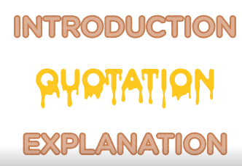
Quotation
​
​
​
Introduce the idea in your own words
Quote
Explain why you think that quotation is important.
Notes:
The third and final component is the "so what" sentence.
This is your closing statement that indicates the significance of your topic, evidence, and analysis. It serves as a closing frame for the paragraph.
In a standalone paragraph, this sentence indicates the importance of the paragraph itself.
It answers the question: what have you tried to say in this paragraph, why have you included it, why is it there?
In an essay, this statement refers to your thesis statement or argument.
Each of your paragraphs, all your topic sentences, and all of those "so what" sentences should connect back to your overall argument.
This statement does not expand outwards or refer to the next paragraph.

Slide 23
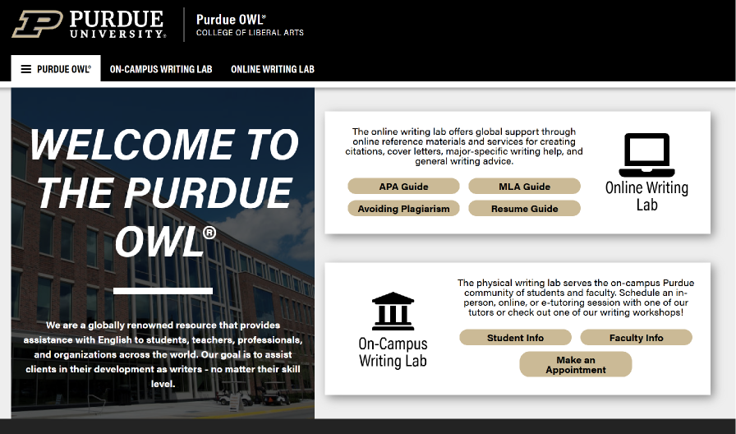
Citation Guide Resource​
Purdue OWL
Notes:
(Purdue OWL) is widely regarded as one of the most authoritative and practical academic writing resources available.

