Slide 1
ENGL/ DIHU 155
Reading, Writing, and Making with Technology in the Humanities
Week 4 Tutorial
Zhehao Sun
Contact: zhehao.sun@ubc.ca

Slide 2
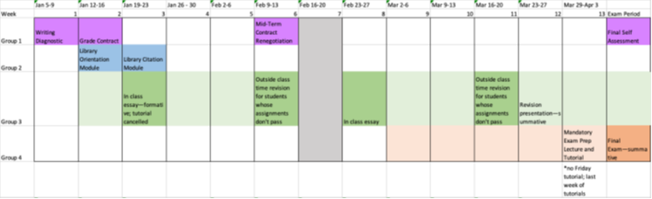
Reminder
Revisions for Essay 1 will be done in week 6 (Tuesday and Wednesday)
  You can bring in your original paper with feedback to do the revisions if necessary
  Revisions are done in person (like the original essay) during either of the allotted time slots
  Please see me or Dr. Murphy if you have any questions! Sign up sheet for office hours is on Canvas
Grade Contract renegotiation due week 6 (in two weeks)
  You must rewrite this even if you are maintaining your current grade contract
  You can change your grade beforehand – this can lead to lighter revisions on your essay
  To renegotiate your grade early, reach out to myself and Dr. Murphy via canvas messenger.

Slide 3
Reminder
Readings for Next Week
Okorafor, Nnedi. The Book of Phoenix. (Read first half by lecture.)
Jorge Luis Borges, “The Library of Babel.” 1941

Slide 4
Reminder
Week 4 Reading
McLuhan, Marshall. Selections from "The Medium is the Message." From Understanding Media: The Extensions of Man. On Canvas Download On Canvas.
  Read pg 1-10 + pg 15.
Marx, Leo. Selections from "'Technology': The Emergence of a Hazardous Concept." Social Research. Vol. 64, no. 3. (available through UBCO Library)
  Read pg. 965-980
Acheson, Katherine O. Writing Essays About Literature (chapter 7 & 8 available on canvas)

Slide 5
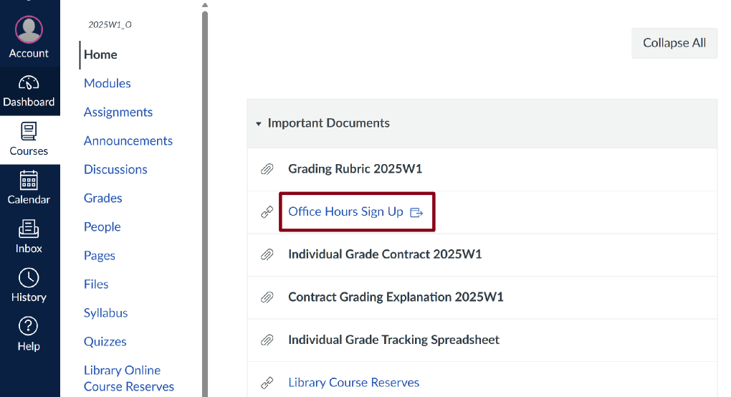
Reminder
Office Hours
Sign Up Sheet
Fridays 10:00 – 12:00

Slide 6
10 minutes Writing Prompts
‘Technology’ and ‘The Medium’ (Marx ; McLuhan)
Did you notice any similar themes within these readings? If so, what were they?
How have any of these readings helped you better understand contemporary digital technologies that you use? If these readings did not help you understand the technologies/mediums being used, what new concepts are you beginning to grasp?
What aspects of these readings did you find particularly difficult? How might we address these issues as a class?
Writing Essays About Literature (Acheson)
Why do you think Acheson suggests that you gather evidence BEFORE coming up with an argument?
What is ‘charting your evidence’ and why is it useful for writers of literary criticism (That’s you!)
How have you gathered evidence for critical literary papers in previous classes?
Notes:
We are going to talk about paragraph structure:
Let me start with the basic requirements for an effective paragraph.
A paragraph should be around 200 to 300 words, which should be no more than two-thirds of a typed page.
Each paragraph presents one clear idea with evidence and analysis.
A well-written paragraph is that it can stand alone as a piece of writing while also fitting seamlessly with other paragraphs around it.

Slide 7
Essays 1 overall issues
Reading the instructions
  Be careful, be methodical, read them in full.
  Introduction structure.
Formality in academic writing
  Use of contractions in academic writing
  Wording choice
Expansion and including a clear bridge
MLA formatting
  In-text citations
  Incorporating quotations
  Works Cited pages

Slide 8
Themes of the course
(from the syllabus)
When analyzing our own experiences with technology—especially digital technologies—how do we move beyond merely subjective or utility-focused responses?
When writing about digital literature, how do we understand the way that histories of technology have shaped what media forms can express? How do we understand our role in producing and consuming digital media?
Over the last half century, scholars of media, technology, and culture have developed a number of useful approaches to analyzing and engaging in technologies both new and old, to the point where we have a “toolkit” of critical strategies available to us. In this course, we will engage with a variety of cultural products across media platforms—such as digital, print, visual, or sound media—and learn how to analyze them using some of these critical strategies.

Slide 9
Group work: Finding and creating definitions
Find terms within McLuhan or Marx’s work that relate to themes of the course
Write your impressions on these terms – how do they fit into the themes of the course?
Go to Google Doc and work in groups to create definitions for each term
https://docs.google.com/document/d/1txfse6M0Oa8lzeADRcKA6S6fgx4gaFWAAhVZW7LHAbA/edit?usp=sharing
This is exam prep! Defining course terminology and writing about those terms will make up the ‘short answer’ portion of the exam.

Slide 10
Email Policy
ENGLDIHU155 Email Policy
“ Your emails to your instructor and TA are the property of the university and a primary mode of communication in this educational and professional context. When you send me an email, please use appropriate greetings—including using my name and your own name in salutations—please write clearly in complete sentences, and provide me with the contextual information to understand whatever questions you might have.
I require at least 48 hours to respond to emails, and I will not respond after business hours or on weekends. If you have questions regarding essays or assignments, you must ask them at least 48 hours in advance of the due date; I cannot promise that I will respond in time to assignment-related emails after this point. If you have a question that you can easily answer by looking at the Syllabus, I will refer you there.
TAs will set their own email policies. I will encourage them to set similar boundaries to mine so that students get their questions answered and TAs are able to manage their time effectively. ”
Notes:
We are going to talk about paragraph structure:
Let me start with the basic requirements for an effective paragraph.
A paragraph should be around 200 to 300 words, which should be no more than two-thirds of a typed page.
Each paragraph presents one clear idea with evidence and analysis.
A well-written paragraph is that it can stand alone as a piece of writing while also fitting seamlessly with other paragraphs around it.

Slide 11
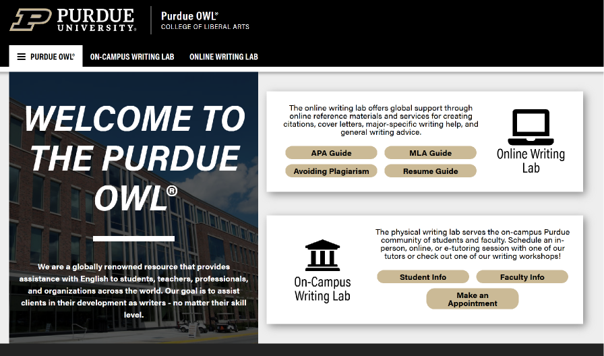
Citation Guide Resource​
Purdue OWL
Notes:
(Purdue OWL) is widely regarded as one of the most authoritative and practical academic writing resources available.

