Slide 1

HPE
Hewlett Packard Enterprise · NYSE: HPE
Investment pitch · 14 September 2026
Bona Fide Student Investment Society · 2026-2027 · Prices as of 11-Sep-2026
Notes:
Title
Time: 0:20 (cumulative 0:20)
Script: Good evening. This is our pitch on Hewlett Packard Enterprise, HPE, priced at the close on 11 September 2026: $62.09. Over the next 24 minutes I won't just show you data. I'll show you how we reasoned from the data to a decision, and which patterns you can reuse on the next company.
Transition: Let me start with the answer.

Slide 2

A better business is not yet a better investment
INVESTMENT THESIS
Investor logic: the business improved, but the price assumes both the improvement and the cycle last, so the question is expectations, not quality.
■ 1 · Better business: networking is 26% of revenue but 40% of segment profit; ROIC of 11.2% now exceeds the 9.3% WACC.
■ 2 · Cycle-boosted: record 40.4% non-GAAP gross margin on memory pricing; about two-thirds of FY26's jump above trend is AI and pricing.
■ 3 · Late-cycle cash: record $4.5bn free cash flow, but a $5.5bn inventory build is funded by $6.0bn of extra payables.
■ 4 · Price extrapolates the peak: 13.5x FY27 EPS against a 4–10x history; the reverse DCF needs an 18% margin or 11% growth for a decade.
■ So: a real quality upgrade priced as permanent; the gap to value is a bet that multiples persist.
WHAT THE MARKET PRICES IN
$62.09
13.5x FY27 EPS (history 4–10x)
Reverse DCF: 18% LT margin or 11% growth to FY36
WHAT FUNDAMENTALS SUGGEST
$35–$43
Base DCF $38.80; bear $22 – bull $54
Damodaran Ginzu $31.57; no rating or target
Source: Bona Fide analysis; HPE filings; Yahoo Finance.
2
Notes:
A better business is not yet a better investment
Time: 1:30 (cumulative 1:50)
Goal: Give the conclusion and the four-step argument up front.
Script: Here is the whole pitch on one slide.
• Step one: HPE is a genuinely better business than a year ago. After buying Juniper, networking is 26% of revenue but 40% of segment profit, and return on invested capital is above the cost of capital for the first time in the six years we reviewed.
• Step two: most of this year's jump is cyclical. Gross margin hit a record 40.4% on memory-driven pricing, and management itself says margins will moderate. About two-thirds of the jump above trend is AI and pricing.
• Step three: the cash flow looks great, a record $4.5 billion, but suppliers are funding a $5.5 billion inventory build.
• Step four: the price. At $62.09 the market pays 13.5 times next year's earnings against a 4-to-10-times history. Our reverse DCF says it needs an 18% long-term margin or 11% growth for a decade.
Our fundamental range is $35 to $43, and even our bull case is $54. So we are not giving you a rating or a target. We are telling you the price is a bet that peak-cycle economics and sector multiples persist, and we will show you the signposts that would prove us wrong.
Numbers to say:
• 26% of revenue, 40% of segment profit;
• ROIC 11.2% vs WACC 9.3%;
• gross margin 40.4%;
• free cash flow $4.5bn;
• 13.5x FY27 EPS vs 4–10x history;
• reverse DCF 18% margin / 11% growth;
• range $35–43, bull $54.
Reasoning move: separate business quality from investment attractiveness. Give the answer first, then earn it.
Transition: How did we get there? Five questions.

Slide 3
Five questions, one decision
HOW WE REASONED
Investor logic: every question has a tool, and every tool could have proved us wrong.
1
What does HPE really sell?
TOOL
Segment profit mix; position in the AI value chain
ANSWER
A server volume business with a networking profit engine
2
Structure or cycle?
TOOL
ARIMA counterfactual; driver regressions; peak-cycle checklist
ANSWER
About a third of the break is Juniper; the rest is AI and pricing
3
Is the cash real?
TOOL
Working-capital pattern; balance sheet
ANSWER
Record free cash flow, but suppliers fund the inventory
4
What does the price assume?
TOOL
Reverse DCF; peer steelman; football field
ANSWER
An 18% margin or 11% growth for a decade
5
What would change our mind?
TOOL
Scenarios; risk transmission; signposts
ANSWER
Margins through a memory downturn; networking growth
Our answer: value of $35–43 per share (bull case $54) against a $62.09 price. The gap is a bet that peak-cycle margins and sector multiples persist.
Source: Bona Fide analysis. Each question maps to one part of this pitch and to sections 1–11 of the HTML report.
3
Notes:
Five questions, one decision
Time: 0:45 (cumulative 2:35)
Goal: Show the reasoning map so the audience can follow the logic.
Script: Our reasoning followed five questions, and each one has a tool that could have proved us wrong.
1. What does HPE really sell? We follow the profit, not the revenue.
2. Is the jump structure or cycle? We compare actual revenue with a no-change counterfactual.
3. Is the cash real? We read working capital.
4. What does the price assume? We run the DCF backwards and steelman the bulls.
5. What would change our mind? Scenarios and signposts.
The rest of the deck answers these in order.
Reasoning move: falsifiable questions before conclusions.
Transition: Question one: what does HPE sell?

Slide 4
Networking is 26% of revenue but 40% of segment profit
PART 1 · BUSINESS MODEL · SNAPSHOT
Pattern: follow profit, not revenue. The smaller segment now decides the valuation.
SHARE PRICE 11-SEP-26
FULLY DILUTED MKT CAP
Segment (TTM) | Revenue | Share | Op. margin | Profit share
Cloud & AI | $29.8bn | 71% | 12.6% | 61%
Networking | $11.0bn | 26% | 22.7% | 40%
Corp. Inv. & Other | $1.1bn | 3% | -7.5% | -1%
$62.09
$89.7bn
ENTERPRISE VALUE
TTM REVENUE
$103.8bn
$41.9bn
■ Products 64% · services 34% · financing 2% of FY25 revenue
■ 61% of revenue outside the US; no customer disclosed above 10%
■ ARR $3.15bn at FY25 (+63%); 52,000 GreenLake customers (+18%)
■ Q3 FY26: revenue $12.2bn (+34%), non-GAAP EPS $1.11, FCF $958m
+31% vs prior TTM
TTM FREE CASH FLOW
NET DEBT / ADJ. EBITDA
$4.5bn
1.75x
HPE definition
company: 1.8x
Source: HPE 10-Q Q3 FY26 and earnings releases; Yahoo Finance prices; Bona Fide calculations.
4
Notes:
Networking is 26% of revenue but 40% of segment profit
Time: 1:15 (cumulative 3:50)
Goal: Establish the first pattern: profit mix, not revenue mix.
Script: HPE sells servers, storage, networking and financing to enterprises, governments and cloud providers.
• Scale: fully diluted market value is $89.7 billion and enterprise value $103.8 billion. Trailing revenue is $41.9 billion, up 31%.
• The table: this is the first pattern, follow profit, not revenue.
- Cloud & AI (servers, storage and financing) is 71% of revenue at a 12.6% segment margin.
- Networking is only 26% of revenue, but at a 22.7% margin it earns 40% of segment profit. The smaller segment now decides the valuation.
• Two facts for later: about two-thirds of revenue is transactional hardware, and recurring ARR is $3.15 billion, up 63%, mostly because Juniper's software support was added.
• Execution: Q3 revenue was $12.2 billion, up 34%. This company is executing. The question is never whether the quarter was good; it is what the good quarter is worth.
Numbers to say: $89.7bn; $103.8bn; $41.9bn +31%; 71% at 12.6%; 26% at 22.7% = 40% of profit; ARR $3.15bn +63%.
Pattern: follow profit, not revenue.
Transition: What kind of revenue is the 71%? That depends on where HPE sits in the AI stack.

Slide 5
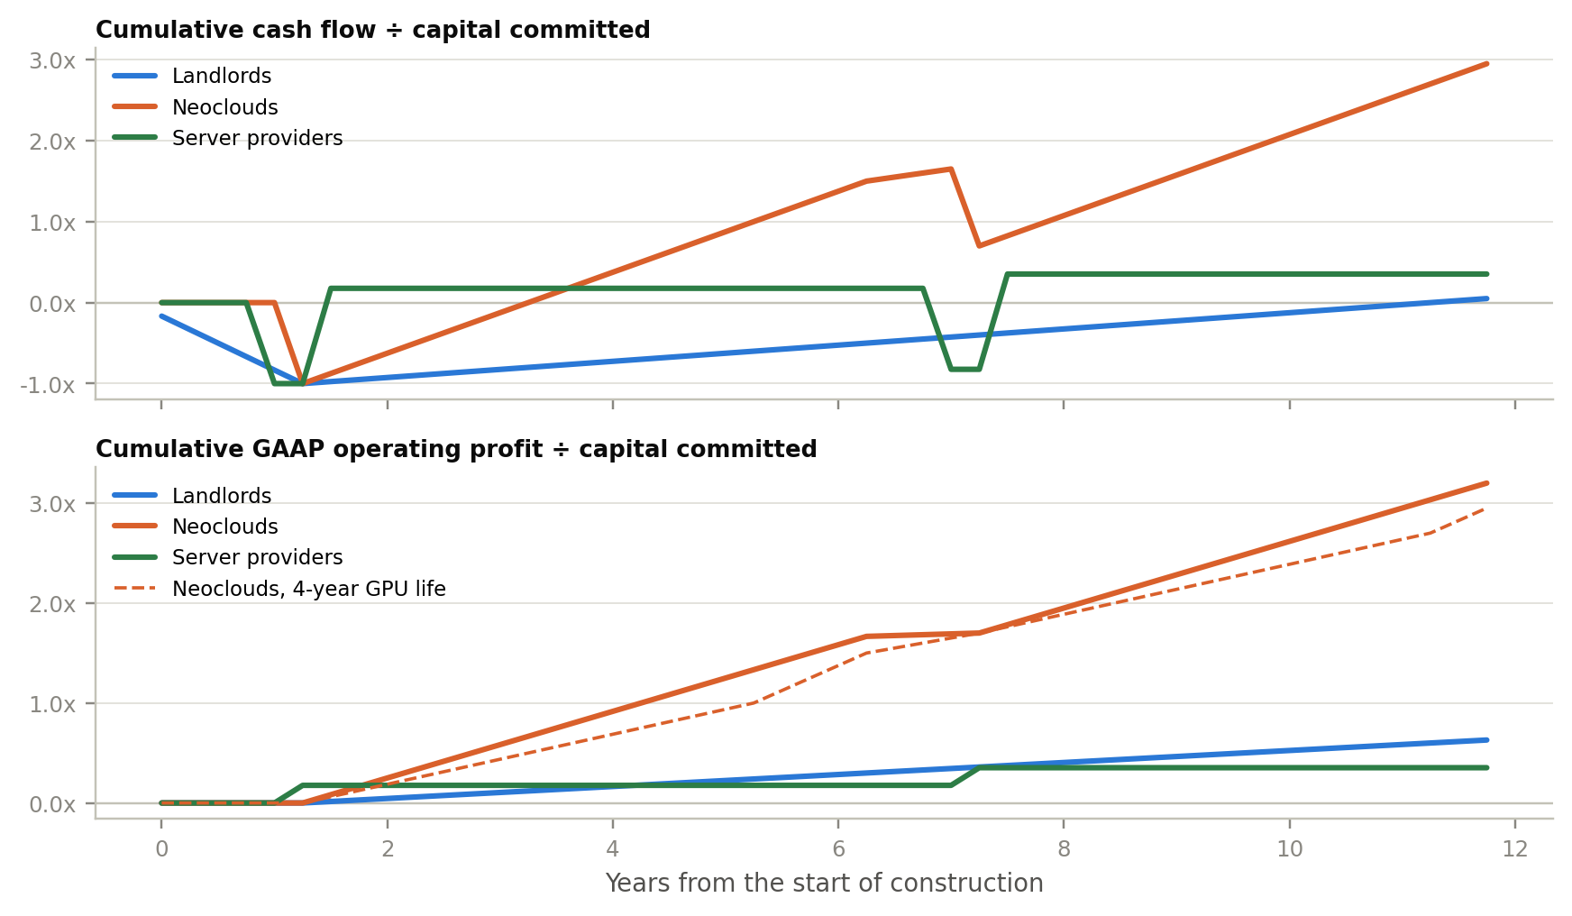
HPE sits in the layer that is paid at shipment
PART 1 · BUSINESS MODEL · VALUE CHAIN
Pattern: your place in the value chain sets your cycle. Shipment-paid vendors get elastic revenue, thin margins and no contract behind the next order.
STYLISED 100 MW BUILD: CUMULATIVE CASH AND PROFIT ÷ CAPITAL
 | Landlords† | Neoclouds | Servers
Capex / revenue | 0.5x | 2.7x–8.2x | ≤0.06x
D&A + interest / rev. | 36% | 67%–74% | 3%–10%
Backlog / revenue | 5.3x est. | 14x–28x | 0.3x–0.9x
Revenue elasticity | 0.06 n.s. | too new | 0.41–0.84
AI beta (share price) | 0.03 | 0.40–0.85 | 0.02–0.18
Cash payback (model) | ~11.5 yrs | ~3.2 yrs | 2 qtrs
SO WHAT FOR HPE
■ Value on through-cycle margins, not the FY26 peak.
■ Less levered than Dell: elasticity 0.41 vs 0.84; controlling for Juniper the capex link is weaker still (0.19, n.s.).
■ Second-order risk: neoclouds burn cash; vendors that finance them share the credit risk.
Source: SEC XBRL; company filings; Yahoo Finance; Bona Fide analysis (code/business_model_analysis.py). † Digital Realty. Revenue elasticity: revenue growth per point of hyperscaler capex growth, 2018Q2–2026Q2. Report section 12.
5
Notes:
HPE sits in the layer that is paid at shipment
Time: 1:30 (cumulative 5:20)
Goal: Place HPE in the AI value chain and explain why its revenue is cyclical.
Script: This comes from our practitioner Q&A work. The AI data centre has three business models:
• landlords like Digital Realty build and lease the building;
• neoclouds like CoreWeave own GPUs and rent compute on multi-year contracts;
• server providers like HPE and Dell sell the equipment.
Same capex dollar, three different financial fingerprints.
• The chart is a stylised 100-megawatt build. The landlord pays first and gets its cash back over about eleven and a half years. The neocloud needs about three years, if its GPUs stay contracted. The server provider is paid at shipment, within two quarters, but earns a thin margin once and needs a new order for every future dollar.
• The table shows the consequence. Server providers have almost no capex and less than a year of revenue in contracted backlog, so their revenue is the most elastic to AI spending: 0.84 at Dell and 0.41 at HPE per point of cloud-capex growth. Digital Realty is the opposite; its revenue hasn't fallen year on year since 2018.
The investing implication: you can't value a shipment-paid business on its best year; you value it on through-cycle margins. HPE's elasticity is half Dell's, because networking and services dampen the swing. Once you control for Juniper, the link to cloud capex is weaker still.
Numbers to say:
• cash payback ~11.5 years (landlord), ~3 years (neocloud), 2 quarters (server provider);
• revenue elasticity: Dell 0.84, HPE 0.41 (Digital Realty 0.06, not significant);
• controlling for Juniper, HPE's capex link sums to 0.19 and is not significant.
Pattern: your place in the value chain sets your cycle.
Transition: So inside HPE, where are the switching costs?

Slide 6
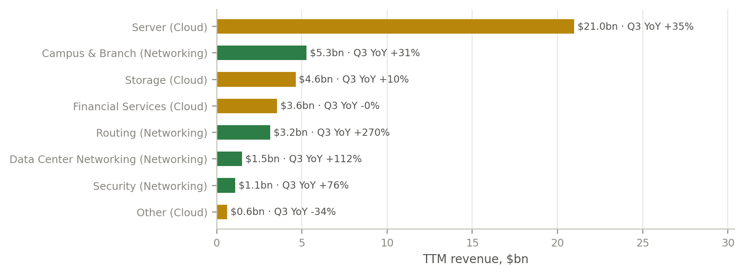
Servers bring the revenue; networking brings the returns
PART 1 · BUSINESS MODEL · MOAT
Investor logic: only networking and storage carry switching costs; servers are a scale game, so returns, not revenue, reveal the moat.
■ Transactional core: servers and AI systems bought competitively; lowest switching costs.
■ Sticky networking: Aruba Central and Juniper Mist management, security policy, own Express 5 routing silicon.
■ Recurring layer: services, Financial Services leases and GreenLake contracts; ARR $3.15bn.
■ Returns test: adjusted ROIC averaged 8.1% over FY20–25, below WACC; 11.2% TTM.
■ Read: Juniper moves HPE toward pricing power; credit it when returns show it.
Business | Moat | Durability
Networking | Narrow | Moderate
Storage / GreenLake | Narrow | Moderate
Servers & AI systems | None | Low
Financial Services | None | Cyclical
Source: HPE earnings releases Q1–Q3 FY26; Bona Fide analysis. Routing/DCN growth largely reflects Juniper consolidation.
6
Notes:
Servers bring the revenue; networking brings the returns
Time: 1:30 (cumulative 6:50)
Goal: Moat reasoning: returns, not stories.
Script: The chart shows HPE's business lines over the last twelve months. Servers are half of revenue; the fastest growth is in routing and data-centre networking, much of it Juniper being consolidated.
The moat table:
• Servers and AI systems: bought competitively, largely interchangeable, so we give them no moat.
• Networking and storage: narrow moats. Campus networks run through Aruba Central and Juniper Mist and are embedded in security policy, and routing uses HPE's own Express 5 silicon. That is switching cost.
• Financial Services: a credit business, not a moat.
Now the test that matters most: returns. A moat you can't see in returns is only a story. HPE's adjusted after-tax ROIC averaged 8.1% from FY2020 to FY2025, below any reasonable cost of capital, and reached 11.2% only in this AI-cycle year.
The honest reading: Juniper is a deliberate move toward the part of the stack with pricing power, and strategically right. But HPE took $1.6 billion of impairments in FY2025 on earlier deals, so we want evidence before we pay for the synergies. That is base-rate discipline: an acquirer's promises get a discount until they show up in returns.
Numbers to say: ROIC 8.1% average FY20–25; 11.2% TTM; WACC 9.3%; FY2025 impairments $1.6bn.
Reasoning move: moat = evidence in returns; apply base rates to acquisitions.
Transition: And the industry around it is booming, which is not the same as a moat.

Slide 7
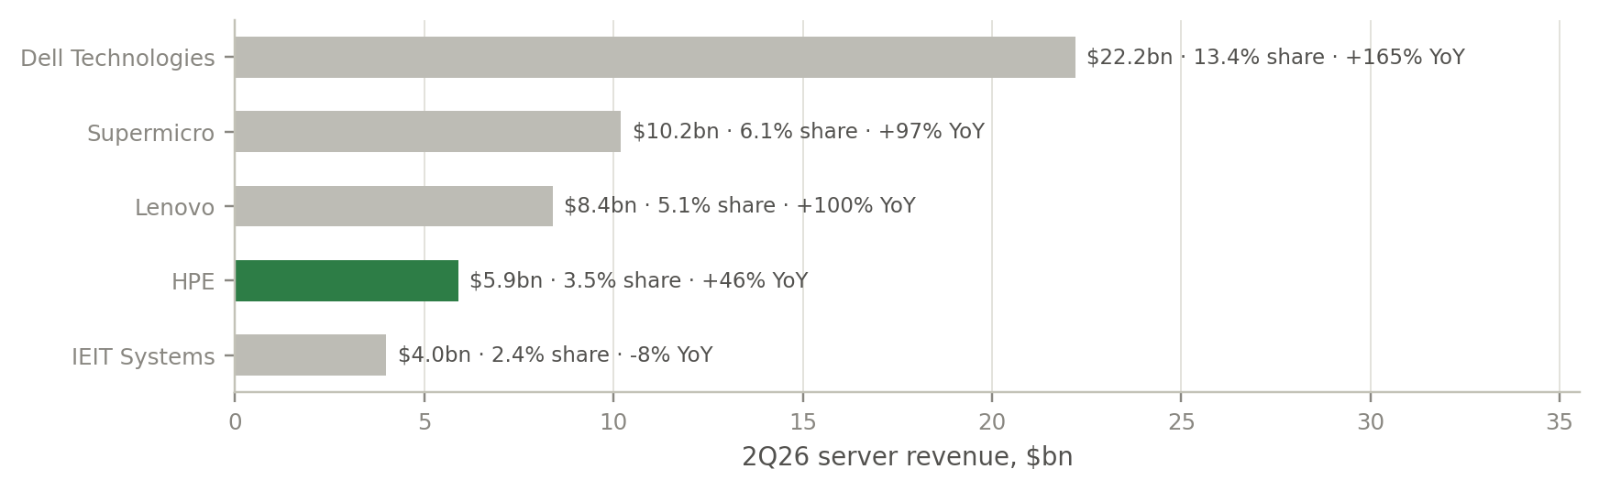
AI spending is exploding, but HPE's server share is shrinking
PART 1 · BUSINESS MODEL · INDUSTRY
Pattern: a booming market is not a moat. Suppliers and hyperscale buyers hold the profit pool, and HPE grew slower than the market.
Market | Size | Growth
AI infrastructure (IDC) | $497bn 2026F | ~30% CAGR to 2030
Servers (IDC, 2Q26) | $166bn / quarter | +52% YoY
Campus switching (Dell'Oro) | >$20bn 2025 | ASP +19% 2Q26
Hyperscaler + Oracle capex | $566bn TTM | +81% YoY
■ Definitions differ: IDC counts AI servers and storage, Gartner adds networking; all include ODM-direct, where HPE barely competes.
■ Share: HPE has 3.5% of all servers, ~7.7% of the OEM market; grew 46% vs the market's 52% and Dell's 165%.
■ Profit pool: suppliers (NVIDIA, memory) and giant buyers hold the bargaining power.
Source: IDC (Jul/Sep-2026), Gartner (Jul-2026, via press coverage), Dell'Oro (2026), SEC capex filings; Bona Fide analysis.
7
Notes:
AI spending is exploding, but HPE's server share is shrinking
Time: 1:00 (cumulative 7:50)
Goal: Growth of the market is not growth of the company.
Script: The market backdrop is huge:
• IDC puts AI infrastructure spending at $497 billion this year;
• the server market grew 52% in the second quarter;
• the five big cloud spenders' capex is $566 billion over twelve months, up 81%.
HPE grew 46%: slower than the market, and far slower than Dell's 165%. It has 3.5% of all servers, about 7.7% of the OEM market it actually competes in, because more than half of servers go straight from ODMs to hyperscalers.
The pattern: a booming market lifts every boat, but the profit pool goes to whoever has bargaining power. Here that is NVIDIA, the memory makers and giant buyers ordering in competitive lots. A rising tide is not a moat.
Numbers to say: $497bn; server market +52%; capex $566bn +81%; HPE +46% vs Dell +165%; 3.5% share, ~7.7% of OEM.
Pattern: a booming market is not a moat; follow bargaining power.
Transition: Now question two: structure or cycle?

Slide 8
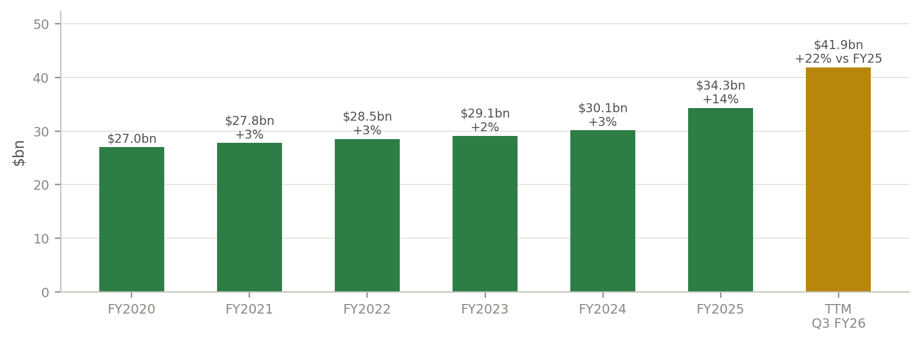
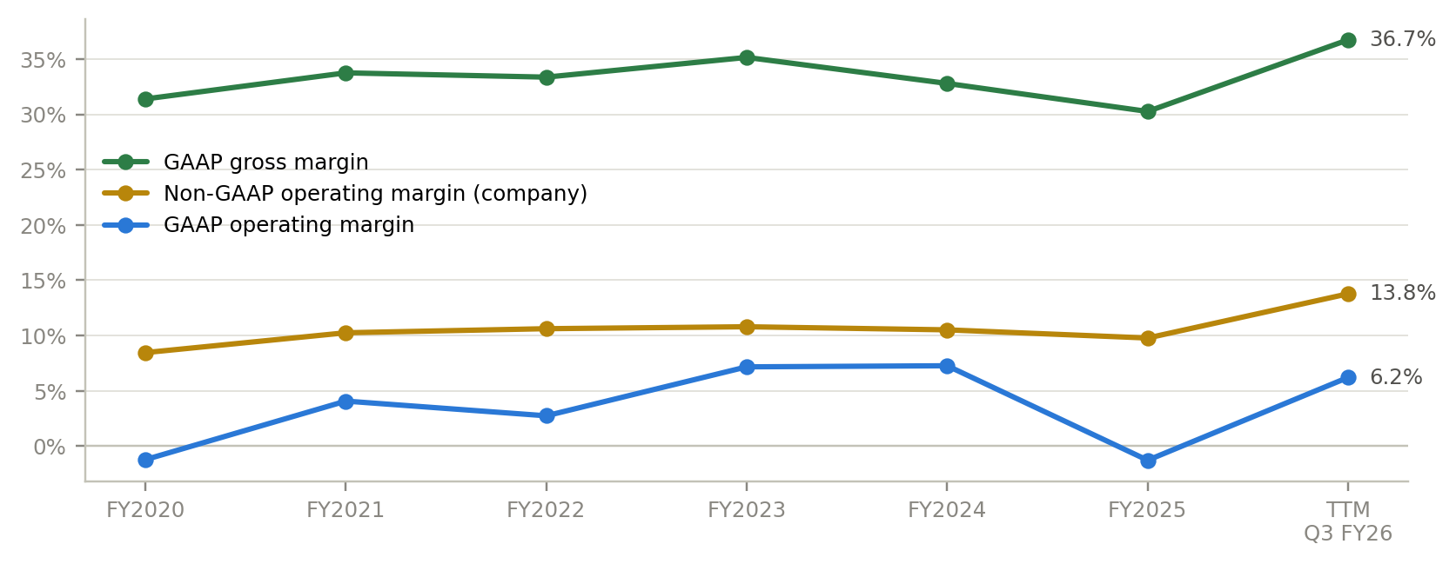
Four flat years, then a step change in scale and margins
PART 2 · STRUCTURE VS CYCLE · FINANCIALS
Investor logic: a step change after four flat years demands one question before any valuation: is it structure or cycle?
Source: HPE 10-K FY2020–FY2025, 10-Q Q3 FY26, earnings releases; Bona Fide analysis.
8
Notes:
Four flat years, then a step change in scale and margins
Time: 1:00 (cumulative 8:50)
Goal: Frame the structure-versus-cycle question.
Script:
• Left chart (revenue): from FY2020 to FY2024 revenue compounded at 2.8% a year, from about $27 billion to $30 billion. FY2025 grew 13.8% with part-year Juniper, and the last twelve months grew 30.8% to $41.9 billion.
• Right chart (margins): non-GAAP operating margin moved from the 10–11% range to 13.8%. GAAP operating margin is 6.2%; the gap is mainly Juniper amortisation and stock-based compensation, which we treat as a real cost.
When a company that was flat for four years suddenly steps up, the first job is not to extrapolate; it is to ask what caused the step.
Numbers to say: 2.8% CAGR FY20–24; +13.8% FY25; +30.8% TTM; non-GAAP margin 13.8% vs GAAP 6.2%.
Reasoning move: don't extrapolate a break; explain it.
Transition: Here is how we explained it.

Slide 9
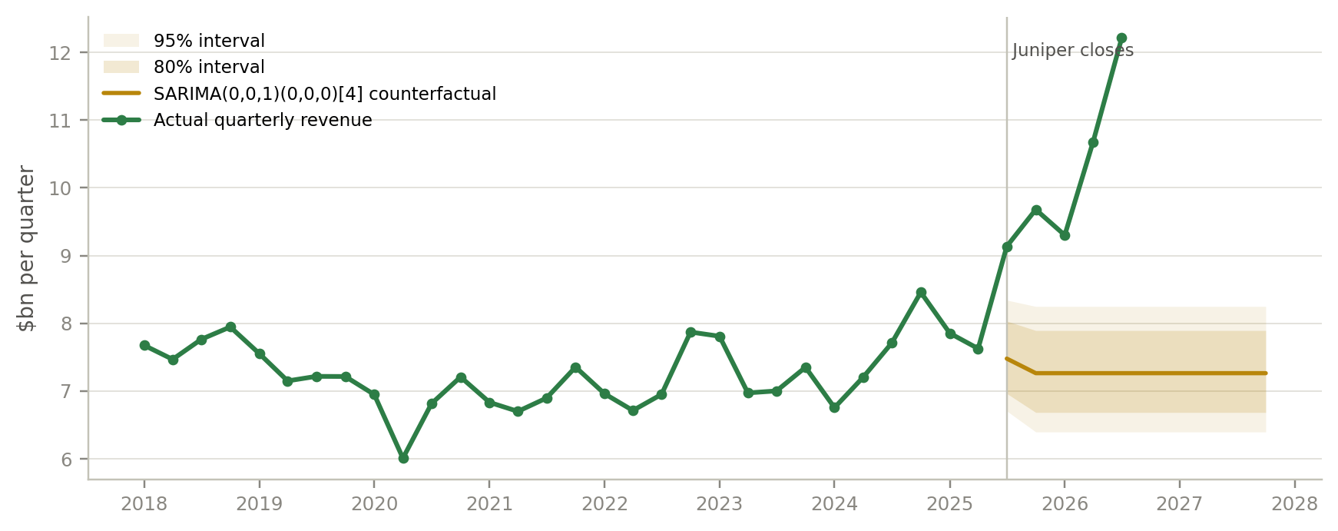
Only a third of FY26's jump above trend is Juniper
PART 2 · STRUCTURE VS CYCLE · COUNTERFACTUAL
Pattern: separate the tide from the boat. Compare revenue with a no-change counterfactual, then attribute the gap.
Test | Coef. | p
Revenue growth ~ capex growth (sum of lags 0–2; best-lag p) | 0.19 | 0.08
Juniper quarters, revenue growth | +15pp | 0.001
Gross margin ~ Micron margin (pp) | -0.046 | 0.002
Juniper quarters, gross margin | +6.8pp | 0.001
Ljung-Box, daily returns (10 lags) |  | 0.06
ARCH-LM, volatility clustering |  | <0.001
3σ days vs normal distribution | 6.8x
■ Attribution: FY26 guide $46.5bn vs $29.1bn trend = $17.4bn excess; Juniper ≈ $5.7bn, AI and pricing ≈ $11.8bn (est.).
■ Market data: returns unpredictable, volatility clusters, fat tails → ranges, not price targets.
Source: HPE XBRL and 10-Q/10-K statements; hyperscaler and Micron XBRL; Yahoo Finance prices; Bona Fide analysis (statsmodels, HAC OLS).
9
Notes:
Only a third of FY26's jump above trend is Juniper
Time: 1:30 (cumulative 10:20)
Goal: Quantify structure versus cycle with a counterfactual.
Script: The tool here is a counterfactual.
• The model: we fitted an ARIMA model, a statistical trend model, to HPE's quarterly revenue from FY2018 to mid-FY2025, before Juniper. In a rolling backtest it missed by 4.8% on average, better than a random walk at 5.8%.
• The question: what would FY26 look like with no structural change? About $29 billion, against guidance of $46.5 billion. That is $17.4 billion above trend. All five quarters since the Juniper close sit above the model's 95% band, so this is a genuine break.
• The attribution: using the company's own normalised growth, Juniper explains about $5.7 billion, roughly a third. The remaining $11.8 billion is AI systems, pricing and refresh: the cyclical part.
• Two regressions back this up:
- once you account for Juniper quarters, revenue growth has only a weak link to cloud capex;
- memory-price spikes, measured by Micron's margin, compress HPE's gross margin only modestly. That tells you HPE has been passing costs through in price, which works in reverse when memory prices fall.
The pattern: separate the tide from the boat. The boat got bigger with Juniper, but two-thirds of the rise is tide.
Numbers to say: backtest error 4.8% vs 5.8%; trend $29.1bn vs guide $46.5bn; excess $17.4bn; Juniper ≈ $5.7bn; AI and pricing ≈ $11.8bn.
Pattern: separate the tide from the boat.
Transition: What drives the tide?

Slide 10
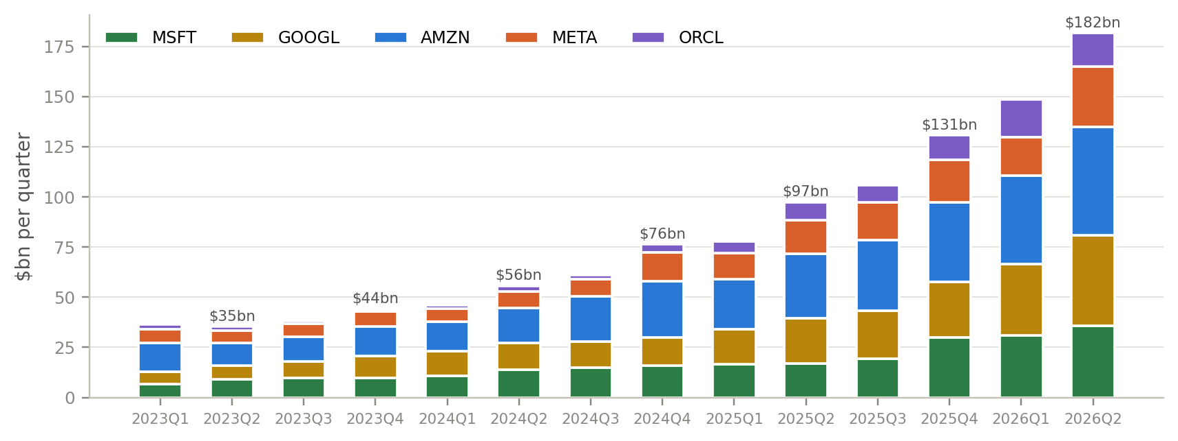
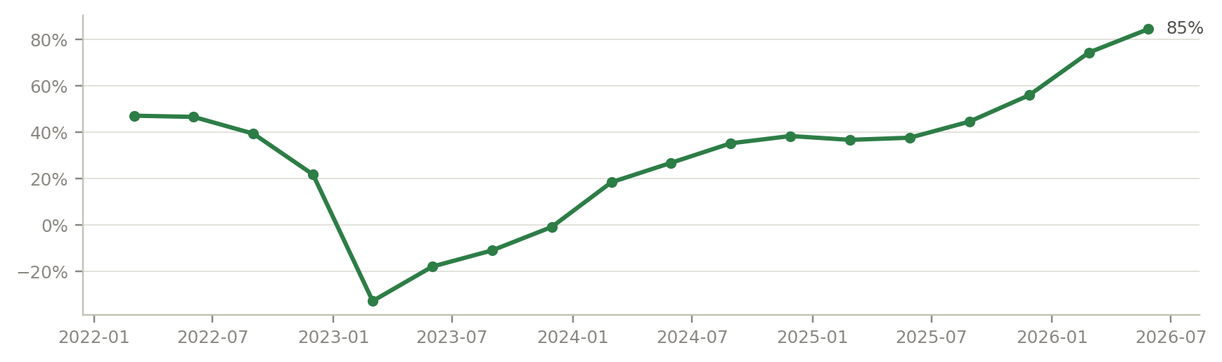
Cloud capex and memory prices drive the cyclical upside
PART 2 · STRUCTURE VS CYCLE · MACRO LEVERS
Investor logic: two external levers explain most of the cyclical upside, and both can run in reverse.
Capex → orders: 5 cloud spenders at a record run-rate feed AI backlog; AI systems dilute margin and swell inventory.
Memory → pricing: DRAM contract +13–18% QoQ in 3Q26; HPE passed costs on, which reverses when prices fall. Rates (10Y 4.95%) set WACC.
Source: Company 10-Q/10-K XBRL via SEC EDGAR; TrendForce (9-Jul-2026); FRED; Bona Fide analysis.
10
Notes:
Cloud capex and memory prices drive the cyclical upside
Time: 1:00 (cumulative 11:20)
Goal: Name the two external levers and their reversibility.
Script: These are the two levers behind that tide.
• Left: cloud capex. Quarterly capex at Microsoft, Alphabet, Amazon, Meta and Oracle is at a record run-rate. It feeds AI orders and backlog, but AI systems dilute margin and swell inventory.
• Right: memory prices. Micron's gross margin, our proxy for memory prices, jumped from 38% to 85% in a year, and DRAM contract prices rose 13 to 18% quarter on quarter in Q3. HPE passed those costs on, so Q3 server revenue grew 35%, largely on price, while units were supply-constrained.
The investing logic: both levers are external, both are at records, and both can run in reverse. When memory prices fall, server revenue can shrink even if unit demand is flat.
Numbers to say: Micron gross margin 38% → 85%; DRAM +13–18% QoQ; Q3 server revenue +35% on price.
Reasoning move: identify the external variables and ask whether they mean-revert.
Transition: If the levers are cyclical, does HPE look like a company at a cycle high? We checked.

Slide 11
Seven late-cycle signals, three structural offsets
PART 2 · STRUCTURE VS CYCLE · PATTERN CHECK
Pattern recognition: no single signal calls a peak; a cluster of them says the price is paying for the good times to last.
Late-cycle signal | The pattern | HPE today | Read
Growth led by price, not units | Pass-through pricing reverses when component costs fall | Q3 server growth ASP-led; DRAM contract prices +13–18% QoQ | Present
Record margin, guided lower | Management sees its own cycle first | Record 40.4% non-GAAP gross margin; guided to “moderate” | Present
Inventory funded by suppliers | Working capital flatters FCF at peaks, then unwinds | Inventory +$5.5bn, payables +$6.0bn since Oct-2025 | Present
Record backlog, supply-constrained | Long lead times inflate orders; slippage follows when supply eases | AI backlog $7.6bn; supply is the binding constraint | Present
Customers' capex at records | Capex cycles overshoot, then digest | Hyperscaler + Oracle capex $566bn TTM, +81%, partly debt-funded | Present
Multiple above its own history | Peak earnings × peak multiple = double exposure | 13.5x FY27 EPS vs 4–10x FY20–24; peers 18–23x | Present
Momentum and insider selling | Informed sellers, no informed buyers | +155% in a year; 2-Jun +19.5% on 7.4x volume; 31 insider sales, no buys (mostly pre-rally) | Partly
STRUCTURAL OFFSETS: WHY THIS IS NOT ONLY A CYCLE
Networking earns 40% of segment profit · ROIC 11.2% above the 9.3% WACC · ARR $3.15bn, +63% · FY27 framework raised
Source: HPE Q3 FY26 materials and 10-Q; TrendForce; SEC capex filings; Form 4 filings; Yahoo Finance; Bona Fide analysis.
11
Notes:
Seven late-cycle signals, three structural offsets
Time: 1:30 (cumulative 12:50)
Goal: Pattern recognition, with the counter-evidence shown.
Script: No single indicator calls a cycle peak, but cycles leave a recognisable cluster of fingerprints. We checked HPE against seven:
1. Growth led by price rather than units: present.
2. Record margins that management guides lower: present, at 40.4%.
3. Inventory financed by suppliers: present. Inventory is up $5.5 billion and payables up $6 billion.
4. Record backlog while supply is the constraint: present, at $7.6 billion. Long lead times inflate orders, and slippage tends to follow when supply eases.
5. Customers' capex at records, partly debt-funded: present, up 81%.
6. A multiple above its own history: present, 13.5 times against 4 to 10.
7. Momentum with insiders selling: only partly. The stock is up 155% in a year with a blow-off day on 2 June, and insiders made 31 sales and no purchases, though most of those sales came before the re-rating.
The discipline is to also list what doesn't fit a pure cycle story: networking earns 40% of profit, ROIC is above WACC, and ARR grew 63%. So our conclusion isn't "HPE is at a cyclical peak". It is "HPE is a better business at a cyclical high", and the price has to tell the two apart.
Numbers to say: gross margin 40.4%; inventory +$5.5bn, payables +$6.0bn; backlog $7.6bn; capex +81%; 13.5x vs 4–10x; +155% in a year; 31 insider sales, no purchases.
Pattern: late-cycle signals come in clusters; always list the counter-evidence.
Transition: Signal three deserves a closer look: is the cash real?

Slide 12
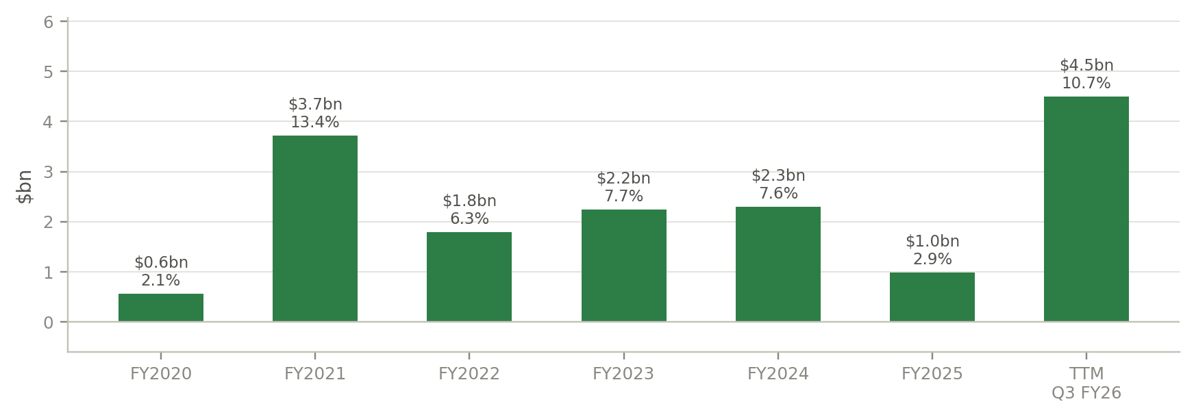
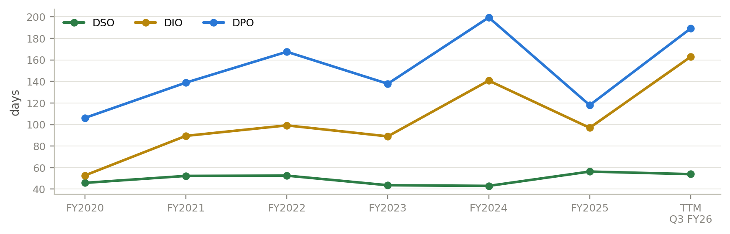
Record free cash flow, but suppliers fund the AI backlog
PART 2 · STRUCTURE VS CYCLE · CASH QUALITY
Pattern: at cycle peaks suppliers finance inventory, so free cash flow looks best just before it reverses.
GROSS DEBT / CASH
FULLY DILUTED SHARES
LIQUIDITY
BUYBACK AUTHORISATION
$20.2bn / $6.2bn
1,445m
$11.5bn
$3.2bn
~$11.5bn funds FS receivables (est.)
+8.8% vs basic
cash + undrawn revolver
≥75% of FCF returned from Q4
Source: HPE 10-K/10-Q; Q3 FY26 press release; Bona Fide analysis.
12
Notes:
Record free cash flow, but suppliers fund the AI backlog
Time: 1:15 (cumulative 14:05)
Goal: Cash quality, and why the balance sheet is not the issue.
Script: Question three: is the cash real?
• The headline: trailing free cash flow is a record $4.5 billion, a 10.7% margin, against about $1 billion in FY2025.
• Working capital (right chart): since October, inventory rose $5.5 billion and payables rose $6 billion. Suppliers are financing the AI backlog.
• The pattern: at cycle peaks, when orders grow, payables can grow faster than inventory, so free cash flow looks best. When orders slow the financing unwinds, and free cash flow can swing by billions.
• The balance sheet (bottom row) can absorb that:
- gross debt is $20.2 billion against $6.2 billion of cash, but about $11.5 billion of that debt funds Financial Services receivables;
- liquidity is $11.5 billion;
- dilution from the preferred and employee awards is 8.8%.
So the balance sheet isn't the risk; the quality of this year's cash is.
Numbers to say: free cash flow $4.5bn (10.7%) vs $986m in FY2025; inventory +$5.5bn; payables +$6.0bn; debt $20.2bn, cash $6.2bn; ~$11.5bn funds FS; dilution 8.8%.
Pattern: working capital narrates the cycle.
Transition: Part three: what does the price assume? First, the best case for the bulls.

Slide 13
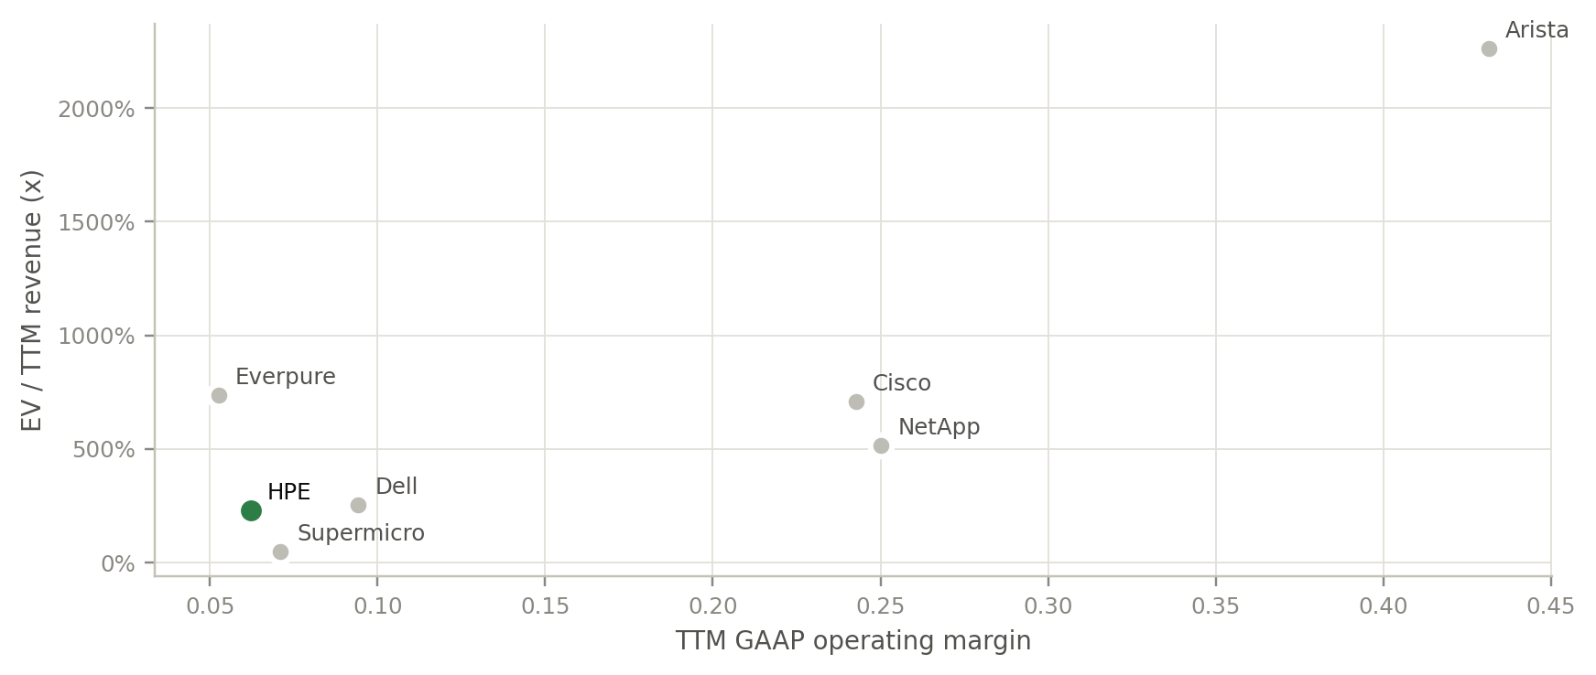
Steelman: at peer multiples, HPE is worth $67–106
PART 3 · WHAT THE PRICE ASSUMES · STEELMAN
Steelman: the strongest case for the price is relative, but peer multiples embed the same AI-cycle assumptions we are testing.
Company | Rev $bn | GM | Op. margin | FCF mgn | P/E NFY | EV/Rev
HPE | 41.9 | 37% | 6% | 11% | 13.5x | 2.3x
Dell | 151.2 | 20% | 9% | 6% | 23.0x | 2.5x
Supermicro | 39.1 | 11% | 7% | -18% | 7.5x | 0.5x
Cisco | 63.3 | 65% | 24% | 20% | 20.0x | 7.1x
Arista | 10.5 | 63% | 43% | n/a | 38.7x | 22.6x
NetApp | 7.4 | 71% | 25% | 22% | 18.0x | 5.1x
■ Bull logic: twice Dell's gross margin and a Cisco-like networking arm, yet 13.5x vs Dell 23.0x and Cisco 20.0x; sum of the parts $67–94.
■ Our test: peer multiples embed the same AI-cycle assumptions; relative value cannot show the sector is right.
■ Also true: HPE's GAAP operating margin is 6% and it is losing server share.
Source: SEC XBRL TTM fundamentals; prices 11-Sep-2026; consensus EPS Yahoo Finance; Bona Fide analysis.
13
Notes:
Steelman: at peer multiples, HPE is worth $67–106
Time: 1:00 (cumulative 15:05)
Goal: Steelman the bull case before testing it.
Script: Before attacking the price, steelman it. The best bull argument is relative:
• HPE has about twice Dell's gross margin and a networking business that looks more like Cisco;
• yet it trades at 13.5 times next year's earnings, against Dell at 23 and Cisco at 20;
• apply the core peers' multiples and you get $67 to $106, and a sum of the parts using Cisco's multiple for networking gives $67 to $94.
Our response: those multiples aren't independent evidence. Dell at 23 times already embeds the same AI-cycle assumptions we are testing. Relative value can tell you HPE is cheap against its sector; it can't tell you the sector is priced right.
Numbers to say: gross margin 37% vs Dell 20%; P/E 13.5x vs Dell 23.0x, Cisco 20.0x; peers imply $67–106; sum of the parts $67–94.
Reasoning move: steelman first; check whether "cheap vs peers" is independent evidence.
Transition: So we value the cash flows directly, and then run the valuation backwards.

Slide 14
The price needs an 18% margin or 11% growth for a decade
PART 3 · WHAT THE PRICE ASSUMES · REVERSE DCF
Investor logic: treat the price as a forecast. Solve for what it requires, then judge whether that world is plausible.
Cost of capital | Value
Risk-free (10Y UST) | 4.95%
Equity risk premium | 3.97%
Levered beta | 1.35
Cost of equity | 10.32%
After-tax cost of debt | 4.79%
WACC | 9.30%
What $62.09 implies (one variable at a time) | Implied | Our base
LT non-GAAP margin (base growth) | 18.4% | base 12.5%
Revenue CAGR FY27–36 (base margin) | 10.8% | base 5.0%
WACC (base case) | 7.0% | ours 9.3%
WACC \ terminal g | 2.25% | 2.50% | 2.75% | 3.00%
8.30% | $45.5 | $46.1 | $46.7 | $47.3
8.80% | $41.6 | $42.0 | $42.4 | $42.9
9.30% | $38.2 | $38.5 | $38.8 | $39.1
9.80% | $35.3 | $35.5 | $35.7 | $35.9
10.30% | $32.7 | $32.8 | $33.0 | $33.1
■ FY26E revenue $46.5bn (guidance midpoint)
■ FY27E +15%, 14.5% non-GAAP margin (framework)
■ LT margin 12.5%, terminal growth 2.75%, SBC expensed
■ Equity = EV − debt $20.2bn + cash $6.2bn
Source: FRED DGS10; Damodaran ERP and betas (Jan-2026); Bona Fide DCF (FY27E–FY36E, SBC expensed, mid-year discounting).
14
Notes:
The price needs an 18% margin or 11% growth for a decade
Time: 1:30 (cumulative 16:35)
Goal: Expectations investing with a reverse DCF.
Script: Instead of forecasting the price, we treat the price as the forecast and solve for what it requires.
• Our DCF: FY27 to FY36 at a 9.3% WACC (risk-free rate 4.95%, equity risk premium 3.97%, beta 1.35), with stock compensation expensed. It uses FY26 guidance and the FY27 framework, revenue up 15% at a 14.5% non-GAAP margin, fading to 12.5% long term.
• Reversed, one variable at a time, $62.09 needs one of:
- a long-term non-GAAP margin of 18.4%, when HPE's range from FY2020 to FY2025 was 8.5 to 10.8% and the FY27 guide is 14–15%;
- revenue growth of 10.8% a year for ten years instead of 5%;
- a 7% cost of capital, which isn't plausible for a hardware company with a 1.4 beta.
• Even if FY27's 14.5% margin held forever, growth would still need to be 3.5 points faster than our base.
The logic: we don't have to be right about next quarter. We only have to ask whether the world the price implies is more likely than not, and here it looks like a stretch.
Numbers to say: WACC 9.3%; implied margin 18.4% vs history 8.5–10.8% and guide 14–15%; implied CAGR 10.8% vs 5.0%; implied WACC 7.0%; +3.5pp growth even at 14.5% margin.
Pattern: the price is a forecast; reverse it.
Transition: Here is every method on one scale.

Slide 15
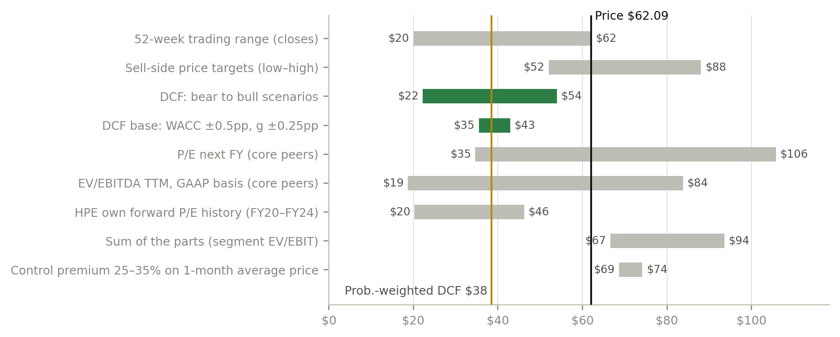
Intrinsic value sits below the price; peer multiples sit above
PART 3 · WHAT THE PRICE ASSUMES · VALUATION RANGE
Investor logic: methods that value HPE's own cash flows cluster at $31–43; only methods that borrow today's sector multiples reach the price.
SHARE PRICE
11-Sep-2026 close
$62.09
BASE-CASE DCF
WACC 9.30%
$38.80
PROBABILITY-WEIGHTED
25 / 50 / 25
$38.43
DAMODARAN GINZU
independent model
$31.57
CORE-PEER P/E RANGE
if sector multiples hold
$35–$106
Source: Bona Fide DCF, comps and M&A analysis; Yahoo Finance targets; excel/HPE_valuation_model.xlsx.
15
Notes:
Intrinsic value sits below the price; peer multiples sit above
Time: 1:15 (cumulative 17:50)
Goal: Show where the methods cluster and why they disagree.
Script: The football field puts every method on one scale against the $62.09 price line.
• Methods that value HPE's own cash flows cluster together:
- base DCF $38.80, with a $35 to $43 range for half a point either way on WACC and a quarter point on terminal growth;
- probability-weighted scenario value $38.43;
- an independent Damodaran model at $31.57, using a regional equity risk premium.
• HPE's own forward P/E history gives $20 to $46.
• Only methods that borrow today's peer multiples reach the price: comparables and sum of the parts. An M&A value of $69–74 needs a buyer, which is improbable at an enterprise value above $100 billion.
The pattern: when intrinsic methods agree with each other and disagree with the price, relative multiples are setting the price, and relative multiples are the most fragile input in a sector cycle.
Numbers to say: DCF $38.80 ($35–43); probability-weighted $38.43; Ginzu $31.57; own history $20–46; M&A $69–74.
Reasoning move: look for agreement between independent methods; ask which input sets the price.
Transition: How lopsided is the risk-reward? Scenarios.

Slide 16
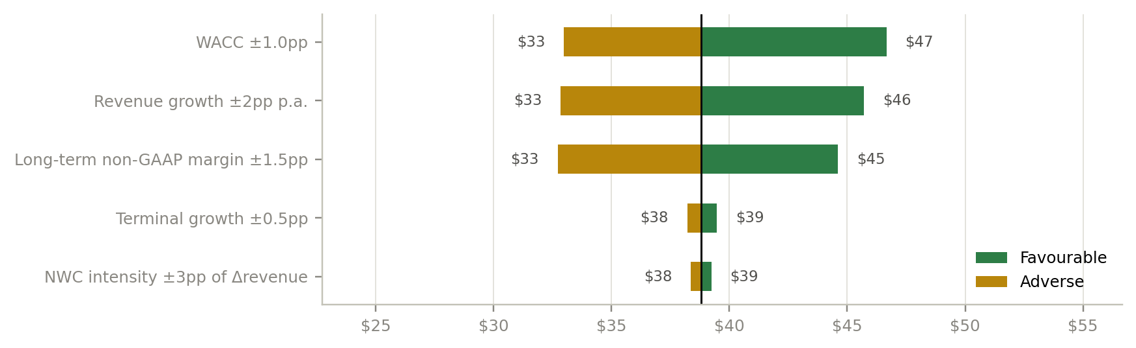
Asymmetry: even our bull case falls short of today's price
PART 3 · WHAT THE PRICE ASSUMES · SCENARIOS
Asymmetry: if even the bull case sits below the price, upside needs assumptions beyond what the evidence supports.
Case | Prob. | FY27 g | FY28 g | LT margin | Term. g | Value/sh
Bear | 25% | +10% | -3% | 10.5% | 2.25% | $22.19
Base | 50% | +15% | +6% | 12.5% | 2.75% | $38.80
Bull | 25% | +17% | +9% | 14.5% | 3.25% | $53.93
Prob.-weighted | 100% |  |  |  |  | $38.43
■ Bear: AI digestion and memory normalisation reverse FY26 price gains; margin back to ~10.5%.
■ Base: FY27 framework delivered; growth fades to mid-single digits; margin 12.5%.
■ Bull: Oracle and Helios lift networking mix; margin holds ~14.5%.
■ Largest drivers: WACC, growth and long-term margin; margin is the open question.
Source: Bona Fide DCF scenarios; drivers flexed one at a time around the base case.
16
Notes:
Asymmetry: even our bull case falls short of today's price
Time: 1:15 (cumulative 19:05)
Goal: Make the asymmetry explicit.
Script: Scenarios make the asymmetry explicit.
• Bear (25%): AI digestion and memory normalisation reverse this year's price gains, FY28 revenue falls 3%, and margin returns to 10.5%. Value: $22.
• Base (50%): the FY27 framework is delivered, growth fades to mid-single digits, and margin settles at 12.5%. Value: $38.80.
• Bull (25%): Oracle and Helios lift networking, and margin holds at 14.5%. Value: $54.
• Probability-weighted: $38.43.
The key point: even the bull case sits below today's price, so upside from here needs assumptions beyond what the evidence supports. The tornado on the right shows what matters: the discount rate, growth and long-term margin each swing value by about $12 to $14, while terminal growth and working capital matter much less. Margin is the one where the evidence is genuinely open, which is why margin durability is at the centre of our monitoring.
Numbers to say: $22 / $38.80 / $54; probability-weighted $38.43; WACC ±1pp $33–47; growth ±2pp $33–46; margin ±1.5pp $33–45.
Pattern: think in ranges and probabilities; find the one input where the evidence is open.
Transition: Part four: what the market is doing, the risks, and the decision.

Slide 17
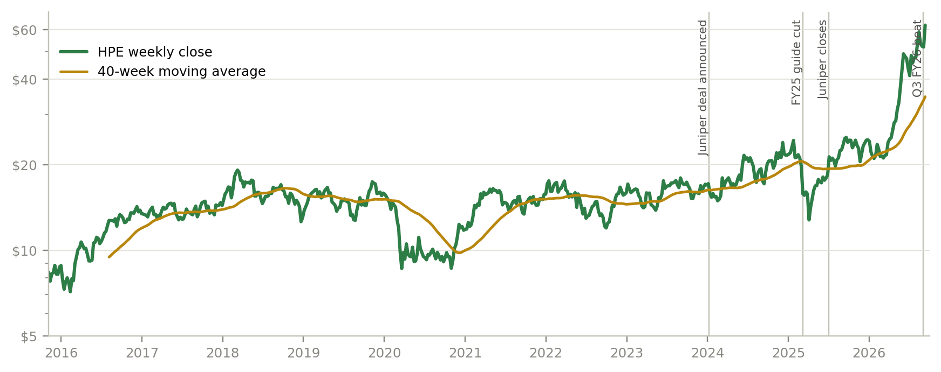
The market is pricing a regime change, not a cycle
PART 4 · MARKET, RISKS & DECISION · STOCK
Pattern: HPE now trades as an AI-hardware name, and its returns have fat tails: think in ranges, size for turbulence.
Total return | 1Y | 3Y | 5Y
HPE | +155% | +289% | +396%
S&P 500 | +18% | +77% | +84%
Tech (XLK) | +39% | +120% | +149%
Dell | +358% | +725% | +1194%
Cisco | +69% | +114% | +123%
■ Trades as AI hardware: correlation with Dell 0.66 > S&P 500 0.47; beta 1.40.
■ Catalysts: 30-Sep Networking Investor Day; early Dec Q4 FY26 and FY27 guide; ~Sep-2027 preferred conversion.
PATTERN IN THE RETURNS
■ Direction: no significant autocorrelation (Ljung-Box p = 0.06); past prices don't predict the next move.
■ Turbulence: volatility clusters; 3σ days occur 6.8x as often as a normal distribution implies.
Source: Yahoo Finance (spin-off and dividend adjusted); Bona Fide analysis.
17
Notes:
The market is pricing a regime change, not a cycle
Time: 1:15 (cumulative 20:20)
Goal: Read the market's behaviour and draw the position-sizing lesson.
Script: For a decade the stock traded between about $8 and $26, as an ex-growth hardware company at 4 to 10 times earnings. In April 2026 it broke out, and it is up 155% in a year; Dell is up 358%.
Two patterns in the market data matter for how you act:
• HPE now trades as an AI-hardware name. Its correlation with Dell (0.66) exceeds its correlation with the S&P 500 (0.47), so sector sentiment can overwhelm company news.
• The return statistics: returns show no significant autocorrelation, so past prices don't predict direction. But volatility clusters, and three-sigma days happen 6.8 times as often as a normal distribution implies. That is why we give ranges rather than point targets, and why position sizing has to assume fat tails.
The catalysts to watch:
• the Networking Investor Day on 30 September;
• Q4 results and full FY27 guidance in early December;
• the preferred conversion around September 2027.
Numbers to say: range $7.83–26.25 for a decade; +155% in a year vs Dell +358%; correlation with Dell 0.66 vs S&P 500 0.47; 3σ days 6.8x normal.
Pattern: momentum and fat tails; the market prices the regime, fundamentals price the cycle.
Transition: What could go wrong for anyone owning it at $62?

Slide 18
The biggest risks are the forces that created the rally
PART 4 · MARKET, RISKS & DECISION · RISKS
Investor logic: the biggest risks are the rally's own drivers running in reverse. Trace each to valuation and watch its indicator.
Risk | Type | Transmission: revenue → margin → cash flow → balance sheet → valuation | Monitor
Cloud & AI margin reversal | Company | Memory prices fall → ASPs and GM ↓ → FCF ↓, inventory write-downs | TrendForce prices; HPE non-GAAP GM
Networking execution | Company | Share loss / synergy miss → highest-margin revenue ↓ → multiple ↓ | Normalised growth; Dell'Oro share; Investor Day
AI deal lumpiness & credit | Company | Slips/cancellations → FCF swings of $bn → leverage ↑ | Backlog conversion; DIO/DPO; FS reserves
AI capex digestion | External | Orders ↓ → revenue ↓ → sector de-rating (peers 18–23x P/E) | Hyperscaler capex guides; IDC growth
Supply & trade policy | External | Shortages/tariffs → unfilled orders, COGS ↑ → FCF ↓ | Lead times; USTR/BIS actions
Rates & enterprise budgets | External | WACC ↑, refresh delayed → ±1pp WACC ≈ ±$6–8/share | 10Y yield; BBB spreads; Gartner IT spend
Source: Bona Fide analysis; IDC, TrendForce, Dell'Oro, SEC capex filings, HPE Q3 FY26 materials.
18
Notes:
The biggest risks are the forces that created the rally
Time: 1:15 (cumulative 21:35)
Goal: Trace each risk through the statements to valuation.
Script: The risk slide has one idea: the biggest risks are the forces that created the rally, running in reverse. For each one we trace the chain from revenue to margin to cash to balance sheet to valuation, and name the indicator to watch.
Company-specific:
• Cloud & AI margin reversal: memory prices fall, prices and gross margin fall together, and inventory bought at peak cost gets written down. Watch TrendForce prices and HPE's gross margin.
• Networking execution: share loss to Cisco and Arista, or missed synergies, hits the highest-margin revenue. Watch normalised growth and the Investor Day.
• Lumpy AI deals and customer credit: slippage swings free cash flow by billions. Watch backlog conversion and inventory days.
External:
• AI capex digestion: the largest valuation risk, because it hits both earnings and sector multiples.
• Supply and trade policy.
• Rates: each percentage point of WACC is worth roughly $6 to $8 a share.
Notice the asymmetry: most of these risks push value down from $38, and almost none push it toward $62.
Numbers to say: peers at 18–23x P/E; ±1pp WACC ≈ ±$6–8 per share.
Reasoning move: transmission chains, not risk lists.
Transition: Which brings us to the decision.

Slide 19
Price vs range: what must be true, and what to watch
PART 4 · MARKET, RISKS & DECISION · CONCLUSION
Decision logic: we don't need to predict the cycle; we need to know which signposts would move value toward the price, or the price toward value.
FOR $62.09 TO BE FAIR VALUE, ONE OF THESE MUST HOLD
■ Long-term non-GAAP margin ≈ 18% (FY27 guide 14–15%)
■ Revenue CAGR ≈ 11% for ten years (base 5%)
■ Cost of capital ≈ 7.0%, or AI-hardware peer multiples persist
WHAT WOULD CHANGE THE VIEW
■ Up: Cloud & AI margin ≥13% through a memory-price decline; networking mid-teens organic growth; FY27 FCF well above $5bn
■ Down: non-GAAP GM <33%, AI backlog declines, sector de-rating
Relative value if peer multiples hold: $67–$106 per share
Source: Bona Fide DCF and comps; no rating or price target is expressed.
19
Notes:
Price vs range: what must be true, and what to watch
Time: 1:30 (cumulative 23:05)
Goal: Close on the decision logic without a rating.
Script: Here is the decision framework.
• Left: our ranges against the price. Intrinsic value is $35 to $43. Relative value is $67 to $106, but only if peer multiples hold.
• Right: for $62.09 to be fair value, one of these must be true:
- an 18% long-term margin, when FY27 guidance is 14–15%;
- 11% revenue growth for ten years, when our base is 5%;
- a 7% cost of capital, or AI-hardware multiples that persist.
We don't need to predict which way the cycle turns. We need to know what would change our mind.
• Upward: Cloud & AI margin holding at 13% or more through a memory-price decline, networking growing mid-teens organically at 25%-plus margins, and FY27 free cash flow well above $5 billion with inventory normalising. Together those would lift the long-term margin toward 15% and our range toward $55–60: still below today's price, but close.
• Downward: non-GAAP gross margin back below 33%, a sequential decline in AI backlog, or a sector de-rating.
That is the conclusion: a better business, priced as if the cycle never turns, with a clear list of signposts to update on.
Numbers to say: $35–43 vs $62.09; peer multiples $67–106; 18% vs 14–15%; 11% vs 5%; 7% WACC. Upward signposts: 13%, 25%, $5bn → $55–60. Downward: gross margin below 33%.
Reasoning move: decide with signposts, not predictions.
Transition: Let me leave you with what carries over to the next company.

Slide 20
Five patterns to take away
CLOSING
The HPE case in one line: a better business, priced as if the cycle never turns.
Pattern | What we saw at HPE | Where else to use it
1 · Follow profit, not revenue | Networking: 26% of revenue, 40% of segment profit | Any company that reports segments
2 · Separate the tide from the boat | FY26 $17.4bn above trend: about a third Juniper, two-thirds AI and pricing | Acquirers in booming markets
3 · Your place in the value chain sets your cycle | Paid at shipment: elastic revenue, thin margins, little contracted backlog | Semiconductor equipment, memory, contract manufacturers
4 · Working capital narrates the cycle | Record free cash flow while payables fund a $5.5bn inventory build | Hardware and distribution businesses near peaks
5 · The price is a forecast; think in ranges | $62.09 needs an 18% margin; 3σ days 6.8x a normal distribution | Momentum stocks and re-ratings
Thank you. Questions?
Source: Bona Fide analysis; HTML report sections 1–12.
20
Notes:
Five patterns to take away
Time: 0:45 (cumulative 23:50)
Goal: Make the reasoning reusable.
Script: Five patterns outlive this stock:
1. Follow profit, not revenue.
2. Separate the tide from the boat.
3. Your place in the value chain sets your cycle.
4. Working capital narrates the cycle.
5. Treat the price as a forecast: reverse it, and think in ranges, because the tails are fat.
Thank you. I'm happy to take questions; the appendix has backup on the moat, capital structure, price action, catalysts and our two practitioner questions.
Transition: Open for questions; use the Q&A preparation below.

Slide 21
Appendix
Backup slides for questions
Moat · capital structure · price action · catalysts
Q&A: Juniper security; landlords, neoclouds, servers
Bona Fide Student Investment Society · 2026-2027 · Prices as of 11-Sep-2026
Notes:
Appendix divider
When to use: Jump here when a question needs detail. Slides 22–28 are not timed.

Slide 22
Moat is narrow and sits in networking, not servers
APPENDIX · COMPETITIVE POSITION & MOAT
Porter force | Intensity | Evidence
Rivalry | High | Dell, Supermicro, Lenovo, Cisco, Arista, ODMs
Suppliers | High | NVIDIA, memory triopoly, Broadcom
Buyers | Med–high | Hyperscalers and sovereigns buy in huge lots
Substitutes | Medium | Public-cloud IaaS vs on-prem inference
New entrants | Low–med | Scale and supply allocation barriers
Business | Moat | Durability
Networking | Narrow | Moderate
Storage / GreenLake | Narrow | Moderate
Servers & AI systems | None | Low
Financial Services | None | Cyclical
■ Juniper is a deliberate move toward the part of the stack with pricing power; servers remain a scale business losing share
■ Technology edge: Express 5 routing silicon, liquid cooling (Cray heritage), on-prem inference (PCAI)
■ Returns test: adj. ROIC averaged 8.1% FY20–25, below WACC; 11.2% TTM
Source: Bona Fide analysis using IDC, Dell'Oro, HPE filings and peer financials.
22
Notes:
Appendix: competitive position and moat
When to use: Questions about competition or pricing power.
• Porter: rivalry and supplier power are high (NVIDIA, the memory makers, Broadcom); buyers medium-to-high; substitutes medium (public cloud vs on-premises inference); new entrants low-to-medium.
• Moat by business: narrow in networking and storage/GreenLake; none in servers and AI systems or in Financial Services.
• Returns test: adjusted ROIC averaged 8.1% over FY20–25 and is 11.2% TTM. Technology edge: Express 5 routing silicon, liquid cooling (Cray heritage), on-premises inference.

Slide 23
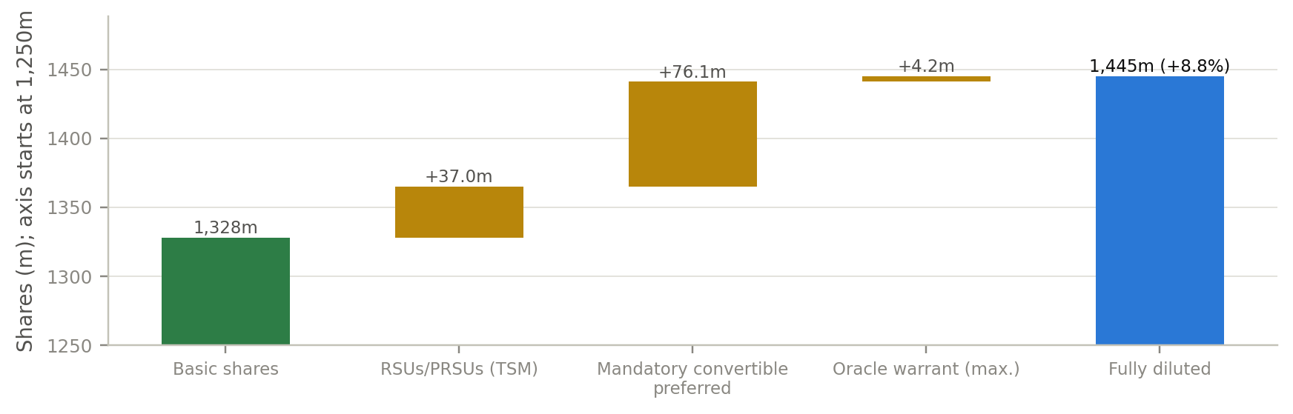
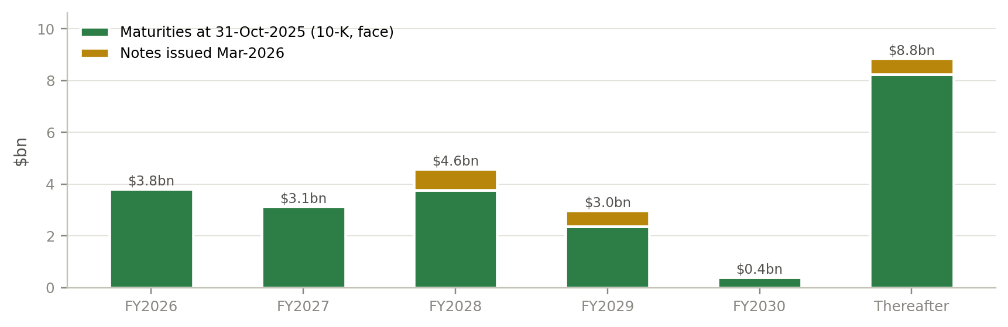
Leverage is back near 1.8x; the preferred drives most dilution
APPENDIX · BALANCE SHEET, CAPITAL STRUCTURE & DILUTION
GROSS DEBT / CASH
FULLY DILUTED SHARES
LIQUIDITY
BUYBACK AUTHORISATION
$20.2bn / $6.2bn
1,445m
$11.5bn
$3.2bn
~$11.5bn funds FS receivables (est.)
+8.8% vs basic
cash + undrawn revolver
≥75% of FCF returned from Q4
Source: HPE 10-K FY2025, 10-Q Q3 FY26, Q3 FY26 call; Bona Fide analysis.
23
Notes:
Appendix: balance sheet, capital structure and dilution
When to use: Questions about leverage, the preferred, buybacks or refinancing.
• Debt and cash: gross debt $20.2bn and cash $6.2bn; about $11.5bn funds Financial Services receivables (estimate); net debt 1.75x adjusted EBITDA; S&P rating BBB, stable.
• Share count: 1,445m fully diluted shares (+8.8%). Mostly the 7.625% mandatory convertible preferred (76.1m shares at the minimum conversion rate, around 1-Sep-2027), plus RSUs and the Oracle warrant (up to 4.2m).
• Capital returns: $3.2bn buyback authorisation remaining; management intends to return at least 75% of free cash flow from Q4 FY26.

Slide 24
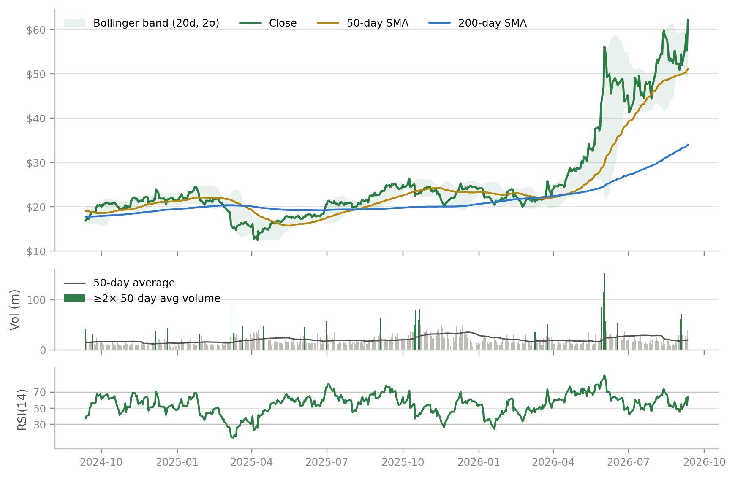
Consolidating below $63–64 resistance after a blow-off
APPENDIX · PRICE ACTION & TECHNICALS
■ Breakout: first close above the $26.25 decade high on 17-Apr-2026, after a golden cross (15-Apr)
■ Blow-off: 2-Jun opened +34%, closed +19.5% on 7x volume; −26% drawdown into July
■ Range: highs $64.25 / $63.44, lows $40.72 / $45.70 — contracting; bandwidth 85% → 18%
■ Test: record close $62.09 on 2x volume, still below intraday highs; ~9% lower intraday on 14-Sep after a downgrade
■ Read: trend up but 83% above 200-day SMA; support ~$51 (50-day) and $41–46
Source: Yahoo Finance daily data; ta library indicators; Bona Fide analysis. 14-Sep intraday move is after the valuation date.
24
Notes:
Appendix: price action and technicals
When to use: Questions about timing or the chart.
• Breakout: first close above the $26.25 decade high on 17-Apr-2026, after a golden cross on 15-Apr.
• Blow-off: on 2-Jun the stock opened +34% and closed +19.5% on 7.4x volume, then drew down 26% into July.
• Range: highs $64.25 / $63.44, lows $40.72 / $45.70, with Bollinger bandwidth compressing from 85% to 18%. Support is at the ~$51 50-day average and $41–46; resistance at $63–64.

Slide 25
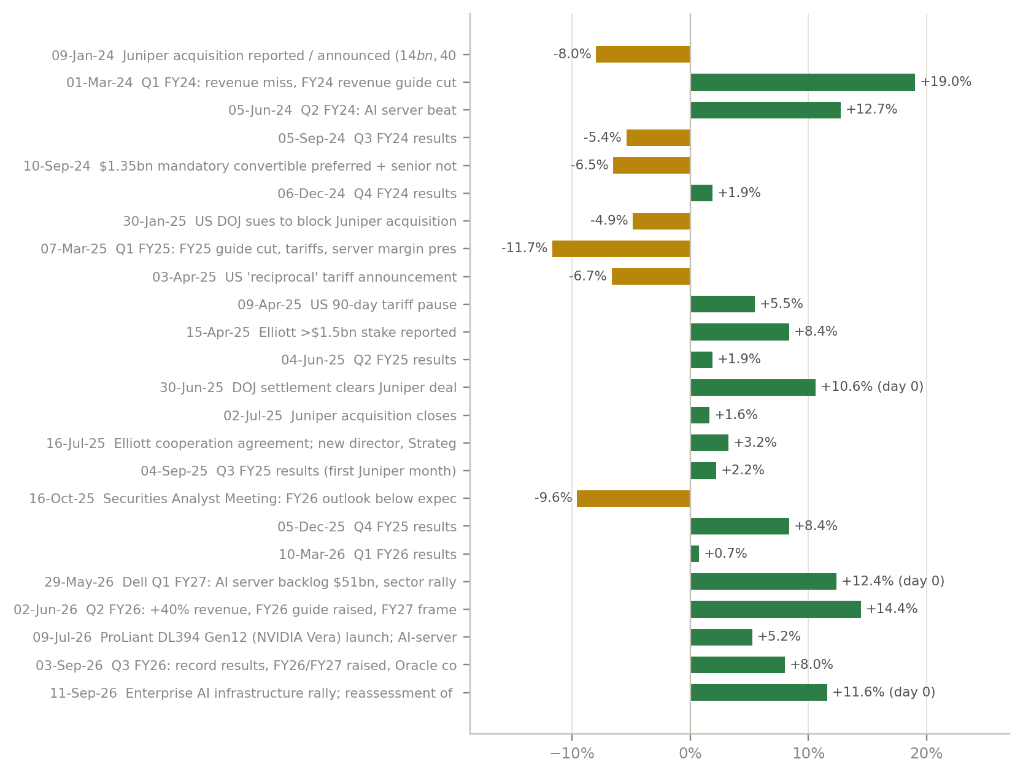
Earnings, not deals, move the stock; next test is 30-Sep
APPENDIX · MAJOR STOCK MOVES & CATALYSTS
UPCOMING CATALYSTS
■ 30-Sep-2026: Networking Investor Day
■ Early Dec-2026: Q4 FY26 results and full FY27 guidance
■ Ongoing: Oracle warrant milestones; Helios ramp
■ ~1-Sep-2027: mandatory preferred conversion
FILINGS & OWNERSHIP
■ 31 insider open-market sales ($49m, 12m), no purchases
■ Elliott raised stake 18% in Q2 (2.4%); board seat
■ Average earnings day-0 move 6.7% vs 1.6% on a normal day
Source: SEC 8-K filing dates; Yahoo Finance; news sources in report/source_log.csv; Bona Fide analysis.
25
Notes:
Appendix: major stock moves and catalysts
When to use: Questions about what moves the stock, or upcoming dates.
• What moves it: earnings and guidance, not deals. The average earnings-day move is 6.7%, against 1.6% on a normal day; the largest was +19.5% on the Q2 FY26 results.
• Catalysts: 30-Sep-2026 Networking Investor Day; early December Q4 FY26 and FY27 guidance; Oracle warrant milestones and the Helios ramp; ~1-Sep-2027 preferred conversion.
• Ownership: 31 insider open-market sales ($49m) and no purchases in 12 months, mostly at $24–30. Elliott raised its stake 18% in Q2 to 2.4% and holds a board seat.

Slide 26
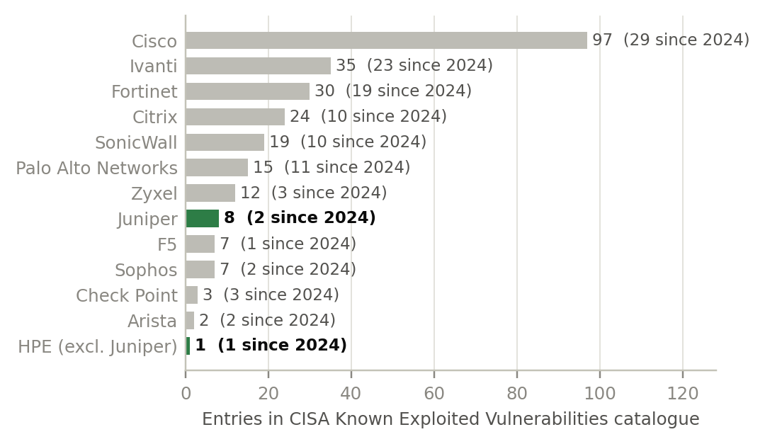
Juniper sign-off: governance, not unique hardware
APPENDIX · PRACTITIONER Q&A · QUESTION 1
Revised question: our data-centre SOP requires notifying designated personnel whenever Juniper equipment is installed. Does that imply Juniper devices have technical, security or compliance characteristics that other network equipment lacks?
SHORT ANSWER
CISA KNOWN EXPLOITED VULNERABILITIES, ENTRIES BY VENDOR
Not unique hardware. Junos OS and Juniper silicon are proprietary, but the devices do the same job as Cisco or Arista kit. A named step signals how the equipment is governed.
LIKELY REASONS THE SOP NAMES JUNIPER
■ Role: core routers (MX, PTX) and perimeter firewalls (SRX) have a large blast radius; any vendor’s would need change control.
■ Security history: unauthorised code in ScreenOS (2015), exploited J-Web flaws (2023), China-nexus backdoors on end-of-life MX routers (2025).
■ Speed: a live inventory lets security teams meet CISA deadlines: 3 weeks for CVE-2025-21590, 4 days for the 2023 J-Web flaws.
■ Cloud management: Mist-managed devices connect out to the Mist cloud (TCP 443/2200), so firewall and data reviews apply.
■ Ownership: HPE has owned Juniper since 2-Jul-2025; support contracts and supplier records are changing.
■ Not a legal ban: Juniper is not on the U.S. Covered List (Huawei, ZTE, Hytera, Hikvision, Dahua).
WHAT IT MEANS FOR HPE
■ Not an outlier: 8 entries, 8th of 13 vendors (Cisco 97). The risk is a new implant-style incident while HPE cross-sells Juniper.
■ Refresh driver: end-of-life routers were the target; replacing them is Networking revenue. Watch KEV additions and the 30-Sep Investor Day.
Source: CISA KEV catalogue 2026.09.11 (not normalised for installed base); Mandiant; Checkoway et al.; Juniper docs; DOJ; FCC. Report section 12.
26
Notes:
Appendix: Q&A 1, Juniper equipment and security
When to use: Questions about Juniper's security history or reputation.
• Why SOPs single out Juniper: mainly governance, not unique hardware. Core-router role, security history (ScreenOS 2015, J-Web 2023, backdoors on end-of-life MX routers in 2025), cloud management and the ownership change.
• Not an outlier: Juniper has 8 entries in CISA's Known Exploited Vulnerabilities catalogue, 8th of 13 vendors (Cisco 97).
• For HPE: the risk is event-driven (a new implant-style incident during cross-selling), and replacing end-of-life routers is also Networking revenue.

Slide 27
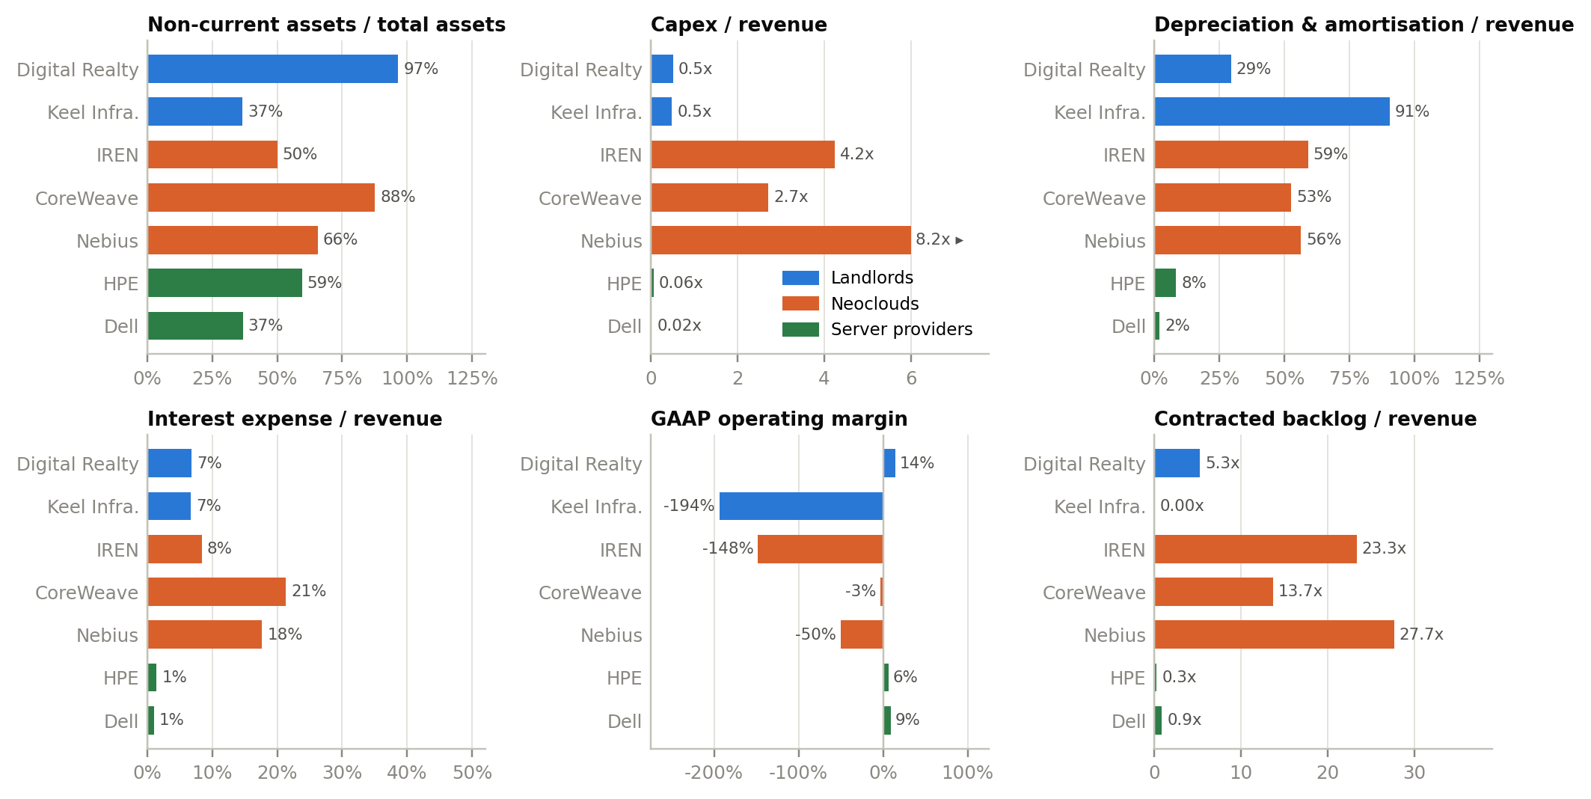
Three business models, three financial profiles
APPENDIX · PRACTITIONER Q&A · QUESTION 2 (1 OF 2)
Revised question: how do data-centre landlords, neoclouds and server providers differ financially, which gains most from AI spending, and should an investor own one model or several?
WHAT THE NUMBERS SAY
■ Landlords: property and leases are 62% of Digital Realty's assets; depreciation cuts a 44% EBITDA margin to 14%; revenue has not fallen year on year since 2018.
■ Neoclouds: capex 2.7–8.2x revenue; depreciation plus interest 67%–74% of revenue; backlog 14–28x revenue; free cash flow −435% to −127%.
■ Server providers: capex ≤0.06x revenue, operating margins 6%–9%, positive free cash flow, backlog under a year of revenue.
■ Phase shift: in a stylised 100 MW build, cash payback takes ~11.5 years for the landlord, ~3.2 for the neocloud (if GPUs stay contracted), two quarters for the server provider.
■ Useful life: CoreWeave's operating margin is −3% on a 6-year GPU life, −26% on 4 years.
Source: SEC XBRL; company 10-K, 10-Q, 20-F, 6-K and 8-K filings; Bona Fide analysis. TTM to Jun/Jul-2026. DLR operating income excludes real-estate gains; DLR backlog coverage estimated. Report section 12.
27
Notes:
Appendix: Q&A 2, three business models
When to use: Questions about landlords, neoclouds or how HPE compares.
• Landlords (Digital Realty): property and leases are 62% of assets; depreciation cuts a 44% EBITDA margin to 14%; revenue has not fallen year on year since 2018.
• Neoclouds: capex 2.7–8.2x revenue; depreciation plus interest 67–74% of revenue; backlog 14–28x revenue; deeply negative free cash flow.
• Server providers: capex at most 0.06x revenue; operating margins 6–9%; positive free cash flow; backlog under a year of revenue. CoreWeave's operating margin would be −26% on a 4-year GPU life instead of −3% on 6 years.

Slide 28
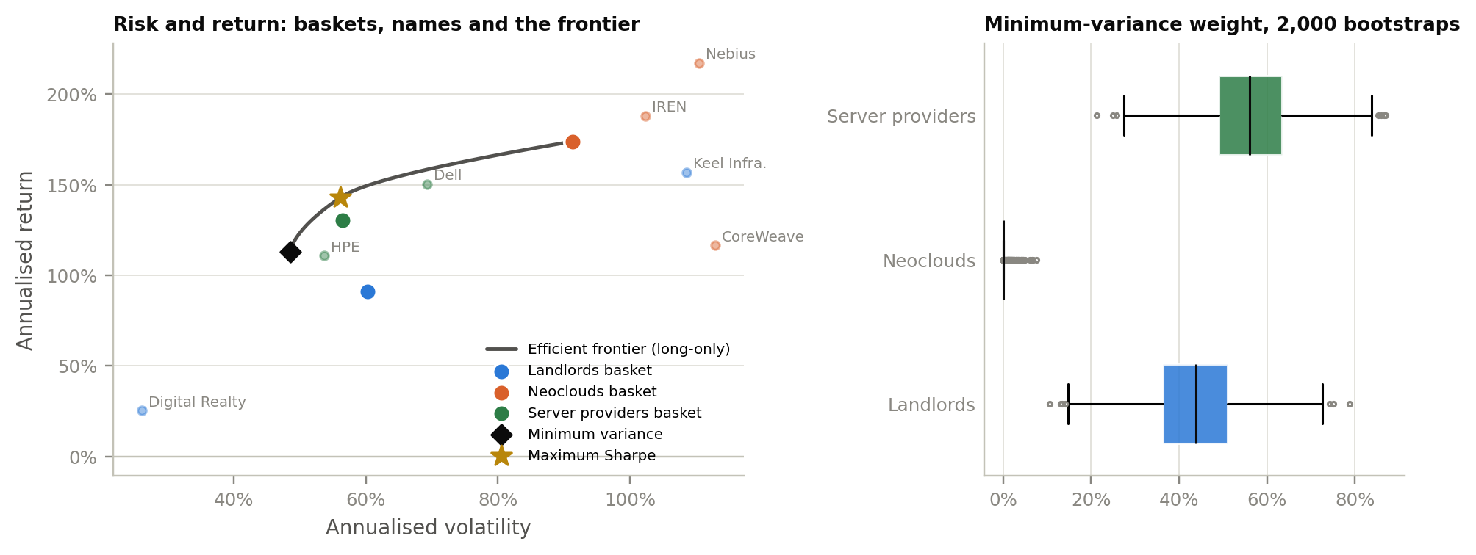
AI elasticity and the one-or-several question
APPENDIX · PRACTITIONER Q&A · QUESTION 2 (2 OF 2)
Answer: revenue is most elastic at server providers, share prices at neoclouds; a mix of models beats any single one, but the best pair depends on the objective.
WHICH IS MORE ELASTIC?
■ Revenue: server providers. Dell 0.84 and HPE 0.41 per point of hyperscaler capex growth, same quarter; Digital Realty 0.06, not significant.
■ Share price: neoclouds. AI beta 0.81–0.85 for Nebius and CoreWeave, against 0.02–0.18 for HPE and Dell.
ONE MODEL OR SEVERAL?
■ Pareto test: only the neocloud basket touches the frontier, at its riskiest end; landlord and server baskets sit below it.
■ Lowest risk: landlords 45% + servers 55%; neoclouds get no weight in 97% of 2,000 bootstraps.
■ Best Sharpe: servers 72% + neoclouds 28%; servers weighted in 98% of bootstraps.
■ Caveat: 17 months of AI-boom returns. Trust the covariance more than the averages.
Model | Revenue elasticity | AI beta | Market beta | Per +10bp yield
Landlords | DLR 0.06 (n.s.) | 0.03–0.31 | 0.7–2.9 | DLR −0.6%
Neoclouds | too new | 0.40–0.85 | 2.5–2.9 | n.s.
Server providers | 0.41–0.84 | 0.02–0.18 | 1.7–2.0 | n.s.
Source: SEC XBRL; Yahoo Finance; FRED; Bona Fide analysis (code/business_model_analysis.py). Daily returns 31-Mar-2025 to 11-Sep-2026; revenue elasticity 2018Q2–2026Q2. Report section 12.
28
Notes:
Appendix: Q&A 2, AI elasticity and portfolio mix
When to use: Questions about which layer benefits most from AI, or whether to own several.
• Revenue elasticity is highest at server providers (Dell 0.84, HPE 0.41). Share-price AI beta is highest at neoclouds (0.81–0.85 at Nebius and CoreWeave).
• Only the neocloud basket touches the efficient frontier, and only at its riskiest end. The lowest-risk mix was landlords 45% plus servers 55%; neoclouds got no weight in 97% of bootstraps.
• Best Sharpe: servers 72% plus neoclouds 28%. This rests on 17 months of AI-boom returns, so trust the covariance more than the averages.

