Slide 1
Quantitative Data Analysis
Lab 1
2/10/2026

Slide 2
Tutor contact details
Dr Plamena Panayotova
plamena.panayotova@glasgow.ac.uk

Slide 3
Labs (suggested) structure
Each lab session lasts 1.5 hours:
  Part 1 (ca. 55 mins) – Exercises in R Studio
  Break (5 mins)
  Part 2 (ca. 30 mins) – Working towards your project

Slide 4
Part 1
Link on Moodle >> Tutorials >> Tutorial exercises
Cumulative structure – it’s fine if you don’t finish the exercises by the end of the first hour; however, make sure that you complete them before the next session.
You may work independently or in groups.
Think about (and discuss with your peers) what each line of code does and what the output means.

Slide 5
Part 1 - Tutorial exercises
Lab 1: Reading in our data
Lab 2: Descriptive Statistics
Lab 3: Data Visualisation - Numeric variables
Lab 4: Data Visualisation - Numeric and Factor variables
Lab 5: Inference - the t-test
Lab 6: Inference - ANOVA and Correlation
Lab 7: Model Building
Lab 8: Diagnostics I
Lab 9 and 10: Diagnostics II

Slide 6
Part 2 – Working towards your project
Workshop 1: Your research question and variables
Workshop 2: Identifying possible datasets
Workshop 3: Getting your data and reading it into R
Workshop 4: Data Cleaning
Workshop 5: Exploring the Dependent Variable and Research Question
Workshop 6: Selecting an appropriate inferential test
Workshop 7: Creating a Model Building strategy
Workshop 8: Diagnostic testing
Workshop 9: A Robust, Final Model
Workshop 10: Working on Summative Assignment

Slide 7
Questions?

Slide 8
Lab 1 – Part 1
Open the Lab Tutorial exercises file via the link on Moodle.
Download R and RStudio (if you haven’t already) and open R Studio.
Set up an R Project
  Keeps all you files and datasets together and makes it easy and quick to access them.
Download the AirBnB data (listings_edinburgh.csv).
Open an R markdown and get familiar with its structure.
Work through the exercises listed under Tutorial 1.

Slide 9
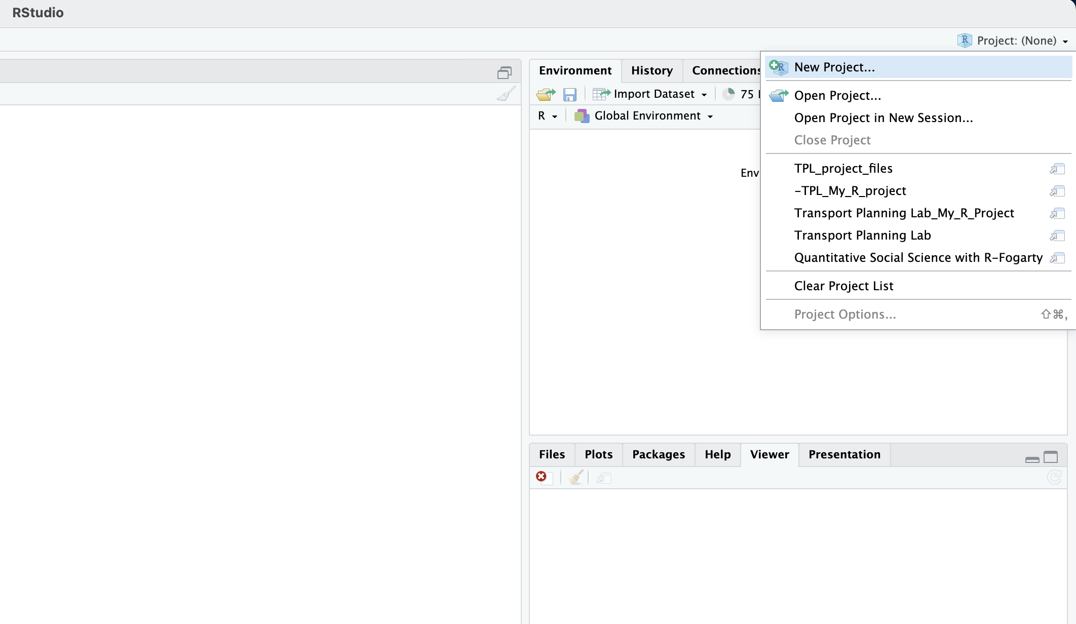
Setting up an R project

Slide 10
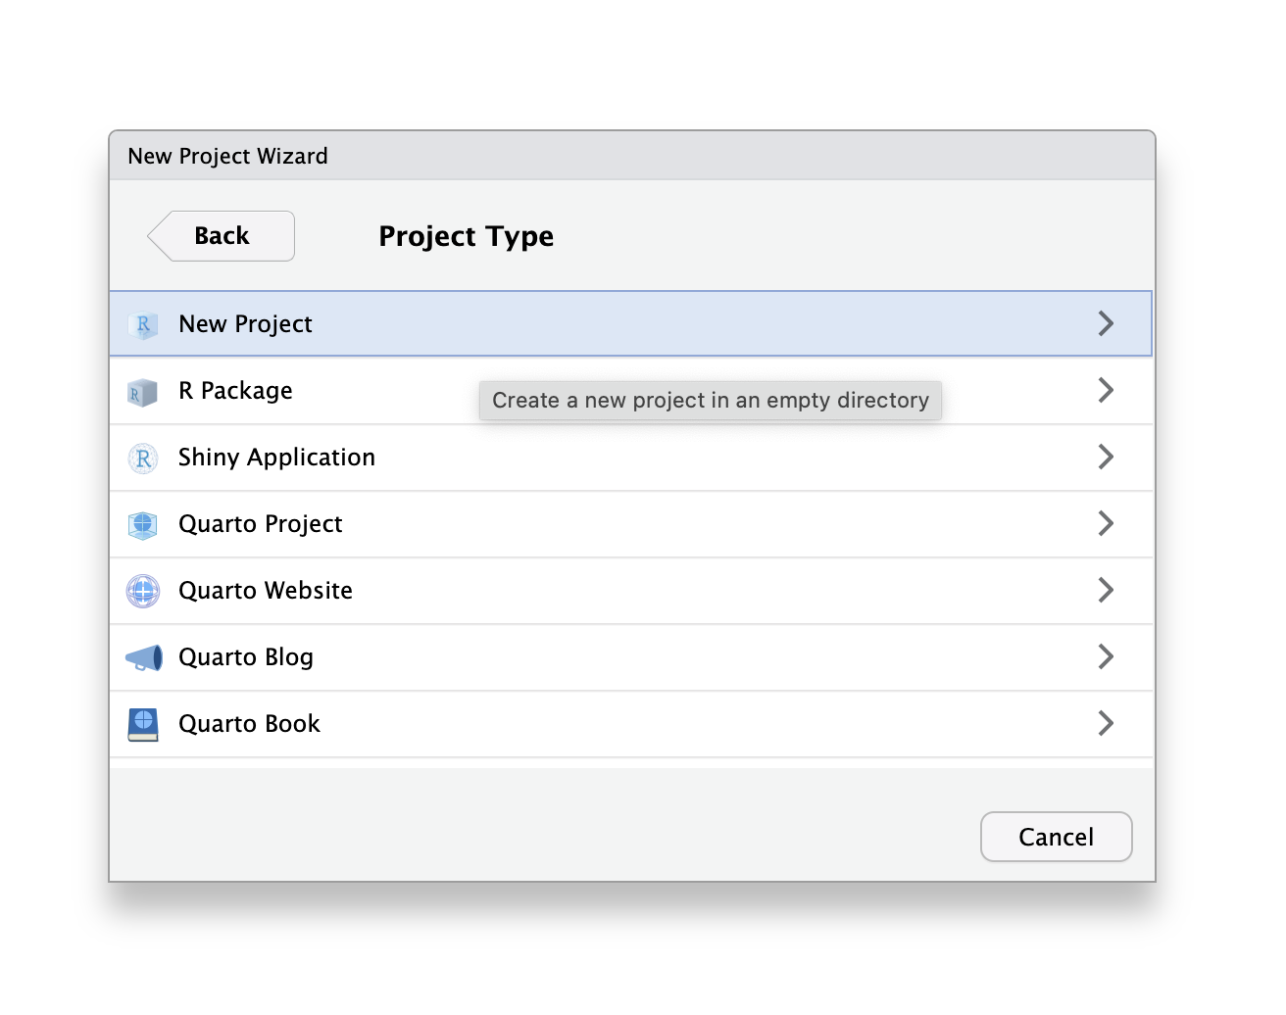
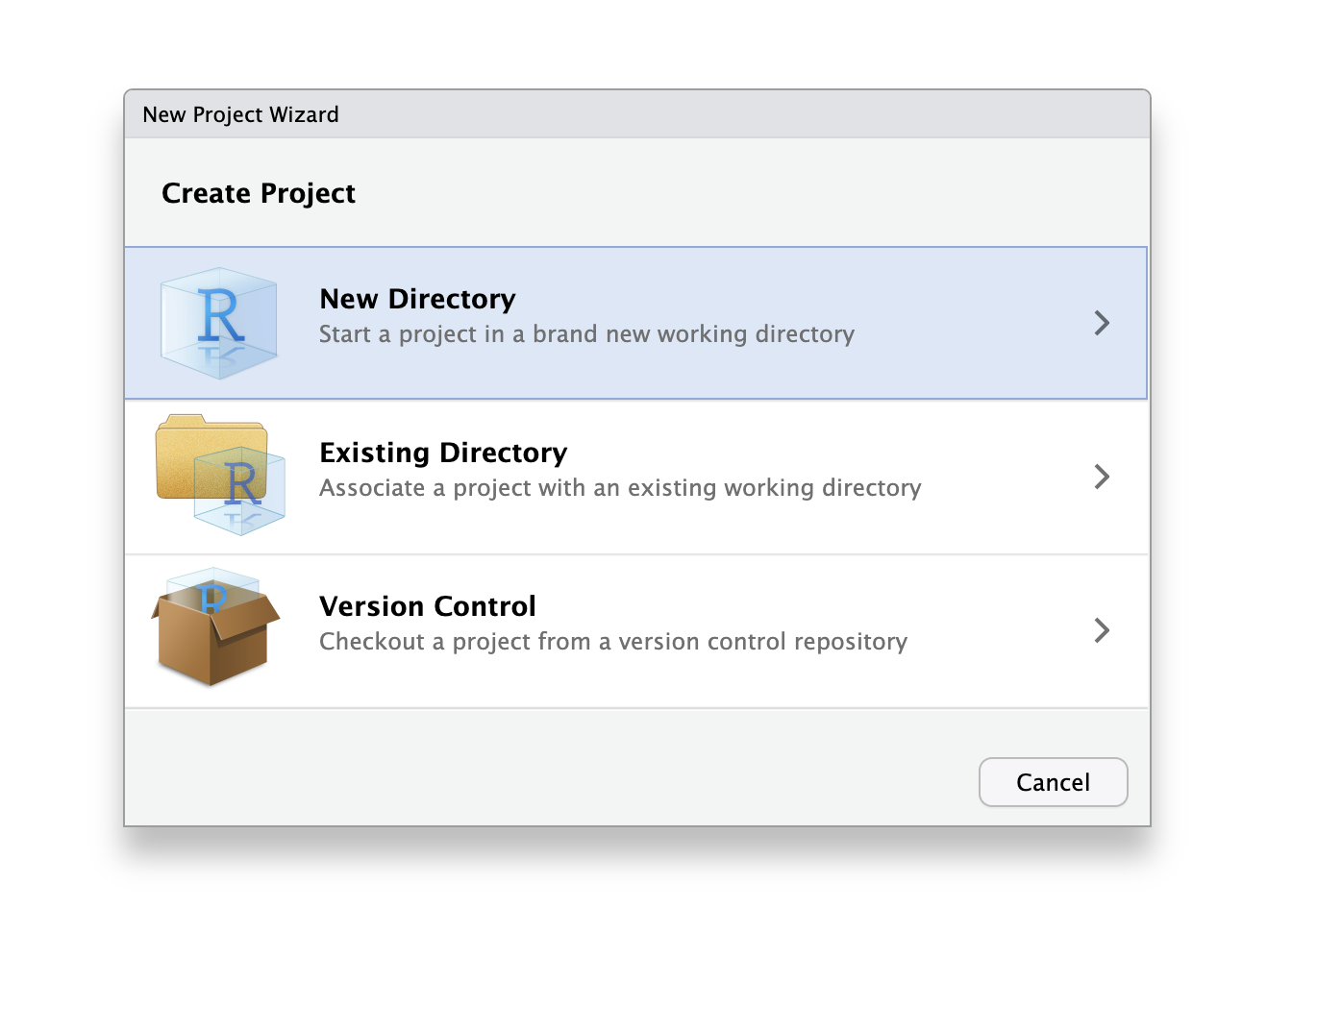
Setting up an R project

Slide 11
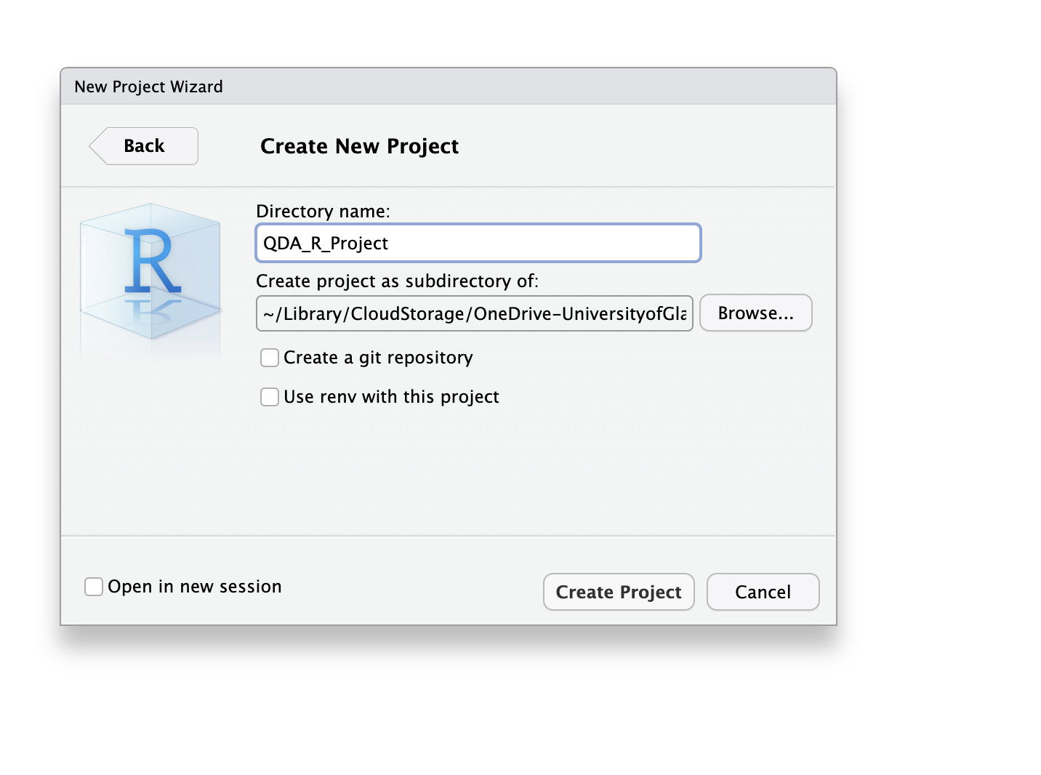
Setting up an R project
1. Choose a simple and clear name for the project
2. Choose a folder where you’d like the R project to appear; R will create a new subfolder inside. This subfolder will host the newly created R project.
3. Select “Create Project”

Slide 12
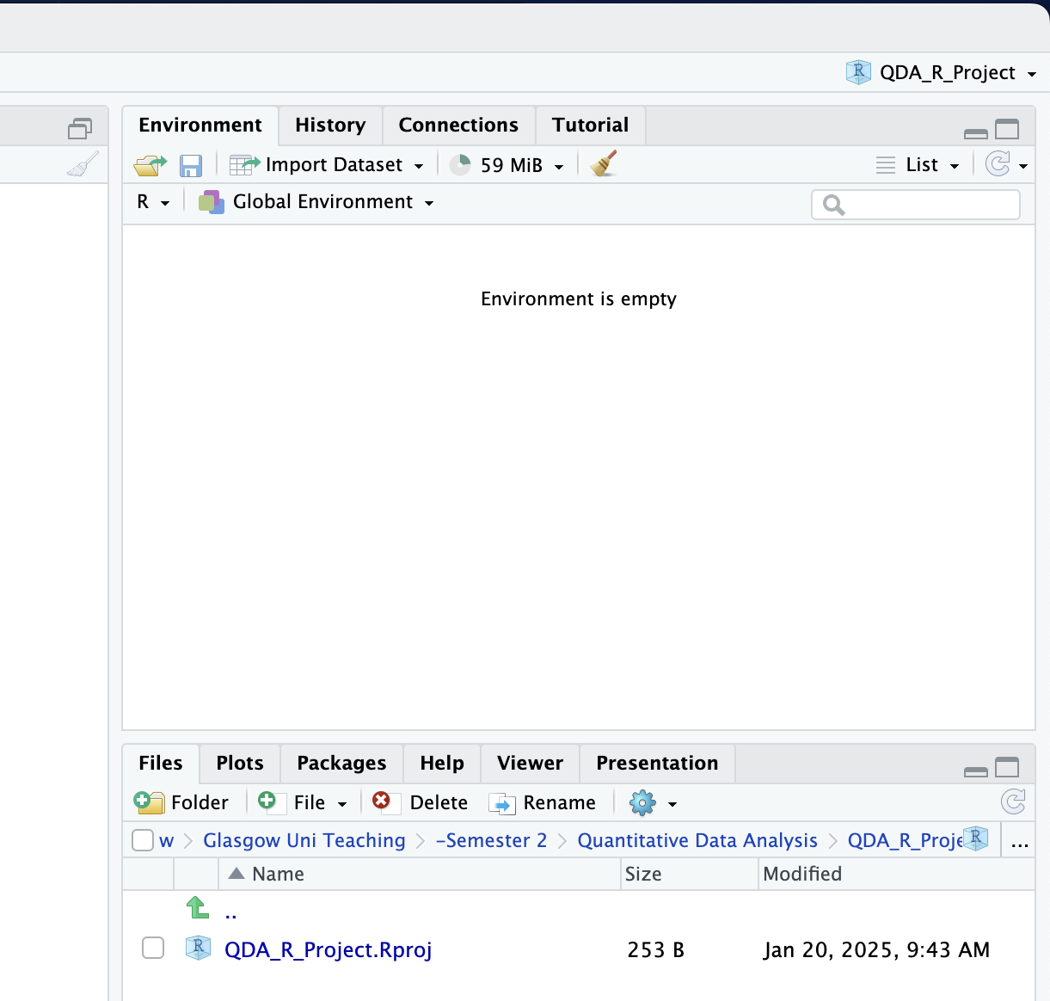
Setting up an R project

Slide 13
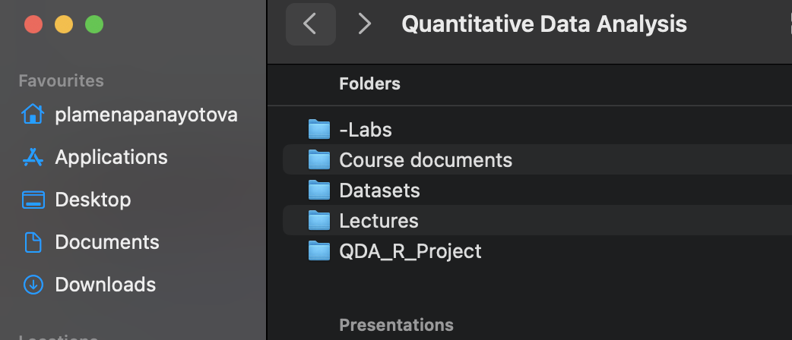
Setting up an R project

Slide 14
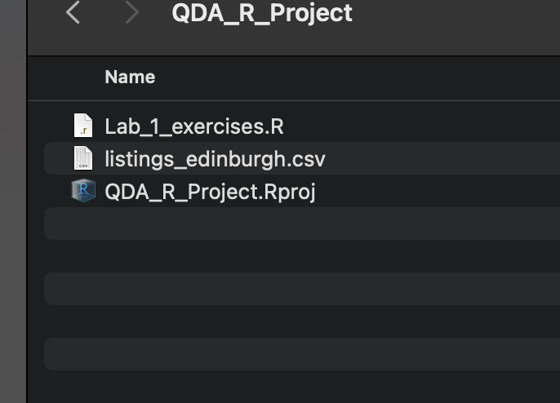
Download the AirBnB data from Moodle
Once the R project is set up, go to Moodle >> Tutorials >> Data for Tutorials.
Download the AirBnB dataset and transfer the file to your R Project folder.

Slide 15
R Markdown
What is R Markdown?
  A document format that lets you combine text, code, and results (output) in one place.
  Perfect for reports, assignments, and reproducible analysis.

Slide 16
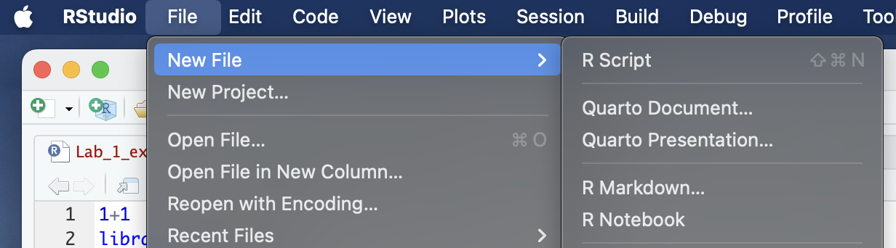
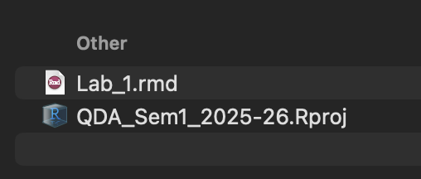
Open an R Markdown document
In R Studio: File -> New File -> R Markdown

Slide 17
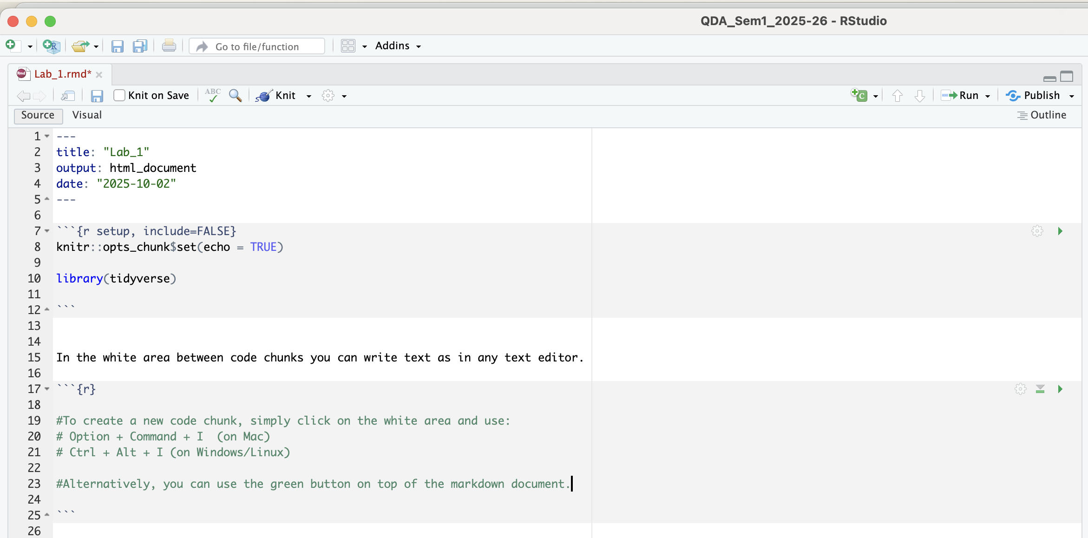
R Markdown
YAML header (document settings)

Slide 18
R Markdown
Chunks of R code
In code chunks, use # to write comments.

Slide 19
R Markdown
Chunks of R code
In code chunks, use # to write comments.

Slide 20
R Markdown
White area for plain text.

Slide 21
R Markdown cheatsheet
In your search engine type “r markdown cheatsheet pdf” which should take you to the following pdf document:

Slide 22
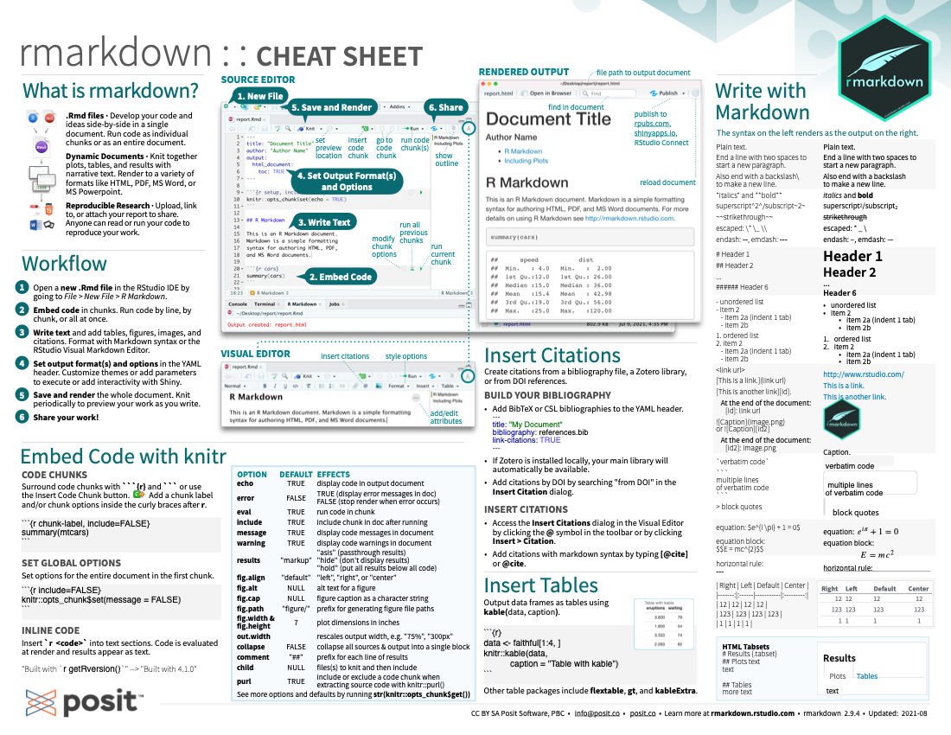

Slide 23
Part 1 – Tutorial exercises
Install the package “tidyverse” (use the console for this).
Load the “tidyverse” package using library(tidyverse) – do this in the markdown.
Assign the AirBnB data to an object and read it in using the read_csv() function. In the brackets, type in the name of the object to which you assigned the data.
Examine the data using glimpse(). What’s in the rows and what is in the columns?
Convert the room_type variable into a factor variable – use the mutate function. Why do we do this?
Check the levels of the variable using levels() function.
Create a frequency table using using table() function.

Slide 24
Part 2 – Working towards your project
In pairs:
  Define a research question – something that interests you, aligns with your PhD/Masters research and can be answered empirically.
  Identify a numeric (continuous) dependent variable (DV).
  Identify suitable independent variables (including control variables).
If any of the terminology is unclear, discuss with your peers/tutor.

