Slide 1
Quantitative Data Analysis Lab 3
16/10/2026

Slide 2
Checklist!
Have you set up an R project and do you know where to find it?
Have you downloaded the AirBnB data and added it to the R project folder?
Have you completed all exercises from Labs 1 and 2 in an R Markdown document (or two separate R Markdown documents)?
  Any questions?
Have you made progress finding a dataset for your projects?

Slide 3
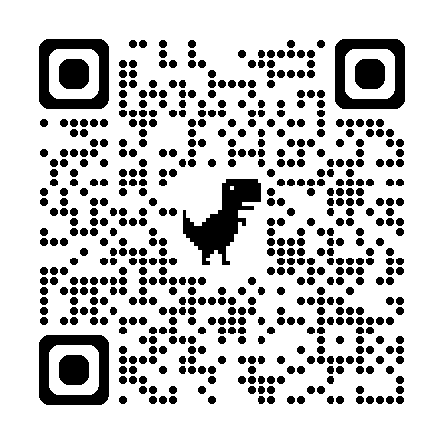
Part 1 – Basic data visualisation
We’ll be using a package called ggplot2.
ggplot2 cheat sheet via QR code

Slide 4
Part 1 – Basic data visualisation
Use David’ lecture notes to help you solve the following exercises:
  Make sure that the variables price, room_type and review_scores_rating are in the appropriate format (code from Labs 1 and 2).
  Make a histogram of the price variable. Ensure that the scales make sense and that you label it accordingly.
  Make a density plot of price showing how the price varies by room_type. Ensure that the scales make sense and that you label the chart accordingly.
  Make a histogram or a density plot of review_scores_rating.

Slide 5
Part 2 – Working towards your project
If you have it, write down:
  your project title;
  your research question;
  the dataset you’ve chosen;
  the variables you’ve chosen (DV (numeric!) and IVs).
If you have chosen a dataset:
  Create a new R project. Download the dataset and add it to the project folder.
  Read the data onto R.

