Slide 1
Code Like a Pro:
Observations on Expert ML Code
COMP150FP Final Project
(and Master's Project)
Zhe Lu
6 December 2013

Slide 2


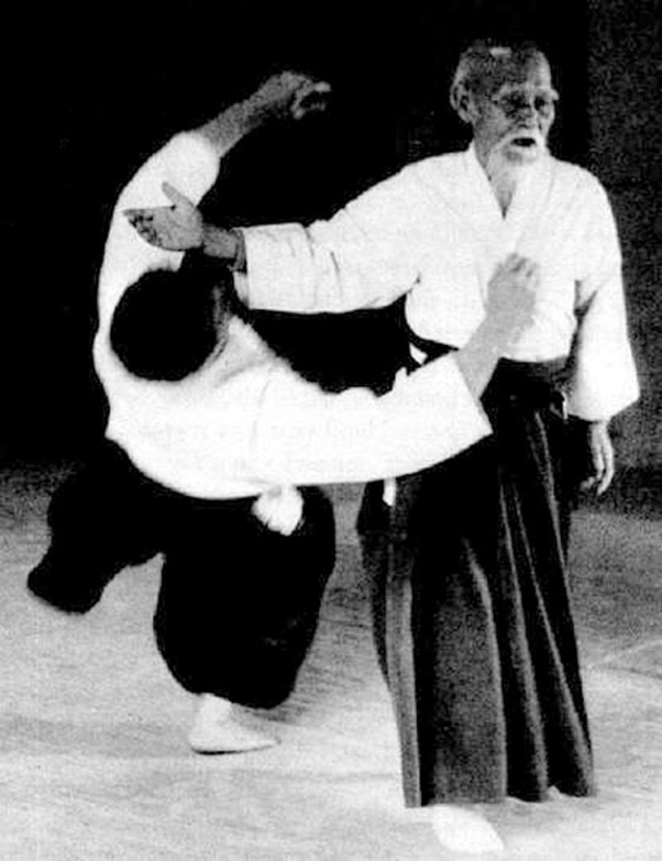
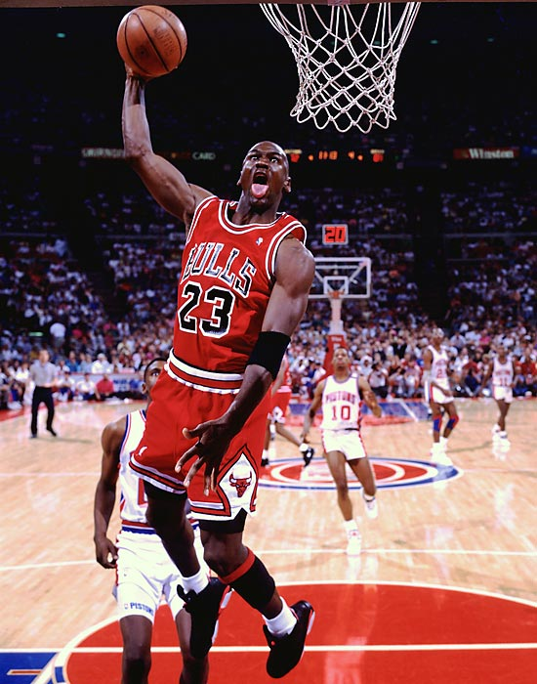

Becoming an Expert
Novice
Expert
PRACTICE

Slide 3


What About Programming in ML?
?
Novice
Expert

Slide 4
What Does Expert Code Look Like?
Employ software metrics
Look at source code

Slide 5
Software Metrics
Measuring stuff about software
Frequently used to track progress of projects
Could measure, for example:
  Lines of code
  Number of bugs
  Level of effort
  Etc.
Loved by managers, hated by developers?

Slide 6
Source Code Analysis
Take source code or artifacts derived from source code
Convert to some representation (AST)
Perform analysis
Has been used for:
  Debugging and fault location
  Software reliability engineering
  Visualization
  Cloned code detection

Slide 7
Examples of Expert Code
SML/NJ compiler
  299 parseable files, 81102 lines
ML Kit compiler
  2286 parseable files, 530334 lines
Foxnet implementation of TCP/IP stack
  74 parseable files, 8545 lines
Til, a type-direct ML compiler
  615 parseable files, 222317 lines
MLton, optimizing, whole-program compiler
  853 parseable files, 168323 lines

Slide 8
Features We Measured
Style
Use of Syntactic Forms

Slide 9
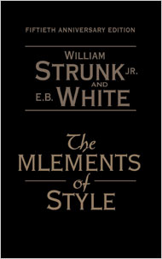
What Is Good Style?
We found some style guides on the internet...
  Cornell
  CMU
  MLton

Slide 10
What's Wrong With This Code?
datatype exp =
…
and dec = ValDec of (vb list * tyvar list)
| ValrecDec of (rvb list * tyvar list)
| FunDec of (fb list * tyvar list)
...
“Emphasize structure with white space.”
:set tabstop = 8
datatype exp =
…
and dec = ValDec of (vb list * tyvar list)
| ValrecDec of (rvb list * tyvar list)
| FunDec of (fb list * tyvar list)
...
3 of 3 style guides suggest spaces instead of tabs.

Slide 11

Tabs vs Spaces: No Consensus
Project | Fraction of Lines with Tabs | Lines per Violation
SML/NJ | 0.28 | 3.51
MLKit | 0.35 | 2.87
Foxnet | 0.33 | 2.99
Til | 0.35 | 2.83
MLton | 0 | ------
Spaces!
Everyone is principled, but not in the same way.
MLton puts money where mouth is
Tabs!
PRO TIP: You should probably use spaces. But it's more important to pick one and be consistent.

Slide 12
What's Wrong With This Code?
fun getStrs (STR { sign = SIG{elements,...}, rlzn = {entities,...}, access,prim,...}) =
List.mapPartial
(fn (sym,STRspec{sign,slot,def,entVar}) =>
SOME(STR{sign = sign,
rlzn = EE.lookStrEnt(entities,entVar),
access = A.selAcc(access, slot),
prim = POI.selStrPrimId (prim, slot)})
| _ => NONE)
elements
| getStrs ERRORstr = nil
| getStrs _ = bug "getStrs"
12345678901234567890123456789012345678901234567890123456789012345678901234567890
“Many text editors are set to soft-wrap or truncate at 80 characters, so violating this limit will make your code render badly. 80 character lines is a long-standing UNIX convention, so following it will make your program substantially easier to manipulate with the body of UNIX utilities.”

Slide 13
80-Column Rule Is Somewhat Ignored
Project | Fraction of “Wide” Lines | Lines per Violation
SML/NJ | 0.0043 | 231.7
MLKit | 0.034 | 29.2
Foxnet | 0.0036 | 275.6
Til | 0.0062 | 161.1
MLton | 0.019 | 53.4
At least people are trying?
80 columns may be harder to enforce
PRO TIP: Do your best, but you need to check yourself often.

Slide 14
What's Wrong With This Code?
fun isFlt t =
if unboxedfloat then (case t of FLTt => true | _ => false)
else false
This is probably better:
fun isFlt t =
unboxedfloat
andalso (case t of FLTt => true | _ => false)
Worst offender:
fun tcflt tc = if LT.tc_eqv(tc, tc_real) then true else false

Slide 15
If Style
if <expression> then <boolean> else <expression>
if <expression> then <expression> else <boolean>
if not <expression> then
<expression>
else <expression>
Rewrite by reordering and using not, orelse, andalso

Slide 16
If Style Violations Are Rare
Project | If Violations | Lines per Violation
SML/NJ | 25 | 3244.1
MLKit | 182 | 2913.9
Foxnet | 0 | ---------
Til | 149 | 1492.1
MLton | 72 | 2337.8
Rewrite opportunities of if statements are very rare.
Experts are very good at adhering to good style.
Sometimes, rewrites don't even help much:
if e then true else (<side-effects>; false)
e orelse (<side-effects>; false)
PRO TIP: Experts avoid unnecessary if expressions. You should, too.

Slide 17
What's Wrong With This Code?
fun wc [] = % L "N"
| wc ((a, b, c, d, e) :: r) =
"C" $ [w a, w b, w c, w d, w e, wc r]
This is probably better:
fun wc = List.foldr
(fn ((a, b, c, d, e), acc) =>
"C" $ [w a, w b, w c, w d, w e, acc])
(% L “N”)

Slide 18
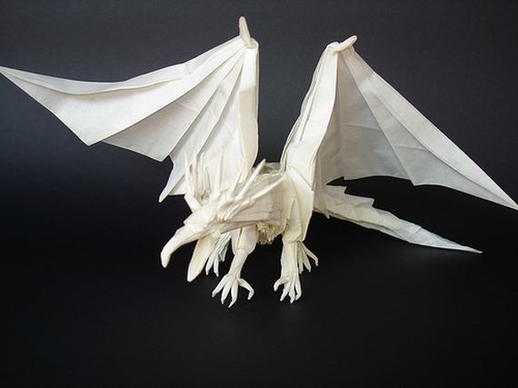
Finding Folds
“Programs written in terms of higher-order recursion schemes like foldr ... can benefit from program optimizations like shortcut fusion.”
I eat explicit recursion for breakfast!
cons cell
fun f v1 v2 ... vi (x :: xs) ... vn =
...
f e1 e2 ... ei xs ... en ...
(x :: xs)
xs
tail / cdr of cons cell
| f v1 v2 ... vi [] ... vn = ...
| f v1 v2 ... vi _ ... vn = ...

Slide 19
Folds Are Hard(er)
Project | Missed Folds | Lines per Violation
SML/NJ | 75 | 1081.4
MLKit | 1470 | 360.8
Foxnet | 10 | 854.5
Til | 751 | 296.0
MLton | 202 | 833.3
Fold opportunities are harder to identify than chances to rewrite if
Still somewhat infrequent
PRO TIP: Rewrite explicit recursion on lists with fold. (I'll try to convince you again later.)

Slide 20
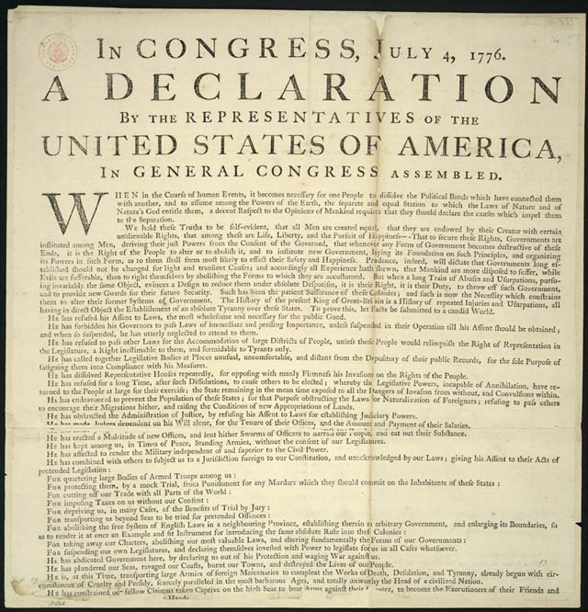
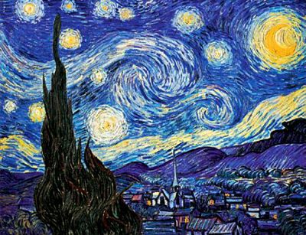
Syntax
Expressions
Declarations

Slide 21
Do Experts Use Imperative Features?
While loops
while <expression> do <expression>
Expression lists
(<expression>; <expression>; ... ; <expression>)

Slide 22
Whiles Are Uncommon.
Expression Are Lists Common.
Project | Whiles | Lines per While | Expression Lists | Lines per Instance
SML/NJ | 0 | ------- | 1970 | 41.2
MLKit | 18 | 29463 | 7900 | 67.1
Foxnet | 0 | ------- | 77 | 111.0
Til | 104 | 2137.7 | 4414 | 50.4
MLton | 20 | 8416.2 | 1907 | 88.3
All while loops except 2 in Til occur in tests / benchmarks
Whiles are rare
Expression lists are common
  Used mostly for I/O
PRO TIP: Avoid while loops. It's OK to use expression lists to perform I/O.

Slide 23
Library Functions
List
^
Not all projects use the same libraries
But it's hard to program in ML without using lists
:: | @ | all | app | drop
exists | filter | find | foldl / foldr | getItem
hd | last | length | map | mapPartial
nth | null | partition | rev | revAppend
tabulate | take | tl

Slide 24
Calling on the List Library
Project | Library Calls | Lines per Call
SML/NJ | 2904 | 27.9
MLKit | 21812 | 24.3
Foxnet | 213 | 40.1
Til | 7832 | 28.4
MLton | 4163 | 40.4
List library functions are used often and with about the same frequency
PRO TIP: Use library functions, especially from the List library.

Slide 25
Top of the List
Top library functions (>5% of all calls)
SML/NJ | MLKit | Foxnet | Til | MLton
:: | :: | :: | :: | ::
map | map | map | map | map
app | app | @ | exists | length
@ | fold(l/r) | fold(l/r) | tl | rev
fold(l/r) | length | rev | @ | @
length | @ |  | app | app
 |  |  | length
 |  |  | hd
PRO TIP: Look for opportunities to use map, app, and folds
BONUS TIP: Use pattern matching instead of hd and tl.

Slide 26
Modules
ML module system
  Signatures
  Structures
  Functors
How many files contain module declarations at top level?

Slide 27
Modules at Top Level
Project | Only Module | Fraction | Has Module | Fraction
SML/NJ | 297 | 0.99 | 297 | 0.99
MLKit | 1442 | 0.63 | 1590 | 0.70
Foxnet | 29 | 0.39 | 31 | 0.42
Til | 466 | 0.76 | 477 | 0.78
MLton | 484 | 0.57 | 576 | 0.68
In most projects, >2/3 of all files contain a signature, structure, or functor at top level.
Almost as many have only signature, structure, or functors at top level.
PRO TIP: Use the module system, especially when your project gets large.
“Otherwise, you get no abstraction” – NR

Slide 28
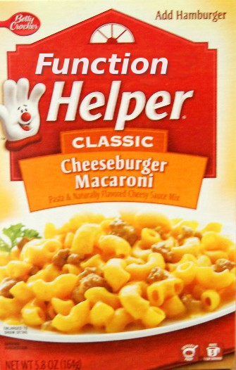
Helper Functions
Allow code reuse
Name complicated lambda expressions
Too hard to find all helper functions
How about functions inside of local declarations and let expressions?

Slide 29
Functions in Local and Let
Project | “Helper Functions” | Functions | Fraction “Helper”
SML/NJ | 2884 | 4866 | 0.58
MLKit | 18883 | 28267 | 0.67
Foxnet | 122 | 532 | 0.23
Til | 10804 | 15455 | 0.70
MLton | 3556 | 10842 | 0.33
In most projects, 1/3 to 2/3 of all functions are declared inside let or local
These are likely to be helper functions
PRO TIP: Make heavy use of helper functions.

Slide 30
Pro Tip Summary
Tabs vs Spaces: Pick one and be consistent.
Try to stick to 80 columns and check often.
Rewrite if expression if it has a boolean literal
Use folds
Avoid while, but expression lists are OK for I/O
Make heavy use of library functions
Modularize your code, especially if you have lots
Make frequent use of helper functions

Slide 31
Contributions
Identified features of expert ML code based not on what experts said but what they wrote
Compiled a short list of tips for novice coders in ML
Created a set of tools to evaluate how well code performs on the selected features (lots of opportunities for future work here!)

Slide 32
Acknowledgments
Norman for advance, guidance, and leading by example
COMP150FP for an excellent class
All of you for listening

Slide 33
Questions?

