Slide 1

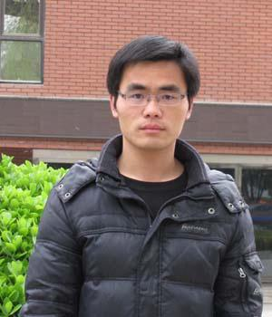



Flaky Test Detection in Android via Event Order Exploration
Zhen Dong Abhishek Tiwari Xiao Liang Yu Abhik Roychoudhury
Notes:
Hello everyone, I am Zhen Dong from National University of Singapore. I am gonna present our work “Flaky Test Detection in Android via Event Order Exploration”. This is a joint work with Abhishek Tiwari, XiaoLiang Yu, Abhik Roychoudhury.

Slide 2
Flaky Tests
A test is considered flaky if it non-deterministically passes or fails when running on the same version of code[1]
[1] J. Bell, O. Legunsen, M. Hilton, L. Eloussi, T. Yung, and D. Marinov. 2018. DeFlaker: Automatically Detecting Flaky Tests. In 2018 IEEE/ACM 40th International Conference on Software Engineering (ICSE)
Notes:
Flaky tests：
A test is considered flaky if it passes or fails non-deterministically when running on the same version of code.

Slide 3
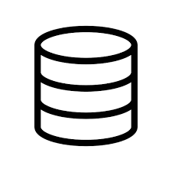


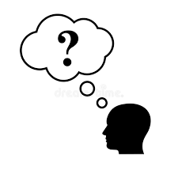
Problems with Flaky Tests
Reducing developer’ trust in test results
Waste developer’s time on debugging nonexistent fault in code
Regression
bugs?
Make changes to code
Run tests
Notes:
The problem with flaky tests is that they reduce developer’s trust in test results. Image a developer makes change to code and runs tests and finds some test failed. The developer considers a regression bug is found. After investigation, it might show it is a flaky test not a bug. This reduces developer’s trust in test results. At the same time, it also wastes developer’s time on debugging nonexistent fault in code.

Slide 4
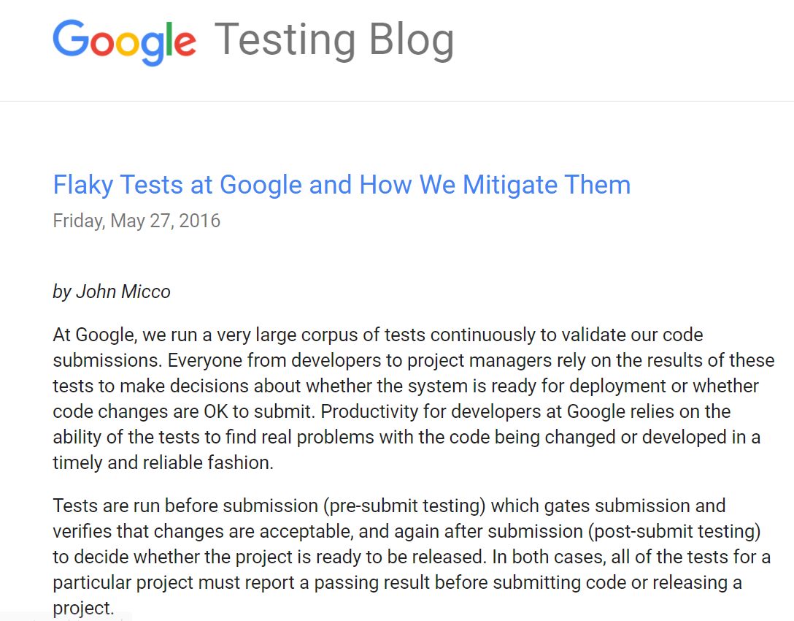

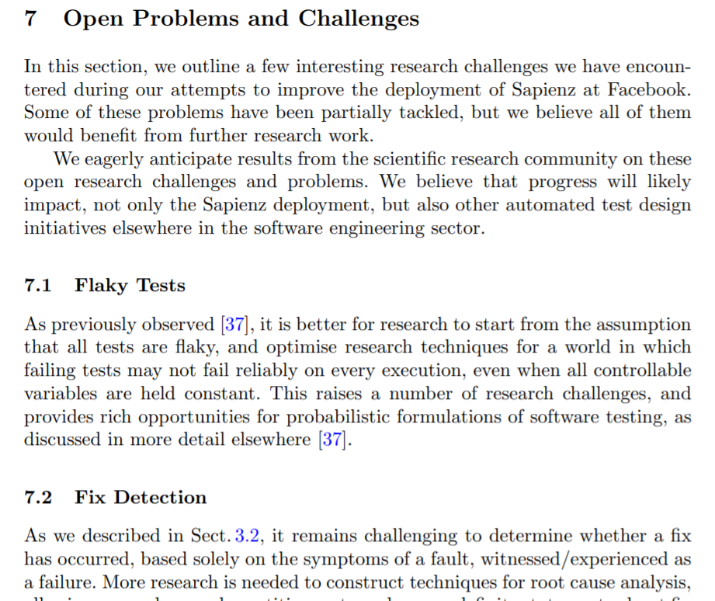
Flaky Tests—A Real World War
1.5% of test results are flaky
Assume All Tests Are Flaky
16% of our tests have some level of flakiness
Notes:
Flaky tests have been reported as a serious problem in software development. Google testing reports 1.5% of test results are flaky and 16% of their tests have some level of flakiness. Facebook research also identifies flaky tests as a major research challenge and assumes all tests are flaky.

Slide 5
Detecting Concurrency-Related Flaky Tests in Android Apps
Concurrency-related flaky tests are the most common flaky tests in Android
%
%
[1] Alan Romano, Zihe Song, Sampath Grandhi, Wei Yang, and Weihang Wang. 2021. An Empirical Analysis of UI-based Flaky Tests. In IEEE/ACM International Conference on Software Engineering
[2] Swapna Thorve, Chandani Sreshtha, and Na Meng. 2018. An Empirical Study of Flaky Tests in Android Apps. In International Conference on Software Maintenance and Evolution (ICSME).
Notes:
Recent studies show concurrency-related flaky tests are the most common flaky tests in Android apps. In this work, we focus on detecting this category of flaky tests, concurrency-related flaky tests.

Slide 6
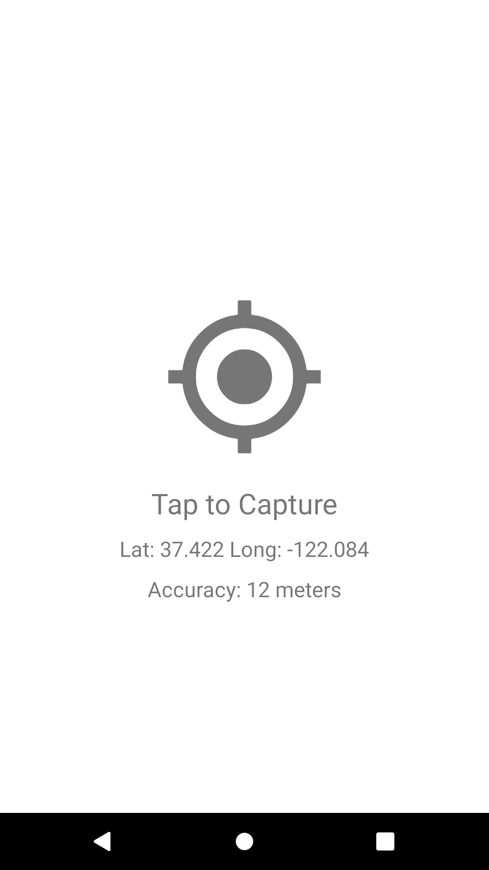
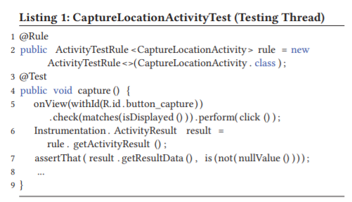
An Example Flaky Test in Android Apps
Clicking button
Checking results
Passes in some runs and fails in others
RapidPro Surveyor
Notes:
Let’s have a look at an example flaky test in Android. This test checks if the app is able to get location data of the device. The test first clicks a button on the activity to fetch the location data and then checks the returned data. This test is simple. But it is a flaky test. It passes in some runs and fails in others.

Slide 7
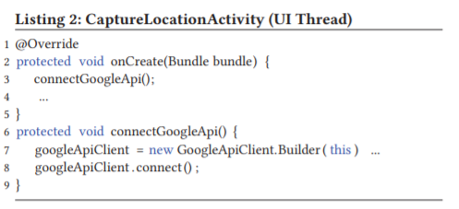
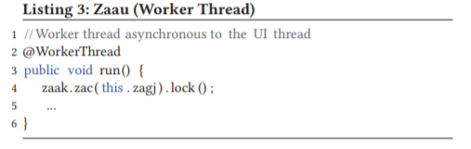
An Example Flaky Test in Android Apps
Pass
Calling the handler
Clicking button
Updating
results
Launching
an async task
Checking results
Returning results
Notes:
The test passes when it is executed in the following. The test clicks the button and the corresponding event handler is executed in UI thread. The handler launches an async task on a background thread to fetch GPS data. Then the background gets GPS data and returns to the UI thread and UI thread updates the results to GUI. Then test checks the returned results. Then the test passes.

Slide 8

An Example Flaky Test in Android Apps
Fail
Calling the handler
Clicking button
Launching
an async task
Checking results
Taking longer to get results
Notes:
However, for some run, the background thread may take longer time to get GPS data. The test checks results on the GUI before the data is updated. Then test fails.

Slide 9
Android Event-Driven Concurrency Model
Insight: Non-deterministic Execution of Async Events Causes Flaky Tests
Testing framework
Main thread
Thread pool
Async events
Testing
thread
UI thread
Async
thread
UI
automation
Looper
Async
thread
Pass
Event
queue
e₇
e₅
Pass
e₄
e₁
e₆
e₃
e₂
Async event
Fail
Enqueue
Possible event execution orders of a test
Notes:
Our investigation shows that a major root cause of flaky tests in Android is non-deterministic execution of async events. In Android, tests are executed in a separated thread that creates events, called testing thread. The UI threads process generated events. To be responsive, the UI thread offloads long-running tasks to background threads such as network access. When background threads complete tasks and post an async event to update results. This causes event race. Different runs may have different event execution orders. For some event order, the test may fail.

Slide 10
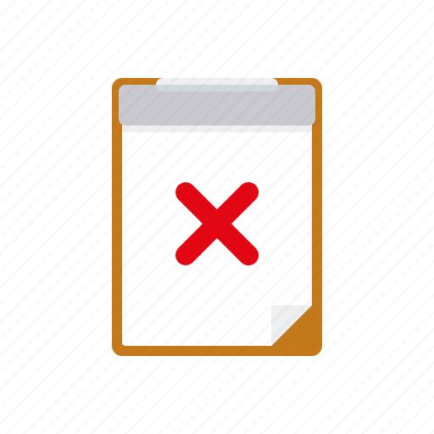
Idea: Detecting Flaky Tests by Exercising Different Event Execution Orders
A passing test
Witnessing a failing run
Flaky test
Exploring possible event orders
Notes:
Based on this insight, we propose to detect flaky tests by exercising possible event execution orders. Given a passing test, we explore possible event orders in the test run. If a failing run is witnessed, then we consider the test is a flaky test.

Slide 11
Exploring Possible Event Execution Orders by Scheduling Async Events
Identify schedule space for an async event
Scheduling an async event
Notes:
We explore possible event execution orders by schedule async events. It mainly consist of two steps: first identifying schedule space for an async event and then schedule an async event.

Slide 12
Identifying Schedule Space of An Async Event
Localizing its lower bound event
the latest event that the async event can not be executed earlier than.
Localizing its upper bound event
the earlier event that the async event cannot be executed later than.
Schedule space is between the bound event and upper event
Notes:
The idea of identifying schedule space of an async event is to localize its lower bound event and its upper bound event. The lower bound event is the latest event that the async event can not be executed earlier than. The upper bound event is the earlier event that the async event cannot be executed later than. So, the schedule space is between the lower bound event and upper bound event.

Slide 13
Identifying Schedule Space via Dynamic Analysis
Localizing the lower bound event
Lower bound event of e_{i}
Async events
e_{i-1}
e_{i}
Generated events
Test statements
S1
S2
S3
S4
S5
by mapping events to test statements
Notes:
To localize the lower bound event, we execute a test statement by statement. For each statement, we record events that are generated by the statement. For an async event, its lower bound event is the first event that the corresponding statement generates. The first event generated by a statement typically is a GUI event. Async events are often triggered after them. So we identify it as the lower bound event. In this case, ei’s lower bound event is the ei-1 that is in black.

Slide 14
Identifying Schedule Space via Dynamic Analysis
Localizing upper bound event via thread operations
Suspending the
async thread posting e_{i}
Upper bound event of e_{i}
e_{i-1}
e_{i}
e_{j}
S1
S2
S3
S4
S5
Testing thread
Stop at S5
Execution of S5 depends on e_{i}
Notes:
To localize the upper bound event, we perform another test run where we suspend the async thread that posts ei and let the testing thread free to go and monitor the testing thread. When the testing thread stops at a statement and cannot go further due to synchronization operations, then we consider the first event that this statement generates is the upper bound event. In this case, the testing thread stops at statement 5. So the upper bound event is ej, the first event that is generated by statement S5.

Slide 15
Identifying Schedule Space via Dynamic Analysis
Scheduling an async event in statement boundary positions
Reason: more likely to trigger flaky test failures in those positions
Schedule space of e_{i}
e_{i}
e_{j}
e_{i-1}
S1
S2
S3
S4
S5
Statement boundary positions
Notes:
Now, we know the schedule space, it is between the lower bound event and upper bound event. To more efficient, we only schedule the event to statement boundary positions. A statement boundary position is between the last event of a statement and the first event that next statement generates. Scheduling those positions are more likely to trigger flaky test failure because their executions are cross statements. This is how the schedule space of an async event is identified.

Slide 16
Scheduling An Event via Thread Operations
Suspending the
async thread posting e_{i}
The Target position p
e_{i-1}
e_{i}
S1
S2
S3
S4
S5
Testing thread
Free to go
Notes:
Scheduling events.
We schedule an async event via thread operations. Suppose we schedule ei to position p. Then we launch a test run where we suspend the async thread that posts ei and let the testing thread free to go until it reaches statement 4.

Slide 17
Scheduling An Event via Thread Operations
free the async thread posting e_{i}
The Target position
e_{i-1}
e_{i}
S1
S2
S3
S4
S5
Testing thread
Stop at S4
Monitoring the testing thread
Notes:
Then, we let the async thread go

Slide 18
Scheduling An Event via Thread Operations
e_{i} is processed prior to S4
e_{i-1}
e_{i}
S1
S2
S3
S4
S5
Testing thread
Stop at S4
Monitoring the testing thread
Notes:
So the ei will be posted and executed before the first event of statement s4.

Slide 19
Scheduling An Event via Thread Operations
e_{i} is processed prior to S4
e_{i-1}
e_{i}
Checking
test failures
S1
S2
S3
S4
S5
Testing thread
Free to go
Monitoring the testing thread
Notes:
Then we let the testing thread continue until the test is completed and then check if the test passes or not.
This is how we schedule an async event via thread operation.

Slide 20
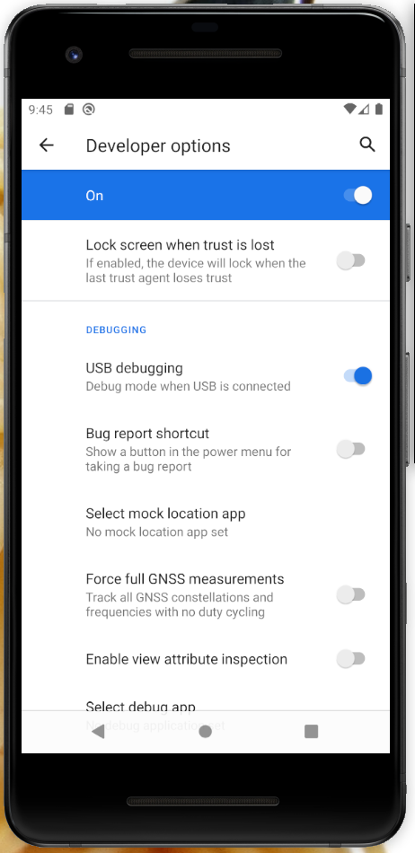
Implementation: FlakeScanner
Android debugging tool (DDMS)
Hooking events
Operating threads
FlakeScanner
ADB
Notes:
We implement our approach into a tool called FlakeScanner. FlakeScanner leverages the Android debugging tool to hook events and operate threads. It works with both emulators and physical devices.

Slide 21
Evaluation
Effectiveness on known flaky tests reported by developers?
Comparing with existing techniques?
Detecting unknown flaky tests in Android apps?
Notes:
In evaluation, we answer three questions:
How does FlakeScanner perform on known flaky tests reported bydevelopers?
How does it compare with existing techniques?
Can flakeScanner detect unknown flaky tests in Android apps?

Slide 22
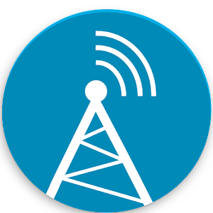

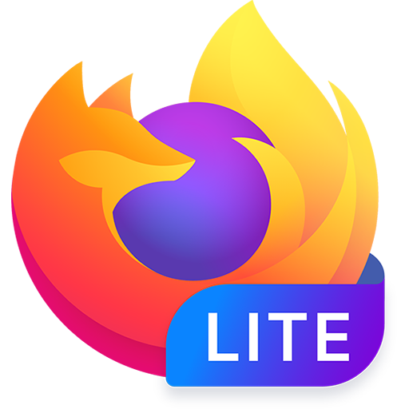



Subjects
33 Android projects,
2300 Github stars on average
5000+ developer tests
Tests
Tests
Tests
Selected 52 known flaky tests
1444 tests (unknown)
Notes:
For evaluation, we collected 33 well-known android projects including firefox and wordpress so on. It contains 5000+ developer tests. We selected 52 known flaky tests as a known data set and 1444 passing tests as the other dataset.

Slide 23
Results: Effectiveness & Comparison
Shaker: a tool for detecting flaky tests in Android apps published on ICSME2020.
100RUN: running a test for 100 times.
Results on the 52 known flaky tests
Notes:
As we see, flakescanner dectected 45 out of 52 known flaky tests.
We compare FlakeScanner with Shaker and 100RUN. Shaker is a tool for detecting flaky tests in Android apps published on ICSME2020. 100RUN is a baseline tool that runs a test for 100 times in the hope of witnessing a flaky test failure. As shown, flakeScanner detected the most of flaky tests.

Slide 24
Results: Detecting unknown Flaky Tests
Detected 245 flaky tests out of 1444 developer tests
13 got confirmed out of the reported 20 unknown flaky tests
Notes:
On the unknown dataset, FlakeScanner detected 245 previously unknown flaky tests. We reported 20 flaky tests to developers and 13 got confirmed and addressed by developers. The experiment show FalkeScanner is effective on detecting flaky tests in Android.

Slide 25
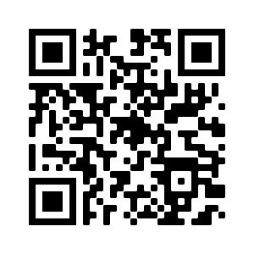
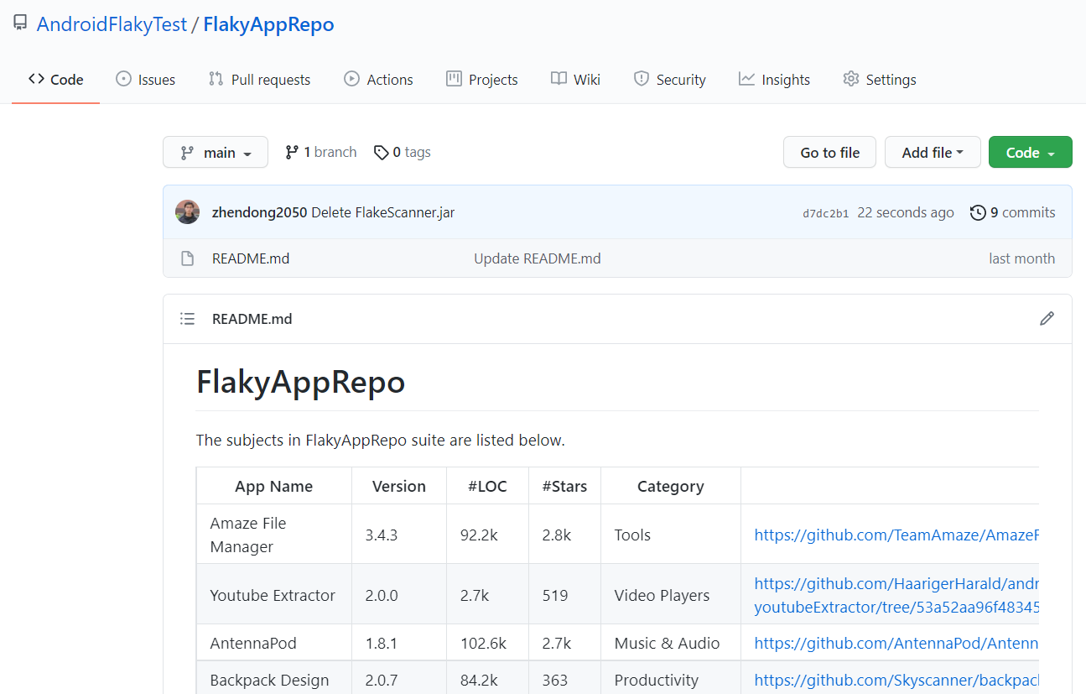
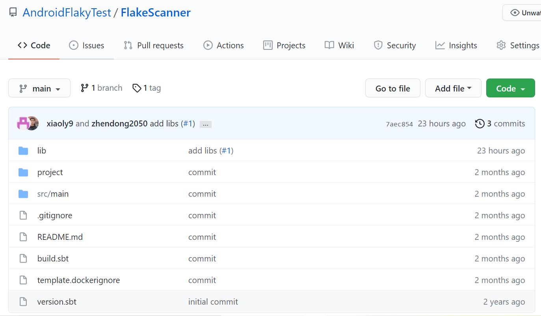
Open Source of our tool and data set
https://github.com/AndroidFlakyTest
Notes:
We make our dataset and tool open source on the Github. Welcome to explore them. Thanks!

Slide 26
Backup

Slide 27
An Example Flaky Test in Android Apps
Clicking button

Slide 28
An Example Flaky Test in Android Apps
Calling the handler
Clicking button

Slide 29
An Example Flaky Test in Android Apps
Calling the handler
Clicking button
Launching
an async task

Slide 30
An Example Flaky Test in Android Apps
Calling the handler
Clicking button
Launching
an async task
Taking longer to get results

Slide 31
An Example Flaky Test in Android Apps
Calling the handler
Clicking button
Launching
an async task
Checking results
Taking longer to get results

Slide 32
Insight: Non-deterministic Execution of Async Events Causes Flaky Tests
Async events
Run1
Pass
Pass
Run2
Fail
Run3
Possible event execution orders of test T

Slide 33
Exploring Possible Event Execution Orders by Scheduling An Async Event
Scheduling
A possible event execution order of test T
Identifying the schedule space

Slide 34
Identifying Schedule Space via Dynamic Analysis
Identifying the upper bound event by hooking the async event
Suspending the
async thread posting e_{i}
e_{i-1}
e_{i}
S1
S2
S3
S4
S5
Testing thread
Free to go

Slide 35
Identifying Schedule Space via Dynamic Analysis
Identifying upper bound event by hooking the async event
Suspending the
async thread posting e_{i}
e_{i-1}
e_{i}
S1
S2
S3
S4
S5
Testing thread
Stop at S5

Slide 36
Identifying Schedule Space via Dynamic Analysis
Identifying upper bound event by hooking the async event
Suspending the
async thread posting e_{i}
e_{i-1}
e_{i}
S1
S2
S3
S4
S5
Testing thread
Stop at S5
Execution of S5 depends on e_{i}

Slide 37
Identifying Schedule Space via Dynamic Analysis
Scheduling an async event in statement boundary positions
Schedule space of e_{i}
e_{i}
e_{j}
e_{i-1}
S1
S2
S3
S4
S5

Slide 38
An Example Flaky Test in Android Apps
Clicking button
Notes:
The code inspection shows that

Slide 39
An Example Flaky Test in Android Apps
Calling the handler
Clicking button

Slide 40
An Example Flaky Test in Android Apps
Calling the handler
Clicking button
Launching
an async task

Slide 41
An Example Flaky Test in Android Apps
Calling the handler
Clicking button
Returning results via an async event
Launching
an async task

Slide 42
An Example Flaky Test in Android Apps
Calling the handler
Clicking button
Updating
results
Returning results via an async event
Launching
an async task

Slide 43
An Example Flaky Test in Android Apps
Calling the handler
Clicking button
Updating
results
Returning results via an async event
Launching
an async task
Checking results

