Slide 1
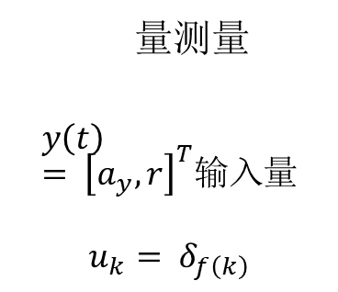
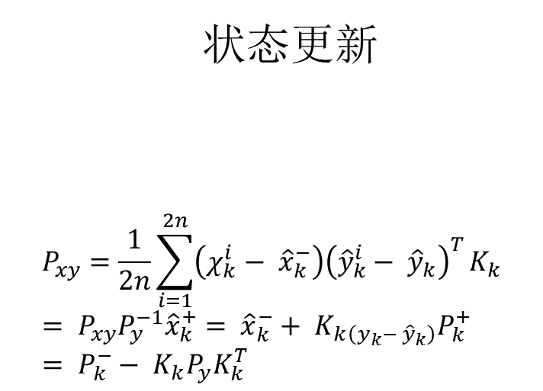

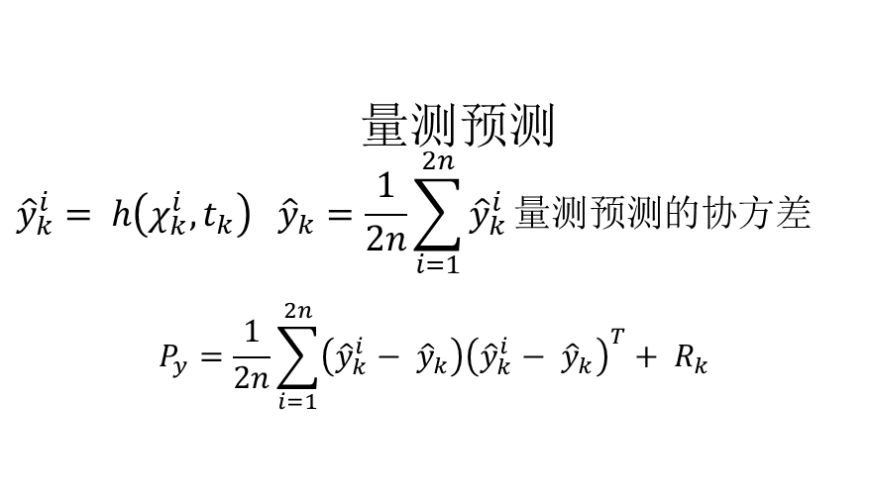
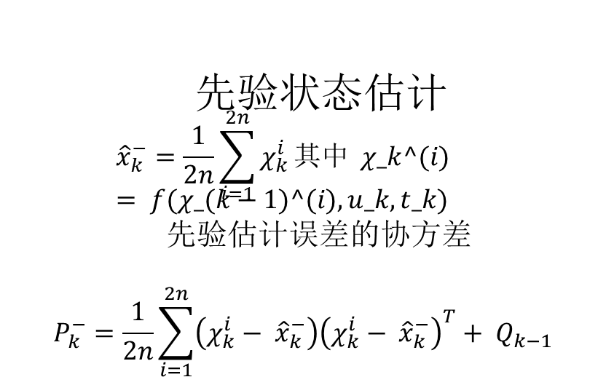
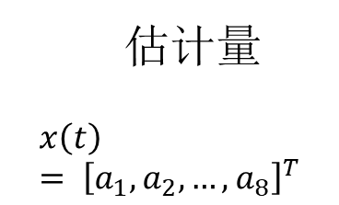
生成sigma点
$${\tilde{χ}}_{k−1}^{i}= {\hat{x}}_{k−1}^{+}+ {\tilde{χ}}^{i} i = 1, …, 2n其中$$
$${\tilde{χ}}^{i}= {\left(\sqrt{nP_{k−1}^{+}}\right)}_{i}^{T}, {\tilde{χ}}^{n+i}= −{\left(\sqrt{nP_{k−1}^{+}}\right)}_{i}^{T}$$
初始化
x0= 0, …, 0Tx0+= Ex0P0+= Ex0- x0x0- x0T
量测量
$$y\left(t\right)= {\left[a_{y}, r\right]}^{T}输入量$$
$$u_{k}= δ_{f\left(k\right)}$$
先验状态估计
$${\hat{x}}_{k}^{−}=\frac{1}{2n}\sum_{i=1}^{2n}{χ_{k}^{i}}其中 χ_k^(i) = f(χ_(k−1)^(i), u_k, t_k)$$
先验估计误差的协方差
$$P_{k}^{−}=\frac{1}{2n}\sum_{i=1}^{2n}{\left(χ_{k}^{i}− {\hat{x}}_{k}^{−}\right){\left(χ_{k}^{i}− {\hat{x}}_{k}^{−}\right)}^{T}}+ Q_{k−1}$$
估计量
$$x\left(t\right)= {\left[a_{1}, a_{2}, …, a_{8}\right]}^{T}$$
状态更新
$$P_{xy}=\frac{1}{2n}\sum_{i=1}^{2n}{\left(χ_{k}^{i}− {\hat{x}}_{k}^{−}\right){\left({\hat{y}}_{k}^{i}− {\hat{y}}_{k}\right)}^{T}}K_{k}= P_{xy}P_{y}^{−1}{\hat{x}}_{k}^{+}= {\hat{x}}_{k}^{−}+ K_{k\left(y_{k}− {\hat{y}}_{k}\right)}P_{k}^{+}= P_{k}^{−}− K_{k}P_{y}K_{k}^{T}$$
量测预测
$${\hat{y}}_{k}^{i}= h\left(χ_{k}^{i}, t_{k}\right) {\hat{y}}_{k}=\frac{1}{2n}\sum_{i=1}^{2n}{{\hat{y}}_{k}^{i}}量测预测的协方差$$
$$P_{y}=\frac{1}{2n}\sum_{i=1}^{2n}{\left({\hat{y}}_{k}^{i}− {\hat{y}}_{k}\right){\left({\hat{y}}_{k}^{i}− {\hat{y}}_{k}\right)}^{T}}+ R_{k}$$

