Slide 1
How to use this deck
Intended audience
Product owners & JATIC development teams preparing slides for external talks such as conferences or corporate presentations.
Purpose
This deck is not intended to replace the JATIC Overview decks or provide an exact set of required slides teams must use for presentations!
Instead, this deck is designed as a jumping off point for JATIC teams who are looking for a template to start with as they prepare product-specific presentations. Design style, text, and other features do not need to stay in this format, please adjust according to your specific organization’s style guide. Feel free to remove, add, edit or re-order slides as you put together your presentation. Additional comments can be found in the “Notes” below each slide.
Instructions
There are two slide deck templates below: one that starts with the AI T&E overview first and a second that begins with an overview of your product first. Feel free to use either one.
The following slides have been approved for use by CDAO. Please take them and run as you prepare your own presentation!
Notes:
Reach out to Tabitha or David with additional questions

Slide 2


Presentation Title
Presenter/Team Members
Event Title & Date
Logo/other image can go here
Logo can go here
Insert Distribution Statement & Copyright Information Here
Notes:
As with all slides in this deck, please feel free to adjust the style to your organization’s/presentation’s requirements. You could also give an attribution note here on the first slide instead of at the end (slide 8 in this deck).
This slide order starts with the broader AI T&E Overview piece first, then transitions to your specific product & the challenges it solves. This approach of starting with the big picture and then moving to the specifics of your product might be better for a general audience who doesn’t have a lot of experience with AI T&E. Feel free to adjust any content leading up to the introduction of the JATIC program (slide #5)

Slide 3


Introduction: Why Does AI T&E Matter?
Interest in Artificial Intelligence (AI) technologies is on the rise across the public and private sectors.
Despite this wide interest, many users are uncertain about the novel risks and impacts of incorporating AI and are looking for resources.
The AI community needs strong test & evaluation (T&E) processes in place to ensure AI-enabled systems are safe, effective, reliable and robust.
Logo can go here
Notes:
This is a very generic “why does AI T&E matter?” slide intended to provide a generic overview of the motivation behind JATIC/AI T&E as a whole. You know your audience and motivation you want to present best, so please feel free to scope and adjust this introduction to cover the motivation you want to get at during the specific talk.
The image on the right is a copyright-free one from Unsplash.

Slide 4
The Challenges
Traditional T&E Experts
Minimal experience with AI systems and their unique vulnerabilities
AI Experts
Minimal experience with T&E best practices successfully used with other technologies
Knowledge
AI T&E practitioners might be able to find a variety of AI T&E tools in the wild but lack the knowledge to integrate them into a clear workflow.
Operational Realism
Many existing T&E tools cannot be applied in operationally-realistic conditions or are hard to scale up for real-world missions.
AI T&E
Logo can go here
Notes:
Similarly, this is a broad overview of challenges the full JATIC program/AI T&E community faces. Your team might want to re-work any “challenges” section you choose to include in your presentation to address more specific challenges in your field.

Slide 5



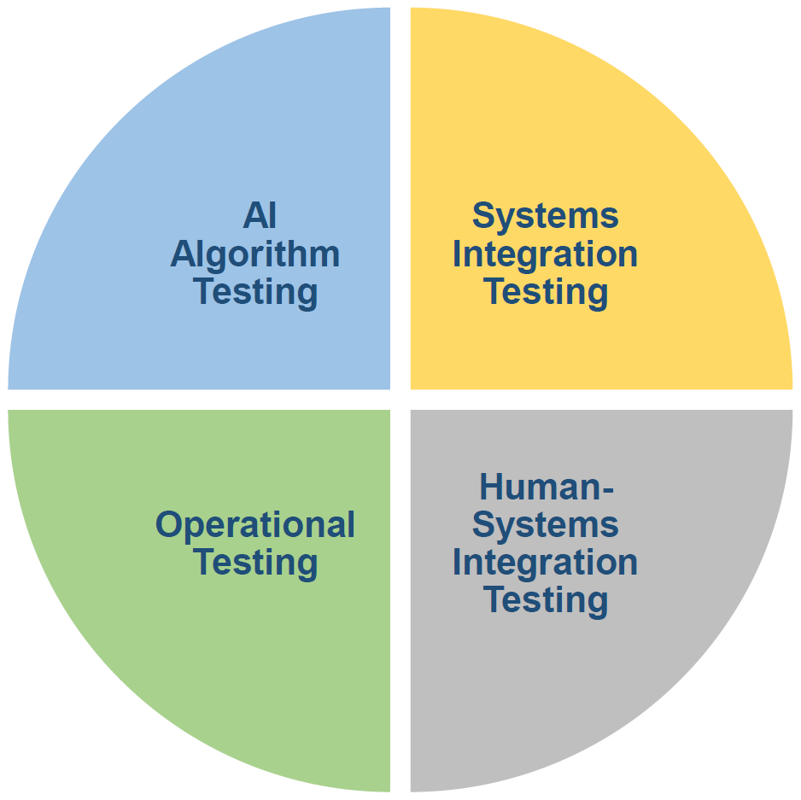






JATIC Program (Joint AI T&E Infrastructure Capability)
Goal: Develop a suite of interoperable software tools for comprehensive and rigorous testing of AI algorithms
JATIC provides functionality for:
Assessing model performance, explainability, and robustness against adversarial and natural perturbations
Assessing dataset similarity, difficulty, and label accuracy
Generating model cards, data cards, and test reports
Logo can go here
Notes:
This slide can help provide an overview of the JATIC program as a whole and its motivation. It also provides an opportunity to touch on the broader suite of JATIC products and how your product fits into the broader, resourced program.
JATIC organization logos as of March 2024

Slide 6
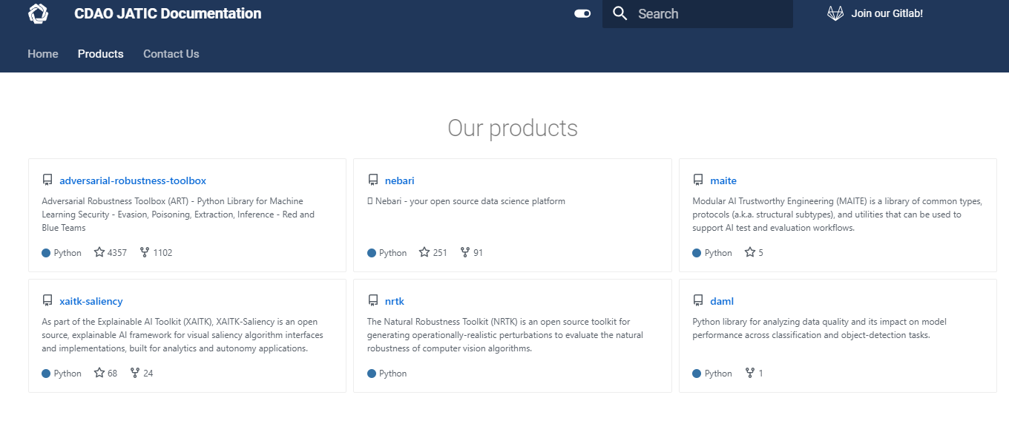



JATIC Resources
https://gitlab.jatic.net/jatic/
cdao-jatic@groups.mail.mil
Learn more at JATIC’s website: https://cdao.pages.jatic.net/public/
Logo can go here
Notes:
Note that the JATIC GitLab page currently requires an account with an email linked to a government, FFRDC or UARC account. The website linked here is public.

Slide 7
Your Product
Recommendation: Start with a short high-level description of your product and the specific T&E problem it addresses. Use as many slides as needed and use images/graphs where possible to provide interesting visuals and support.
Logo can go here
Notes:
Add additional slides about your product that are relevant to the presentation audience as time allows. A good rule of thumb for how many slides to use in a presentation is to spend an average of 1-2 minutes per slide (e.g. a 20-minute presentation should have ~10-15 slides).
Try to avoid overwhelming these slides with too much text! Instead, create new slides as needed.

Slide 8

Your Product Resources
https://github.com/yourproduct
email@your.org
Learn more at JATIC’s website: https://cdao.pages.jatic.net/public/products/
Logo can go here
Notes:
You can use a similar slide to the JATIC resources one to share final contact information or resources about your product. Be sure to update the hyperlinks with your specific email & website information!
This can be a great place to share any additional information about upcoming increment demos, deep dives, recordings, conferences, etc that your team is engaged with.
Plugging the general JATIC public website is another way to encourage people to continue learning more about AI T&E and how your work fits into that bigger picture.

Slide 9

Acknowledgements
This material is partially based upon work supported by the Department of Defense’s Chief Digital and AI Office (DoD CDAO) under Contract No. XXXXXX for the Joint AI Test Infrastructure Capability (JATIC) Program. Any opinions, findings, and conclusions or recommendations expressed in this material are those of the author(s) and do not necessarily reflect the views of the CDAO or JATIC program.
Logo can go here
Notes:
Please update the Contract No. section with your specific contract for attribution. If you have other acknowledgements to make, feel free to reduce the text and/or remove the additional CDAO logo to make space.

Slide 10
Presentation Title
Presenter/Team Members
Event Title & Date
Logo/other image can go here
Logo can go here
Insert Distribution Statement & Copyright Information Here
Notes:
As with all slides in this deck, please feel free to adjust the style to your organization’s/presentation’s requirements. You could also give an attribution note here on the first slide instead of at the end (slide 16 in this deck).
This slide order starts with an overview of your product first, then transitions to how your work fits into the broader JATIC portfolio. This approach of starting with your specific work might be better for events where you want to quickly dive into the details of your product and how it addresses T&E challenges before ending with additional resources. It also allows you to start out with the specific motivation your product team has before rounding out with a description of how you fit into the broader JATIC program.

Slide 11
Introduction
Recommendation: Use an introduction slide to tee up the specific AI T&E problem(s) that your tool can address.
Logo can go here
Insert Distribution Statement & Copyright Information Here
Notes:
Recommendation: Use an introduction slide to tee up the specific AI T&E problem(s) that your tool can address.

Slide 12
Your Product
Recommendation: Transition from the introduction of the problem to an overview of your product & how it addresses the problem(s). Be sure to also include an access link/contact information (see slide #13) and use images/graphs to provide interesting visuals and support.
Logo can go here
Insert Distribution Statement & Copyright Information Here
Notes:
Add additional slides about your product as time allows. A good rule of thumb for how many slides to use in a presentation is to spend an average of 1-2 minutes per slide (e.g. a 20-minute presentation should have ~10-15 slides).
Try to avoid overwhelming these slides with too much text! Instead, create new slides as needed.

Slide 13
Your Product Resources
https://github.com/yourproduct
email@your.org
Learn more at: https://cdao.pages.jatic.net/public/products/
Logo can go here
Notes:
Make sure you include information for the audience on how they can access your tool, contact your team, or learn more. Be sure to update the links with your specific email & site info!
This can be a great place to share any additional information about upcoming increment demos, deep dives, recordings, conferences, etc that your team is engaged with.
Plugging the general JATIC public website is another way to encourage people to continue learning more about AI T&E and how your work fits into that bigger picture.

Slide 14
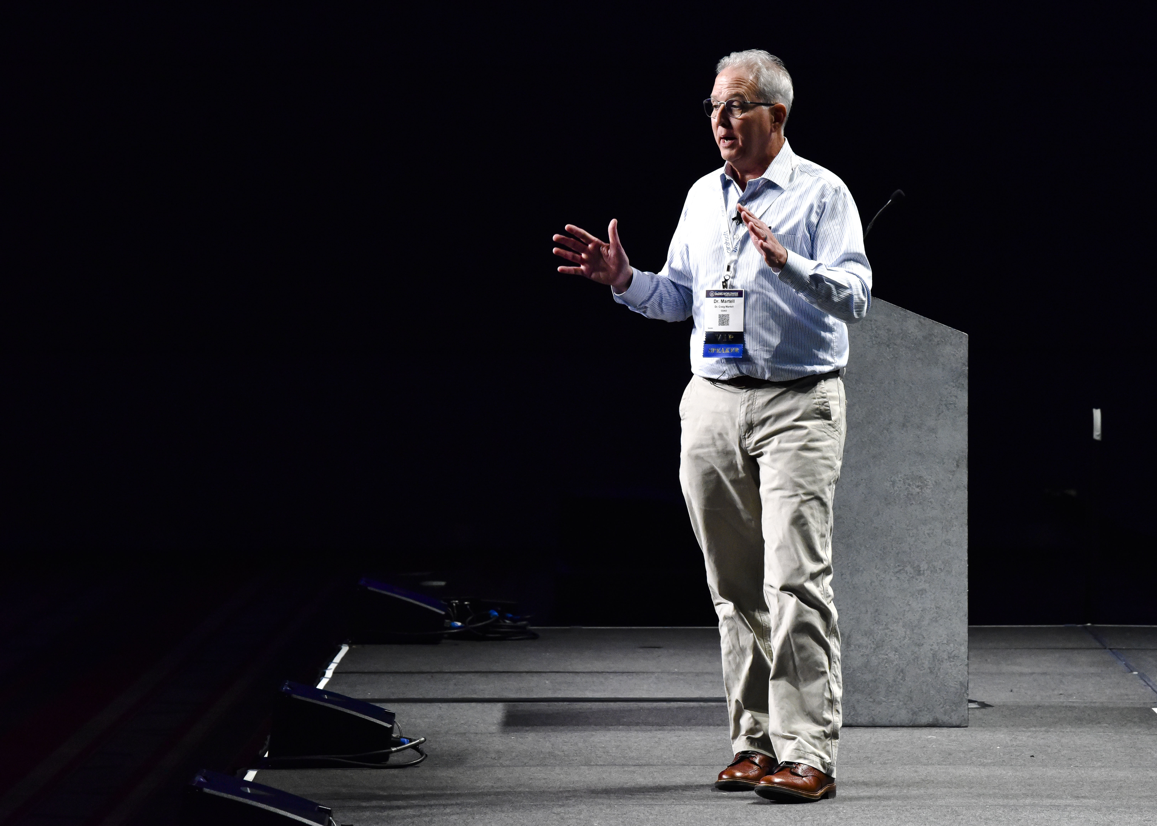
What about other aspects of AI T&E?
“
There is a critical need for comprehensive AI test and evaluation (T&E) tools that can easily and reliably assess AI models along multiple dimensions to support the development, evaluation, deployment, and monitoring of trusted AI systems that are robust to these and other challenges.
- Department of Defense’s Chief Digital and Artificial Intelligence Office (CDAO), 2022
“
Logo can go here
Insert Distribution Statement & Copyright Information Here
Notes:
This slide can be used to prompt the transition from the information about your product to how it fits into the overall mission and suite of tools within the JATIC program.

Slide 15
JATIC Program (Joint AI T&E Infrastructure Capability)
Goal: Develop a suite of interoperable software tools for comprehensive and rigorous testing of AI algorithms
JATIC provides functionality for:
Assessing model performance, explainability, and robustness against adversarial and natural perturbations
Assessing dataset similarity, difficulty, and label accuracy
Generating model cards, data cards, and test reports
Logo can go here
Insert Distribution Statement & Copyright Information Here
Notes:
This slide can then be used to provide that overview of the JATIC program as a whole and its motivation. It also provides an opportunity to touch on the broader suite of JATIC products and how your product fits into the broader, resourced program.
JATIC organization logos as of March 2024

Slide 16
JATIC Resources
https://gitlab.jatic.net/jatic/
cdao-jatic@groups.mail.mil
Learn more at JATIC’s website: https://cdao.pages.jatic.net/public/
Logo can go here
Notes:
Note that the JATIC GitLab page currently requires an account with an email linked to a government, FFRDC or UARC account. The website linked at the bottom is publicly accessible.

Slide 17
Acknowledgements
This material is partially based upon work supported by the Department of Defense’s Chief Digital and AI Office (DoD CDAO) under Contract No. XXXXXX for the Joint AI Test Infrastructure Capability (JATIC) Program. Any opinions, findings, and conclusions or recommendations expressed in this material are those of the author(s) and do not necessarily reflect the views of the CDAO or JATIC program.
Logo can go here
Insert Distribution Statement & Copyright Information Here
Notes:
Please update the Contract No. section with your specific contract for attribution. If you have other acknowledgements to make, feel free to reduce the text and/or remove the additional CDAO logo to make space.

