Slide 1
Amplitude Modulation (part four)
EE202
yanyan.wu@xjtlu.edu.cn
Department of Electronics and Electrical Engineering
Xi’an Jiaotong – Liverpool University

Slide 2
Lecture five
Vestigial Side Band (VSB)
Baseband representation of Modulated Waves and Band-pass filters

Slide 3
VSB
SSB works ok for an information- bearing signal with an energy gap centered around zero frequency. However the spectra of wideband signals (e.g. video signal) contain significant low frequency.
DSB-AM
f
Ideal highpass filter
Leaks some of the lower sideband
Instead of complete removing a sideband, a vestige of that sideband is transmitted, thus results in the bandwidth of a VSB modulated signal is
B_{T}=f_{v}+W
Where f_{v} is the vestige bandwidth.

Slide 4
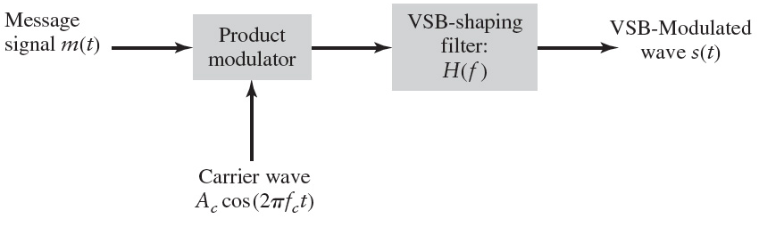
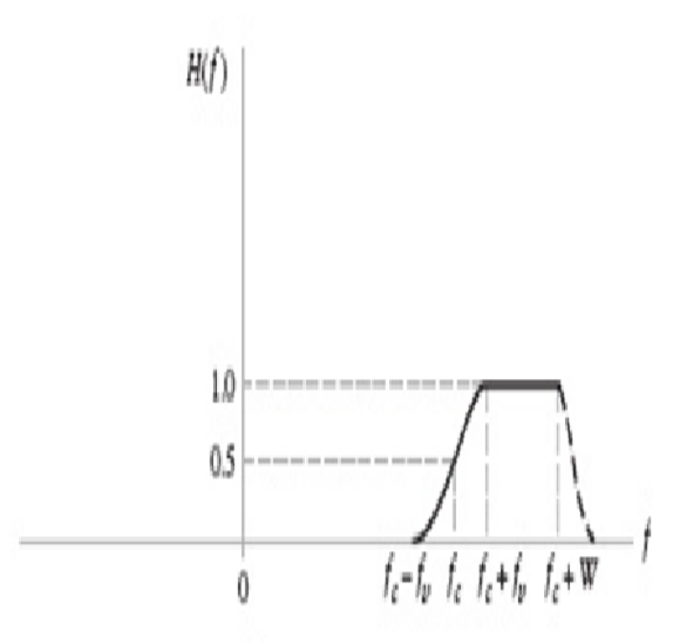
VSB modulator
H(f) is the transfer function of the of the VSB shaping filter, which satisfies
H(f+f_{c})+ H(f-fc)=1 (-w<f<w)

Slide 5
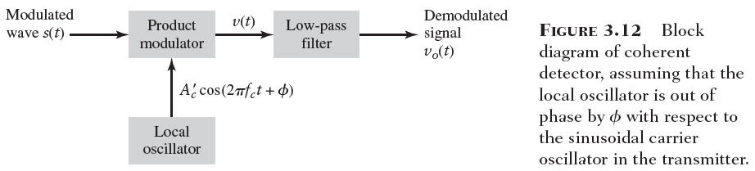
VSB: coherent detection

Slide 6
Class activity
Drill problem
Verify the outputs from the receiver are as indicated in the figure, assuming perfect synchronization between the transmitter and the receiver.

Slide 7
Vestigial Side Band (VSB)
VSB is mainly used in analogue TV broadcasting for their video transmissions.
TV signal consists of
  Audio signal – transmitted by FM
  Video signal – transmitted by VSB
A video signal consists a range of frequency and fmax = 4.5 MHz.
If it transmitted using conventional AM, the required BW is 9 MHz (BW=2fm). But according to the standard, TV signal is limited to 7 MHz only
So, to reduce the BW, a part of the LSB of picture signal is not fully transmitted.

Slide 8
Vestigial Side Band (VSB)
The frequency spectrum for the TV signal / VSB:
Video
Carrier
Audio
Carrier
Total TV signal bandwidth = 7 MHz
1.25Mhz
4.5 MHz
Lower
Video
Bands
Upper
Video
Bands
Lower
Audio
Bands
Upper
Audio
Bands
f (MHz)
5.75Mhz

Slide 9
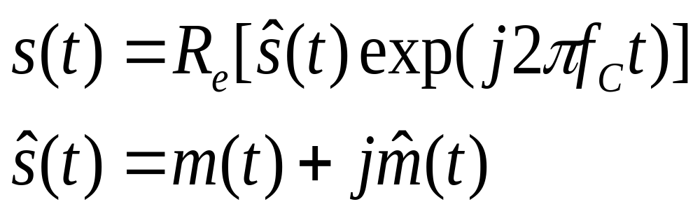
Base-band representation of modulated signals

Slide 10
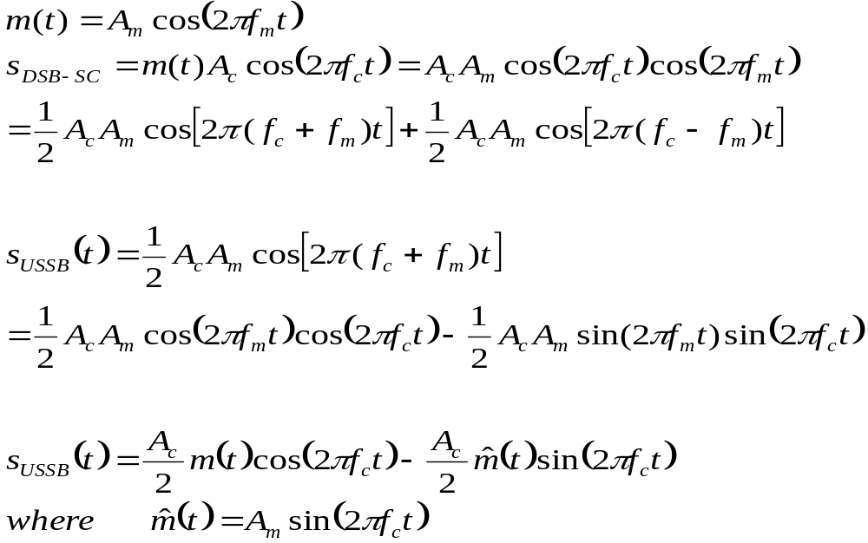
Example given by SSB-AM

Slide 11
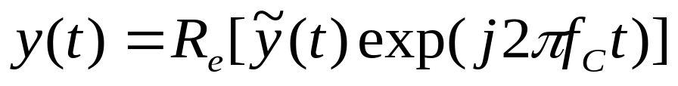
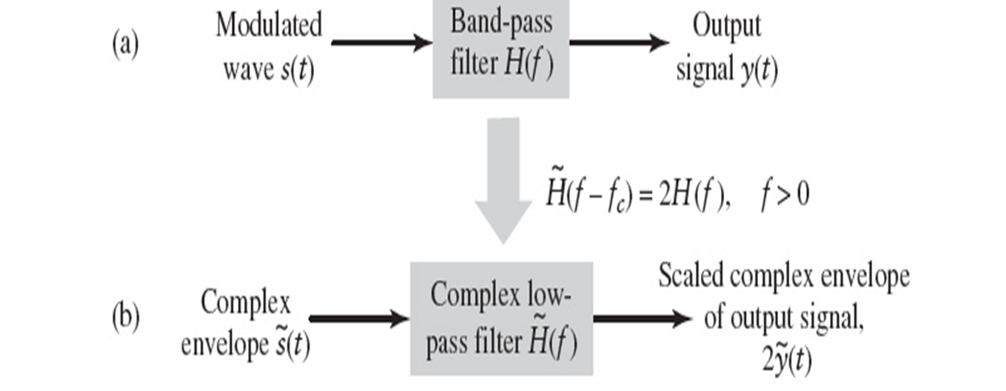
Class Activity
Prove the following relation can be obtained for the schematic below:

Slide 12

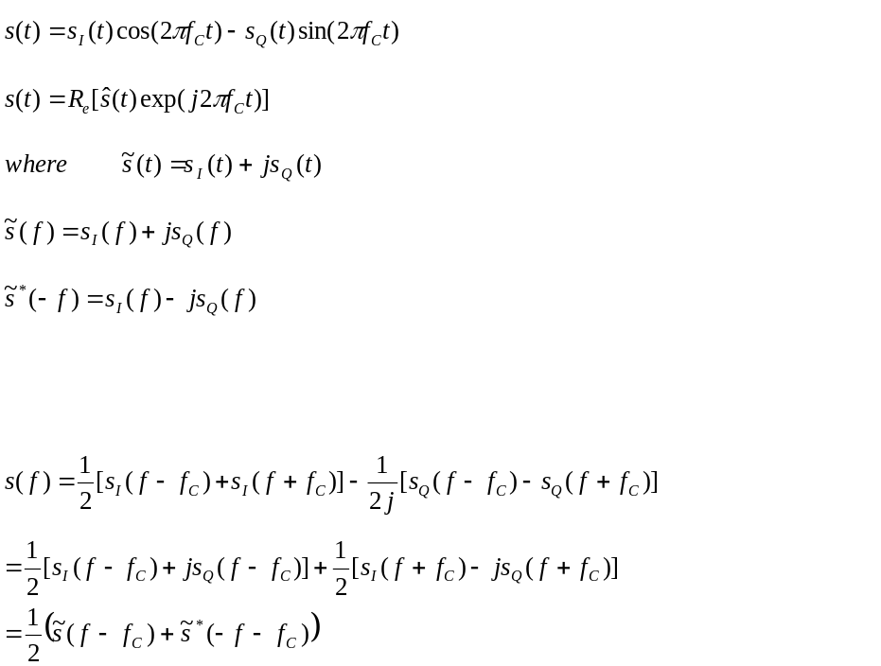
Tips:

