Slide 1
EDAgent
Tool-Using LLM Agent for Economic Dispatch
ECE 285 · Final Presentation · March 2026
Track B: LLMs as Agents and Tool Orchestrators
ReAct Agent
CVXPY Solver
Working Memory
IEEE Benchmarks

Slide 2
Motivation
Can an LLM autonomously solve Economic Dispatch?
Economic Dispatch (ED)
The Challenge
Allocate generator output to meet demand at minimum cost
Subject to: power balance (ΣPᵢ = Pload) + capacity limits
Quadratic cost: aP² + bP + c per generator
LLMs alone → hallucinate, violate physics constraints
Classical solvers → exact, but need structured input
Our approach: LLM orchestrates verified tools via ReAct
Research Question: Can tool-augmented LLM agents achieve higher feasibility and accuracy than prompting alone?
User (NL query) → LLM Agent → Data Loader → CVXPY Solver → Verified Dispatch + Visualization

Slide 3
Related Work
Three lines of prior work — our contribution bridges the gap
Traditional Solvers
LLMs for Power (Mohammadi '25)
ReAct + Tools (Yao '23)
CPLEX, Gurobi, CVXPY
Optimal but need structured input
No natural language interface
CoT prompting on IEEE cases
Flexible NL interface
Hallucination & constraint violations
Interleave reasoning with tool calls
Grounded via external tools
Our work: physics-grounded suite
Reliable ✓ Flexible ✗
Reliable ✗ Flexible ✓
Reliable ✓ Flexible ✓
Our contribution: Apply ReAct to ED with physics-grounded tools + working memory

Slide 4
System Architecture
OpenWebUI + FastAPI + ReAct Agent + SQLite
Frontend
Backend
Persistence
OpenWebUI
FastAPI + ReAct Agent
SQLite Store
Chat-based UI
OpenAI-compatible API
Renders visualizations
Thought → Action → Observation
Chained tool calls
Working memory in-process
Importance-scored memories
TF-IDF + keyword retrieval
Concept graph for entity links
User → OpenWebUI → /chat/completions → ReAct Agent → Tools + Memory → SQLite → Response

Slide 5
ReAct Framework & Tools
Thought → Action → Observation cycle with 4 specialized tools
ReAct Cycle
Memory
Data Loader
Thought
Store / Retrieve / Forget
TF-IDF + decay scoring
IEEE 14/30/57/118/200
Gen limits, costs, demand
Decompose NL query into sub-tasks
Action
Issue chained tool calls atomically
Observation
Solver
Visualizer
Inspect results, detect failures
CVXPY + OSQP backend
Quadratic ED, box constraints
Dispatch bar chart
Load distribution pie
Safety
Hard iteration cap prevents infinite loops
Cycle repeats until conclusive answer or iteration limit · Chained actions: tool₁ → memory.store → tool₂ → … executed atomically

Slide 6
Working Memory System
Human-inspired architecture for multi-turn coherence
Storage
Retrieval
Each memory: content + importance
score + timestamp + metadata
Capacity: 10 items, 2000 tokens
Hybrid: TF-IDF cosine similarity
+ keyword overlap
Modulated by time decay + importance
Priority & Decay
Forgetting
Priority = importance × exp(−λ·hours)
Heap-based eviction of lowest priority
Decay rate: 0.95 per 6 hours
Three strategies:
importance / time / capacity-based
Graceful degradation: TF-IDF → keyword
TTL: 120 min · Priority = importance × exp(−0.95 × hours/6) · Enables what-if re-simulation without reloading data

Slide 7
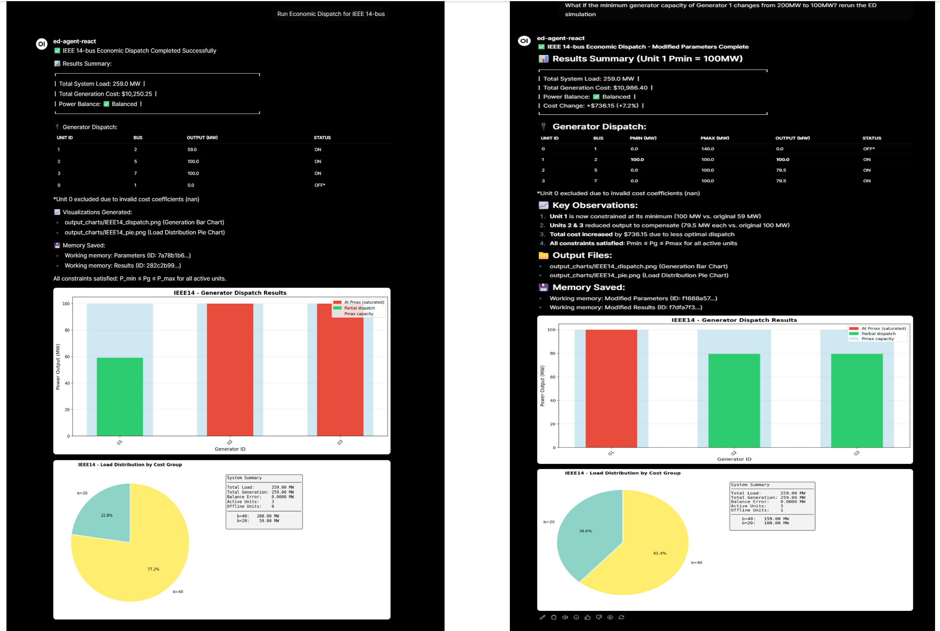
Live Demo: Running Results
IEEE 14-bus initial dispatch + what-if re-simulation (Stretch Goal ✓)
① Initial Dispatch
IEEE 14-bus, 259 MW load
Cost: $10,250/hr
Bar chart + pie auto-generated
Params stored to memory
② What-if (Stretch +)
Gen 1 Pmin 200→100 MW
New cost: $6,896/hr
Recalled params from memory
No data reload needed!
Both stretch goals completed: ✓ Interactive what-if via memory · ✓ 5 IEEE cases (14, 30, 57, 118, 200-bus)

Slide 8
Evaluation Setup
25 test queries · 5 IEEE systems · 3 scenario types
IEEE 14
IEEE 30
IEEE 57
IEEE 118
IEEE 200
3 gens
259 MW
5 gens
189 MW
6 gens
1,251 MW
53 gens
4,242 MW
29 gens
2,229 MW
Small
Small
Medium
Large
Large
Scenarios: Baseline dispatch · Unit outage (1–2 gens offline) · Load change (±30%)
EDAgent (ReAct + Tools)
LLM-Only Baseline (CoT)
Multi-step: load → solve → visualize → store
CVXPY guarantees constraint satisfaction
Single API call, no tools (Mohammadi et al.)
LLM computes dispatch values directly
Metrics: success rate · cost error vs CVXPY reference · physics violations · failure modes

Slide 9
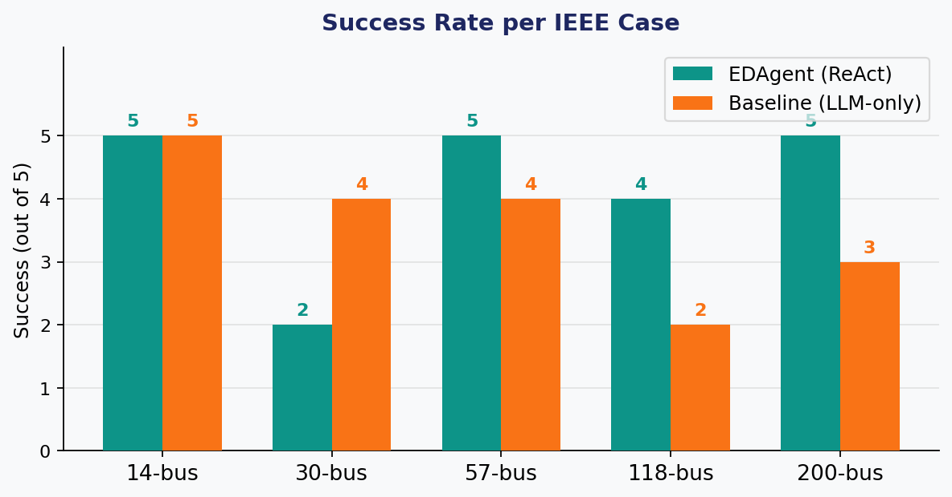
Results: Success Rate
EDAgent 84% vs Baseline 72% · 25 queries across 5 IEEE systems
84%
EDAgent
21/25 queries
IEEE 200: 5/5 perfect
72%
Baseline
18/25 queries
IEEE 118: only 2/5
Analysis: EDAgent advantage grows with system size — at 57-bus+ the LLM-only approach degrades. IEEE 200 (largest tested, 29 gens) shows Agent maintains 100% while Baseline drops to 60%. Both struggle with IEEE 30 due to NaN-cost data quality issue, not a scale problem.
Success = correct cost extracted within 300s timeout · CVXPY reference as ground truth

Slide 10
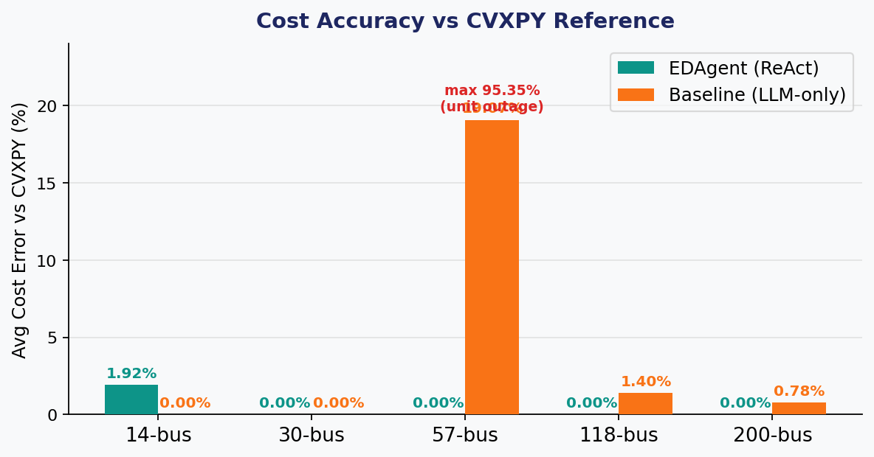
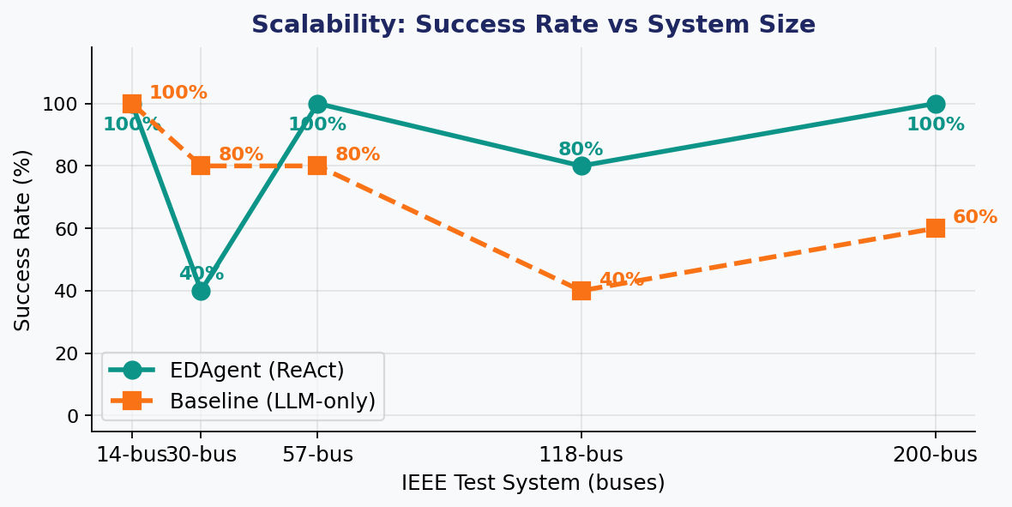
Results: Cost Accuracy
EDAgent 0.46% avg error · 10× more accurate than Baseline
0.46%
EDAgent avg error
Max: 6.33%
4.56%
Baseline avg error
Max: 95.35%!
57-bus unit outage: BL $2,158 vs ref $46,412 = 95% error
Why the gap?
EDAgent delegates math to CVXPY solver — cost is always optimal or near-optimal.
Baseline LLM must "guess" dispatch values for all generators simultaneously. With 6+ generators, numerical reasoning collapses (57-bus: 95% error).

Slide 11
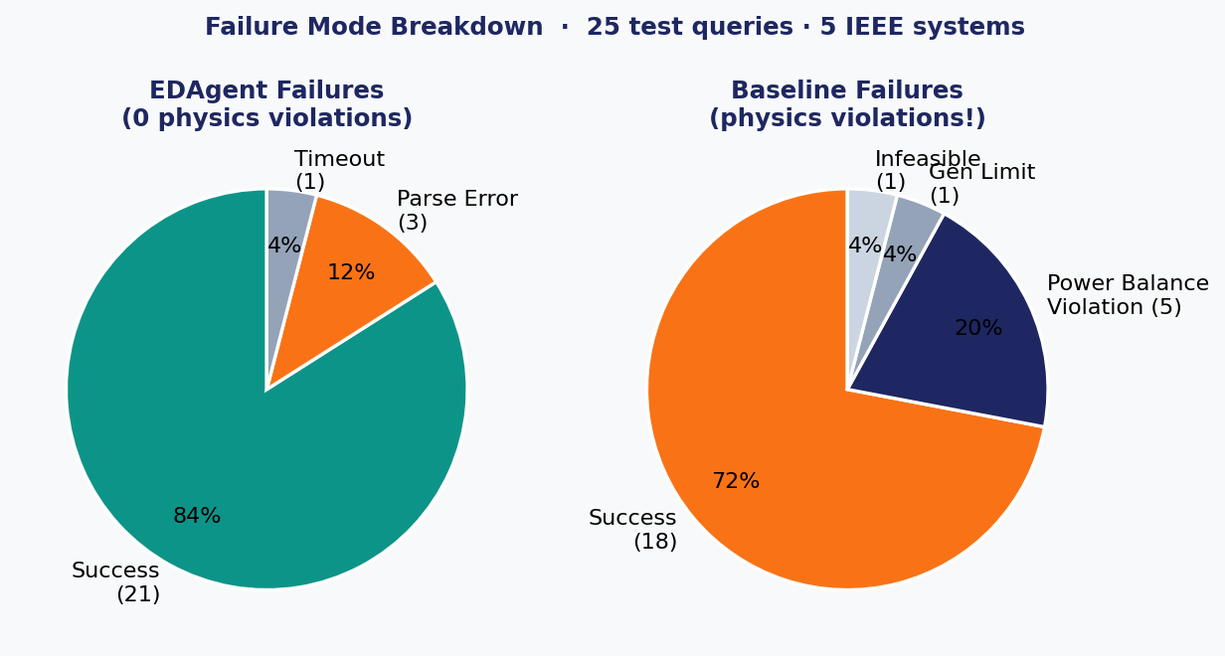
Failure Mode Analysis
EDAgent: fixable format issues · Baseline: physics violations
EDAgent: 4 failures
3 × parse error + 1 × timeout
0 physics violations
All fixable via output schema
Baseline: 7 failures
5 × power balance violation
1 × generator limit exceeded
Fundamental — no solver to verify
Case | EDAgent | Baseline | Cost Err (Agent / BL)
IEEE 14 | 5/5 ✓ | 5/5 ✓ | 1.92% / 0.00%
IEEE 30 | 2/5 | 4/5 | 0.00% / 0.00% (NaN data issue)
IEEE 57 | 5/5 ✓ | 4/5 | 0.00% / 19.07%
IEEE 118 | 4/5 | 2/5 | 0.00% / 1.40%
IEEE 200 | 5/5 ✓ | 3/5 | 0.00% / 0.78%
Key: EDAgent failures are engineering issues (regex parsing, timeout) — fixable without changing the architecture. Baseline failures are fundamental physics violations — the LLM lacks mathematical verification.

Slide 12
Conclusion & Future Work
Key Results
Future Work
84% vs 72%
Output Format Hardening
+12 pp success from tool augmentation
JSON schema to eliminate parse errors
0.46% vs 4.56%
What-if Stress Test
10× more accurate (solver vs LLM math)
3+ cascading parameter changes
0 violations
Ramp-Rate Constraints
CVXPY guarantees power balance + gen limits
Multi-period dispatch for realism
IEEE 200: 5/5
Scale to IEEE 300+
Scales to 29 gens, 2229 MW with 0% error
Larger grids, real-world ISO data
Takeaway: Tool-augmented LLM agents can reliably solve constrained optimization — the solver ensures correctness, memory enables what-if analysis, and ReAct provides structured reasoning.
EDAgent · ECE 285 Final Presentation · Thank you — Questions?

