Slide 1




Memory Management System
A human-inspired architecture for AI agent working memory
Storage
Retrieval
Priority & Decay
Forgetting
Each memory carries content, importance score, timestamp, and metadata. Strict capacity, token, and TTL limits enforce resource discipline.
Hybrid scoring blends TF-IDF vector similarity with keyword overlap, modulated by time decay and importance weighting.
Exponential time decay reduces older memories’ influence. A heap structure enables efficient eviction of the lowest-priority item.
Three strategies — importance-based, time-based, and capacity-based — prune low-value content while preserving critical information.
Capacity: 10 items • Token Limit: 2,000 • TTL: 120 min • Decay: 0.95 / 6h

Slide 2


Tool Integration
Four specialized tools integrated into the ReAct framework
Memory
Data Loader
Optimization Solver
Visualizer
store — save key facts with importance scores
retrieve — query relevant memories by context
forget — prune low-value or expired entries
Standardized parser for IEEE bus test cases
Loads generator limits, cost curves, and demand data
Feeds structured inputs to downstream solvers
Interfaces with MATPOWER and CVXPY
Solves quadratic ED optimization problems
Returns optimal dispatch and objective cost
Generates dispatch curves per generator
Produces cost-benefit comparison plots
Exports publication-ready figures
Agent reasons over the task → selects the appropriate tool → acts and observes the result → iterates

Slide 3




ReAct Framework
Thought – Action – Observation cycle with chained tool invocation
Thought
Action
Observation
Safety
▶
▶
▶
The LLM decomposes the user’s natural language query into logical sub-tasks, identifying which data, solvers, and constraints are relevant.
The agent issues a chained tool call — a sequence of tools executed atomically. Memory is updated within the chain, preserving intermediate results for future reasoning.
Tool outputs and error messages serve as grounded feedback. The agent inspects results, detects failures, and decides whether to iterate or conclude.
A hard iteration cap prevents infinite loops from tool errors or reasoning failures, bounding computational cost and ensuring system robustness.
↻ Cycle repeats until conclusive answer or iteration limit reached
Chained Actions: tool₁ → memory.store → tool₂ → memory.store → … executed atomically per action step

Slide 4




System Architecture
OpenWebUI frontend communicating with a FastAPI backend and SQLite persistence layer
Frontend
Backend
Persistence
OpenWebUI
FastAPI + ReAct Agent
SQLite Document Store
Chat-based user interface
Sends queries via OpenAI-compatible API
Renders agent responses and visualizations
No custom frontend code required
Exposes OpenAI-format /chat/completions endpoint
ReAct engine orchestrates Thought–Action–Observation cycles
Chained tool calls: solver, loader, visualizer, memory
Working memory managed in-process with priority and decay
Stores memories with importance scores and timestamps
Indexed by user, type, time, and importance
Concept graph links memories to semantic entities
Thread-safe singleton with connection pooling
User → OpenWebUI → /chat/completions → ReAct Agent → Tools + Memory → SQLite → Response

Slide 5
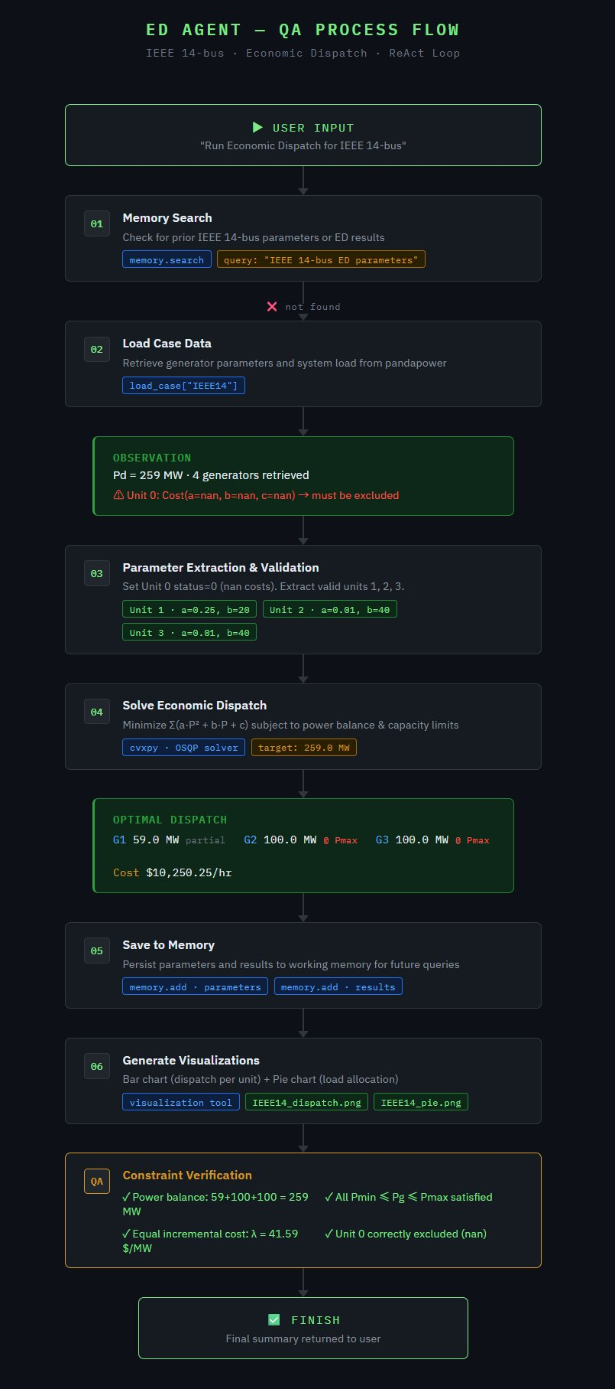
End-to-End Example
IEEE 14-bus Economic Dispatch — Full ReAct Loop

