Slide 1
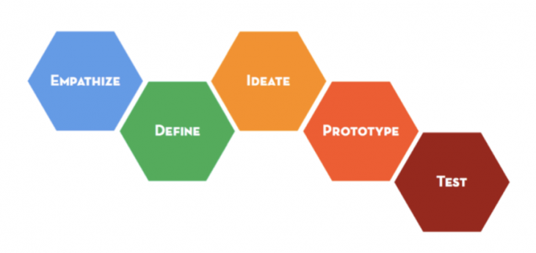
Design Thinking Practice Session
Lee Wee Sun
School of Computing
National University of Singapore
leews@comp.nus.edu.sg

Slide 2

Acknowledgement Virtual Crash Course from Stanford D.school

Slide 3
Practice Session
Work in pairs
If you have decided your app, explore further during the session
If you have not decided, use something you are familiar with
Improving your life in NUS
Expand beyond NUS to the Smart Nation …
…
Talk to your partner for 5 minutes to agree on topic

Slide 4
Six stages of design thinking
Running example: Do something about the haze that has been affecting Singapore every year for the past few years.

Slide 5
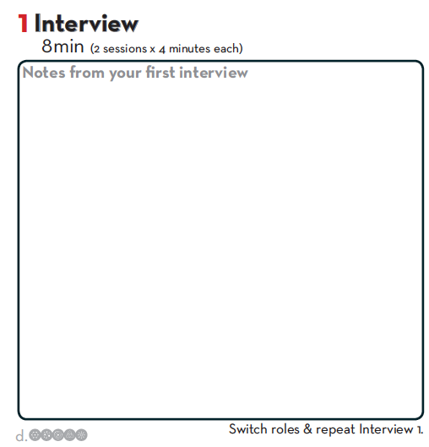
Empathize
When haze happens, eyes hurt, develop cough
Cannot go outdoors to do regular exercise
Inconvenient to use air filter at home
Not comfortable wearing mask
Also worried about global warming, future of the world
….
Think like an anthropologist

Slide 6
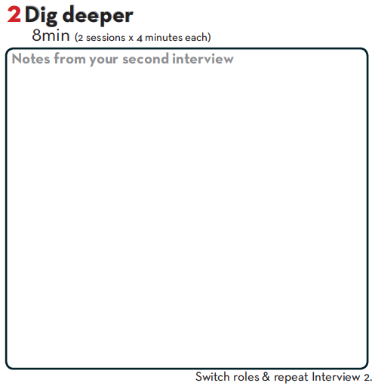
Empathize
Feel helpless, not sure what to do
Feel angry, want to punish those responsible
Willing to take action, but what?
No expertise
Have limited free time
…
Think like an anthropologist

Slide 7
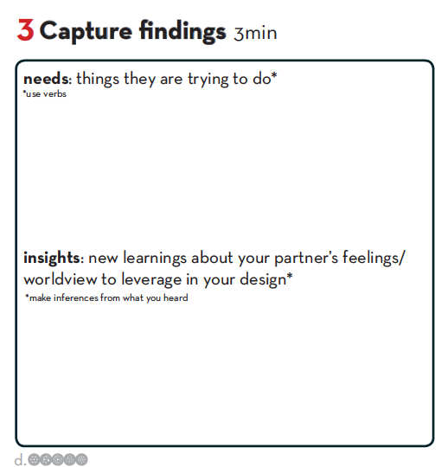
Define
Do something to improve haze situation
Take action to reduce anger, helplessness
…
No expertise
Not willing to spend too much time
…

Slide 8
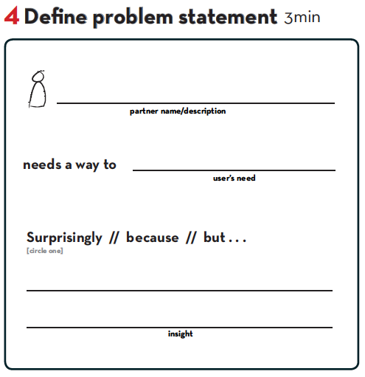
Define
Lee Wee Sun
take action to improve the
haze situation
But does not know what to do and has
limited time

Slide 9
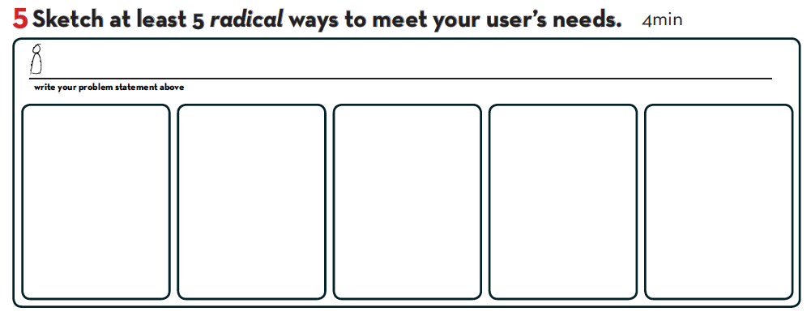
Ideate
Build a tool to help people
Complain to MP
Go to fire region and help put fire out
Buy and distribute masks
Stop buying products that contribute to fire
Report firestarters to the authorities
😱
😇
😷
😠
😤
Notes:
How might we Amp up the good
Remove the bad
Explore the opposite
Question an assumption
Change a status quo
Create an analogy from need

Slide 10
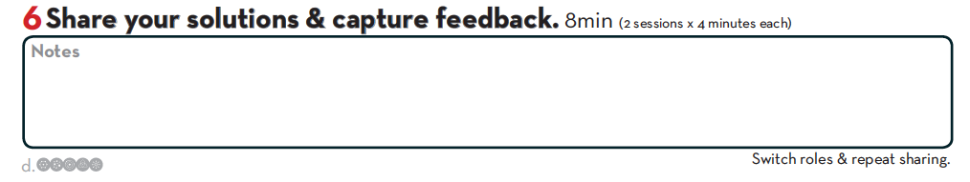
Ideate
Complaint: Gov already taking action
Going to fire region: no time
Distribute mask: no impact on fire
Stop buying: too little effect?
Report firestarter: can only do in fire region

Slide 11
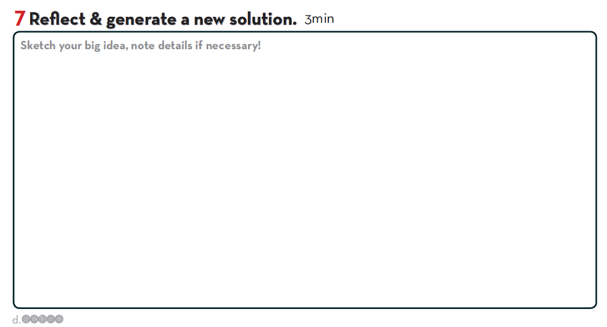
Ideate
Instead of not buying, get others to also stop buying: collective action has larger impact
How to identify product? Boycott the whole country!

Slide 12
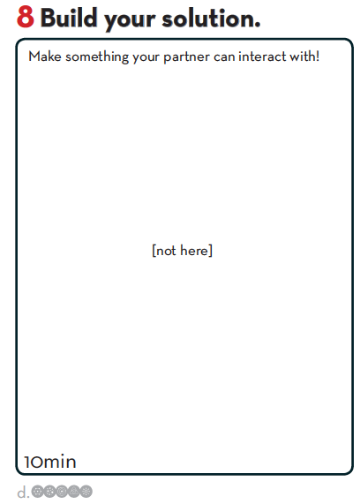
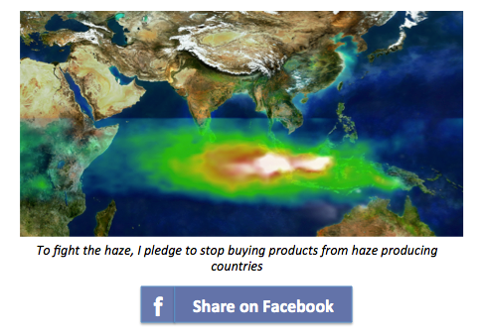
Prototype and Test

Slide 13
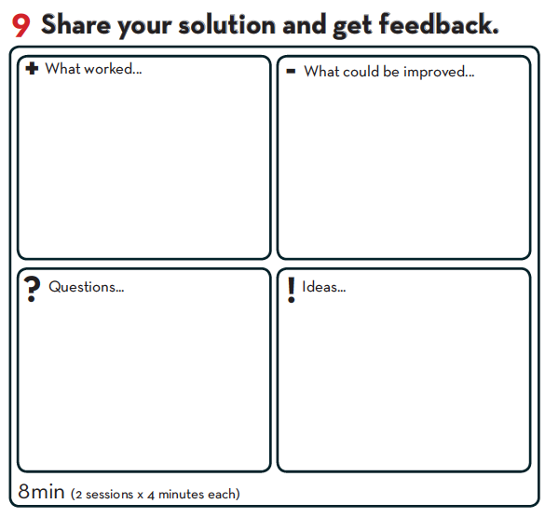
Prototype and Test
Can do something and can have larger impact by influencing others.
What if people pledge and forget? No real impact.
Is this punishing all citizens of haze producing countries even if they have no role in producing haze?
Pledge to buy certified products instead, so that demand for sustainable products reduce fraction of non-sustainable products.

Slide 14
Demo

Slide 15
Acknowledgements
A substantial portion of the material comes from the virtual crash course in design thinking https://dschool.stanford.edu/dgift/

Slide 16
Prepare to Build
The app is online at http://fighthazepledge.appspot.com/
We will build the app in the Google App Engine session tomorrow
For those doing the Google App Engine session, do the following before attending
Install Python 2.7 (note the version)
Install Google App Engine https://cloud.google.com/appengine/downloads#Google_App_Engine_SDK_for_Python

