Slide 1
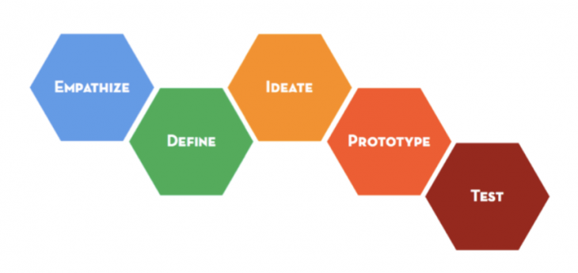
Design Thinking
Lee Wee Sun
School of Computing
National University of Singapore
leews@comp.nus.edu.sg
This presentation can be found at http://www.comp.nus.edu.sg/~leews/LiftOff.zip

Slide 2
Design Thinking
Design thinking is a methodology that matches people’s needs to technology for successful innovation

Slide 3
Six stages of design thinking

Slide 4
Empathize
Observe
See human behaviour in the natural environment
Engage
Interact with and interview users
Immerse
Get personal experience
Empathy tools
Don’t judge, question everything, be curious, find patterns
Try to engage extreme users
Interview: ask why, encourage stories, look for inconsistencies, pay attention to body language and emotion, don’t suggest answers
Think like an anthropologist

Slide 5
Example: Let’s say we are interested in getting more SoC students to start up companies. Possible Observations
Risk averse, prefer small sure thing rather than uncertain thing with high potential reward
Place lots of importance on grades
Fear failure
…
Think like an anthropologist

Slide 6
Define
Capture the finding into needs and insights
Needs: verbs, what users are trying to do
Insights: Knowledge that is useful for design
Look for contradictions, surprises, tensions, strange behaviour, etc.

Slide 7
Startup Example:
Needs:
learn how to build things
tolerate failure
enjoy creating change
…
Insights:
Courses teach techniques but no opportunity to put knowledge together to build complete product.
Student ability mostly judged from exams.
…

Slide 8
Ideate
From the needs and insights, state your point of view
Meaningful challenge to take on
How to change people’s lives
What assumption are you going to disrupt
Brainstorm using How Might We questions
Select ideas
Keep multiple ideas: most rational, most delightful, long shot, etc.
Example POV: Every SoC student should have discovered a need, developed an application, tried (maybe failed) to get users for it, and got rewarded outside of grades

Slide 9
How Might We
Brainstorm Rules
Amp up the good
HMW exploit students’ focus on grades?
Remove the bad
HMW reduce fear of failure?
Explore the opposite
HMW make failure a badge of honour?
Question an assumption
HMW avoid teaching students?
Change a status quo
HMW recognize students for other form of excellence?
Create an analogy from need
HMW make SoC like Silicon Valley?
Defer judgement – never get critical!
Get as many ideas as possible
Build on ideas of others
Use visual aid
Encourage crazy ideas
Example POV: Every SoC student should have discovered a need, developed an application, tried (maybe failed) to get users for it, and got rewarded outside of grades

Slide 10
Prototype and Test
Prototype is a simplified realization of the idea
Brings clarity
Test: use prototype to get feedback from user
Fail quickly and cheaply
For web app, simple to prototype, e.g. using PowerPoint
Demo: Create link to next slide
Next

Slide 11
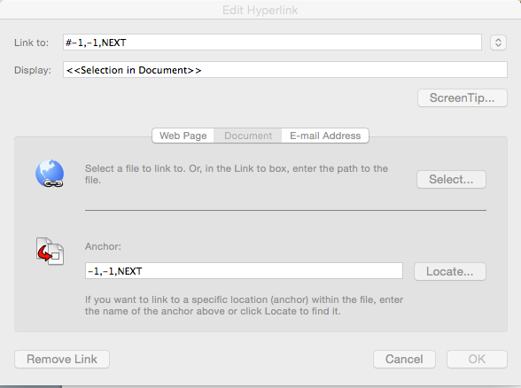
How to create a link in Powerpoint
Select -> Insert -> Hyperlink

Slide 12
Practice Session
Work in pairs
If you have decided your app, explore further during the session
If you have not decided, use something you are familiar with
Improving your life in NUS
Expand beyond NUS to the Smart Nation …

Slide 13
Acknowledgements
A substantial portion of the material comes from the virtual crash course in design thinking https://dschool.stanford.edu/dgift/

