Slide 1
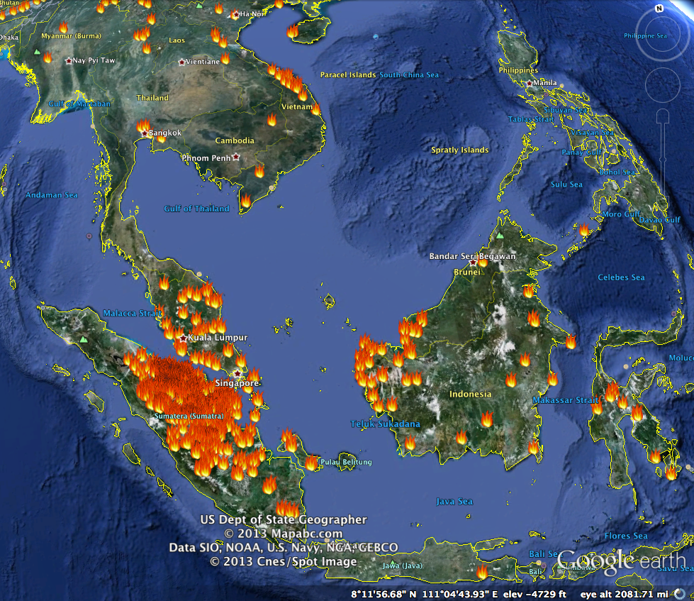
Frustrated with the never ending haze? Want to do your part to fight the haze?
Make a pledge to buy products that are certified for sustainability. Do your part to reduce the demand for non-sustainable products.
Make your pledge public on Facebook so that all people within 6 degrees of separation follow suit and take collective action.
Log in and sign up to send yourself a reminder each time the PSI exceed your pre-specified tolerance.

Slide 2
Frustrated with the never ending haze? Want to do your part to fight the haze?
Make a pledge to buy products that are certified for sustainability. Do your part to reduce the demand for non-sustainable products.
Make your pledge public on Facebook so that all people within 6 degrees of separation follow suit and take collective action.
Log in and sign up to send yourself a reminder each time the PSI exceed your pre-specified tolerance.

Slide 3
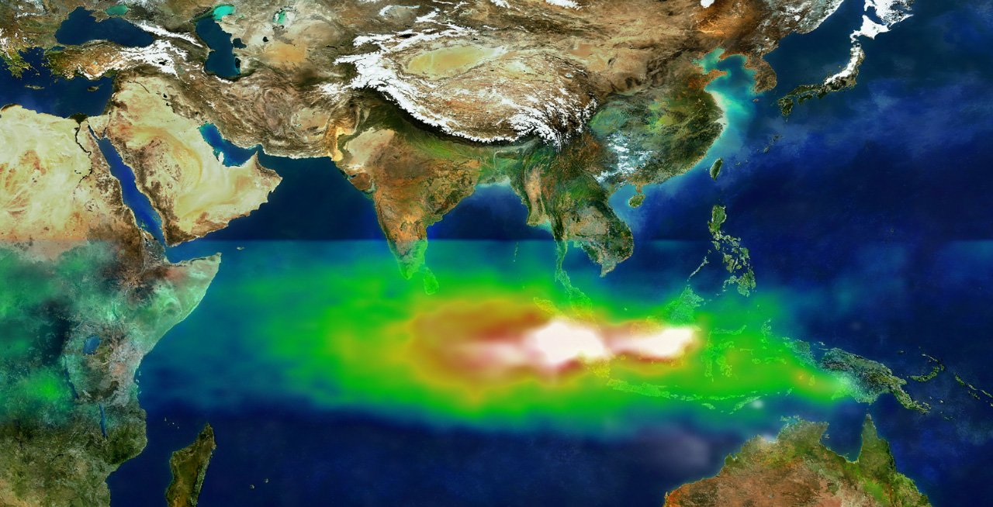
To fight the haze, I pledge to buy products certified for sustainability whenever there are choices.
f
Share on Facebook
Image credit: https://commons.wikimedia.org/wiki/File:TOMS_indonesia_smog_lrg.jpg

Slide 4
To fight the haze, I pledge to buy products certified for sustainability whenever there are choices.
f
Share on Facebook
Image credit: https://commons.wikimedia.org/wiki/File:TOMS_indonesia_smog_lrg.jpg

Slide 5
Send me an email reminder of my pledge each time the PSI in Singapore exceeds for consecutive days.
Submit

