Slide 1

Orbital Google App Engine Tutorial
Lee Wee Sun
School of Computing
National University of Singapore
leews@comp.nus.edu.sg

Slide 2
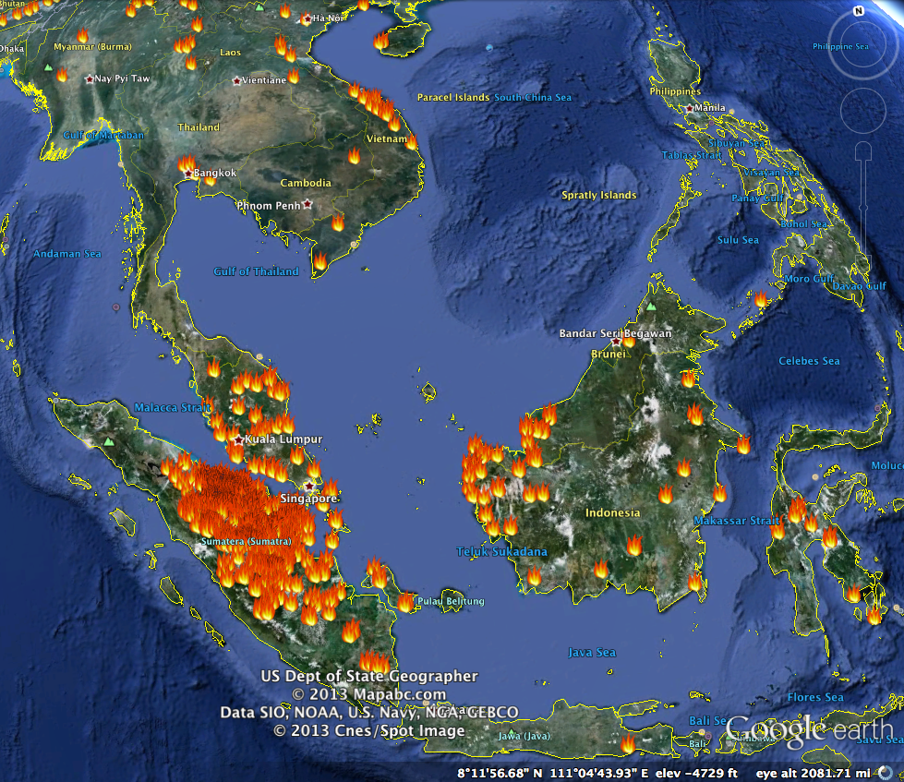
Frustrated with the never ending haze? Want to do your part to fight the haze?
Make a pledge to buy products that are certified for sustainability. Do your part to reduce the demand for non-sustainable products.
Make your pledge public on Facebook so that all people within 6 degrees of separation follow suit and take collective action.
Log in and sign up to send yourself a reminder each time the PSI exceed your pre-specified tolerance.
By the end of this tutorial, we would have built most components of this app …

Slide 3
Outline
Installation
Hello World!
Template
Forms
Datastore

Slide 4
Installation
For more documentation, go to https://developers.google.com/appengine/docs/python/gettingstartedpython27/introduction. Useful to also work through the tutorial there in your own time.
You should have installed Python 2.7 earlier
Now go to https://developers.google.com/appengine/docs/python/gettingstartedpython27/devenvironment and follow the instructions to install Google App Engine for your platform
Get LiftOff.zip from http://www.comp.nus.edu.sg/~leews/LiftOff.zip
Unzip it in the directory you want to work from

Slide 5
Hello World!

Slide 6
Hello World!
In the directory helloworld, look at helloworld.py
Web application framework to help handle HTTP requests
import webapp2
class MainPage(webapp2.RequestHandler):
def get(self):
self.response.headers['Content-Type'] = 'text/plain'
self.response.write('Hello, webapp2 World!')
app = webapp2.WSGIApplication([('/', MainPage)],
debug=True)
MainPage inherit from this
Handles HTTP GET request
Class MainPage is handler for root url ‘/’
Exercise: Change the message to “Hello, Orbital World!”

Slide 7
Have a look at the configuration file app.yaml
App identifier is helloworld
application: helloworld
version: 1
runtime: python27
api_version: 1
threadsafe: true
handlers:
- url: /.*
script: helloworld.app
All requests to urls matching “/.*” (all urls) are handled by helloworld module

Slide 8
Template

Slide 9
Template
Writing HTML using webapp2 is inefficient.
Use Jinja2 template. Go to directory FightHazeBasic. Look at fighthaze.py
import webapp2
import jinja2
import os
jinja_environment = jinja2.Environment(
loader=jinja2.FileSystemLoader(os.path.dirname(__file__) + "/templates"))
class MainPage(webapp2.RequestHandler):
""" Handler for the front page."""
def get(self):
template = jinja_environment.get_template('front.html')
self.response.out.write(template.render())
app = webapp2.WSGIApplication([('/', MainPage)],
debug=True)
Template directory
Get template ‘front.html’ and render

Slide 10
Look at the file front.html
Use stylesheet from Twitter Bootstrap
Documentation: http://twitter.github.io/bootstrap/getting-started.html
Our own stylesheet in /stylesheets/main.css
<head>
<title> FightHaze</title>
<link href="../bootstrap/css/bootstrap.css" rel="stylesheet”>
<link type="text/css" rel="stylesheet" href="../stylesheets/main.css">
</head>
Exercise: Change the size of the logo and the height of the top bar

Slide 11
Login

Slide 12
Login using Google API
Look at configuration file app.yaml in front directory
handlers:
- url: /stylesheets
static_dir: stylesheets
- url: /images
static_dir: images
- url: /scripts
static_dir: scripts
# Twitter Bootstrap
- url: /bootstrap
static_dir: bootstrap
# Handler for front page
- url: /
script: fighthaze.app
# All other pages require login
- url: /.*
script: fighthaze.app
login: required
libraries:
- name: jinja2
version: latest
Login not required for ‘/’
Order is important. “/.*” should be placed last
Look in directory
Login required for all else
Use Jinja2 templates

Slide 13
<a href=”/fighthaze"><img src="../images/google.png"></a>
Recall “/” does not require login, all others including “/fighthaze” requires login
Frustrated with the never ending haze? Want to do your part to fight the haze?
Make a pledge to buy products that are certified for sustainability. Do your part to reduce the demand for non-sustainable products.
Make your pledge public on Facebook so that all people within 6 degrees of separation follow suit and take collective action.
Log in and sign up to send yourself a reminder each time the PSI exceed your pre-specified tolerance.

Slide 14
Passing Parameters to Templates

Slide 15
How to get nickname here?
User information
from google.appengine.api import users
class MainPageUser(webapp2.RequestHandler):
""" Front page for those logged in """
def get(self):
user = users.get_current_user()
if user: # signed in already
template_values = {
'user_nickname': users.get_current_user().email(),
'logout': users.create_logout_url(self.request.host_url),
}
template = jinja_environment.get_template('front.html')
self.response.out.write(template.render(template_values))
else:
self.redirect(self.request.host_url)
app = webapp2.WSGIApplication([(’/fighthaze', MainPageUser)],
debug=True)
Frustrated with the never ending haze? Want to do your part to fight the haze?
Make a pledge to buy products that are certified for sustainability. Do your part to reduce the demand for non-sustainable products.
Make your pledge public on Facebook so that all people within 6 degrees of separation follow suit and take collective action.
Log in and sign up to send yourself a reminder each time the PSI exceed your pre-specified tolerance.
Pass key: value pairs to template

Slide 16
In front.html
Keys passed to Jinja2 template and converted into values
<!-- Top bar -->
<div class="row-fluid top-container">
<div class="span5">
<img class="logo" src="../images/logo.png">
</div>
<div class="span3 offset9 signin-align">
<span> {{ user_nickname }} <a href="{{ logout }}">logout</a></span>
</div>
</div>
<!-- End of top bar -->

Slide 17
Conditionals in Jinja2

Slide 18
In front.html
<!-- Top bar -->
<div class="row-fluid top-container">
<div class="span5">
<img class="logo" src="../images/logo.png">
</div>
{% if user_nickname %}
<div class="span3 offset9 signin-align">
<span> {{ user_nickname }} <a href="{{ logout }}">logout</a></span>
</div>
{% else %}
<div class="span3 offset9 signin-align">
<span> Login with <a href="/fighthaze"><img src="../images/google.png"></a></span>
</div>
{% endif %}
</div>
<!-- End of top bar -->
Using conditional, show nickname if logged in, login prompt otherwise.
Can also do loops in Jinja2. See documentation.

Slide 19
Exercise

Slide 20
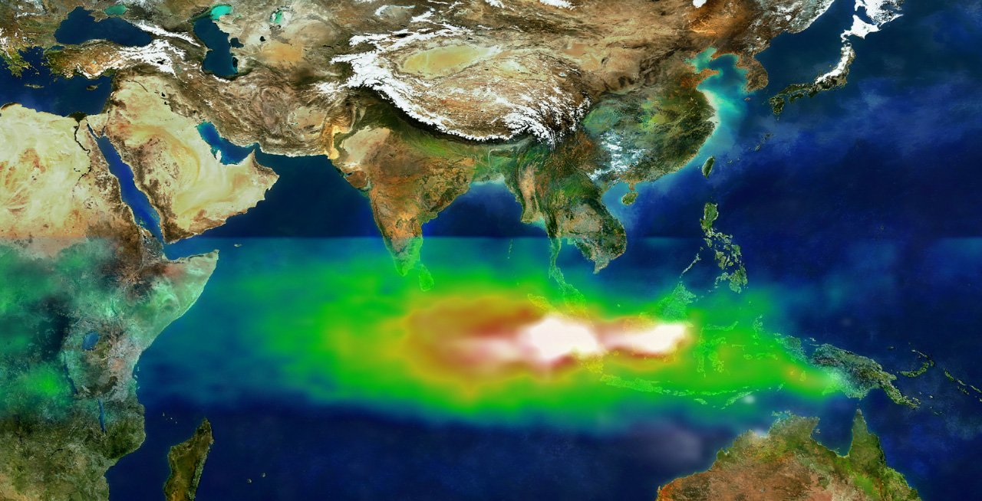
Exercise: The template pledge.html needs to be rendered as shown.
Complete the handler Pledge in fighthaze.py
In pledge.html, the code currently displays the login prompt instead of the user nickname. Modify the file to show the user nickname if the user is logged in and the login prompt otherwise
To fight the haze, I pledge to buy products certified for sustainability whenever there are choices.
f
Share on Facebook
Image credit: https://commons.wikimedia.org/wiki/File:TOMS_indonesia_smog_lrg.jpg

Slide 21
Summary So Far …
Jinja2 template allows HTML to be written in different files
Set login: required in app.yaml to require login. Google login provided
Parameters can be passed to Jinja2 template in the form of key: value pairs
Can use conditionals and loops in Jinja2

Slide 22
Create a Form

Slide 23
In the file reminder.html, we can find the form
<form action="/reminder" method="post">
<fieldset>
<p> Send me an email reminder of my pledge each time the PSI in Singapore
exceeds <input class="input-small" type="number" name="psilimit”> for <input class="input-small” name="daylimit”> consecutive days.</p>
<p><input type="submit" value="Edit"></p>
…
Need to write handler with post method to get data from this form
Send me an email reminder of my pledge each time the PSI in Singapore exceeds for consecutive days.
In the file fighthaze.py, we can find the handler
Class Reminder(webapp2.RequestHandler):
def get(self):
…
def post(self):
…
person.psi_limit = self.request.get_range('psilimit')
person.day_limit = self.request.get_range('daylimit')
person.put()
app = webapp2.WSGIApplication([(’/reminder', Reminder))
Submit
Post request
Handler
mapped to /reminder
Datastore object field

Slide 24
Data Model

Slide 25
Send me an email reminder of my pledge each time the PSI in Singapore exceeds for consecutive days.
Submit
Read the form and insert into datastore
Read from the datastore

Slide 26
Data Model
App Engine uses the NDB Datastore to store objects known as entities
Model for entities defined using Python class
class Preference(ndb.Model):
# Models a person's preference. Key is the nickname.
email = ndb.StringProperty() # user email
psi_limit = ndb.IntegerProperty() # max acceptable PSI
day_limit = ndb.IntegerProperty() # days before reminder
last_reminder = ndb.DateProperty() # the last time reminder sent

Slide 27
Insert Data

Slide 28
Insert into datastore
Handles post from form
def post(self):
curr = ndb.Key('Preference', users.get_current_user().nickname())
person = curr.get()
if person == None:
person = Preference(id=users.get_current_user().nickname())
person.email = users.get_current_user().email()
person.psi_limit = self.request.get_range('psilimit')
person.day_limit = self.request.get_range('daylimit’)
…
person.put()
Get from datastore
Construct key
Create new person. nickname is key (unique identifier)
Insert
Get info from form

Slide 29
Querying Data

Slide 30
Send me an email reminder of my pledge each time the PSI in Singapore exceeds 100 for 5 consecutive days.
Submit
Query to get all user preferences
qry = Preference.query()
for pref in qry:
curr_email = pref.email
psi_target = pref.psi_limit
day_target = pref.day_limit
# Check that every day in day_limit pass psi_target
…
# Send email
Iterate through and process each entity pref

Slide 31
Datastore Properties
NDB model is hierarchical
Example: Group all people in the same country together to specialize PSI to their country
Create new Country class
class Country(ndb.Model)
name = ndb.StringProperty()
Create key for country, then use it as ancestor
sgp = Country(name=‘Singapore’ )
pref1 = Preference(parent=sgp.key)
pref2 = Preference(parent=sgp.key)
Ancestor query getting all entities from ‘Singapore’
Preference.query(ancestor=sgp.key).fetch()
Singapore
Pref1
Pref1
…

Slide 32
The datastore is a noSQL database
Designed to scale
Eventual consistency
A write followed immediately by a read of the same entity may return the old value of the entity
But consistency guaranteed for ancestor queries; use ancestor query if you need consistency

Slide 33
Other Components
For Facebook Share button, see Facebook Developers documentation
For Haze data, see https://data.gov.sg for the API
Lot of other useful data and APIs: weather, dengue, real-time traffic, facilities (libraries, museums, hawker centers, etc.), map, etc.
For scheduled jobs (to get PSI and send emails), see GAE documentation on scheduling with cron.

Slide 34
Upload App

Slide 35
Upload your app …
Finally, you can upload your app …
See https://developers.google.com/appengine/docs/python/gettingstartedpython27/uploading for instructions

Slide 36
Summary
Process form
NDB model
Insert
Query
Datastore properties
Other components

Slide 37
Finally
FightHaze app online at http://fighthazepledge.appspot.com/
Source included in directory FightHaze
If you want to help make FightHaze better, talk to me about extending it into a Gemini/Apollo11 project!

Slide 38
Thank you!

