Slide 1
Factors Influencing Map Checking In Pedestrian Navigation and Checking Points Prediction
Motivation
Research Questions
Hypotheses
Data
Expected outcomes and anticipated challenges
Brief timeline and planned milestones
Things that need to be determined

Slide 2
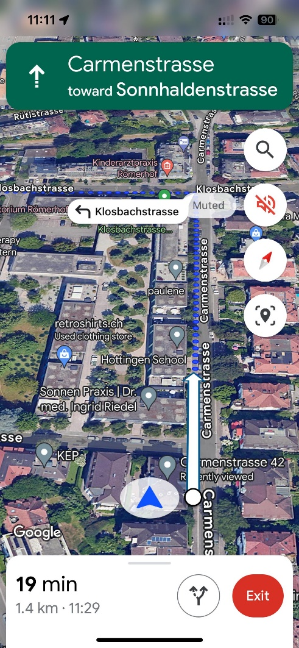
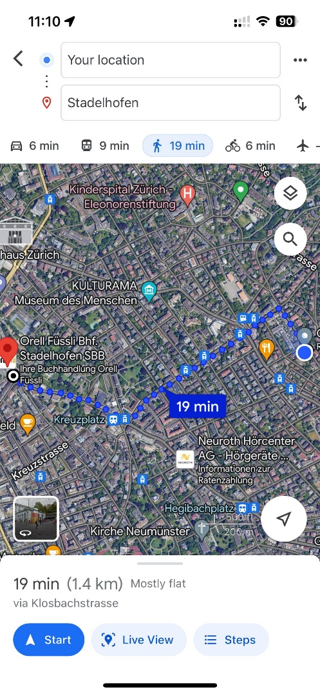
Motivation :
Directions may not be accurate during walking navigation
Navigation is too detailed to overlook all the information
Decrease spatial cognition
Unable to provide any proactive prompts
Unnecessary checks during navigation
If we could learn when and where are the most likely checking points during walking navigation, walking navigation prompts can be improved.

Slide 3
Research Questions:
What are the main factors which influence when and where the pedestrians check the mobile map during walking navigation?
What is the difference of factors that affect checking map in walking navigation between high and low traffic density?
What are the results of using artificial intelligence algorithms to predict map-checking points in pedestrian navigation? (Talked this with people majoring in AI and Data Science. Theoretically feasible)

Slide 4
Hypothesis:
What are the main factors which influence when and where the pedestrians check the mobile map during walking navigation?
Distance to intersections/ Distance from start point/ Time from start point/ Spatial cognitive confidence/ ……
What is the difference of factors that affect viewing maps in walking navigation between high and low traffic density?
There may be new influencing factors emerging, and the weights of each factor may different
What are the results of using artificial intelligence algorithms to predict map-checking points in pedestrian navigation?

Slide 5
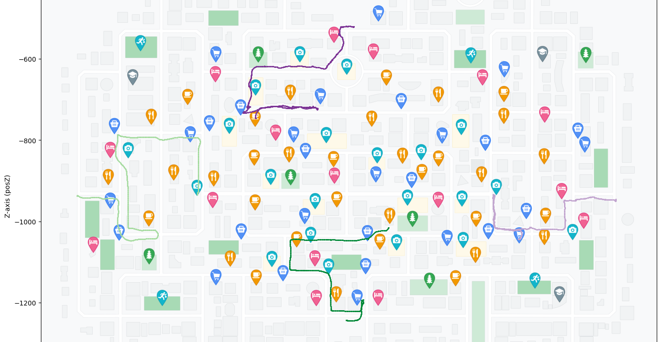
Trajectory of Participant 12
Data:

Slide 6
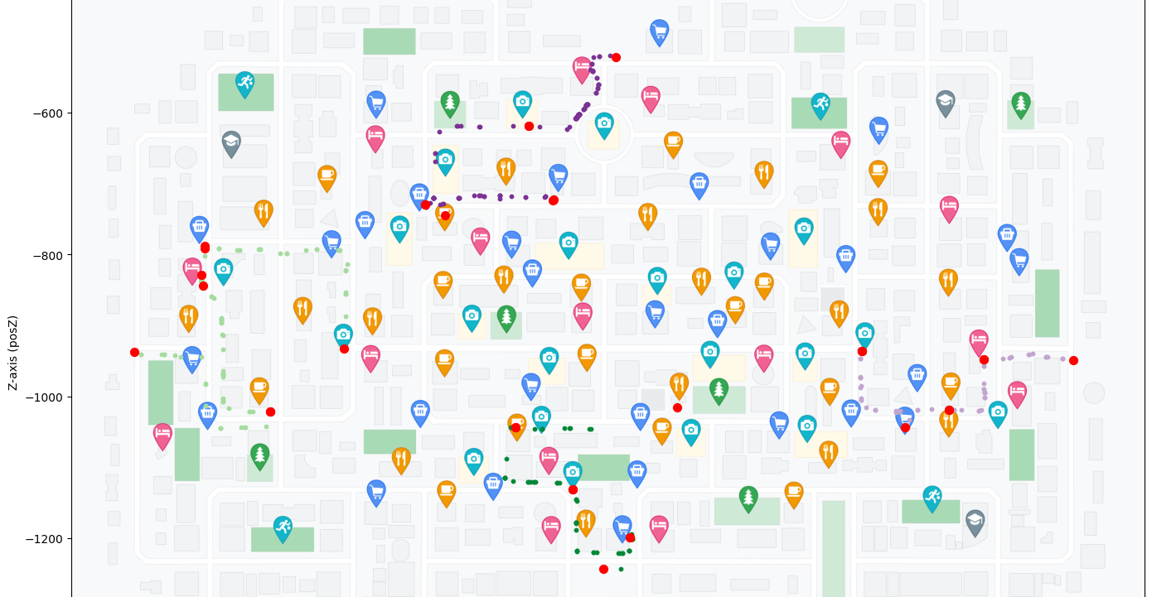
Map checking points of Participant 12
Data:

Slide 7
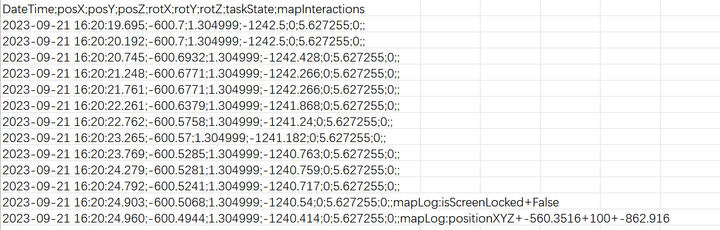
Data:
Data Structure: Time; Position; Rotation; Taskstate; Mapinterations

Slide 8
Expected outcomes
Summary of influence factors and validation
Difference results between high and low traffic density
Results from AI algorithm predicting checking points
Anticipated challenges
AI-related technical support
Data volume for AI training
Time Limitation

Slide 9
Brief timeline and planned milestone :
Milestones | Deadline
Comprehensive/systematic literature review | 04.03.2024
Determine Specific Methods and Algorithm | 18.03.2024
Research Question 1 | 15.04.2024
Research Question 2 | 06.05.2024
Research Question 3 | 30.06.2024
Paper writing | 19.08.2024
Paper review and revision | 23.09.2024
Final submission | 30.09.2024

Slide 10
Things that need to be determined:
Supervisor (Sara, Mona, Would Mona like to be the co-supervisor? Will talk it in today’s meeting. How to differentiate guidance distribution?)
Concept uploaded to lean gate (Will be finished after meeting, whether this needs to be reviewed?)
Approximate length of the Master's Thesis? (Not mandatory, default 80 pages)
Potential Journals and Conferences (What are some potential journals or conferences that may publish this project?)

