Slide 1
Agenda
Literature Review
Next steps for RQ1
Comments and Suggestions

Slide 2
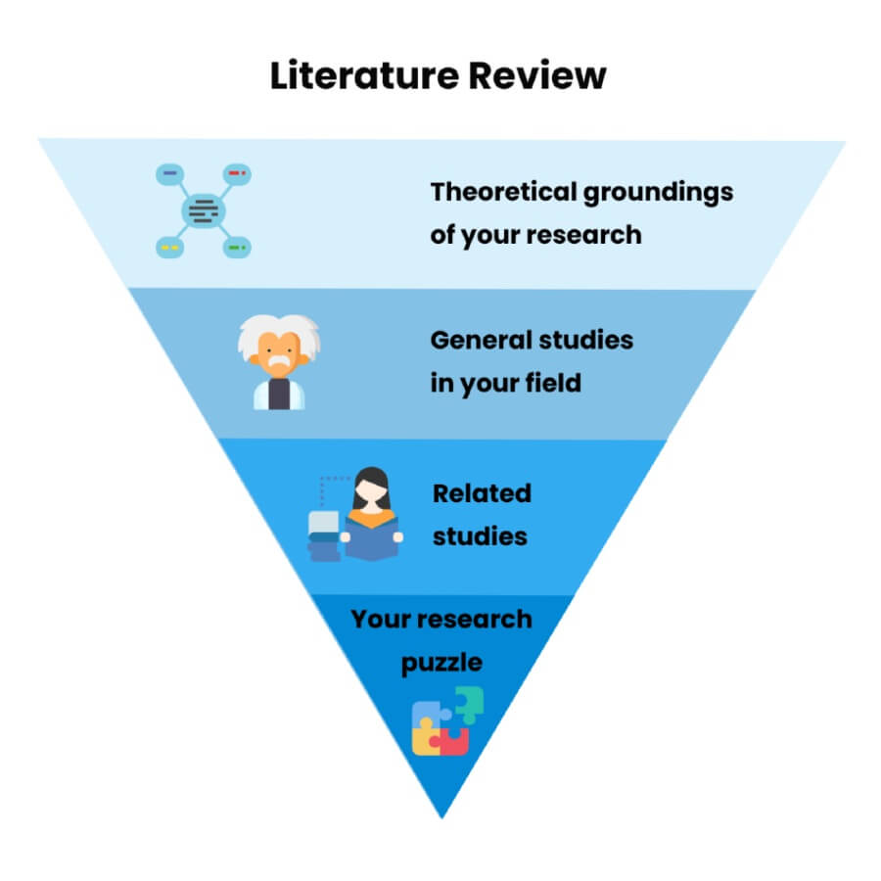
Navigation
Pedestrian Navigation
Mobile Map Pedestrian Navigation
Research Gap
Q1：Method
keyword search, citation tracking, others?
Efficient tools?
Q2：Should literature about methodology (such as data analysis/ algorithm) be put into literature review or in Chapter Methodology?

Slide 3
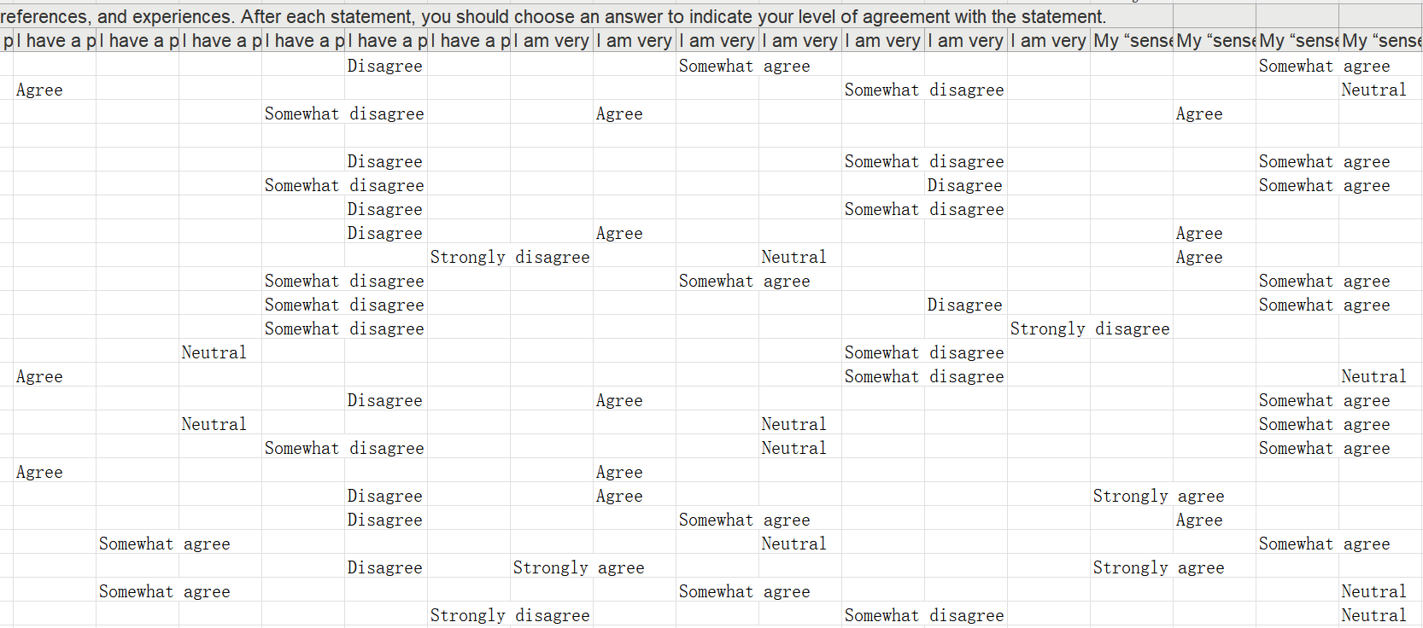
What are the main factors which influence when and where the pedestrians check the mobile map during walking navigation?
Factor | Variable X | Variable Y | Analysis
Spatial and Navigational Abilities | Santa Barbara Sense of Direction Scale | Average number of map checking points( Based on distance/ time) | Correlational Analysis/ Regression Analysis/ Statistical Significance
Santa Barbara Sense of Direction Scale

Slide 4
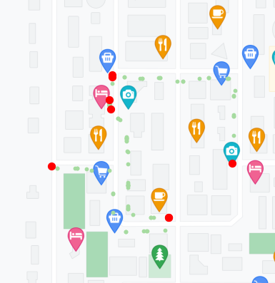
What are the main factors which influence when and where the pedestrians check the mobile map during walking navigation?
Factor | Variable X | Variable Y | Analysis
Distance to intersections | Distance interval to Intersections (0-5/5-10/10-15 ……） | Number of map checking points | Correlational Analysis/ Regression Analysis/ Statistical Significance
Interval (5-10)
Route
Intersection
Interval (0-5)

Slide 5
What are the main factors which influence when and where the pedestrians check the mobile map during walking navigation?
Factor | Variable X | Variable Y | Analysis
Distance from start point | Distance Interval from Start Point(0-5/5-10/10-15 ……） | Number of map checking points | Correlational Analysis/ Regression Analysis/ Statistical Significance
Interval (5-10)
Route
Start Point
Interval (0-5)

Slide 6
What are the main factors which influence when and where the pedestrians check the mobile map during walking navigation?
Factor | Variable X | Variable Y | Analysis
Time from start point | Time duration from Start Point(0-5/5-10/10-15 ……） | Number of map checking points | Correlational Analysis/ Regression Analysis/ Statistical Significance
Interval (Second 5s)
Route
Start Point
Interval (First 5s)

Slide 7
Comments and Suggestions:

