Slide 1
Where do you typically check the map during your navigation route?
Zhengfang Xu

Slide 2
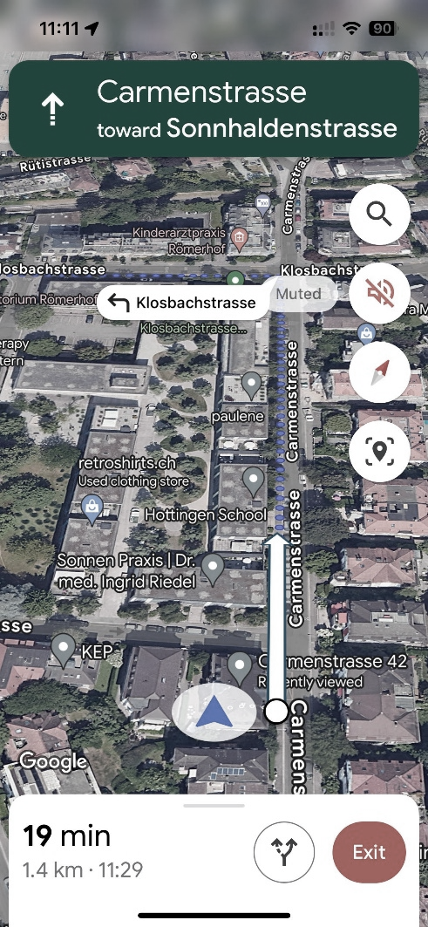
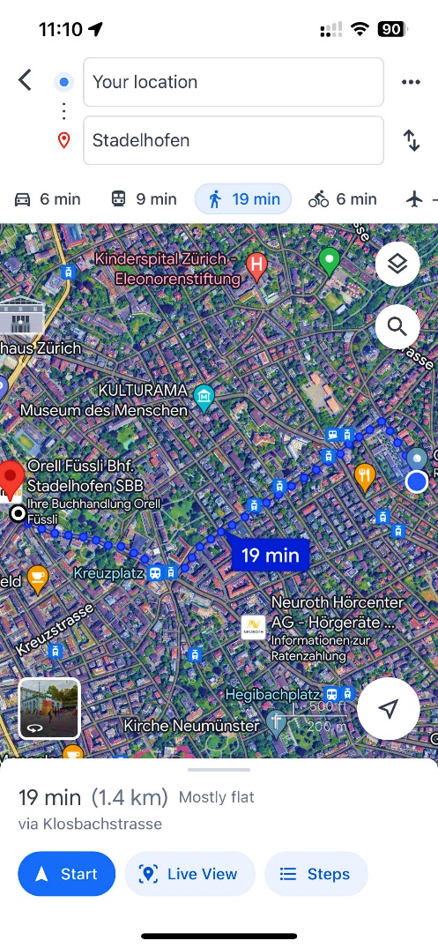
Not optimal for pedestrian navigation.
Turn-by-turn guidance have made users overly reliant on such guidance and impaired their independent wayfinding ability. [1]
Turn-by-turn navigation system negates route learning and impairs scene recognition.[2]
……
Useful paradigm for assisting people with visual impairments during mobility. [3]
Pedestrian tend to use Map Based navigation
Question:
Where do you typically check the map during your navigation route?
……
Turn by turn navigation
Map Based navigation

Slide 3
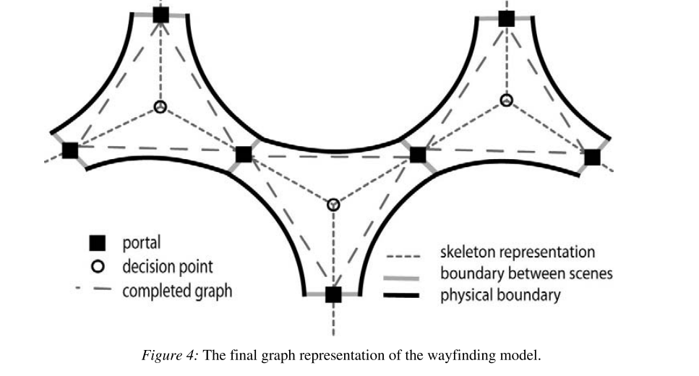
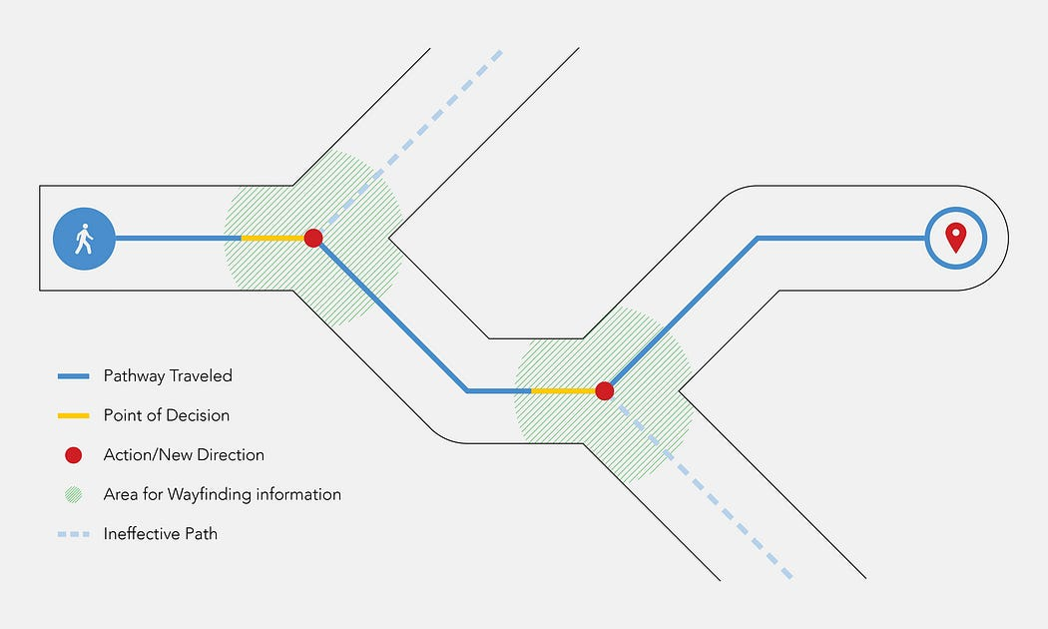
Decision points not sufficient for the more complex domain of pedestrians. [7]
Decision Points
Knowledge of routes is represented as a sequence of intersection-based choice points where procedural decisions must be made. [4]
People consistently implicate intersections as critical decision points. [5]
Path segments between intersections are distinctly non-decision-related. [6]
(Argue: It may be non-decision-related, but there are many interactions between pedestrian and map in this process.)
Decision Senses [7]
Deciding whether to continue straight or turn involves a dynamic distributed decision-making process. People tended to make the request within path segments, not intersections.[5]
Source: Medium_Written by Joseph Mackereth

Slide 4
Back to Question:
Where do you typically check the map during your navigation route?
Decision Senses Still not sufficient
If people are unsure whether the current route is correct, pedestrians must frequently confirm their current walking route with the planed route during the process of navigation.[8]
People require information between those decision points in order to maintain his trust in the information source and his confidence and orientation throughout the route.[9]
Environment (Route) Learning from spatial perspectives

Slide 5
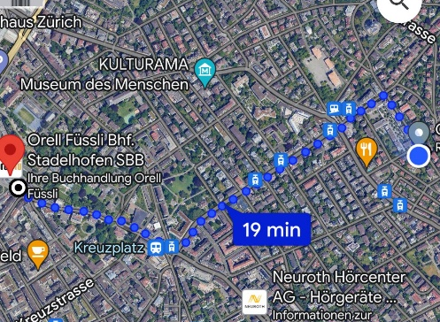
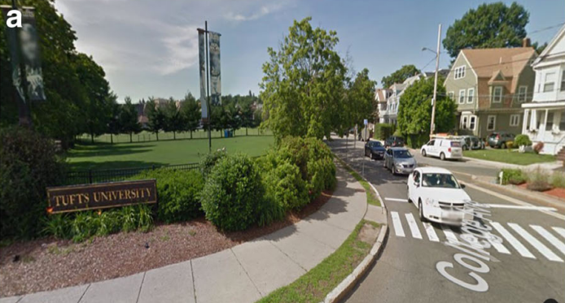
Environment Learning(EI) from spatial perspectives [10] :
Environment learning can be achieved through map study or through direct experience with the environment.
Map Study(check map in navigation)
Route Experience(without map checking)
Metacognition
Monitor&Control
EI is Goal-directed manner.
Focus on Navigating Goal. (In our case)

Slide 6
EI Research Gap [10]:
Explored the nature of EL within spatial perspectives independently.
Less studies on switching or combining Map Study and Route Experience.
EL research limited participants’ ability to choose and/or switch between spatial perspectives freely.
Hard to examine how metacognition affects how participants switch between different perspectives in EL.
Back to Question:
Where do you typically check the map during your navigation route?
Understanding the spatial distribution of Map Study and Route Experience during the navigation process can be very effective in helping us answer this question.

Slide 7
Potential Research Questions:
How are the two spatial perspectives learning, map study and route experience, distributed in a navigation route?
What are the factors that affect perspective switching in a navigation process? (e.g. environment complexity, metacognitive monitoring, individual differences in spatial skills).
How effective is predicting the distribution of the two spatial perspectives in a route using machine learning methods for individuals? (Each participant has 16 navigation routes, when give a new navigation route, could we predict where is map study and route experience segments for this individual?)
How do monitoring and control in metacognition interact during navigation route learning? (Spatial Cognition, Psychology)

Slide 8
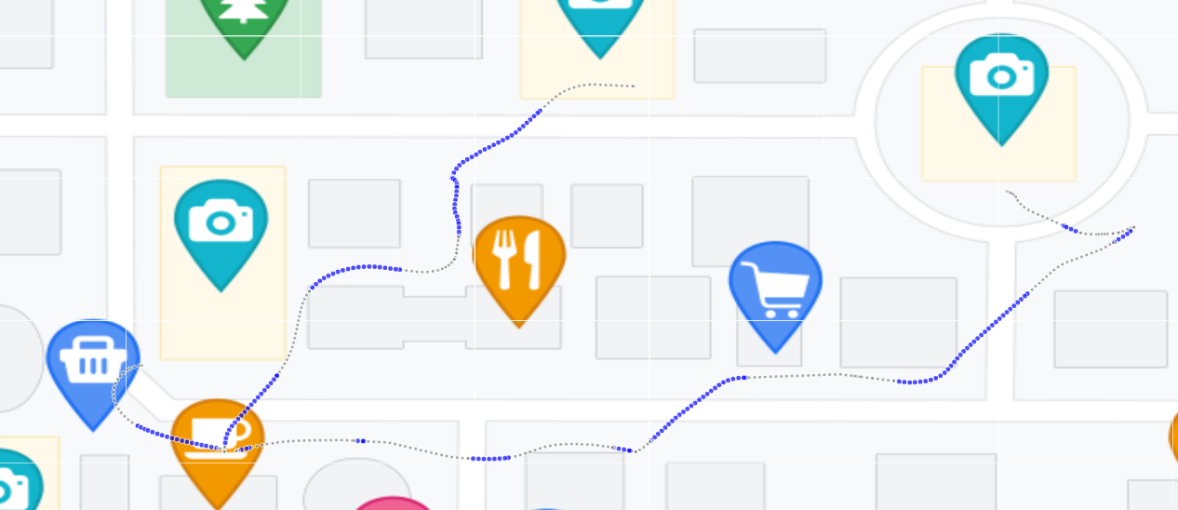
How to apply our data to research question (Interactive Visualization):
Map Study(check map in navigation)
Route Experience(without map checking)
Duration of screen unlocked
Duration of screen locked
1. How are the two spatial perspectives learning, map study and route experience, distributed in a navigation route? (Spatial Science)
Locked screen(Route experience)

Slide 9
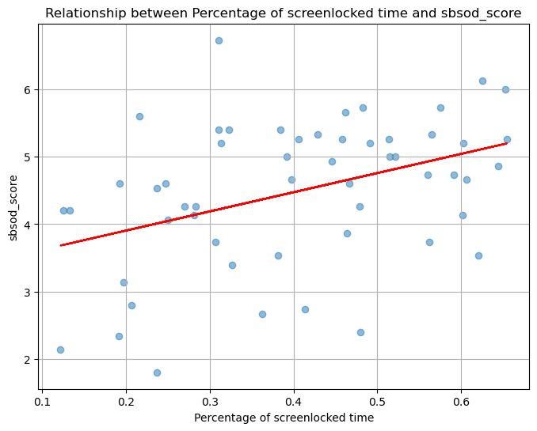
How to apply our data to research question (Interactive Visualization):
2. What are the factors that affect perspective switching in a navigation process? (e.g. environment complexity, metacognitive monitoring, individual differences in spatial skills)

Slide 10
Potential Limitations:
Is it rigorous to consider two spatial perspective learning by distinguish the screen lock or unlock?
Map Study(check map in navigation)
Route Experience(without map checking)
Duration of screen unlocked
Duration of screen locked
Alternative:
Only focus on the process of screenlocked. Because people may have undetected map check while screenunlocked, but we can definitely say they do not check map while screenlocked.

Slide 11
Reference:
[1]:Ishikawa T, Fujiwara H, Imai O, et al. Wayfinding with a GPS-based mobile navigation system: A comparison with maps and direct experience[J]. Journal of environmental psychology, 2008, 28(1): 74-82.
[2]:Fenech, E. P., Drews, F. A., & Bakdash, J. Z. (2010). The Effects of Acoustic Turn-by-turn Navigation on Wayfinding. Proceedings of the Human Factors and Ergonomics Society Annual Meeting, 54(23), 1926-1930.
[3]:Dragan Ahmetovic, Cole Gleason, Chengxiong Ruan, Kris Kitani, Hironobu Takagi, and Chieko Asakawa. 2016. NavCog: a navigational cognitive assistant for the blind. In Proceedings of the 18th International Conference on Human-Computer Interaction with Mobile Devices and Services (MobileHCI '16). Association for Computing Machinery, New York, NY, USA, 90–99. https://doi.org/10.1145/2935334.2935361.
[4]:Spatial Cognition VI Learning Reasoning and Talking about Space, 2,22–38. Kim, H., & Hirtle, S. C. (1995). Spatial metaphors and disorientation in hypertext.
[5]:Brunyé, T. T., Gardony, A. L., Holmes, A., & Taylor, H. A. (2018). Spatial decision dynamics during wayfinding: Intersections prompt the decision-making process. Cognitive Research: Principles and Implications, 3(1), 1-19.
[6]:Klippel, A. (2003). Wayfinding choremes. In Spatial Information Theory: Foundations of Geographic Information Science (Kuhn W, Worboys MF, TimpfS, Eds.) (pp. 320–334). New York, NY: Springer, Inc.
[7]:Gaisbauer C, Frank A U. Wayfinding model for pedestrian navigation[C]//AGILE 2008 Conference-Taking geo-information science one step further, University of Girona, Spain. 2008, 9.
[8]: Millonig, A., Schechtner, K. (2007). Decision Loads and Route Qualities for Pedestrians — Key Requirements for the Design of Pedestrian Navigation Services. In: Waldau, N., Gattermann, P., Knoflacher, H., Schreckenberg, M. (eds) Pedestrian and Evacuation Dynamics 2005. Springer, Berlin, Heidelberg. https://doi.org/10.1007/978-3-540-47064-9_10
[9]:May A J, Ross T, Bayer S H, et al. Pedestrian navigation aids: information requirements and design implications[J]. Personal and [9]: Ubiquitous Computing, 2003, 7: 331-338.
[10]: Dai R, Thomas A K, Taylor H A. When to look at maps in navigation: metacognitive control in environment learning[J]. Cognitive Research: Principles and Implications, 2018, 3: 1-12.

