Slide 1
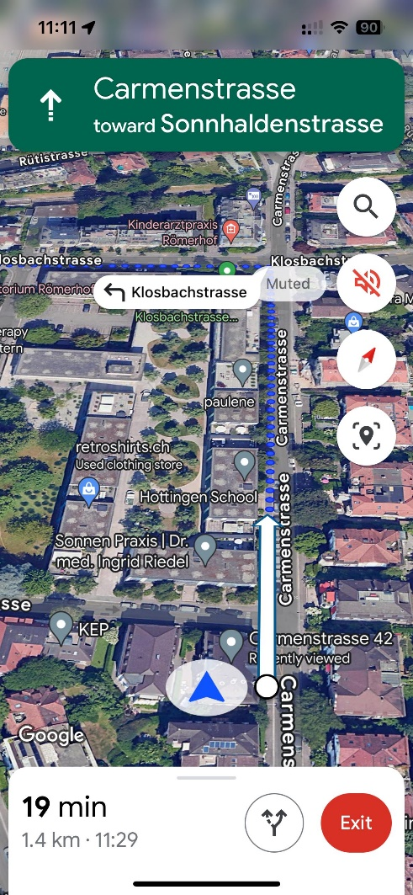
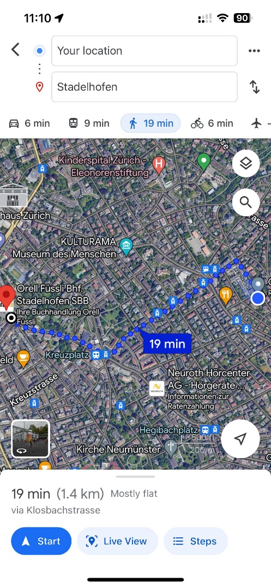
Turn-by-turn navigation aids are not optimal for pedestrian navigation.
Turn-by-turn guidance have made users overly reliant on such guidance and impaired their independent wayfinding ability. [1]
turn-by-turn navigation system negates route learning and impairs scene recognition.[2]
……
Pedestrian tend to use Map Based navigation
(need scientific support)
Question:
Where do you typically check the map during your navigation route?
……
Turn by turn navigation
Map Based navigation

Slide 2
Decision Points
Knowledge of routes is represented as a sequence of intersection-based choice points where procedural decisions must be made. [3]
People consistently implicate intersections as critical decision points. [4]
Path segments between intersections are distinctly non-decision-related. [5]
(Argue: It may be non-decision-related, but there are many interactions between pedestrian and map in this)

Slide 3
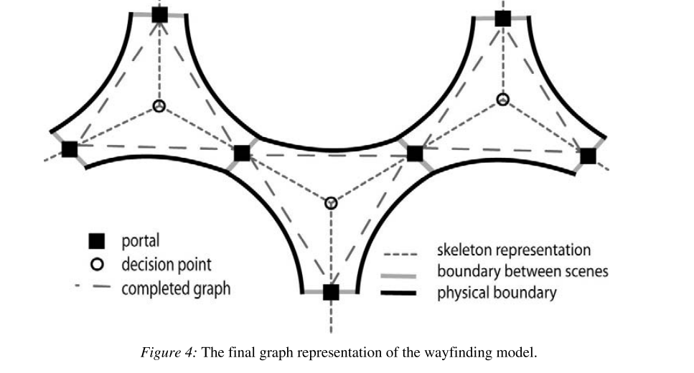
Decision Points are not enough
Decision points not sufficient for the more complex domain of pedestrians. [6]
Deciding whether to continue straight or turn involves a dynamic distributed decision-making process. People tended to make the request within path segments, not intersections.[4]
Decision Sence [6]
Argue: Still work on intersections(Decision Points).

Slide 4
Confirmation Points (need scientific support for terminology)
Four factors in wayfinding orientation, route decision, route monitoring and destination recognition. [7]
If people are unsure whether the current route is correct, pedestrians must frequently confirm their current walking route with the planed route during the process of navigation.[8]
People require information between those decision points in order to maintain his trust in the information source and his confidence and orientation throughout the route.[9]
Argue: There need more deep studies to the confirmation points.

Slide 5
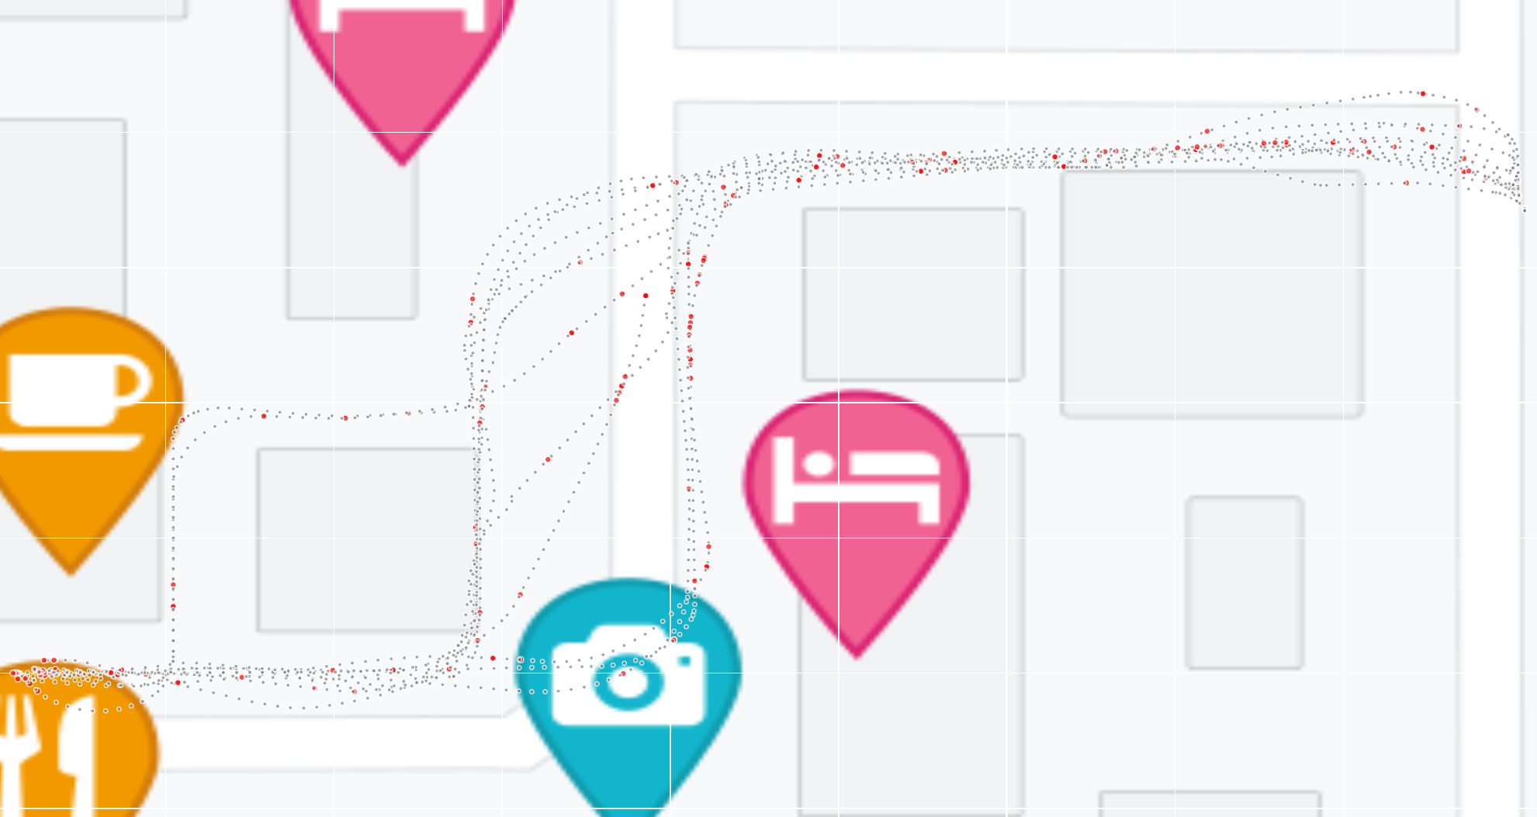
Data
Map check points
Interactive Visualization

Slide 6
Potential research questions:
A: How to differentiate decision points and confirm points through the interaction between people and maps?
B: How are decision points and confirm points distributed along the navigation route?
C: Can machine learning algorithms predict the distribution of decision points and confirm points in different navigation routes?

Slide 7
Reference:
[1]:Ishikawa T, Fujiwara H, Imai O, et al. Wayfinding with a GPS-based mobile navigation system: A comparison with maps and direct experience[J]. Journal of environmental psychology, 2008, 28(1): 74-82.
[2]:Fenech, E. P., Drews, F. A., & Bakdash, J. Z. (2010). The Effects of Acoustic Turn-by-turn Navigation on Wayfinding. Proceedings of the Human Factors and Ergonomics Society Annual Meeting, 54(23), 1926-1930.
[3]:Spatial Cognition VI Learning Reasoning and Talking about Space, 2,22–38. Kim, H., & Hirtle, S. C. (1995). Spatial metaphors and disorientation in hypertext.
[4]:Brunyé, T. T., Gardony, A. L., Holmes, A., & Taylor, H. A. (2018). Spatial decision dynamics during wayfinding: Intersections prompt the decision-making process. Cognitive Research: Principles and Implications, 3(1), 1-19.
[5]:Klippel, A. (2003). Wayfinding choremes. In Spatial Information Theory: Foundations of Geographic Information Science (Kuhn W, Worboys MF, TimpfS, Eds.) (pp. 320–334). New York, NY: Springer, Inc.
[6]:Gaisbauer C, Frank A U. Wayfinding model for pedestrian navigation[C]//AGILE 2008 Conference-Taking geo-information science one step further, University of Girona, Spain. 2008, 9.
[7]:Fateme Teimouri, Kai-Florian Richter & Hartwig H. Hochmair. (2023) Analysis of route choice based on path characteristics using Geolife GPS trajectories. Journal of Location Based Services 17:3, pages 271-297.
[8]: Millonig, A., Schechtner, K. (2007). Decision Loads and Route Qualities for Pedestrians — Key Requirements for the Design of Pedestrian Navigation Services. In: Waldau, N., Gattermann, P., Knoflacher, H., Schreckenberg, M. (eds) Pedestrian and Evacuation Dynamics 2005. Springer, Berlin, Heidelberg. https://doi.org/10.1007/978-3-540-47064-9_10
[9]:May A J, Ross T, Bayer S H, et al. Pedestrian navigation aids: information requirements and design implications[J]. Personal and Ubiquitous Computing, 2003, 7: 331-338.

