Slide 1
RQ
Linear
SA
Research Question:
1. What are trajectory factors (e.g., intersections, turns, length etc.) that influence pedestrian map checking behavior, and how do these factors affect the map checking behavior?
2. What are the differences in map-checking behavior between heavy and light traffic density conditions?

Slide 2
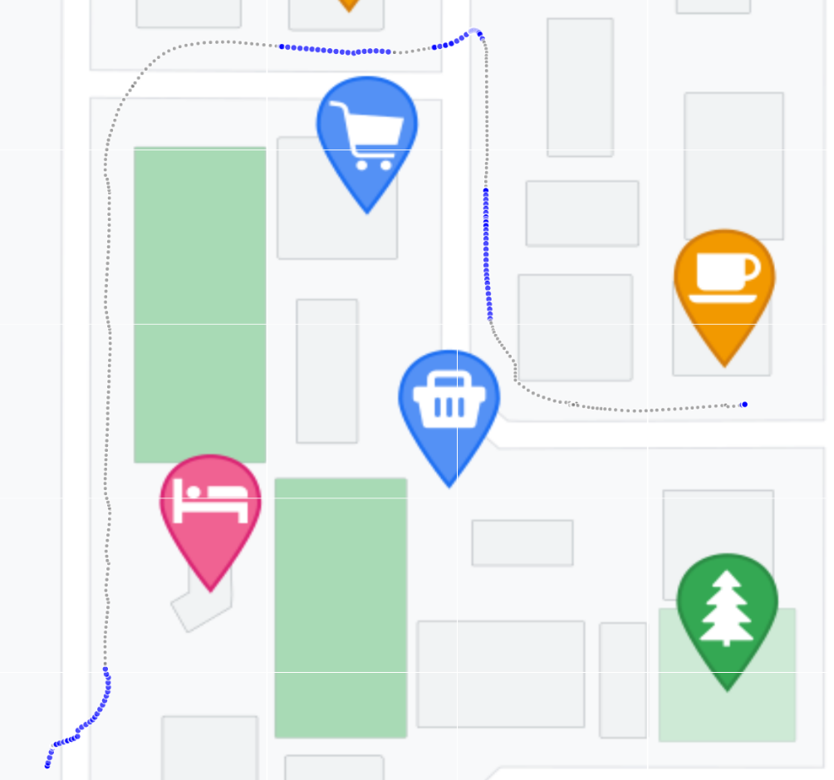
RQ
Linear
SA
Indicator of map checking behavior in this case:
Duration of each mobile map inactive phase
Why?
If we know the duration of each mobile map inactive phase, it can help achieve automatic map activation or other forms of navigation prompts.
Blue: map active phase
Grey: map inactive phase

Slide 3
RQ
Linear
SA
Research questions adjustments:
1. What are trajectory factors (e.g., intersections, turns, length etc.) that influence pedestrian map checking behavior, and how do these factors affect the map checking behavior?
2. What are the differences in map-checking behavior between heavy and light traffic density conditions?
1. Which properties of the environment impact duration of each mobile map inactive phase
in a map-assisted pedestrian navigation session?
2. Which of properties of wayfinders have an impact on duration of each mobile map inactive phase in a map-assisted pedestrian navigation?
3. Which of map interactions have an impact on duration of each mobile map inactive phase in a map-assisted pedestrian navigation?

Slide 4

RQ
Linear
SA
Independent Variable metrics:
Wayfinder | Environment | Map interaction
gender | Traffic_density | map_type
age | if_cross_road | if_pan
sbsod_score | if_pre_cross_road | if_selflocation
mobile_map_using_frequency | if_shortcut | if_follow
 | num_poi | if_zoom
 | segment_length
 | route_completion_rate
Dependent Variable :
The duration of each map inactivity

Slide 5
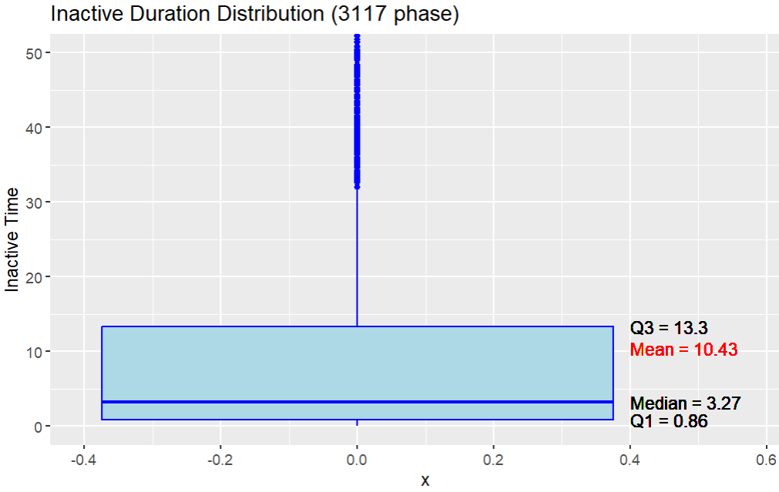
RQ
Linear
SA
Descriptive:

Slide 6
RQ
Linear
SA
Why survival analysis?

Slide 7
RQ
Linear
SA
Ordinary linear regression:
Wayfinder | β | p | Environment | β | p | Map interaction | β | p
age | 1.80548 | 0.000125 | Traffic_density | 1.20512 | 0.016657 | if_follow | -5.37718 | 0.002824
sbsod_score | 1.73167 | 3.69e-13 | if_cross_intersection | 17.24221 | < 2e-1 | map_type | 0.23975 | 0.630537
mobile_map_using_frequency | -1.75111 | 0.000200 | if_pre_cross_intersection | 1.91026 | 0.007193 | if_pan | -0.17795 | 0.819914
gender | 0.53554 | 0.367696 | route_completion_rate | -6.97748 | 8.13e-14 | if_selflocation | 1.94606 | 0.782931
 |  |  | if_shortcut | 0.01729 | 0.977283 | if_zoom | -1.02105 | 0.174546
 |  |  | num_poi | tbd | tbd
 |  |  | segment_length | tbd | tbd

Slide 8
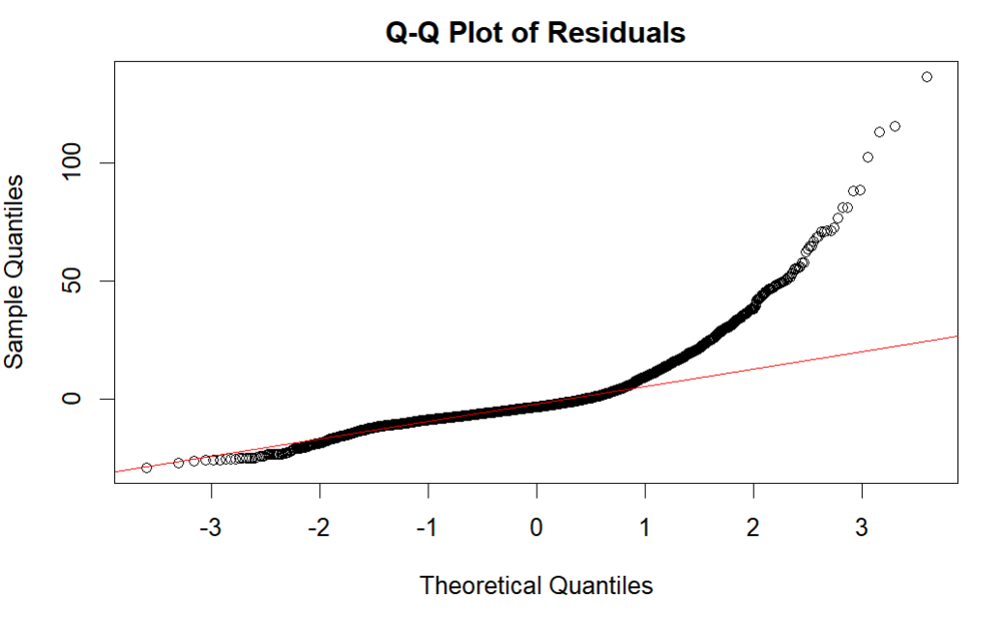
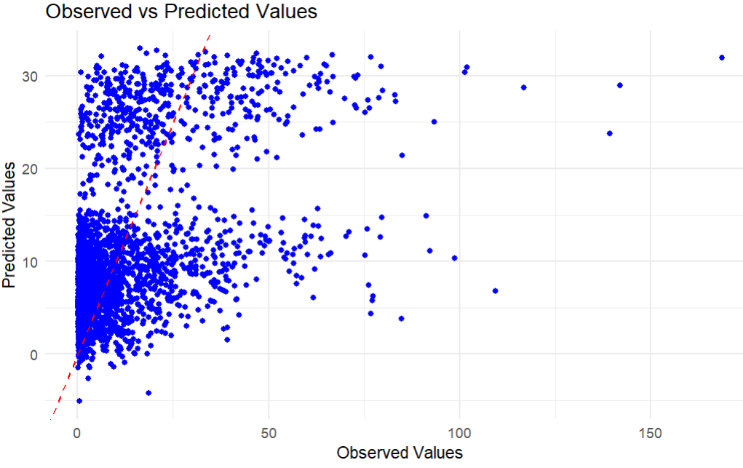
RQ
Linear
SA
Ordinary linear regression:
Adjusted R² = 24.22

Slide 9
RQ
Linear
SA
Why survival analysis:
Less restricted by model assumptions.
Covariate effects over time. (For instance, a factor may have little effect on shorter durations, but a large effect on longer durations.)
Interpretation of results: Survival curve, hazard functions, hazard ratio, etc.
Robust to choose when to automatic active the mobile map or give other types navigation aids.
For different covariates set, the predicted outcome is not a specific number, it is survival curve.
(Comparing with linear model that we give covariates to it, and it returned a specific value.)

Slide 10
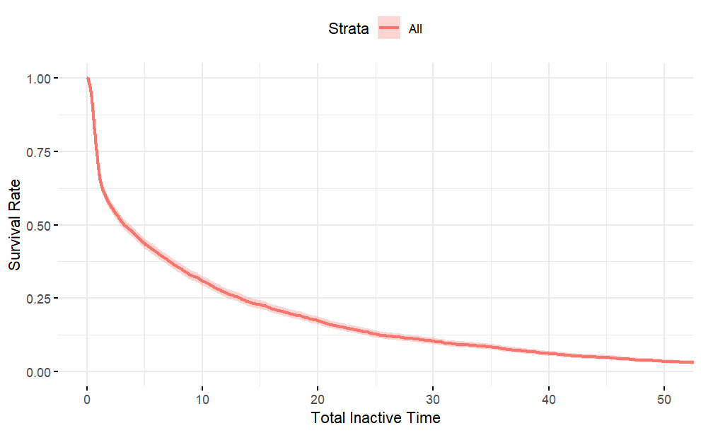
RQ
Linear
SA
Survival analysis(KM curve):
3.27
Duration of each map inactive phase

Slide 11
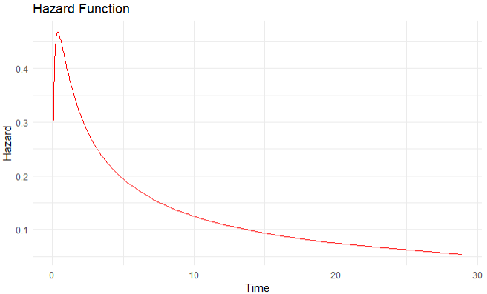
RQ
Linear
SA
Survival analysis(Hazard function):

Slide 12
RQ
Linear
SA
Survival Analysis (model selection):
Proportional hazards model: the covariates have a constant multiplicative effect on the hazard function.
Accelerated failure time (AFT): effect of the covariates on the hazard function is multiplicative on the time scale, thus not constant. More plausible alternative (Giannopoulos, 2017)

Slide 13
RQ
Linear
SA
Survival Analysis results:
Wayfinder | Exp(β) | p | Environment | Exp(β) | p | Map interaction | Exp(β) | p
age | 1.153955 | 0.0019 | Traffic_density | 1.1765054 | 0.0010 | if_follow | 0.673645 | 0.0253
sbsod_score | 1.243211 | <2e-16 | if_cross_intersection | 5.9758095 | <2e-16 | map_type | 0.948879 | 0.2835
mobile_map_using_frequency | 0.835751 | 0.0001 | if_pre_cross_intersection | 1.1501770 | 0.0448 | if_pan | 0.923867 | 0.3021
gender | 1.172570 | 0.0064 | route_completion_rate | 0.7601516 | 0.0027 | if_selflocation | 1.357681 | 0.6592
 |  |  | if_shortcut | 1.0095016 | 0.8739 | if_zoom | 1.041577 | 0.5810
 |  |  | num_poi | tbd | tbd
 |  |  | segment_length | tbd | tbd
β : coefficients (β) represent the effect of covariates on the (log-transformed) survival time.
Exp(β): if exp(β) = 1.5, the expected survival time is 1.5 times longer for a one-unit increase in the covariate.

Slide 14
RQ
Linear
SA
Survival Analysis results:
Wayfinder | Exp(β) | p | Environment | Exp(β) | p | Map interaction | Exp(β) | p
age | 1.153955 | 0.0019 | Traffic_density | 1.1765054 | 0.0010 | if_follow | 0.673645 | 0.0253
sbsod_score | 1.243211 | <2e-16 | if_cross_intersection | 5.9758095 | <2e-16 | map_type | 0.948879 | 0.2835
mobile_map_using_frequency | 0.835751 | 0.0001 | if_pre_cross_intersection | 1.1501770 | 0.0448 | if_pan | 0.923867 | 0.3021
gender | 1.172570 | 0.0064 | route_completion_rate | 0.7601516 | 0.0027 | if_selflocation | 1.357681 | 0.6592
 |  |  | if_shortcut | 1.0095016 | 0.8739 | if_zoom | 1.041577 | 0.5810
 |  |  | num_poi | tbd | tbd
 |  |  | segment_length | tbd | tbd
Vs linear
Wayfinder | β | p | Environment | β | p | Map interaction | β | p
age | 1.80548 | 0.000125 | Traffic_density | 1.20512 | 0.016657 | if_follow | -5.37718 | 0.002824
sbsod_score | 1.73167 | 3.69e-13 | if_cross_intersection | 17.24221 | < 2e-1 | map_type | 0.23975 | 0.630537
mobile_map_using_frequency | -1.75111 | 0.000200 | if_pre_cross_intersection | 1.91026 | 0.007193 | if_pan | -0.17795 | 0.819914
gender | 0.53554 | 0.367696 | route_completion_rate | -6.97748 | 8.13e-14 | if_selflocation | 1.94606 | 0.782931
 |  |  | if_shortcut | 0.01729 | 0.977283 | if_zoom | -1.02105 | 0.174546
 |  |  | num_poi | tbd | tbd
 |  |  | segment_length | tbd | tbd

Slide 15
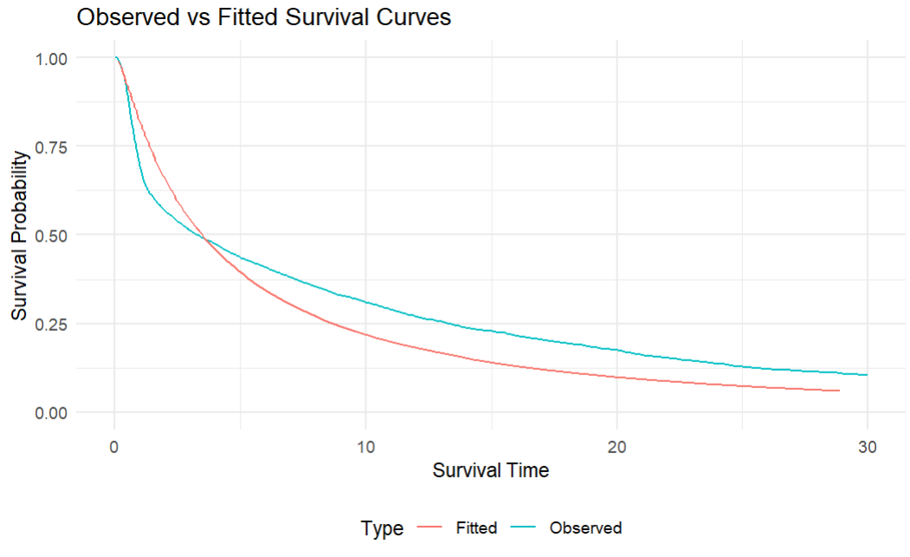
RQ
Linear
SA
Survival Analysis results:

Slide 16
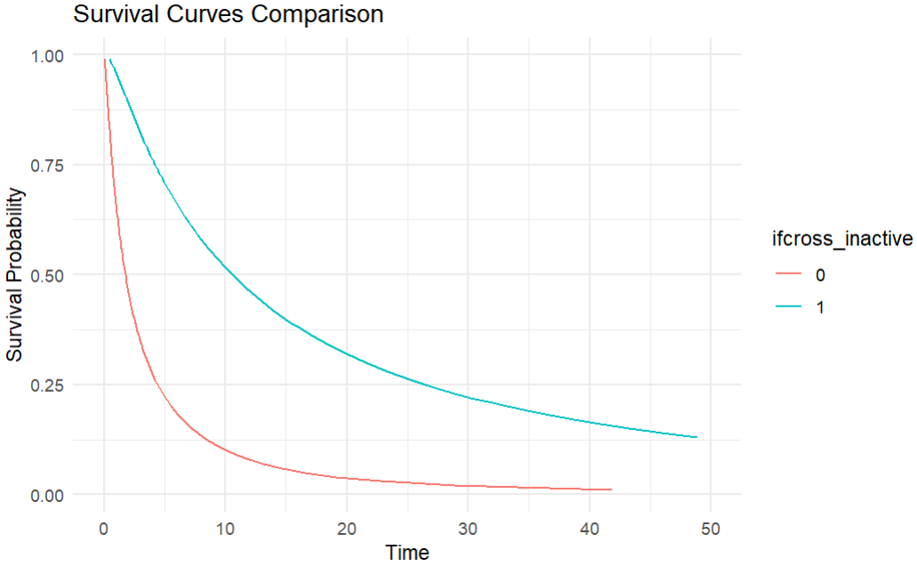
RQ
Linear
SA
Survival Analysis results:
Compare the survival curves for a female aged 18-24 with an SBSOD score of 3 and a map use frequency of at most once a week, under two conditions:
crossing road or not crossing road

Slide 17
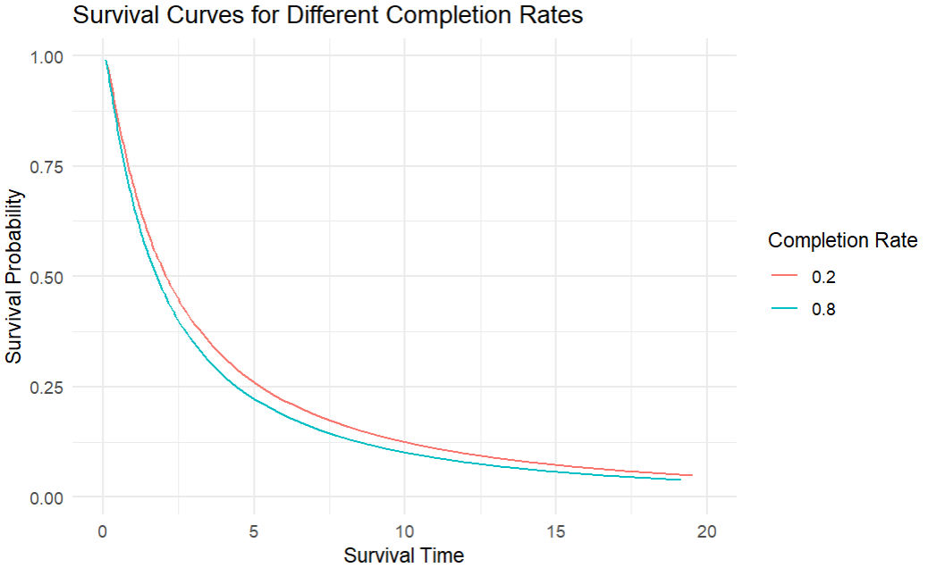
RQ
Linear
SA
Survival Analysis results:
Compare the survival curves for a female aged 18-24 with an SBSOD score of 3 and a map use frequency of at most once a week, under two conditions:
20% completion rate vs 80% completion rate

