Slide 1
Research Question:
1. What are trajectory factors (e.g., intersections, turns, length etc.) that influence pedestrian map checking behavior, and how do these factors affect the map checking behavior?
2. What are the differences in map-checking behavior between heavy and light traffic density conditions?

Slide 2
Indicator of map checking behavior in this case:
Mobile map active phase
Mobile map inactive phase
Holly Taylor in 1992 introduced the concepts of the survey perspective and the route perspective, (difference in viewpoint).
In 1999, she pointed out the correspondence between the survey perspective and maps, and the route perspective and navigation.
In 2018, Ruizhi Dai noted that modern technology has made switching between the two perspectives easier and called for more research on spatial perspective switching.

Slide 3

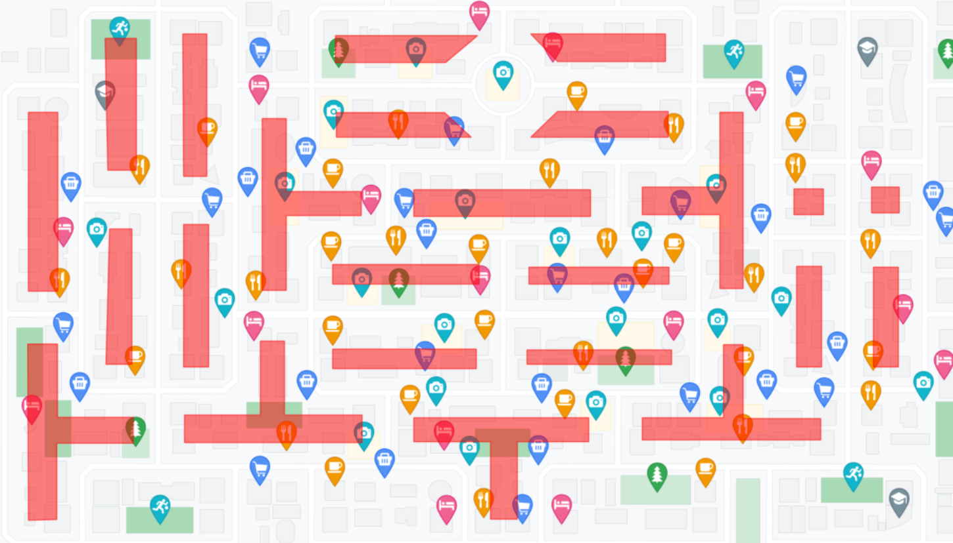
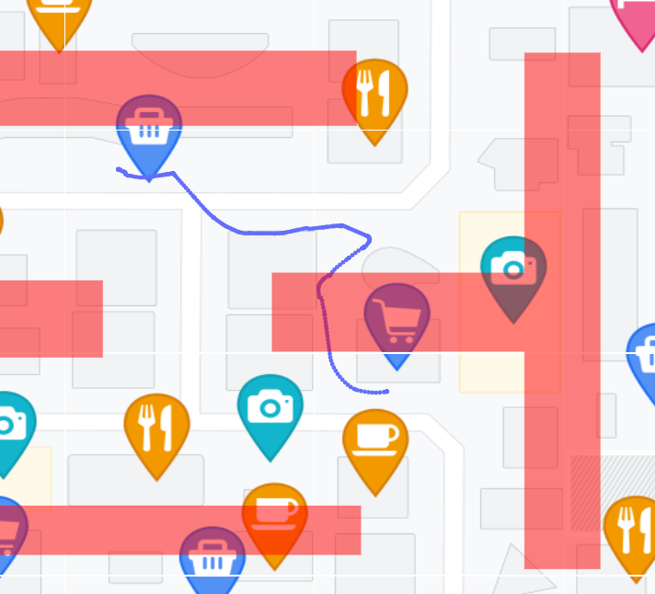
View
DP
Feature
Regression
Next
Data Process: Differentiate trajectory with and without shortcuts
Method:
Building shortcuts blocks
Spatial intersection between trajectory and shortcuts blocks
Shortcuts blocks
Trajectory with shortcuts

Slide 4
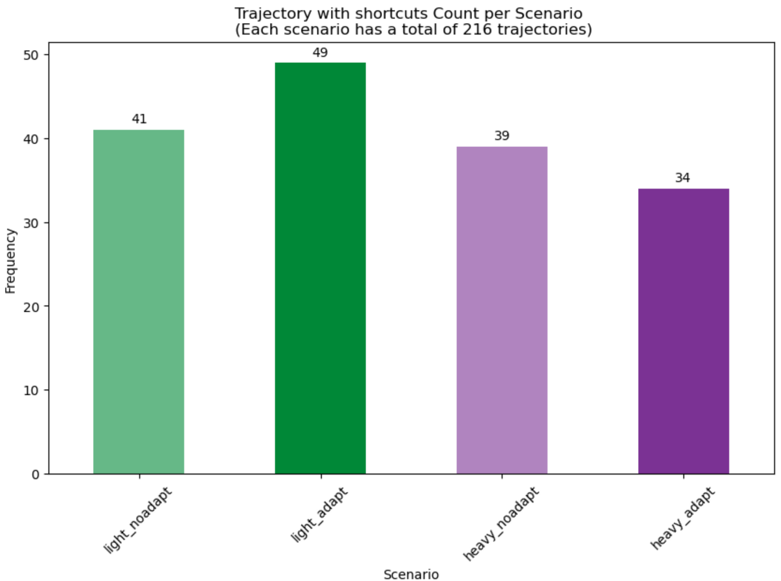
Data Process: Differentiate trajectory with and without shortcuts
Results:
863 Trajectory
701 Trajectory
without shortcuts
162 Trajectory
with shortcuts

Slide 5
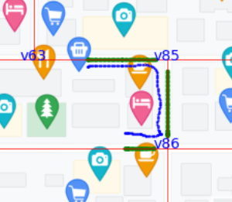
Data Process: Align trajectory to road network
Method:
Building road network (consist of road segments).
Find nearest segment for each point in the original trajectory.
Project the original point to the nearest segment.
Blue: original trajectory
Green: aligned trajectory

Slide 6
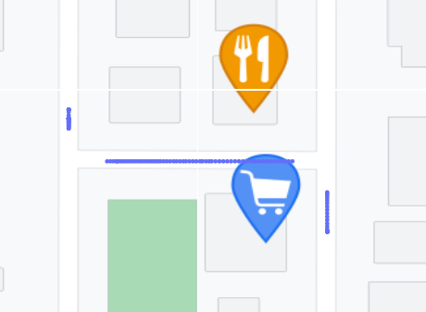
Data Process: Align trajectory to road network
Method:
4. If the length of a segment is less than 10, merge it into the next segment.
Avoid regarding this as an intersection
Segment1
Segment1<10
Segment2
Segment2
Segment2
Segment3
Segment3

Slide 7
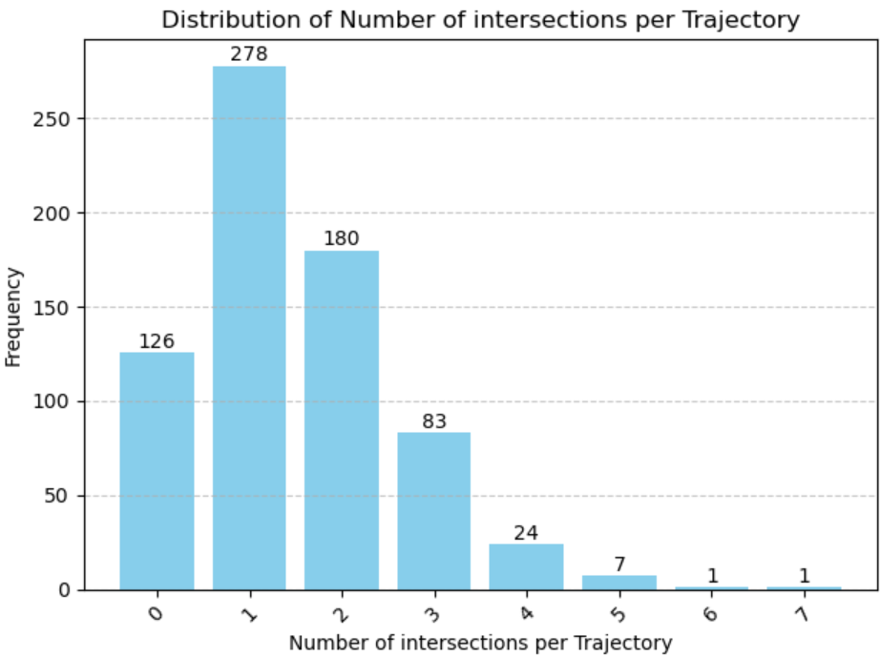
View
DP
Feature
Regression
Next
Data Analysis: Cluster trajectory based on the number of intersections.
Method:
Number of intersections = number of segments - 1
Result:
701 Trajectory
without short cuts
126 Trajectory
with 0 intersection
278 Trajectory
with 1 intersection
180 Trajectory
with 2 intersections
83 Trajectory
with 3 intersections
……

Slide 8
View
DP
Feature
Regression
Next
Data Analysis:

Slide 9
View
DP
Feature
Regression
Next
Data Analysis: For trajectory with 1 intersection (In total 278)
Data Analysis: For trajectory with 1 intersection (In total 278)
167 times checking in first segment
66 times
before intersection
109 times
after intersection
118 times checking in second segment

Slide 10
View
DP
Feature
Regression
Next
Data Analysis: Before / after intersection
66 trajectories
have map checking behavior before intersection
109 trajectories
have map checking behavior after intersection
For 278 trajectories with 1 intersections

Slide 11
View
DP
Feature
Regression
Next
Data Analysis: Before / after intersection
44 trajectories
have map checking behavior before 1st intersection
106 trajectories
have map checking behavior after 1st intersection
52 trajectories
have map checking behavior before 2nd intersection
17 trajectories
have map checking behavior after 2nd intersection
For 180 trajectories with 2 intersections

Slide 12
View
DP
Feature
Regression
Next
Data Analysis: Before / after intersection
For 83 trajectories with 3 intersections
25 trajectories
have map checking behavior before 1st intersection
33 trajectories
have map checking behavior before 2nd intersection
10 trajectories
have map checking behavior before 3rd intersection

Slide 14
View
DP
Feature
Regression
Next
Does the behavior of map checking differ depending on the sequence of intersections? (e.g., fewer checking possibility in the first intersection than latter ones)
278 Trajectory
with 1 intersection
= 40 distance units
180 Trajectory
with 2 intersections
66 trajectories
involve map checking
Probability: 23.7%
44 trajectories
involve map checking
Probability: 24.4%
52 trajectories
involve map checking
Probability: 28.9%

Slide 15
View
DP
Feature
Regression
Next
Does the behavior of map checking differ depending on the sequence of intersections? (e.g., fewer checking possibility in the first intersection than latter ones)
83 Trajectory
with 3 intersections
= 30 distance units
25 trajectories
involve map checking
Probability: 30.1%
33 trajectories
involve map checking
Probability: 39.7%
18 trajectories
involve map checking
Probability: 21.6%

Slide 16
Features
View
DP
Feature
Regression
Next

Slide 17
Features
View
DP
Feature
Regression
Next

Slide 18
Features
View
DP
Feature
Regression
Next

Slide 19
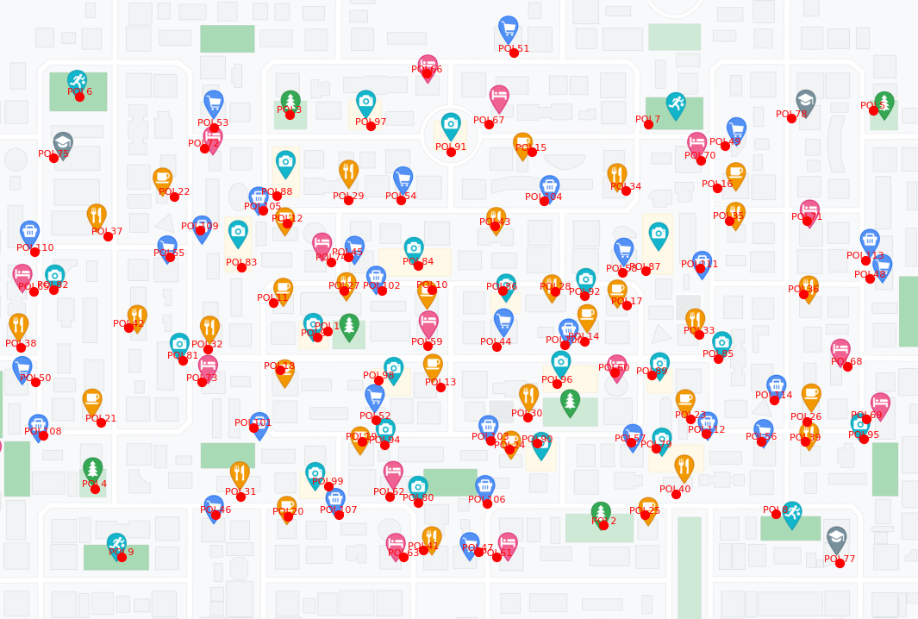
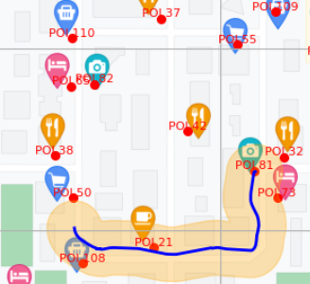
Features
View
DP
Feature
Regression
Next
Num_POIs
Method:
1. Create POI locations
2. Create buffer for trajectory,

Slide 20
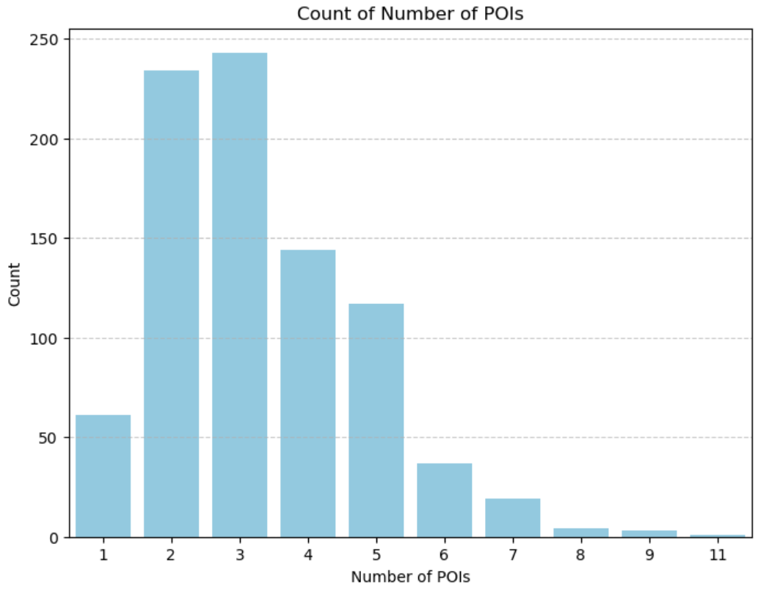
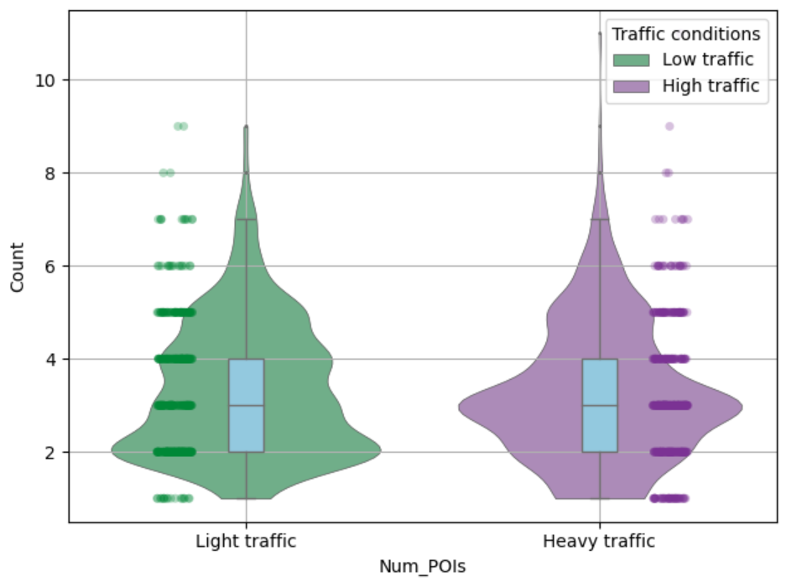
Features
View
DP
Feature
Regression
Next
Num_POIs : result

Slide 21
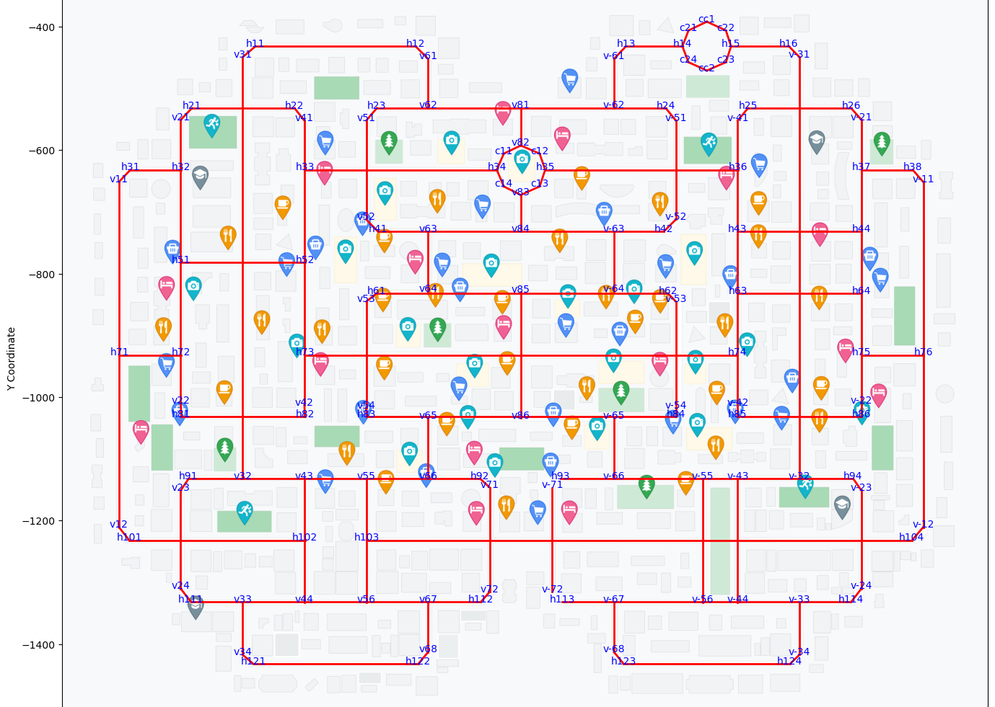
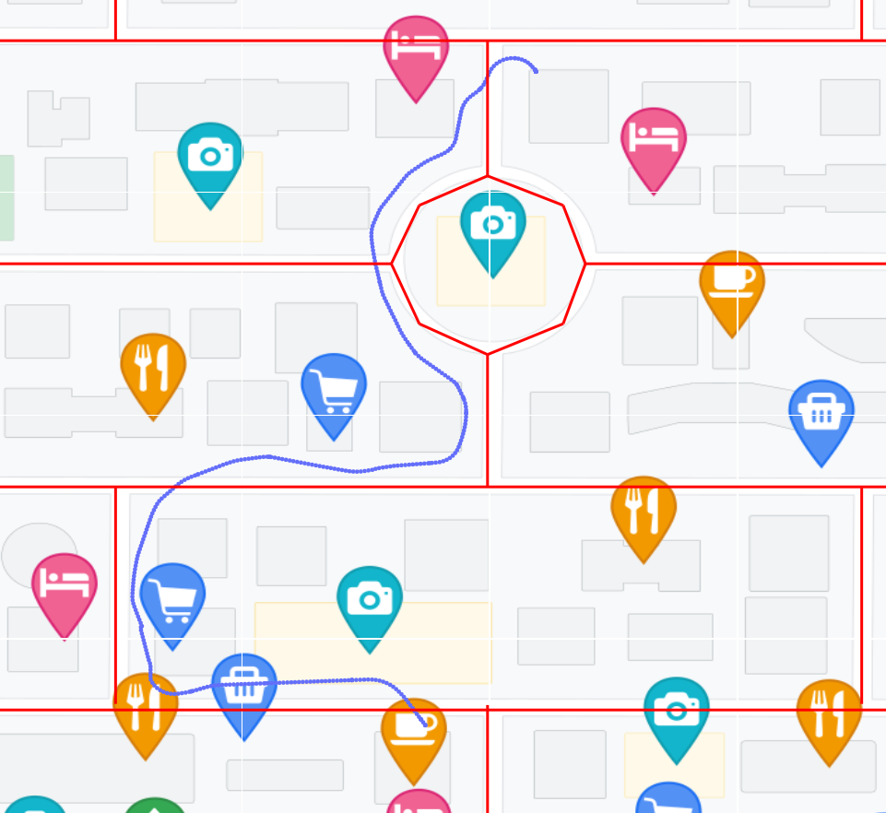
Features
View
DP
Feature
Regression
Next
Num_crossroad
Method:
1. Create road network
2. Spatial intersection between trajectory and road network

Slide 22
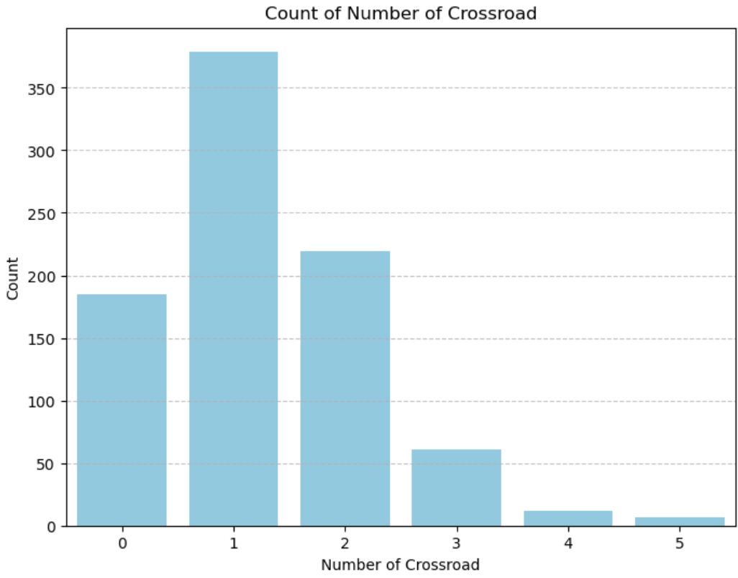
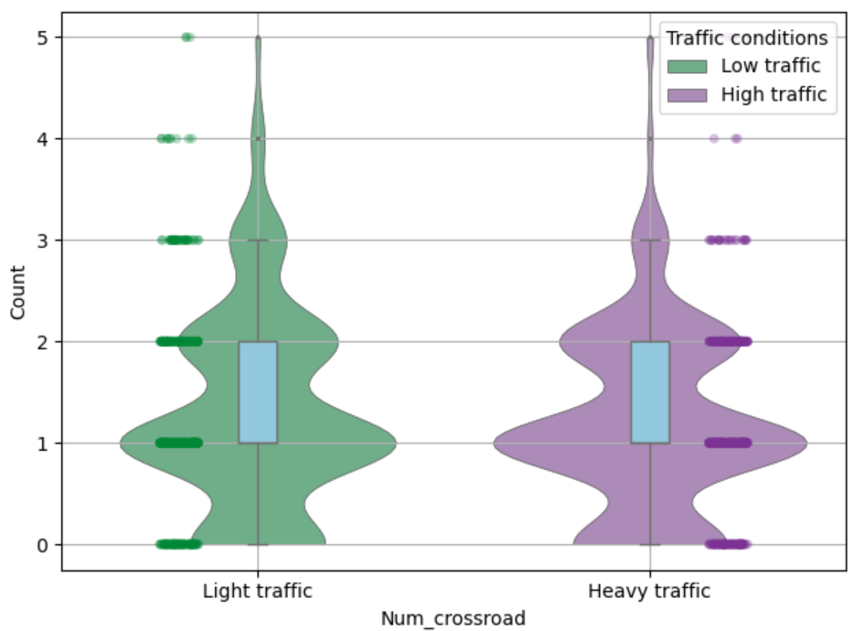
Features
View
DP
Feature
Regression
Next
Num_crossroad : result

Slide 23
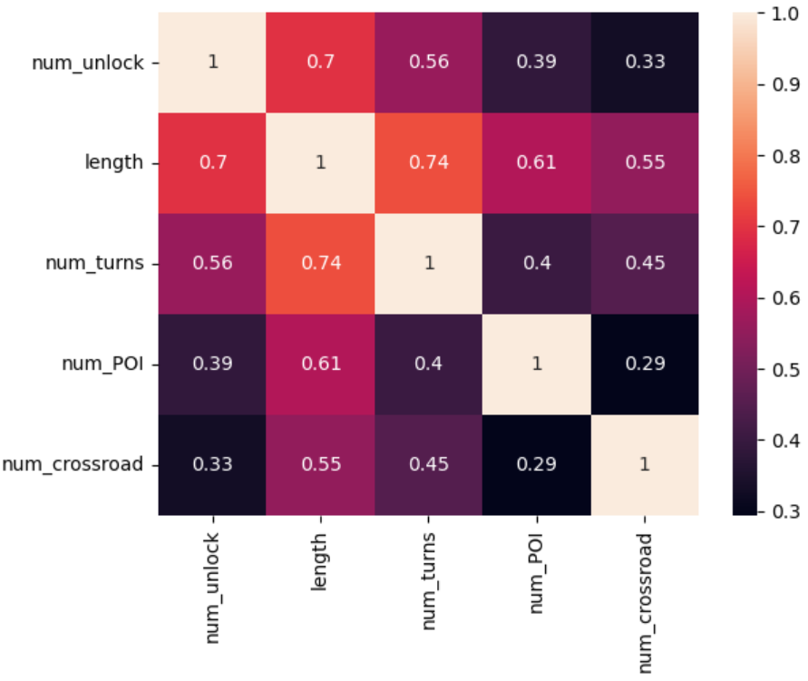
Features
View
DP
Feature
Regression
Next

Slide 24
Regression analysis
View
DP
Feature
Regression
Next
Model | Dependent variable | Predictors | MSE
Linear regression | Num_unlock | Length | 5.0124
Linear regression | Num_unlock | Length, Num_turns | 4.9599
Linear regression | Num_unlock | Length, Num_turns, Num_POIs | 4.9454
Linear regression | Num_unlock | Length, Num_turns, Num_POIs, Num_crossroad | 4.8972
Poisson regression | Num_unlock | Length, Num_turns, Num_POIs, Num_crossroad | 5.5643

Slide 25
Next steps
View
DP
Feature
Regression
Next
Feature detection
Outlier handling
Model learning and experimentation

