Slide 1
View
DP
Feature
Regression
Next
Object: Trajectory
Dependent variable
Features
Number of screen unlock
Length
Number of turns
Number of POIs
Number of crossing roads

Slide 2
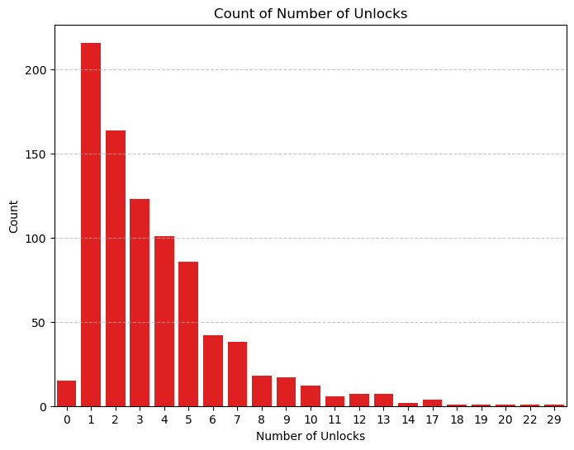
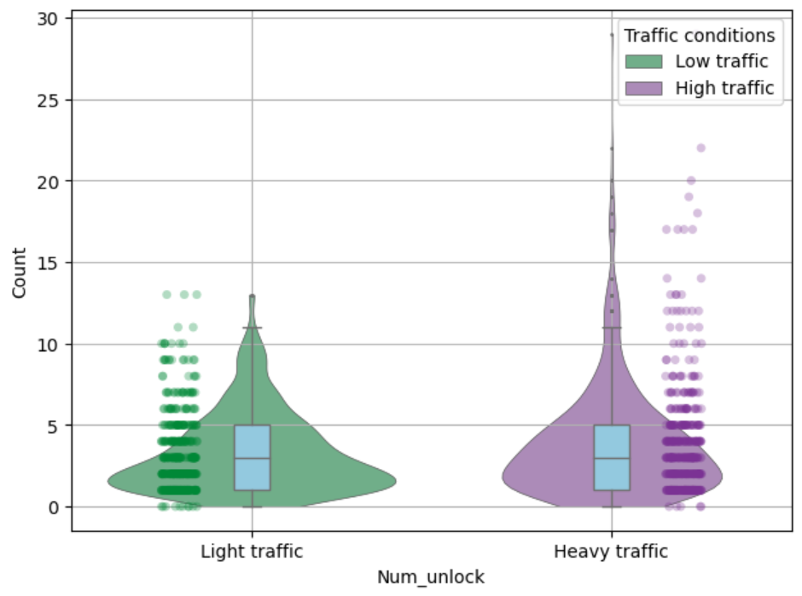
Dependent variable
View
DP
Feature
Regression
Next
Number of screen unlock

Slide 3
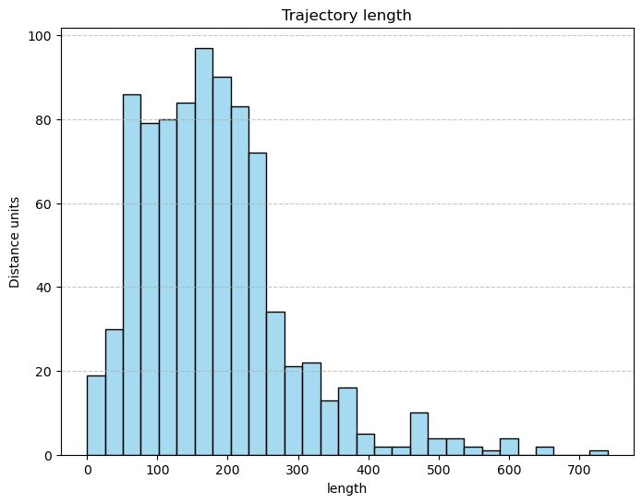
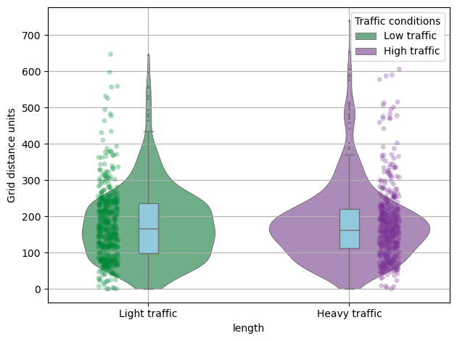
Features
View
DP
Feature
Regression
Next
Length

Slide 4
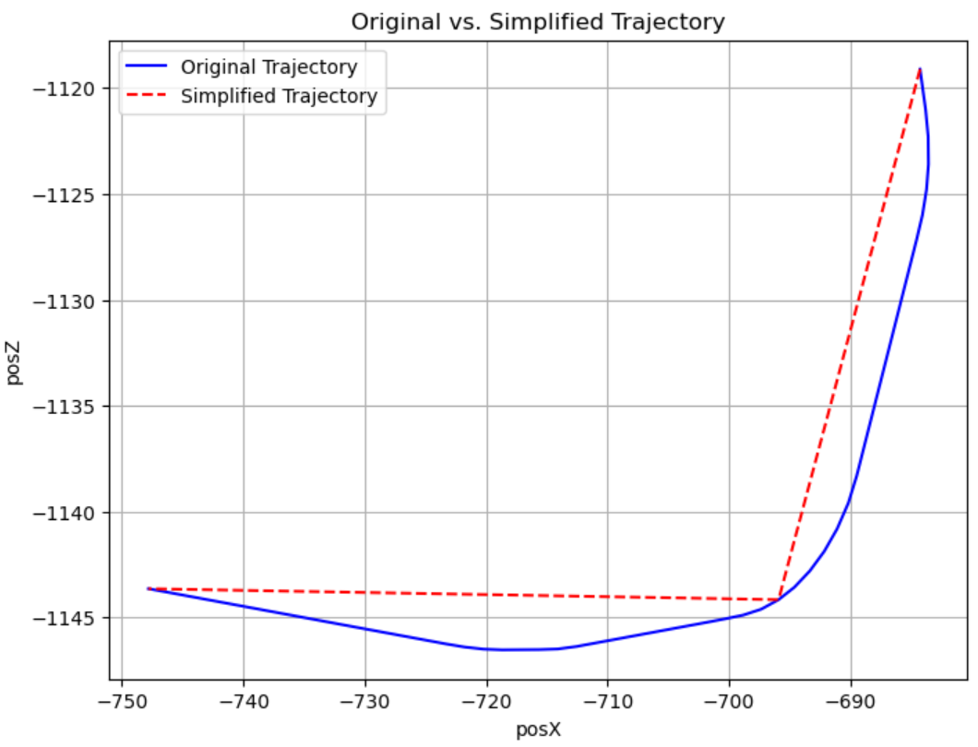
Features
View
DP
Feature
Regression
Next
Num_turns
Method:
1. Douglas algorithm to simplify the trajectory
2. Set threshold for consecutive segment vector:
Threshold angle = 30

Slide 5
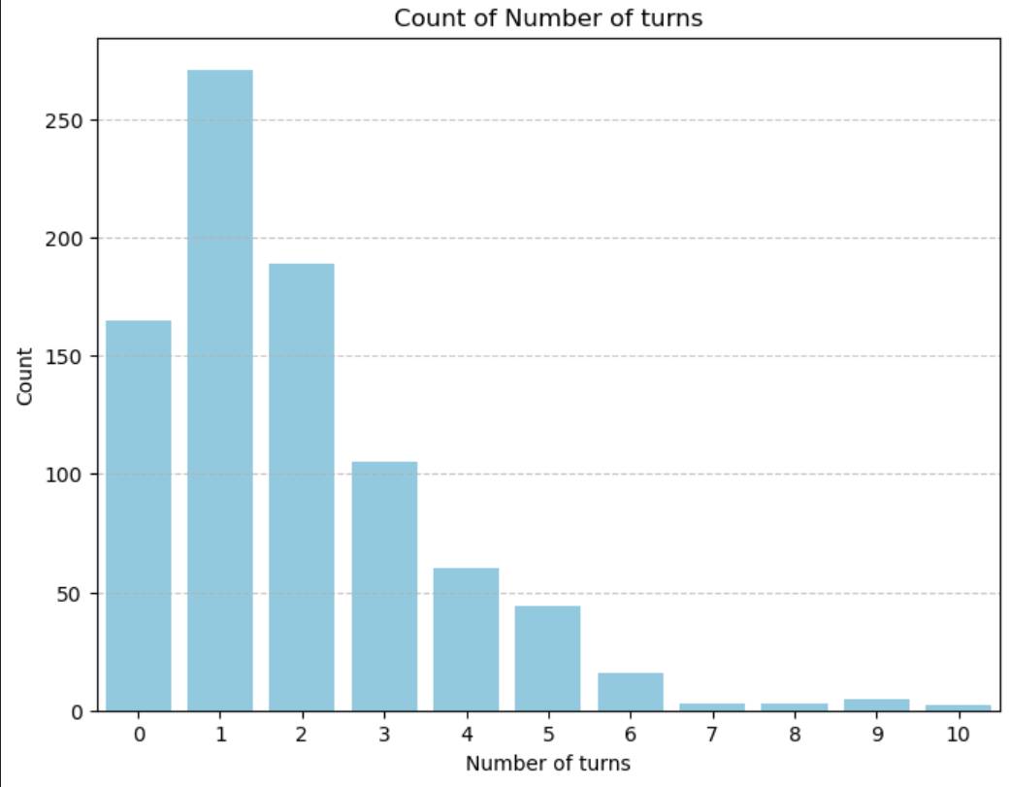
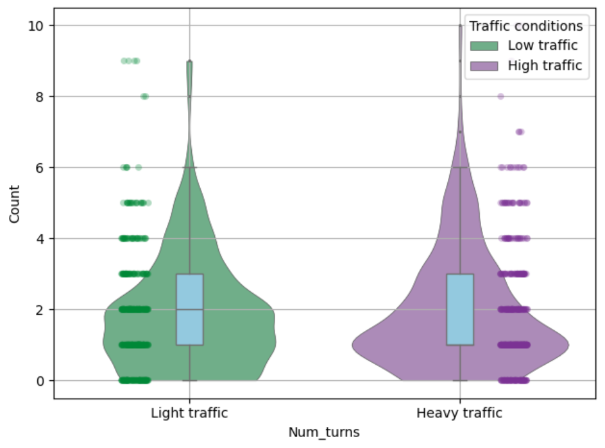
Features
View
DP
Feature
Regression
Next
Num_turns : result

Slide 6
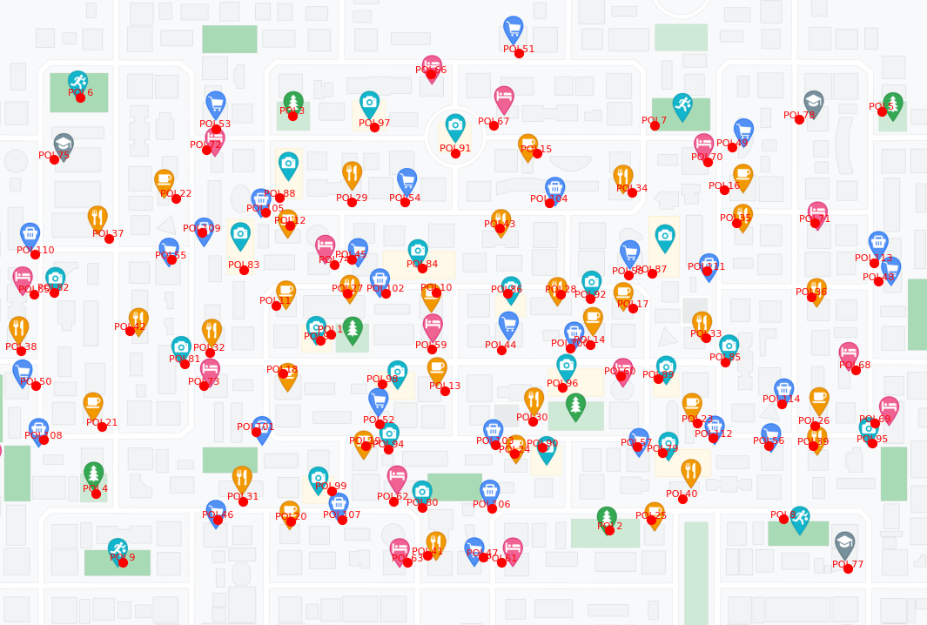
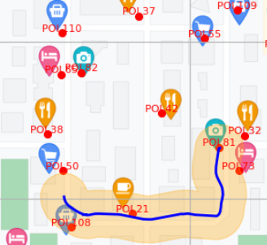
Features
View
DP
Feature
Regression
Next
Num_POIs
Method:
1. Create POI locations
2. Create buffer for trajectory,

Slide 7
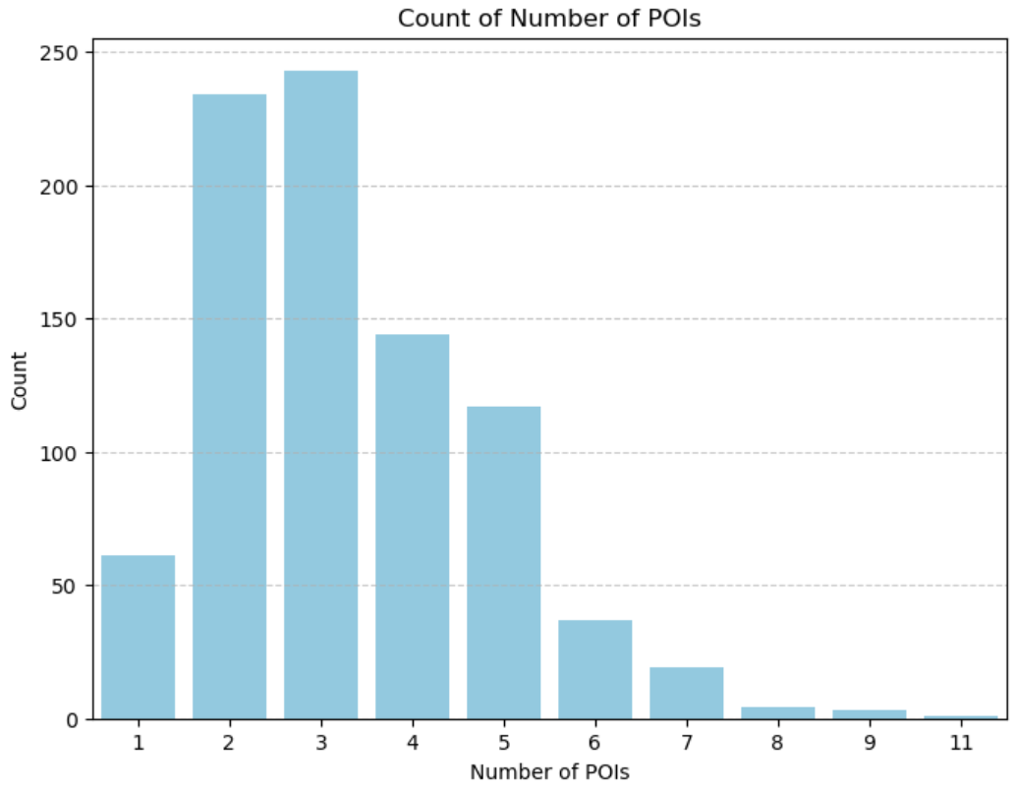
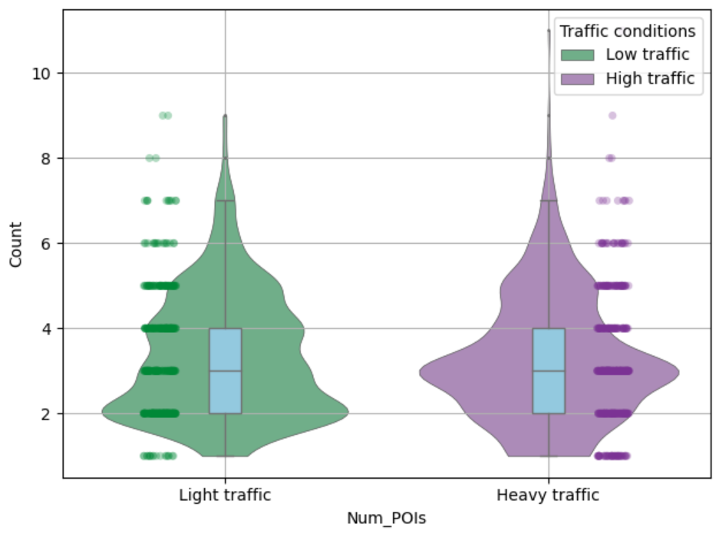
Features
View
DP
Feature
Regression
Next
Num_POIs : result

Slide 8
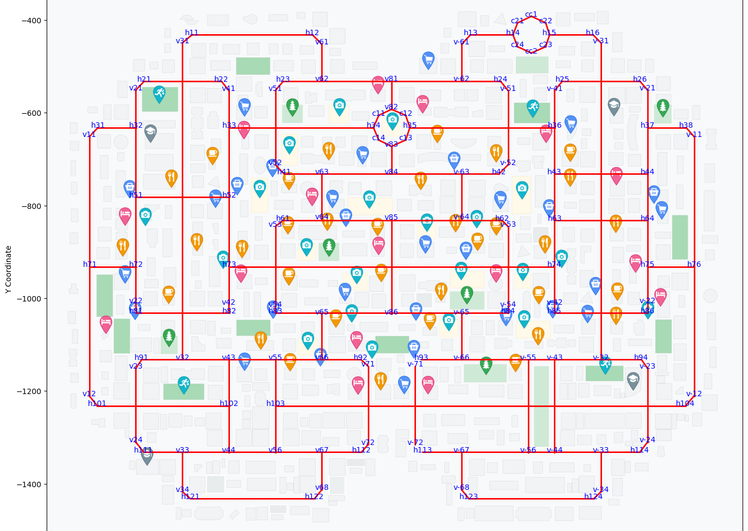
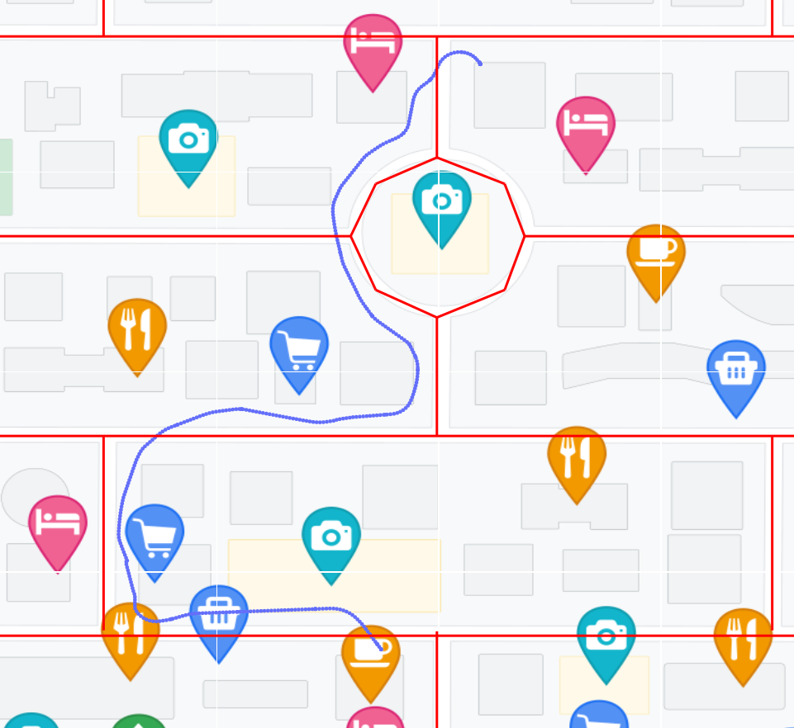
Features
View
DP
Feature
Regression
Next
Num_crossroad
Method:
1. Create road network
2. Spatial intersection between trajectory and road network

Slide 9
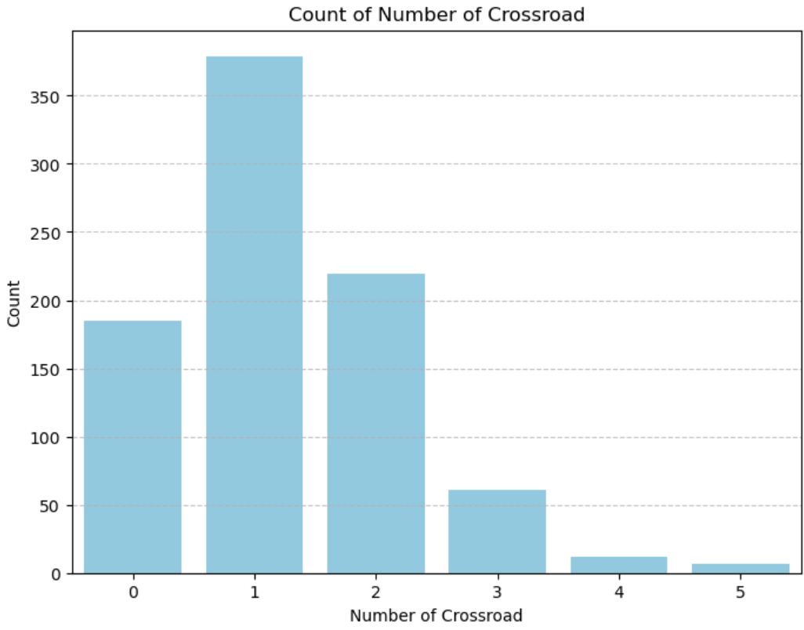
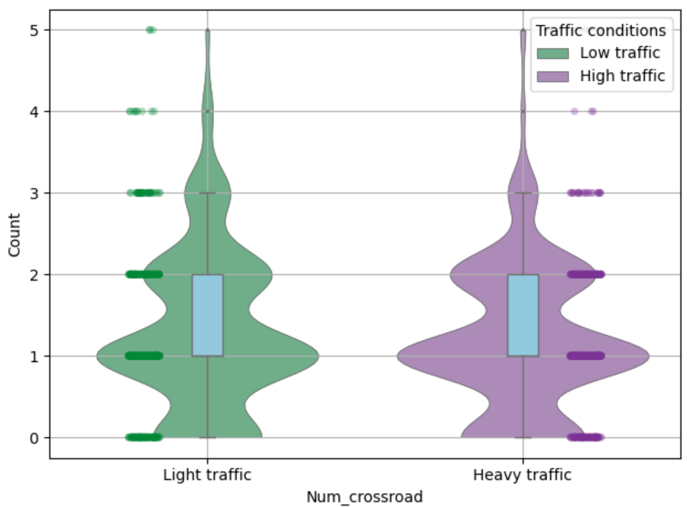
Features
View
DP
Feature
Regression
Next
Num_crossroad : result

Slide 10
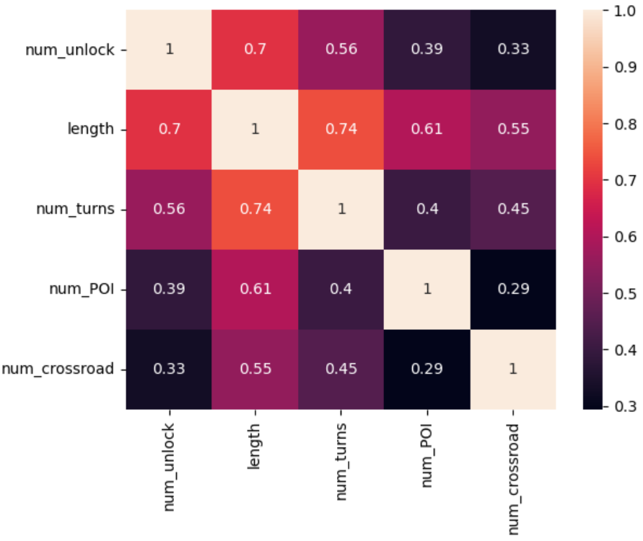
Features
View
DP
Feature
Regression
Next

Slide 11
Regression analysis
View
DP
Feature
Regression
Next
Model | Dependent variable | Predictors | MSE
Linear regression | Num_unlock | Length | 5.0124
Linear regression | Num_unlock | Length, Num_turns | 4.9599
Linear regression | Num_unlock | Length, Num_turns, Num_POIs | 4.9454
Linear regression | Num_unlock | Length, Num_turns, Num_POIs, Num_crossroad | 4.8972
Poisson regression | Num_unlock | Length, Num_turns, Num_POIs, Num_crossroad | 5.5643

Slide 12
Next steps
View
DP
Feature
Regression
Next
Feature detection
Outlier handling
Model learning and experimentation

