Slide 1
RQ
Indicator
SA
Research Question:
1. What are trajectory factors (e.g., intersections, turns, length etc.) that influence pedestrian map checking behavior, and how do these factors affect the map checking behavior?
2. What are the differences in map-checking behavior between heavy and light traffic density conditions?

Slide 2
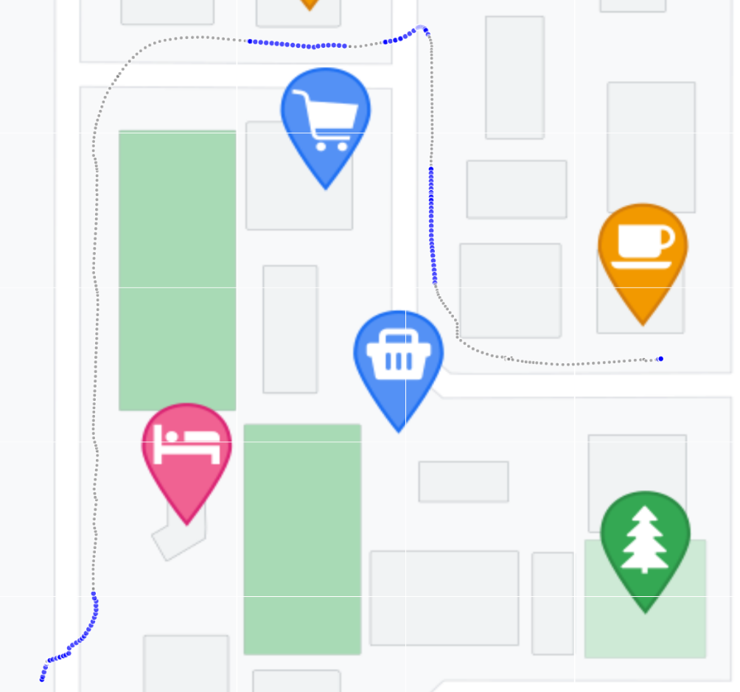
RQ
Indicator
SA
Indicator of map checking behavior in this case:
Mobile map active phase
Mobile map inactive phase
Holly Taylor in 1992 introduced the concepts of the survey perspective and the route perspective, (difference in viewpoint).
In 1999, she pointed out the correspondence between the survey perspective and maps, and the route perspective and navigation.
……
In 2018, Ruizhi Dai noted that modern technology has made switching between the two perspectives easier and called for more research on spatial perspective switching.
Blue: map active phase
Grey: map inactive phase

Slide 3

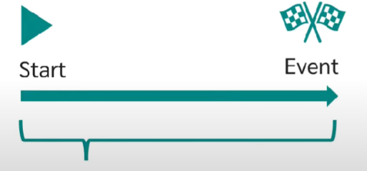
RQ
Indicator
SA
Survival Analysis:
What? A group of statistical methods:
In which the variable is the time until an event occurs (time to event).
Object in this case: Time from map inactive to active
Start: map becomes inactive
Event: map becomes active

Slide 4
RQ
Indicator
SA
Survival Analysis:
Related research:
Survival analysis is widely applied in fields ranging from biometrics to industrial engineering to transportation (Panagiotis, 2012; David A., 1997; David W., 2011).
Brigitte Waldorf explored and verified the conceptual equivalence between survival models applied to both temporal and spatial processes. (Brigitte, 2003)

Slide 5
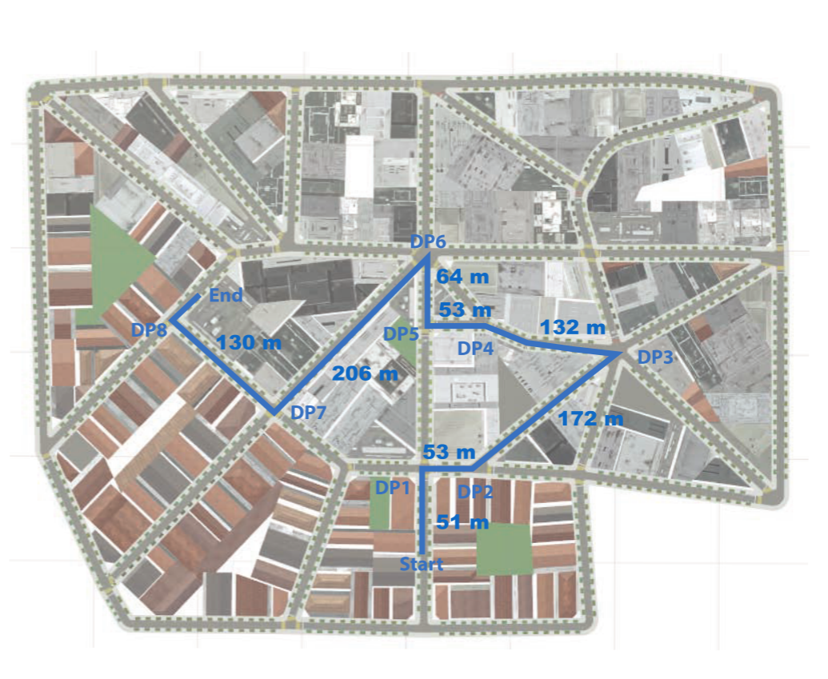
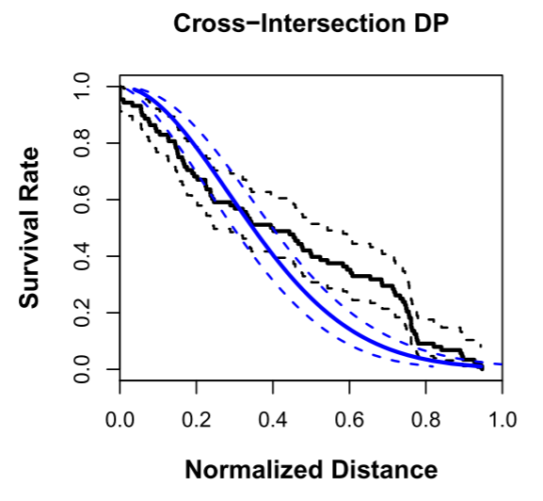
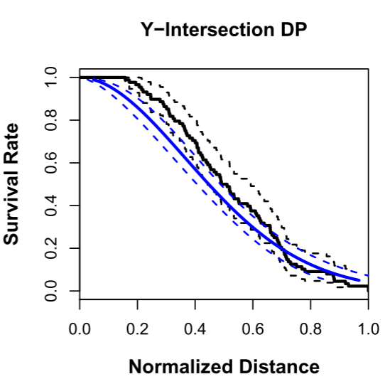
RQ
Indicator
SA
Survival Analysis:
Related research:
Ioannis Giannopoulos used survival model to analyze the time of requesting verbal navigation instructions in a segment in an VR environment, identified relevant environmental (intersection types, length of segments, decision point visibility, etc) and user(age, spatial ability) properties that have an impact on instruction timing. (Ioannis, 2017)
Complete route of the navigation path with 8 decision points and the length of the segments in meters. (Ioannis, 2017)
The mean survival functions (blue) for cross-intersections vs. the mean observed ones (black). The 95 % confidence intervals are presented with dotted lines. (Ioannis, 2017)

Slide 6
RQ
Indicator
SA
Survival Analysis:
Related research:
However, a map does provide much more context than verbal instructions as it naturally includes nearby objects (Christian, 2003). Turn-by-turn instructions do not effectively and properly reply to the
pedestrians’ needs(Fernando, 2021).
This will result in a different behavior in map checking and requesting verbal directions.

Slide 7
RQ
Indicator
SA
Survival Analysis:
The components of survival analysis and why use it
Survival curve (K-M survival curve)
To visualize survival situation
(In this case, to describe time from map inactive to map active)
Log-rank Test
To compare the survival curves of groups
(In this case, compare heavy/light traffic density, RQ2)
Cox regression
To quantify how that distribution changes as a function of the covariates
(In this case, to explore the trajectory factors, RQ1)

Slide 8
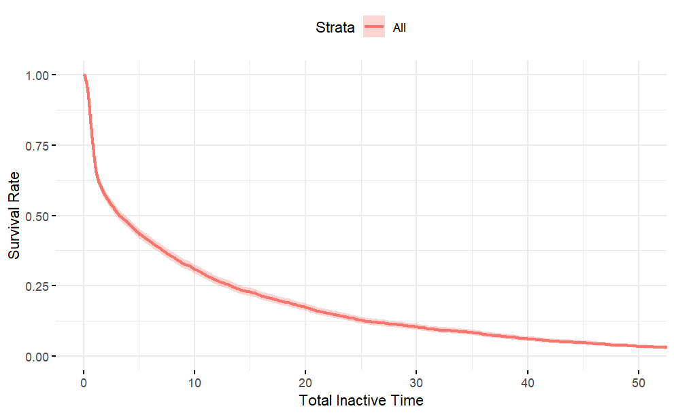
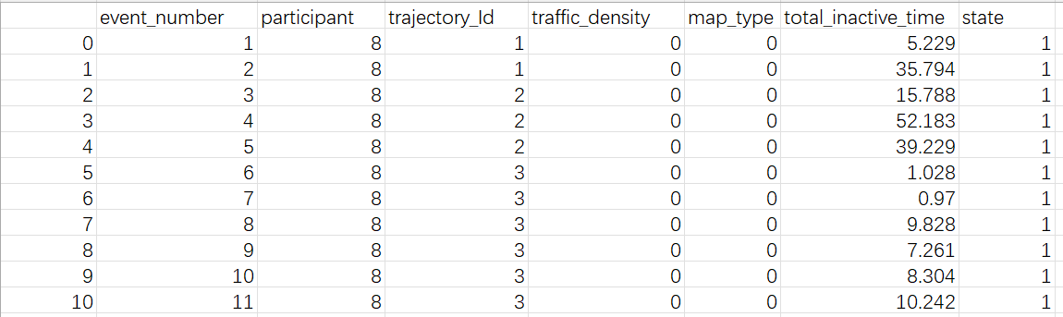
RQ
Indicator
SA
Survival Analysis:
The components of survival analysis and why use it
Survival curve (K-M survival curve)
To visualize survival situation
(In this case, to describe time from map inactive to map active)
3123 events in total

Slide 9
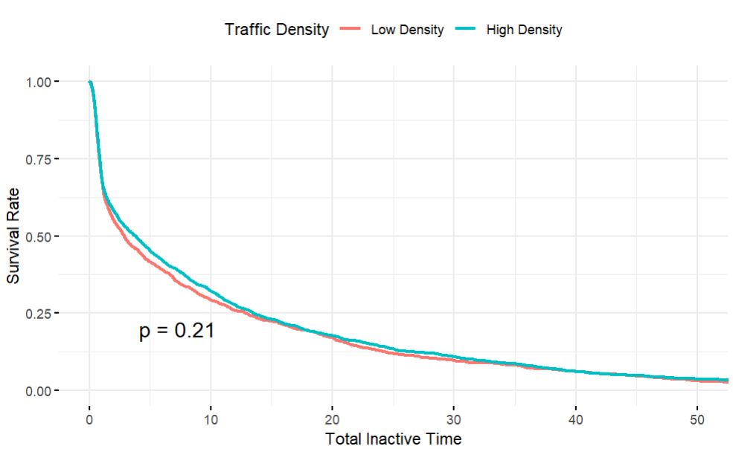
RQ
Indicator
SA
Survival Analysis:
The components of survival analysis and why use it
Log-rank Test
To compare the survival curves of groups
(In this case, compare heavy/light traffic density, RQ2)
N Observed Expected (O-E)^2/E (O-E)^2/V
traffic_density=0（light) 1418 1418 1383 0.893 1.6
traffic_density=1(heavy) 1705 1705 1740 0.710 1.6
Chisq= 1.6 on 1 degrees of freedom, p= 0.2

Slide 10
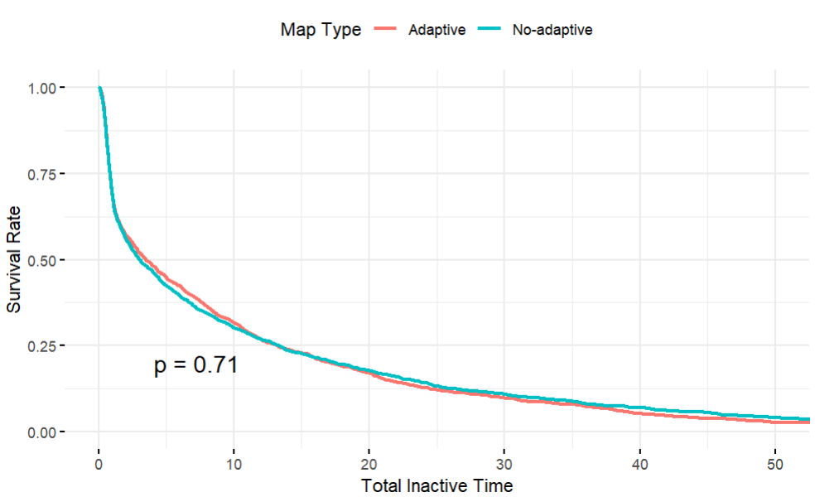
RQ
Indicator
SA
Survival Analysis:
The components of survival analysis and why use it
Also compare adaptive map vs no-adaptive map
N Observed Expected (O-E)^2/E (O-E)^2/V
(no-adaptive) 1477 1477 1466 0.0755 0.143
(adaptive) 1646 1646 1657 0.0668 0.143
Chisq= 0.1 on 1 degrees of freedom, p= 0.7

Slide 11
RQ
Indicator
SA
Survival Analysis:
The components of survival analysis and why use it
Cox regression
To quantify how that distribution changes as a function of the covariates
(In this case, to explore the trajectory factors, RQ1)
Potential trajectory factors:
Intersection types (Ioannis, 2017),
Length of previous active phase,
Distance from start point(Pintrich, 2000; N. Alinaghi, 2022),
Distance to the next intersection(Alinaghi, 2022),
……
Individual factors(future):
Age, gender, Sbsod score
……
Map interaction factors(future):
Map interactions in previous map active phase
……

Slide 12
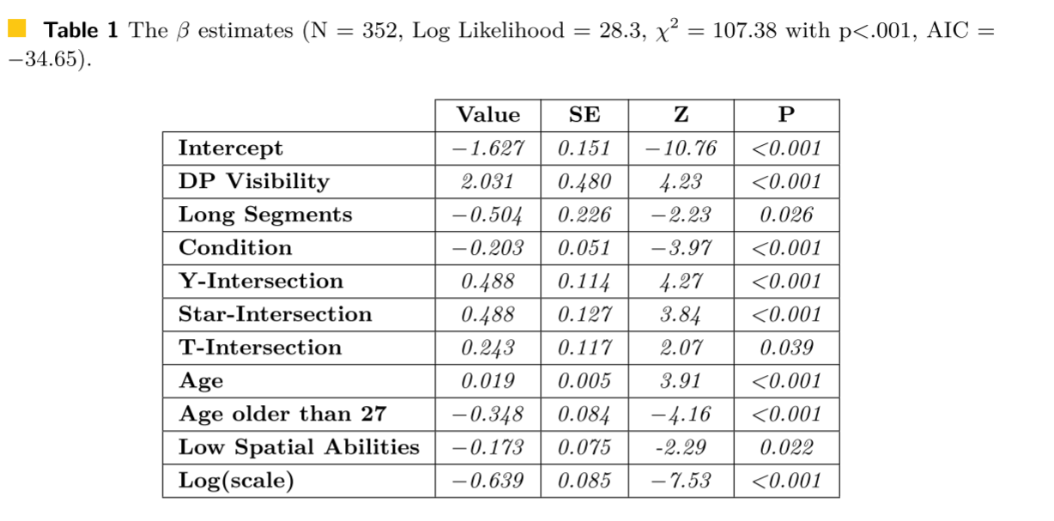
RQ
Indicator
SA
Survival Analysis:
The components of survival analysis and why use it
Cox regression
To quantify how that distribution changes as a function of the covariates
(In this case, to explore the trajectory factors, RQ1)
(Ioannis, 2017)

