Slide 1
Understanding and Using Biological Databases
Francis Ouellette
francis@bioinformatics.ubc.ca

Slide 2
Objectives
Able to recognize various data formats, and know what their primary use is.
Know, understand and utilize all types of sequence identifiers.
Know and understand various feature types present in the GenBank flat files.
Know and understand the various GenBank divisions.

Slide 3
Outline
Information landscape
Data type
Sequence Databases
Data Formats
Other “databases” and “datasets”
GenBank dissection
  identifiers
  divisions

Slide 4
The reagent: databases
Organized array of information
Place where you put things in, and (if all is well) you should be able to get them out again.
Resource for other databases and tools.
Simplify the information space by specialization.
Bonus: Allows you to make discoveries.

Slide 5
What is a database ?
A collection of information, usually stored in an electronic format that can be searched by a computer.
A collection of...
  structured
  searchable (index) -> table of contents
  updated periodically (release) -> new edition
  cross-referenced (hyperlinks) -> links with other db
…data
Includes also associated tools (software) necessary for db access, db updating, db information insertion, db information deletion….

Slide 6
Databases: an simple example
« Introduction To Database »Teacher Database (ITDTdb)
(flat file, 3 entries)
Accession number: 1
First Name: Amos
Last Name: Bairoch
Course: DEA=oct-nov-dec 2000
http://expasy4.expasy.ch/people/amos.html
//
Accession number: 2
First Name: Laurent
Last name: Falquet
Course: EMBnet=sept 2000;DEA=oct-nov-dec 2000;
//
Accession number 3:
First Name: Marie-Claude
Last name: Blatter Garin
Course: EMBnet=sept 2000;DEA=oct-nov-dec 2000;
http://expasy4.expasy.ch/people/Marie-Claude.Blatter-Garin.html
//
Easy to manage: all the entries are visible at the same time !

Slide 7
Why biological databases ?
Explosive growth in biological data
Data (sequences, 3D structures, 2D gel analysis, MS analysis….) are no longer published in a conventional manner, but directly submitted to databases
Essential tools for biological research, as classical publications used to be !

Slide 8
Databases
Information system
Query system
Storage System
Data

Slide 9
Databases
GenBank flat file
PDB file
Interaction Record
Title of a book
Book
Information system
Query system
Storage System
Data

Slide 10
Databases
Boxes
Oracle
MySQL
PC binary files
Unix text files
Bookshelves
Information system
Query system
Storage System
Data

Slide 11
Databases
A List you look at
A catalogue
indexed files
SQL
grep
Information system
Query system
Storage System
Data

Slide 12
Databases
Information system
The UBC library
Google
Entrez
SRS
Query system
Storage System
Data

Slide 13
A brief history of biological databases
1965 M. O. Dayhoff et al. publish “Atlas
of Protein Sequences and
Structures”
EMBL initiates DNA sequence
database, followed within a year by
GenBank (then at LANL) and in
1984 by DNA Database of Japan
EMBL/GenBank/DDBJ agree on
common format for data elements

Slide 14
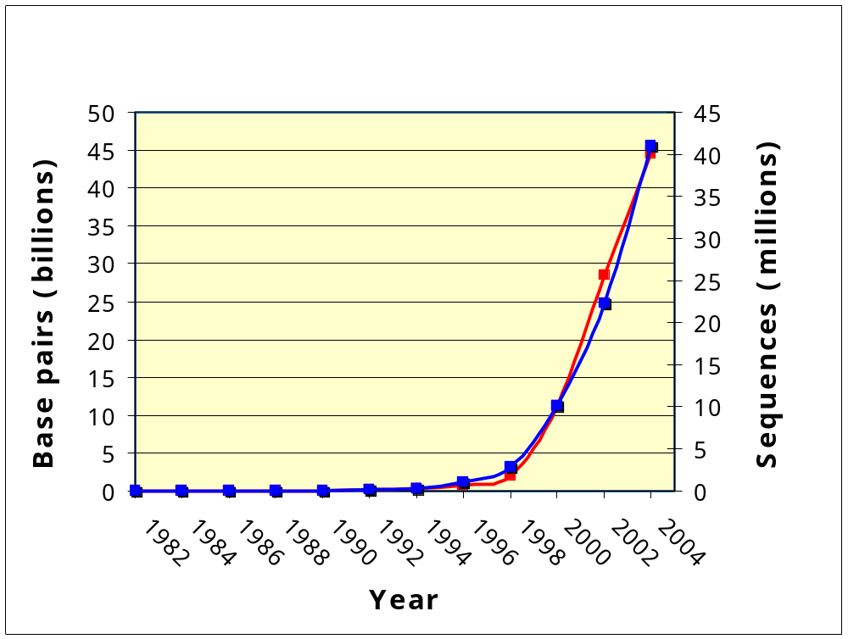
Growth of GenBank database
Base Pairs
Sequences

Slide 15
www.ncbi.nlm.nih.gov
Created in 1988 as part of the National Library of Medicine at NIH
  Establish public databases
  Research in computational biology
  Develop software tools for sequence analysis
  Disseminate biomedical information

Slide 16
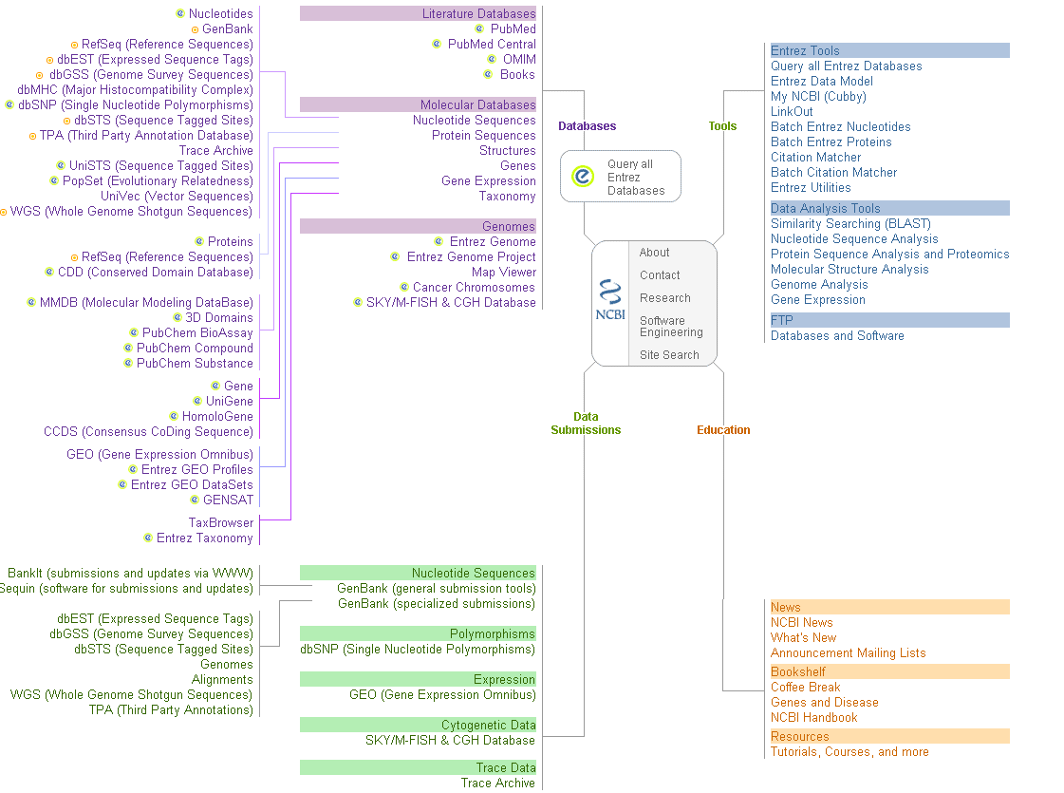

Slide 18
Types of databases at NCBI
Primary databases
  Original submissions by experimentalists
  Content controlled by the submitter
    Examples: GenBank, SNP, GEO
Derivative databases
  Built from primary data
  Content controlled by third party (NCBI)
    Examples: Refseq, TPA, RefSNP, UniGene, NCBI Protein, Structure, Conserved Domain, Gene

Slide 19
Protein Databases
Genpept
  CDS from GenBank entries
TrEMBL (1996)
  Automatic CDS translations from EMBL
  Highly redundant
  Not all experimentally determined
  Many inaccuracies

Slide 20
Secondary protein database
SWISS-PROT (1986)
  Best annotated, least redundant
PIR (Protein Information Resource)
  More automated annotation
  Collaborations with MIPS and JIPID

Slide 21
Secondary protein databases
SWISS-PROT (1986)
  Best annotated, least redundant
PIR (Protein Information Resource)
  More automated annotation
  Collaborations with MIPS and JIPID
Uniprot (2003)
  UniProt (Universal Protein Resource) is a central repository of protein sequence and function created by joining the information contained in Swiss-Prot, TrEMBL, and PIR.

Slide 22
Databases
Primary (archival)
  GenBank/EMBL/DDBJ
  UniProt
  PDB
  Medline (PubMed)
  BIND
Secondary (curated)
  RefSeq
  Taxon
  UniProt
  OMIM
  SGD

Slide 23
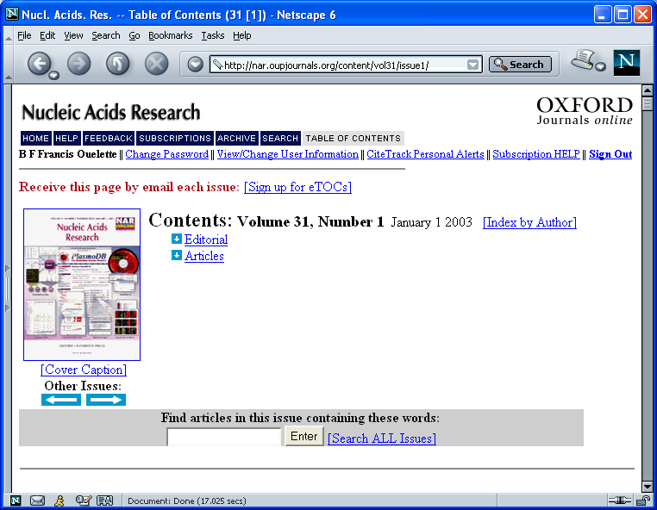
http://nar.oupjournals.org/content/vol31/issue1/

Slide 24
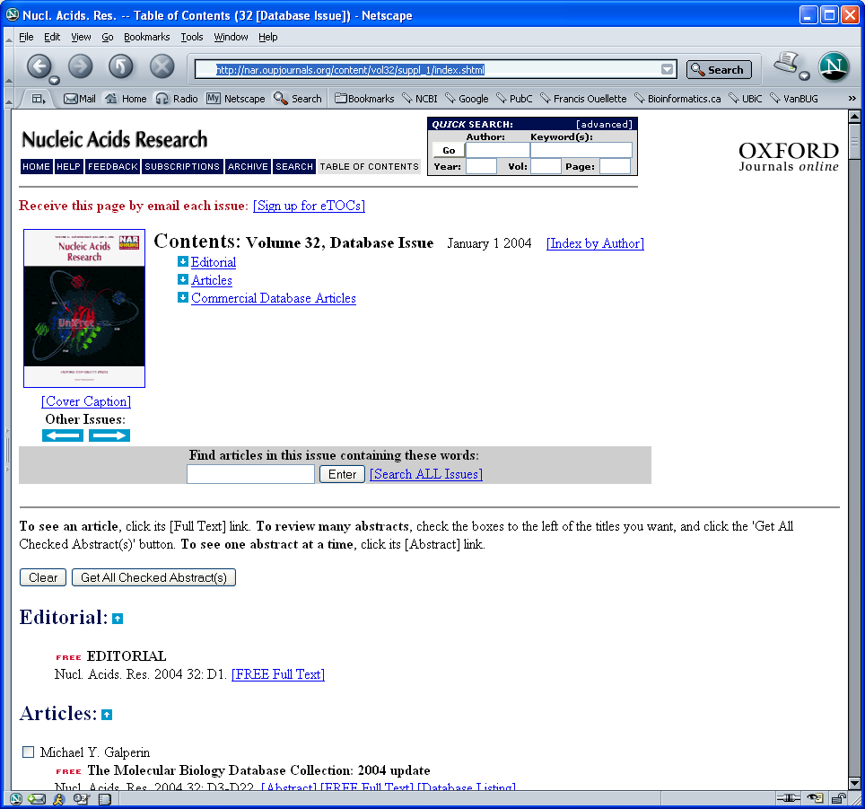
http://nar.oupjournals.org/content/vol32/suppl_1/

Slide 25
Sequence Databases
Primary DNA
  DDBJ/EMBL/GenBank
Primary protein
  GenPept/TrEMBL
Curated DB
  RefSeq (Genomic, mRNA and protein)
  Swiss-Prot & PIR -> UniProt (protein)
Notes:
Others includes
PDB
GSDB
REFGenes
other sequences

Slide 26
What is GenBank?
GenBank is the NIH genetic sequence database of all publicly available DNA and derived protein sequences, with annotations describing the biological information these records contain.
http://www.ncbi.nlm.nih.gov/Genbank/GenbankOverview.html
Benson et al., 2004, Nucleic Acids Res. 32:D23-D26

Slide 27
NIH
Entrez
NCBI
GenBank
Submissions
Updates
Submissions
Updates
EMBL
DDBJ
CIB
EBI
NIG
Submissions
Updates
SRS
EMBL
getentry

Slide 28
GenBank Flat File (GBFF)
LOCUS MUSNGH 1803 bp mRNA ROD 29-AUG-1997
DEFINITION Mouse neuroblastoma and rat glioma hybridoma cell line NG108-15
cell TA20 mRNA, complete cds.
ACCESSION D25291
NID g1850791
KEYWORDS neurite extension activity; growth arrest; TA20.
SOURCE Murinae gen. sp. mouse neuroblastma-rat glioma hybridoma
cell_line:NG108-15 cDNA to mRNA.
ORGANISM Murinae gen. sp.
Eukaryotae; mitochondrial eukaryotes; Metazoa; Chordata;
Vertebrata; Mammalia; Eutheria; Rodentia; Sciurognathi; Muridae;
Murinae.
REFERENCE 1 (sites)
AUTHORS Tohda,C., Nagai,S., Tohda,M. and Nomura,Y.
TITLE A novel factor, TA20, involved in neuronal differentiation: cDNA
cloning and expression
JOURNAL Neurosci. Res. 23 (1), 21-27 (1995)
MEDLINE 96064354
REFERENCE 3 (bases 1 to 1803)
AUTHORS Tohda,C.
TITLE Direct Submission
JOURNAL Submitted (18-NOV-1993) to the DDBJ/EMBL/GenBank databases. Chihiro
Tohda, Toyama Medical and Pharmaceutical University, Research
Institute for Wakan-yaku, Analytical Research Center for
Ethnomedicines; 2630 Sugitani, Toyama, Toyama 930-01, Japan
(E-mail:CHIHIRO@ms.toyama-mpu.ac.jp, Tel:+81-764-34-2281(ex.2841),
Fax:+81-764-34-5057)
COMMENT On Feb 26, 1997 this sequence version replaced gi:793764.
FEATURES Location/Qualifiers
source 1..1803
/organism="Murinae gen. sp."
/note="source origin of sequence, either mouse or rat, has
not been identified"
/db_xref="taxon:39108"
/cell_line="NG108-15"
/cell_type="mouse neuroblastma-rat glioma hybridoma"
misc_signal 156..163
/note="AP-2 binding site"
GC_signal 647..655
/note="Sp1 binding site"
TATA_signal 694..701
gene 748..1311
/gene="TA20"
CDS 748..1311
/gene="TA20"
/function="neurite extensiion activity and growth arrest
effect"
/codon_start=1
/db_xref="PID:d1005516"
/db_xref="PID:g793765"
/translation="MMKLWVPSRSLPNSPNHYRSFLSHTLHIRYNNSLFISNTHLSRR
KLRVTNPIYTRKRSLNIFYLLIPSCRTRLILWIIYIYRNLKHWSTSTVRSHSHSIYRL
RPSMRTNIILRCHSYYKPPISHPIYWNNPSRMNLRGLLSRQSHLDPILRFPLHLTIYY
RGPSNRSPPLPPRNRIKQPNRIKLRCR"
polyA_site 1803
BASE COUNT 507 a 458 c 311 g 527 t
ORIGIN
1 tcagtttttt tttttttttt tttttttttt tttttttttt tttttttttg ttgattcatg
61 tccgtttaca tttggtaagt tcacaggcct cagtcaacac aattggactg ctcaggaaat
121 cctccttggt gaccgcagta tacttggcct atgaacccaa gccacctatg gctaggtagg
181 agaagctcaa ctgtagggct gactttggaa gagaatgcac atggctgtat cgacatttca
241 catggtggac ctctggccag agtcagcagg ccgagggttc tcttccgggc tgctccctca
301 ctgcttgact ctgcgtcagt gcgtccatac tgtgggcgga cgttattgct atttgccttc
361 cattctgtac ggcattgcct ccatttagct ggagagggac agagcctggt tctctagggc
421 gtttccattg gggcctggtg acaatccaaa agatgagggc tccaaacacc agaatcagaa
481 ggcccagcgt atttgtaaaa acaccttctg gtgggaatga atggtacagg ggcgtttcag
541 gacaaagaac agcttttctg tcactcccat gagaaccgtc gcaatcactg ttccgaagag
601 gaggagtcca gaatacacgt gtatgggcat gacgattgcc cggagagagg cggagcccat
661 ggaagcagaa agacgaaaaa cacacccatt atttaaaatt attaaccact cattcattga
721 cctacctgcc ccatccaaca tttcatcatg atgaaacttt gggtcccttc taggagtctg
781 cctaatagtc caaatcatta caggtctttt cttagccata cactacacat cagatacaat
841 aacagccttt tcatcagtaa cacacatttg tcgagacgta aattacgggt gactaatccg
901 atatatacac gcaaacggag cctcaatatt ttttatttgc ttattccttc atgtcggacg
961 aggcttatat tatggatcat atacatttat agaaacctga aacattggag tacttctact
1021 gttcgcagtc atagccacag catttatagg ctacgtcctt ccatgaggac aaatatcatt
1081 ctgaggtgcc acagttatta caaacctcct atcagccatc ccatatattg gaacaaccct
1141 agtcgaatga atttgagggg gcttctcagt agacaaagcc accttgaccc gattcttcgc
1201 tttccacttc atcttaccat ttattatcgc ggccctagca atcgttcacc tcctcttcct
1261 ccacgaaaca ggatcaaaca acccaacagg attaaactca gatgcagata aaattccatt
1321 tcacccctac tatacatcaa agatatccta ggtatcctaa tcatattctt aattctcata
1381 accctagtat tatttttccc agacatacta ggagacccag acaactacat accagctaat
1441 ccactaaaca ccccacccca tattaaaccc gaatgatatt tcctatttgc atacgccatt
1501 ctacgctcaa tccccaataa actaggaggt gtcctagcct taatcttatc tatcctaatt
1561 ttagccctaa tacctttcct tcatacctca aagcaacgaa gcctaatatt ccgcccaatc
1621 acacaaattt tgtactgaat cctagtagcc aacctactta tcttaacctg aattgggggc
1681 caaccagtag acacccattt attatcattg gccaactagc ctccatctca tacttctcaa
1741 tcatcttaat tcttatacca atctcaggaa ttatcgaaga caaaatacta aaattatatc
1801 cat
//
Title
Taxonomy
Citation
Header
Features (AA seq)
DNA Sequence

Slide 29
Types of files in GenBank
From one-gene investigators
  Often a very well annotated cDNA
  A genomic segment from an new invertebrate
  A mitochondria or virus
From population/phylogenetic analysis
  rRNA amplicon from environmental sampling
From Genome Centers:
  Gene expression:
    Expressed Sequence Tags
    Full Length Insert cDNA
  Genome sequencing projects
    WGS
    HTG
    CON

Slide 30
UniProt
New protein sequence database that is the result of a merge from SWISS-PROT and PIR. It will be the annotated curated protein sequence database.
Data in UniProt is primarily derived from coding sequence annotations in EMBL (GenBank/DDBJ) nucleic acid sequence data.
UniProt is a Flat-File database just like EMBL and GenBank
Flat-File format is SwissProt-like, or EMBL-like
Notes:
Includes some PIR sequences
Combines/merges records from different organisms

Slide 31
Swiss-Prot
ID CYS3_YEAST STANDARD; PRT; 393 AA.
AC P31373;
DT 01-JUL-1993 (REL. 26, CREATED)
DT 01-JUL-1993 (REL. 26, LAST SEQUENCE UPDATE)
DT 01-NOV-1995 (REL. 32, LAST ANNOTATION UPDATE)
DE CYSTATHIONINE GAMMA-LYASE (EC 4.4.1.1) (GAMMA-CYSTATHIONASE).
GN CYS3 OR CYI1 OR STR1 OR YAL012W OR FUN35.
OS SACCHAROMYCES CEREVISIAE (BAKER'S YEAST).
OC EUKARYOTA; FUNGI; ASCOMYCOTA; HEMIASCOMYCETES; SACCHAROMYCETALES;
OC SACCHAROMYCETACEAE; SACCHAROMYCES.
RN [1]
RP SEQUENCE FROM N.A., AND PARTIAL SEQUENCE.
RX MEDLINE; 92250430. [NCBI, ExPASy, Israel, Japan]
RA ONO B.-I., TANAKA K., NAITO K., HEIKE C., SHINODA S., YAMAMOTO S.,
RA OHMORI S., OSHIMA T., TOH-E A.;
RT "Cloning and characterization of the CYS3 (CYI1) gene of
RT Saccharomyces cerevisiae.";
RL J. BACTERIOL. 174:3339-3347(1992).
RN [2]
RP SEQUENCE FROM N.A., AND CHARACTERIZATION.
RC STRAIN=DBY939;
RX MEDLINE; 93328685. [NCBI, ExPASy, Israel, Japan]
RA YAMAGATA S., D'ANDREA R.J., FUJISAKI S., ISAJI M., NAKAMURA K.;
RT "Cloning and bacterial expression of the CYS3 gene encoding
RT cystathionine gamma-lyase of Saccharomyces cerevisiae and the
RT physicochemical and enzymatic properties of the protein.";
RL J. BACTERIOL. 175:4800-4808(1993).
RN [3]
RP SEQUENCE FROM N.A.
RC STRAIN=S288C / AB972;
RX MEDLINE; 93289814. [NCBI, ExPASy, Israel, Japan]
RA BARTON A.B., KABACK D.B., CLARK M.W., KENG T., OUELLETTE B.F.F.,
RA STORMS R.K., ZENG B., ZHONG W.W., FORTIN N., DELANEY S., BUSSEY H.;
RT "Physical localization of yeast CYS3, a gene whose product resembles
RT the rat gamma-cystathionase and Escherichia coli cystathionine gamma-
RT synthase enzymes.";
RL YEAST 9:363-369(1993).
RN [4]
RP SEQUENCE FROM N.A.
RC STRAIN=S288C / AB972;
RX MEDLINE; 93209532. [NCBI, ExPASy, Israel, Japan]
RA OUELLETTE B.F.F., CLARK M.W., KENG T., STORMS R.K., ZHONG W.W.,
RA ZENG B., FORTIN N., DELANEY S., BARTON A.B., KABACK D.B., BUSSEY H.;
RT "Sequencing of chromosome I from Saccharomyces cerevisiae: analysis
RT of a 32 kb region between the LTE1 and SPO7 genes.";
RL GENOME 36:32-42(1993).
RN [5]
RP SEQUENCE OF 1-18, AND CHARACTERIZATION.
RX MEDLINE; 93289817. [NCBI, ExPASy, Israel, Japan]
RA ONO B.-I., ISHII N., NAITO K., MIYOSHI S.-I., SHINODA S., YAMAMOTO S.,
RA OHMORI S.;
RT "Cystathionine gamma-lyase of Saccharomyces cerevisiae: structural
RT gene and cystathionine gamma-synthase activity.";
RL YEAST 9:389-397(1993).
CC -!- CATALYTIC ACTIVITY: L-CYSTATHIONINE + H(2)O = L-CYSTEINE +
CC NH(3) + 2-OXOBUTANOATE.
CC -!- COFACTOR: PYRIDOXAL PHOSPHATE.
CC -!- PATHWAY: FINAL STEP IN THE TRANS-SULFURATION PATHWAY SYNTHESIZING
CC L-CYSTEINE FROM L-METHIONINE.
CC -!- SUBUNIT: HOMOTETRAMER.
CC -!- SUBCELLULAR LOCATION: CYTOPLASMIC.
CC -!- SIMILARITY: BELONGS TO THE TRANS-SULFURATION ENZYMES FAMILY.
CC --------------------------------------------------------------------------
CC This SWISS-PROT entry is copyright. It is produced through a collaboration
CC between the Swiss Institute of Bioinformatics and the EMBL outstation -
CC the European Bioinformatics Institute. There are no restrictions on its
CC use by non-profit institutions as long as its content is in no way
CC modified and this statement is not removed. Usage by and for commercial
CC entities requires a license agreement (See http://www.isb-sib.ch/announce/
CC or send an email to license@isb-sib.ch).
CC --------------------------------------------------------------------------
DR EMBL; L05146; AAC04945.1; -. [EMBL / GenBank / DDBJ] [CoDingSequence]
DR EMBL; L04459; AAA85217.1; -. [EMBL / GenBank / DDBJ] [CoDingSequence]
DR EMBL; D14135; BAA03190.1; -. [EMBL / GenBank / DDBJ] [CoDingSequence]
DR PIR; S31228; S31228.
DR YEPD; 5280; -.
DR SGD; L0000470; CYS3. [SGD / YPD]
DR PFAM; PF01053; Cys_Met_Meta_PP; 1.
DR PROSITE; PS00868; CYS_MET_METAB_PP; 1.
DR DOMO; P31373.
DR PRODOM [Domain structure / List of seq. sharing at least 1 domain]
DR PROTOMAP; P31373.
DR PRESAGE; P31373.
DR SWISS-2DPAGE; GET REGION ON 2D PAGE.
KW CYSTEINE BIOSYNTHESIS; LYASE; PYRIDOXAL PHOSPHATE.
FT INIT_MET 0 0
FT BINDING 203 203 PYRIDOXAL PHOSPHATE (BY SIMILARITY).
SQ SEQUENCE 393 AA; 42411 MW; 55BA2771 CRC32;
TLQESDKFAT KAIHAGEHVD VHGSVIEPIS LSTTFKQSSP ANPIGTYEYS RSQNPNRENL
ERAVAALENA QYGLAFSSGS ATTATILQSL PQGSHAVSIG DVYGGTHRYF TKVANAHGVE
TSFTNDLLND LPQLIKENTK LVWIETPTNP TLKVTDIQKV ADLIKKHAAG QDVILVVDNT
FLSPYISNPL NFGADIVVHS ATKYINGHSD VVLGVLATNN KPLYERLQFL QNAIGAIPSP
FDAWLTHRGL KTLHLRVRQA ALSANKIAEF LAADKENVVA VNYPGLKTHP NYDVVLKQHR
DALGGGMISF RIKGGAEAAS KFASSTRLFT LAESLGGIES LLEVPAVMTH GGIPKEAREA
SGVFDDLVRI SVGIEDTDDL LEDIKQALKQ ATN
//
ID CYS3_YEAST STANDARD; PRT; 393 AA.
AC P31373;
DT 01-JUL-1993 (REL. 26, CREATED)
DE CYSTATHIONINE GAMMA-LYASE (EC 4.4.1.1) (GAMMA-CYSTATHIONASE).
GN CYS3 OR CYI1 OR STR1 OR YAL012W OR FUN35.
OS TAXONOMY
OC SACCHAROMYCETACEAE; SACCHAROMYCES.
RX CITATION
CC -!- CATALYTIC ACTIVITY: L-CYSTATHIONINE + H(2)O = L-CYSTEINE +
CC NH(3) + 2-OXOBUTANOATE.
CC -!- COFACTOR: PYRIDOXAL PHOSPHATE.
CC -!- PATHWAY: FINAL STEP IN THE TRANS-SULFURATION PATHWAY SYNTHESIZING
CC L-CYSTEINE FROM L-METHIONINE.
CC -!- SUBUNIT: HOMOTETRAMER.
CC -!- SUBCELLULAR LOCATION: CYTOPLASMIC.
CC -!- SIMILARITY: BELONGS TO THE TRANS-SULFURATION ENZYMES FAMILY.
CC --------------------------------------------------------------------------
CC DISCLAMOR
CC --------------------------------------------------------------------------
DR DATABASE cross-reference
KW CYSTEINE BIOSYNTHESIS; LYASE; PYRIDOXAL PHOSPHATE.
FT INIT_MET 0 0
FT BINDING 203 203 PYRIDOXAL PHOSPHATE (BY SIMILARITY).
SQ SEQUENCE 393 AA; 42411 MW; 55BA2771 CRC32;
TLQESDKFAT KAIHAGEHVD VHGSVIEPIS LSTTFKQSSP ANPIGTYEYS RSQNPNRENL
ERAVAALENA QYGLAFSSGS ATTATILQSL PQGSHAVSIG DVYGGTHRYF TKVANAHGVE
TSFTNDLLND LPQLIKENTK LVWIETPTNP TLKVTDIQKV ADLIKKHAAG QDVILVVDNT
FLSPYISNPL NFGADIVVHS ATKYINGHSD VVLGVLATNN KPLYERLQFL QNAIGAIPSP
FDAWLTHRGL KTLHLRVRQA ALSANKIAEF LAADKENVVA VNYPGLKTHP NYDVVLKQHR
DALGGGMISF RIKGGAEAAS KFASSTRLFT LAESLGGIES LLEVPAVMTH GGIPKEAREA
SGVFDDLVRI SVGIEDTDDL LEDIKQALKQ ATN
//

Slide 32
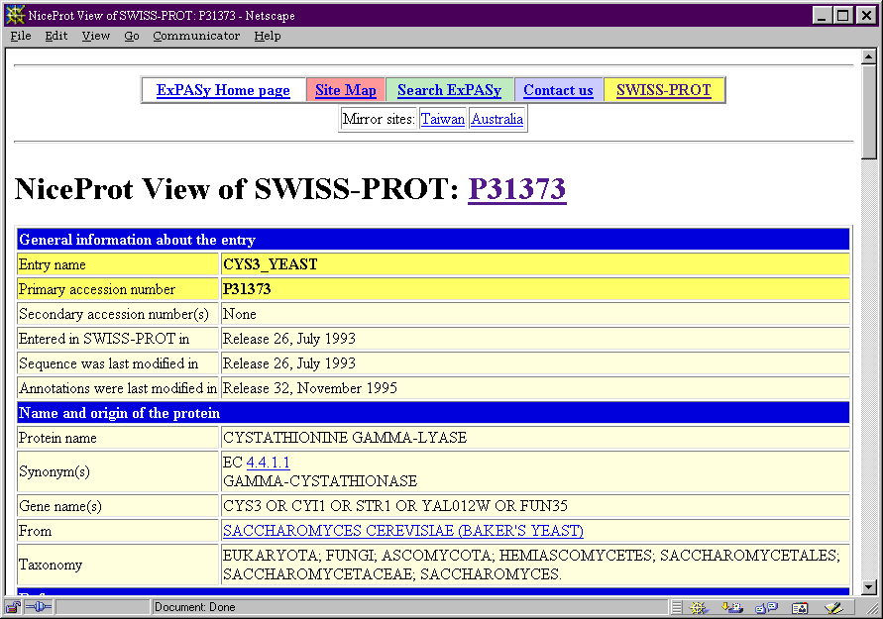
Swiss-Prot

Slide 33
Swiss-Prot
SWISS-PROT incorporates:
    Function of the protein
    Post-translational modification
    Domains and sites.
    Secondary structure.
    Quaternary structure.
    Similarities to other proteins;
    Diseases associated with deficiencies in the protein
    Sequence conflicts, variants, etc.
SWISS-PROT incorporates:
    Function of the protein
    Post-translational modification
    Domains and sites.
    Secondary structure.
    Quaternary structure.
    Similarities to other proteins;
    Diseases associated with deficiencies in the protein
    Sequence conflicts, variants, etc.
Notes:
Includes some PIR sequences
Combines/merges records from different organisms

Slide 34
TREMBL
TrEMBL is a computer-annotated protein sequence database supplementing the SWISS-PROT Protein Sequence Data Bank.
TrEMBL contains the translations of all coding sequences (CDS) present in the EMBL Nucleotide Sequence Database not yet integrated in SWISS-PROT.
TrEMBL can be considered as a preliminary section of SWISS-PROT. For all TrEMBL entries which should finally be upgraded to the standard SWISS-PROT quality, SWISS-PROT accession numbers have been assigned.

Slide 35
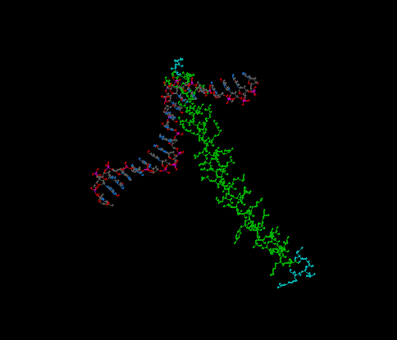
PDB
Protein DataBase
  Protein and NA
  3D structures
  Sequence
  present
  YAFFF

Slide 36
PDB
HEADER LEUCINE ZIPPER 15-JUL-93 1DGC 1DGC 2
COMPND GCN4 LEUCINE ZIPPER COMPLEXED WITH SPECIFIC 1DGC 3
COMPND 2 ATF/CREB SITE DNA 1DGC 4
SOURCE GCN4: YEAST (SACCHAROMYCES CEREVISIAE); DNA: SYNTHETIC 1DGC 5
AUTHOR T.J.RICHMOND 1DGC 6
REVDAT 1 22-JUN-94 1DGC 0 1DGC 7
JRNL AUTH P.KONIG,T.J.RICHMOND 1DGC 8
JRNL TITL THE X-RAY STRUCTURE OF THE GCN4-BZIP BOUND TO 1DGC 9
JRNL TITL 2 ATF/CREB SITE DNA SHOWS THE COMPLEX DEPENDS ON DNA 1DGC 10
JRNL TITL 3 FLEXIBILITY 1DGC 11
JRNL REF J.MOL.BIOL. V. 233 139 1993 1DGC 12
JRNL REFN ASTM JMOBAK UK ISSN 0022-2836 0070 1DGC 13
REMARK 1 1DGC 14
REMARK 2 1DGC 15
REMARK 2 RESOLUTION. 3.0 ANGSTROMS. 1DGC 16
REMARK 3 1DGC 17
REMARK 3 REFINEMENT. 1DGC 18
REMARK 3 PROGRAM X-PLOR 1DGC 19
REMARK 3 AUTHORS BRUNGER 1DGC 20
REMARK 3 R VALUE 0.216 1DGC 21
REMARK 3 RMSD BOND DISTANCES 0.020 ANGSTROMS 1DGC 22
REMARK 3 RMSD BOND ANGLES 3.86 DEGREES 1DGC 23
REMARK 3 1DGC 24
REMARK 3 NUMBER OF REFLECTIONS 3296 1DGC 25
REMARK 3 RESOLUTION RANGE 10.0 - 3.0 ANGSTROMS 1DGC 26
REMARK 3 DATA CUTOFF 3.0 SIGMA(F) 1DGC 27
REMARK 3 PERCENT COMPLETION 98.2 1DGC 28
REMARK 3 1DGC 29
REMARK 3 NUMBER OF PROTEIN ATOMS 456 1DGC 30
REMARK 3 NUMBER OF NUCLEIC ACID ATOMS 386 1DGC 31
REMARK 4 1DGC 32
REMARK 4 GCN4: TRANSCRIPTIONAL ACTIVATOR OF GENES ENCODING FOR AMINO 1DGC 33
REMARK 4 ACID BIOSYNTHETIC ENZYMES. 1DGC 34
REMARK 5 1DGC 35
REMARK 5 AMINO ACIDS NUMBERING (RESIDUE NUMBER) CORRESPONDS TO THE 1DGC 36
REMARK 5 281 AMINO ACIDS OF INTACT GCN4. 1DGC 37
REMARK 6 1DGC 38
REMARK 6 BZIP SEQUENCE 220 - 281 USED FOR CRYSTALLIZATION. 1DGC 39
REMARK 7 1DGC 40
REMARK 7 MODEL FROM AMINO ACIDS 227 - 281 SINCE AMINO ACIDS 220 - 1DGC 41
REMARK 7 226 ARE NOT WELL ORDERED. 1DGC 42
REMARK 8 1DGC 43
REMARK 8 RESIDUE NUMBERING OF NUCLEOTIDES: 1DGC 44
REMARK 8 5' T G G A G A T G A C G T C A T C T C C 1DGC 45
REMARK 8 -10 -9 -8 -7 -6 -5 -4 -3 -2 -1 1 2 3 4 5 6 7 8 9 1DGC 46
REMARK 9 1DGC 47
REMARK 9 THE ASYMMETRIC UNIT CONTAINS ONE HALF OF PROTEIN/DNA 1DGC 48
REMARK 9 COMPLEX PER ASYMMETRIC UNIT. 1DGC 49
REMARK 10 1DGC 50
REMARK 10 MOLECULAR DYAD AXIS OF PROTEIN DIMER AND PALINDROMIC HALF 1DGC 51
REMARK 10 SITES OF THE DNA COINCIDES WITH CRYSTALLOGRAPHIC TWO-FOLD 1DGC 52
REMARK 10 AXIS. THE FULL PROTEIN/DNA COMPLEX CAN BE OBTAINED BY 1DGC 53
REMARK 10 APPLYING THE FOLLOWING TRANSFORMATION MATRIX AND 1DGC 54
REMARK 10 TRANSLATION VECTOR TO THE COORDINATES X Y Z: 1DGC 55
REMARK 10 1DGC 56
REMARK 10 0 -1 0 X 117.32 X SYMM 1DGC 57
REMARK 10 -1 0 0 Y + 117.32 = Y SYMM 1DGC 58
REMARK 10 0 0 -1 Z 43.33 Z SYMM 1DGC 59
SEQRES 1 A 62 ILE VAL PRO GLU SER SER ASP PRO ALA ALA LEU LYS ARG 1DGC 60
SEQRES 2 A 62 ALA ARG ASN THR GLU ALA ALA ARG ARG SER ARG ALA ARG 1DGC 61
SEQRES 3 A 62 LYS LEU GLN ARG MET LYS GLN LEU GLU ASP LYS VAL GLU 1DGC 62
SEQRES 4 A 62 GLU LEU LEU SER LYS ASN TYR HIS LEU GLU ASN GLU VAL 1DGC 63
SEQRES 5 A 62 ALA ARG LEU LYS LYS LEU VAL GLY GLU ARG 1DGC 64
SEQRES 1 B 19 T G G A G A T G A C G T C 1DGC 65
SEQRES 2 B 19 A T C T C C 1DGC 66
HELIX 1 A ALA A 228 LYS A 276 1 1DGC 67
CRYST1 58.660 58.660 86.660 90.00 90.00 90.00 P 41 21 2 8 1DGC 68
ORIGX1 1.000000 0.000000 0.000000 0.00000 1DGC 69
ORIGX2 0.000000 1.000000 0.000000 0.00000 1DGC 70
ORIGX3 0.000000 0.000000 1.000000 0.00000 1DGC 71
SCALE1 0.017047 0.000000 0.000000 0.00000 1DGC 72
SCALE2 0.000000 0.017047 0.000000 0.00000 1DGC 73
SCALE3 0.000000 0.000000 0.011539 0.00000 1DGC 74
ATOM 1 N PRO A 227 35.313 108.011 15.140 1.00 38.94 1DGC 75
ATOM 2 CA PRO A 227 34.172 107.658 15.972 1.00 39.82 1DGC 76
ATOM 842 C5 C B 9 57.692 100.286 22.744 1.00 29.82 1DGC 916
ATOM 843 C6 C B 9 58.128 100.193 21.465 1.00 30.63 1DGC 917
TER 844 C B 9 1DGC 918
MASTER 46 0 0 1 0 0 0 6 842 2 0 7 1DGC 919
END 1DGC 920
HEADER
COMPND
SOURCE
AUTHOR
DATE
JRNL
REMARK
SECRES
ATOM COORDINATES

Slide 37
Format
ASN.1
Flat Files
  DNA
  Protein
FASTA
  DNA
  Protein

Slide 38
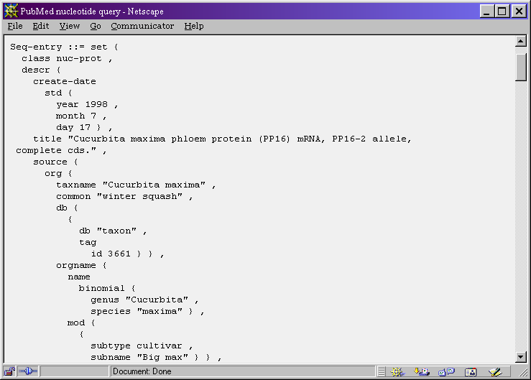
Abstract Syntax Notation (ASN.1)

Slide 39
RefSeq
Curated transcripts and proteins
  reviewed by NCBI staff
Model transcripts and proteins
  generated by computer algorithms
Assembled Genomic Regions (contigs)
Chromosome records

Slide 40
Gene
Gene centric record of genomic information
Integrates information from all databases
Record added to Gene:
  If there is a RefSeq record
  A recognized genome-specific database provides information about genes (i.e. Yeast genome database)
  The NCBI Genome Annotation Pipeline reports model genes.

Slide 41
TaxBrowser
NCBI taxonomy database contains the names of all organisms that are represented in the genetic databases with at least one sequence
BLAST searches can be sorted by taxonomy
Searchable with phonetic and common names
Will find common trees

Slide 42
The Sequence
ORIGIN
1 ttcttgtatc ccaaacatct cgagcttctt gtacaccaaa ttaggtattc actatggaat
61 tcagagttca cttgcaagct gataatgagc agaaaatttt tcaaaaccag atgaaacccg
121 aacctgaagc ctcttacttg attaatcaaa gacggtctgc aaattacaag ccaaatattt
181 ggaagaacga tttcctagat caatctctta tcagcaaata cgatggagat gagtatcgga
1741 ggacccacat cctgtcttta ctattccaac ctcttgtaaa ctagtactca tatagtttga
1801 aataaatagc agcaaaagtt tgcggttcag ttcgtcatgg ataaattaat ctttacagtt
1861 tgtaacgttg ttgccaaaga ttatgaataa aaagttgtag tttgtcgttt aaaaaaaaaa
1921 aaaaaaaaaa a
//
Notes:
1/10,000 bp error ratio

Slide 43
GenPept: FASTA format
>gi|32265058|gb|AAO22848.2| (E,E)-alpha-farnesene synthase [Malus x domestica]
MEFRVHLQADNEQKIFQNQMKPEPEASYLINQRRSANYKPNIWKNDFLDQSLISKYDGDEYRKLSEKLIE
EVKIYISAETMDLVAKLELIDSVRKLGLANLFEKEIKEALDSIAAIESDNLGTRDDLYGTALHFKILRQH
GYKVSQDIFGRFMDEKGTLENHHFAHLKGMLELFEASNLGFEGEDILDEAKASLTLALRDSGHICYPDSN
LSRDVVHSLELPSHRRVQWFDVKWQINAYEKDICRVNATLLELAKLNFNVVQAQLQKNLREASRWWANLG
IADNLKFARDRLVECFACAVGVAFEPEHSSFRICLTKVINLVLIIDDVYDIYGSEEELKHFTNAVDRWDS
RETEQLPECMKMCFQVLYNTTCEIAREIEEENGWNQVLPQLTKVWADFCKALLVEAEWYNKSHIPTLEEY
LRNGCISSSVSVLLVHSFFSITHEGTKEMADFLHKNEDLLYNISLIVRLNNDLGTSAAEQERGDSPSSIV
CYMREVNASEETARKNIKGMIDNAWKKVNGKCFTTNQVPFLSSFMNNATNMARVAHSLYKDGDGFGDQEK
GPRTHILSLLFQPLVN
>gi|32265070|gb|AAP75563.1| putative doublecortin domain-containing protein
MAKTGAEDHREALSQSSLSLLTEAMEVLQQSSPEGTLDGNTVNPIYKYILNDLPREFMSSQAKAVIKTTD
DYLQSQFGPNRLVHSAAVSEGSGLQDCSTHQTASDHSHDEISDLDSYKSNSKNNSCSISASKRNRPVSAP
VGQLRVAEFSSLKFQSARNWQKLSQRHKLQPRVIKVTAYKNGSRTVFARVTAPTITLLLEECTEKLNLNM
AARRVFLADGKEALEPEDIPHEADVYVSTGEPFLNPFKKIKDHLLLIKKVTWTMNGLMLPTDIKRRKTKP
VLSIRMKKLTERTSVRILFFKNGMGQDGHEITVGKETMKKVLDTCTIRMNLNLPARYFYDLYGRKIEDIS
KGKH

Slide 44
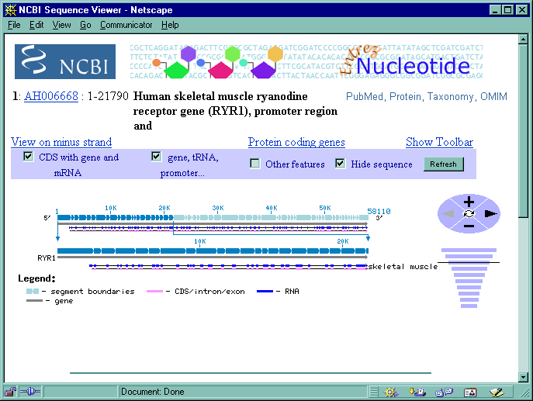

Graphical Representation

Slide 45
EMBL
FASTA
Swiss-Prot
MMDB
ASN.1
GenBank
BIND
GenPept
Graphical
XML

Slide 46
Organismal Divisions
Used in which database?
BCT Bacterial DDBJ - GenBank
FUN Fungal EMBL
HUM Homo sapiens DDBJ - EMBL
INV Invertebrate all
MAM Other mammalian all
ORG Organelle EMBL
PHG Phage all
PLN Plant all
PRI Primate (also see HUM) all (not same data in all)
PRO Prokaryotic EMBL
ROD Rodent all
SYN Synthetic and chimeric all
VRL Viral all
VRT Other vertebrate all

Slide 47
Functional Divisions
PAT Patent
EST Expressed Sequence Tags
STS Sequence Tagged Site
GSS Genome Survey Sequence
HTG High Throughput Genome (unfinished)
HTC High throughput cDNA (unfinished)
CON Contig assembly instructions
Organismal divisions:
BCT FUN INV MAM PHG PLN
PRI ROD SYN VRL VRT

Slide 48
Guiding Principals
In GenBank, records are grouped for various reasons: understand this is key to using and fully taking advantage of this database.

Slide 49
Identifiers
You need identifiers which are stable through time
Need identifiers which will always refer to specific sequences
Need these identifiers to track history of sequence updates
Also need feature and annotation identifiers

Slide 50
LOCUS, Accession, NID and protein_id
LOCUS: Unique string of 10 letters and numbers in
the database. Not maintained amongst databases,
and is therefore a poor sequence identifier.
ACCESSION: A unique identifier to that record, citable
entity; does not change when record is updated. A good
record identifier, ideal for citation in publication.
VERSION: : New system where the accession and version play the
same function as the accession and gi number.
Nucleotide gi: Geninfo identifier (gi), a unique integer
which will change every time the sequence changes.
PID: Protein Identifier: g, e or d prefix to gi number.
Can have one or two on one CDS.
Protein gi: Geninfo identifier (gi), a unique integer which
will change every time the sequence changes.
protein_id: Identifier which has the same
structure and function as the nucleotide Accession.version
numbers, but slightlt different format.

Slide 51
LOCUS, Accession, gi and PID
LOCUS HSU40282 1789 bp mRNA PRI 21-MAY-1998
DEFINITION Homo sapiens integrin-linked kinase (ILK) mRNA, complete cds.
ACCESSION U40282
VERSION U40282.1 GI:3150001
LOCUS: HSU40282
ACCESSION: U40282
VERSION: U40282.1
GI: 3150001
PID: g3150002
Protein gi: 3150002
protein_id: AAC16892.1
LOCUS
ACCESSION
Accession.version
gi
PID
protein gi
Protein_id
CDS 157..1515
/gene="ILK"
/note="protein serine/threonine kinase"
/codon_start=1
/product="integrin-linked kinase"
/protein_id="AAC16892.1"
/db_xref="PID:g3150002"
/db_xref="GI:3150002"

Slide 52
EST: Expressed Sequence Tag
Expressed Sequence Tags are short
(300-500 bp) single reads from mRNA (cDNA)
which are produced in large numbers.
They represent a snapshot of what is expressed
in a given tissue, and developmental stage.
Also see: http://www.ncbi.nlm.nih.gov/dbEST/
http://www.ncbi.nlm.nih.gov/UniGene/

Slide 53
STS
Sequenced Tagged Sites, are operationally
unique sequence that identifies the combination of primer pairs used in a PCR assay that generate a mapping reagent which maps to a single position within the genome.
Also see: http://www.ncbi.nlm.nih.gov/dbSTS/
http://www.ncbi.nlm.nih.gov/genemap/

Slide 54
GSS: Genome Survey Sequences
Genome Survey Sequences are similar in nature
to the ESTs, except that its sequences are genomic
in origin, rather than cDNA (mRNA).
The GSS division contains:
  random "single pass read" genome survey sequences.
  single pass reads from cosmid/BAC/YAC ends (these could
  be chromosome specific, but need not be)
  exon trapped genomic sequences
  Alu PCR sequences
Also see: http://www.ncbi.nlm.nih.gov/dbGSS/

Slide 55
HTG: High Throughput Genome
High Throughput Genome Sequences are
unfinished genome sequencing efforts records.
Unfinished records have gaps in the nucleotides sequence, low accuracy, and no annotations on the records.
Also see: http://www.ncbi.nlm.nih.gov/HTGS/
Ouellette and Boguski (1997) Genome Res. 7:952-955

Slide 56
HTGS in GenBank
phase 0
HTG
Acc = AC000003 gi = 1235673
phase 1
HTG
Acc = AC000003 gi = 1556454
phase 2
HTG
Acc = AC000003 gi = 2182283
phase 3
PRI
Acc = AC000003 gi = 2204282

Slide 57
HTGS in GenBank
Unfinished Record
  Sequencing will be unfinished
  Phase 1 or phase 2
  HTG division
  KEYWORDS: HTG; HTGS_PHASE1 or 2
Finished record
  Sequencing will be finished
  Phase 3
  Organismal division it belongs to PRI,INV or PLN
  KEYWORDS: HTG

Slide 58
HTC in GenBank
GenBank division for unfinished high-throughput cDNA sequencing (HTC).
HTC sequences may have 5'UTR and 3'UTR at their ends, partial coding regions, and introns.
A keyword of "HTC" will be present, in addition to division code "HTC". Those HTC sequences that undergo finishing (eg, re-sequencing) will move to the appropriate taxonomic GenBank division and the "HTC" keyword will be removed.

Slide 59
Top 5 organisms in the HTC division
64106 Mus musculus
62848 Anopheles gambiae
9119 Zea mays
7732 Homo sapiens
2957 Schmidtea mediterranea

Slide 60
WGS in GenBank
Contigs from ongoing Whole Genome Shotgun sequencing projects
The nucleotides from WGS projects go into the BLAST ‘wgs’ database, whereas the proteins go into the BLAST nr database.
More info, and how to submit to this division: http://www.ncbi.nlm.nih.gov/Genbank/wgs.html
Accession format is 4+2+6

Slide 61
CON in GenBank
Points to files that make the contig, does not actually contain sequence
‘Invented’ by NCBI to deal with tracking of segmented sets and 350 KB limit in DDBJ/EMBL/GenBank

Slide 62
CON in GenBank
LOCUS AH007743 7832 bp DNA CON 26-MAY-1999
DEFINITION Gallus gallus ornithine transcarbamylase (OTC) gene, complete cds.
ACCESSION AH007743
VERSION AH007743.1 GI:4927367
KEYWORDS .
SOURCE chicken.
ORGANISM Gallus gallus
Eukaryota; Metazoa; Chordata; Craniata; Vertebrata; Archosauria;
Aves; Neognathae; Galliformes; Phasianidae; Phasianinae; Gallus.
[....]
FEATURES Location/Qualifiers
source 1..7832
/organism="Gallus gallus"
/db_xref="taxon:9031"
/chromosome="1"
CONTIG join(AF065630.1:1..1903,gap(),AF065631.1:1..435,gap(),
AF065632.1:1..509,gap(),AF065633.1:1..722,gap(),AF065634.1:1..707,
gap(),AF065635.1:1..836,gap(),AF065636.1:1..1614,gap(),
AF065637.1:1..605,gap(),AF065638.1:1..501)
//

Slide 63
join(AF065630.1:1..1903,
gap(),
AF065631.1:1..435,
gap(),
AF065632.1:1..509,
gap(),
AF065633.1:1..722,
gap(),
AF065634.1:1..707,
…

Slide 64
Sequences NOT in GenBank
SNPs
SAGE tags
RefSeq (Genomic, mRNA, or protein)
Consensus sequences

Slide 65
Sequences to Public Databases
No longer publish sequences in Journal
Electronic format , is most useful
Allows validations testing of data
best way to move Science forward
Sequences sent to DDBJ/EMBL/GenBank are exchanged daily
Best way to exchange new data, and updates

Slide 66
Which Tool?
BankIt: Web based tool which is simple, easy to use, great for simple submissions, but not ideal for complicated ones.
  Sakura (DDBJ)
  WebIn (EMBL)
Sequin: Client that you need to d/l to your computer, a little harder to learn, but has great documentation, and ideal for complicated, large, multiple submissions.
tbl2asn: ideal for batch records, command line, scriptable, can work with sequin

Slide 67
Which tool?
mRNA
Genomic
STS/
GSS
EST
Other
Other
HTGS
dbEST
Simple
Better control
of annotations
pop/phylo
segmented sets
Simple
dbSTS
dbGSS
Customized
software
or tbl2asn
E-mail
or FTP
WWW
BankIt
Sequin
or tbl2asn
WWW
BankIt
E-mail
or FTP
E-mail
or FTP
E-mail

Slide 68
In closing ...
Often only use FASTA files (eg for BLAST)
GBFF are simply human readable versions of these records
GBFF have become a vehicle for a lot more information than they where meant to do
Keep in mind that GenBank is DNA centric and is a poor vehicle for protein and mRNA expression/interaction information

Slide 69
In closing (cont’d) ...
Able to recognize various data formats, and know what their primary use is.
Know, understand and utilize all types of sequence identifiers.
Know and understand various feature types present in the GenBank flat files.
Know and understand the various GenBank divisions.

Slide 70
In closing (cont’d) ...
Open access to sequences is not only essential for all of the work we do, if it was not there, there would be no bioinformatics, no BLAST, no CBW
As critical as open access to sequence information is the open access to the literature.

Slide 71
Resources
W W W:
  http://www.ncbi.nlm.nih.gov
  http://www.ddbj.nig.ac.jp/
  http://www.ebi.ac.uk/
  http://www.ncbi.nlm.nih.gov/Genbank/GenbankOverview.html
  http://www.ebi.ac.uk/embl/
  http://www.pir.uniprot.org/
  http://www.expasy.ch/sprot/
  http://www.rcsb.org/pdb/
  http://www.ncbi.nlm.nih.gov/Genbank/ (submission info)
  http://genome-www.stanford.edu/Saccharomyces/

Slide 72
Resources
W W W:
      http://nar.oupjournals.org/content/vol30/issue1/
      http://nar.oupjournals.org/content/vol31/issue1/
      http://www.ncbi.nlm.nih.gov/HTGS/
      http://www.ncbi.nlm.nih.gov/dbEST/
      http://www.ncbi.nlm.nih.gov/Genbank/wgs.html
      http://www.ncbi.nlm.nih.gov/dbSTS/
      http://www.ncbi.nlm.nih.gov/dbGSS/
      http://www.ncbi.nlm.nih.gov/genome/guide/

