Slide 1

GPGPU Processing in CUDA Architecture
Ghorpade et al. (2012)
Lim Zheng Haur
32023952

Slide 2
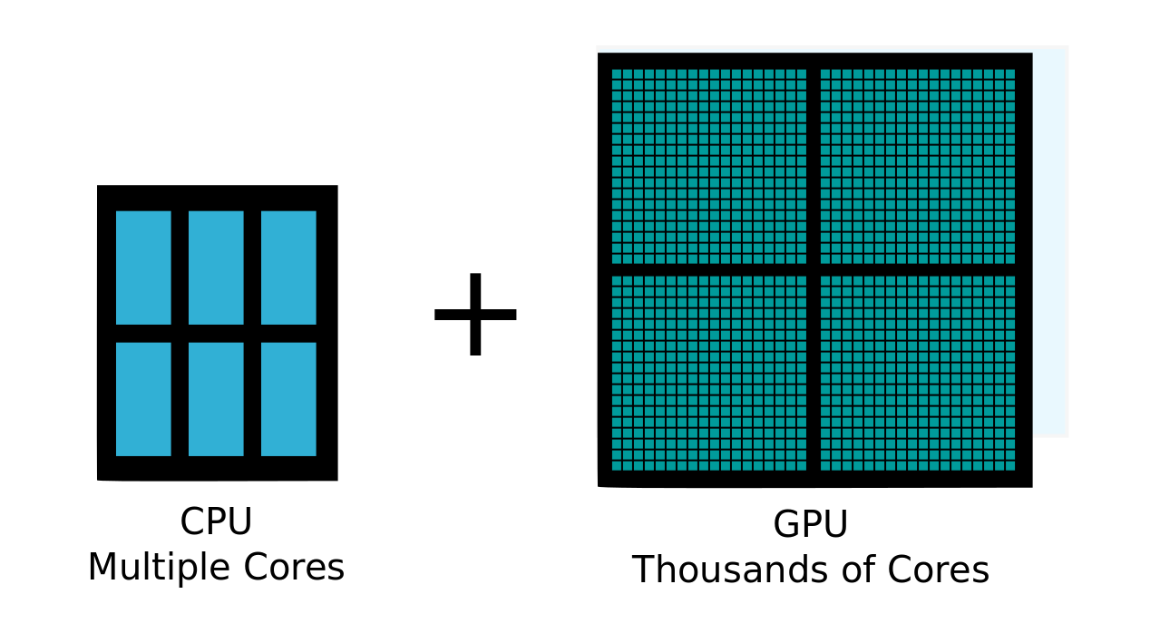
What is a GPU?
GPU - Graphics Processing Unit
Facilitate high definition graphics in modern computing
Similar to the CPU - Single Chip Processor
Difference:
Levinas (2020) [Photograph]

Slide 3
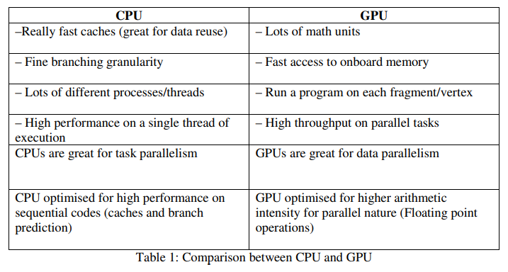
GPU Function
Primary Role: Computation of 3D Functions
Efficiently handle heavy calculations (arithmetic operations)
Ghorpade et al. (2012) Comparison between CPU and GPU [Table].

Slide 4
What is GPGPU?
General Purpose Computing on Graphics Processing Unit
GPGPU → GPU's parallel processing power → accelerate non-graphics applications
Idea:
CPU handle sequential, GPU handle parallel & data intensive computations

Slide 5

How?
Nvidia - CUDA :
Compute Unified Device Architecture
API
Use GPU for general purpose computing
Alternatives:
OpenCL
ATI Stream SDK (ROCm today)
Wikipedia (2023) CUDA.

Slide 6
Problem Statement & Hypothesis
Problem Statement:
What is GPGPU, and how can the use of GPU in General Purpose Computing address the limitations of CPU in parallel processing?
Hypothesis:
Leveraging General Purpose Computing on GPUs is a viable solution to substantially improve the speed of efficiency of parallel processing.

Slide 7
Related Works (Ghorpade et al., 2012)
Introduction to GPU Computing and CUDA Programming: A Case Study on FDTD (De Donno et al., 2010)
Exploiting GPU features by examining the computational time of the Finite-Difference Time-Domain (FDTD) Method
Accelerating Particle Swarm Algorithm with GPGPU (Cádenas-Montes et al., 2011)
Using GPGPU to solve large size optimization problems: Particle Swarm Algorithm

Slide 8
Methodology (Ghorpade et al., 2012)
Installing CUDA
Using CUDA
Allocate memory to CPU and GPU.
Store input data into CPU memory.
Copy the data from CPU memory to GPU memory.
Perform processing in GPU memory using kernel calls.
Copy processed data from GPU memory to CPU memory.
Output results.
Free memory.

Slide 9
Analysis of Results - Architecture (Ghorpade et al., 2012)
CUDA Pros:
Simple C-like language
Pointer support
Long term market support
Large number of languages support
Regular updates
CUDA Cons:
Nvidia GPUs only
Complicated programming environment (nvcc, etc.)

Slide 10
Analysis of Results - Architecture (Ghorpade et al., 2012)
Alternative architectures - OpenCL (Open Computing Language):
Wider range of hardware (AMD, Intel, etc.)
CPU fallback
Open standard
Lacking in maturity

Slide 11
Proof of Concept
CUDA → Matrix Multiplication
Google Colab
Brief Pseudocode:
Initialize matrices (input A, input B, results)
Multiply matrix A and matrix B sequentially
Multiply matrix A and matrix B on GPU with CUDA
Compare results
Output performance (speed)

Slide 12
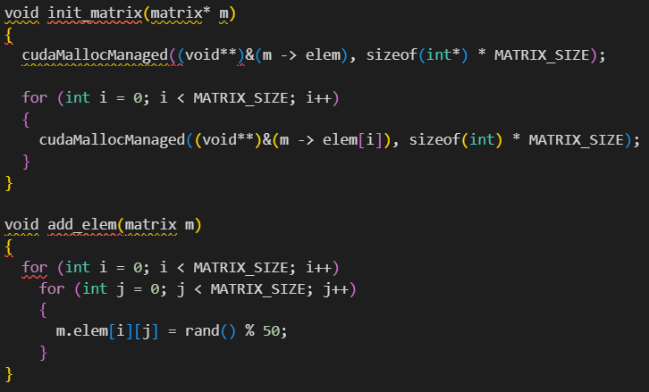
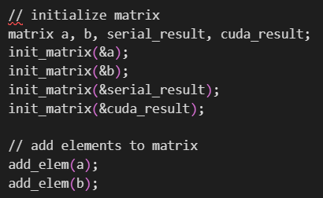
Proof of Concept
Initialize Matrix

Slide 13
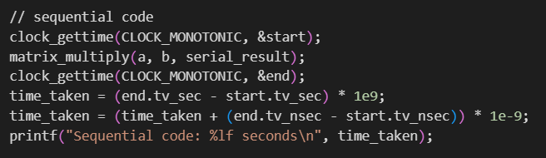
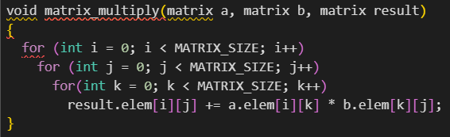
Proof of Concept
Sequential Multiplication

Slide 14
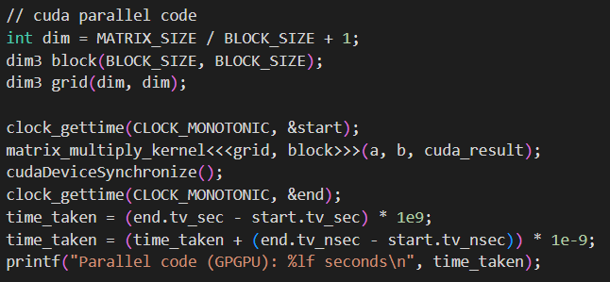
Proof of Concept
Parallel (GPGPU) Multiplication

Slide 15
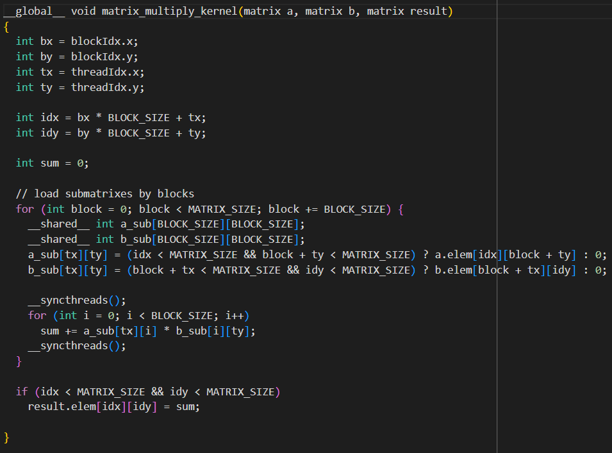

Slide 20
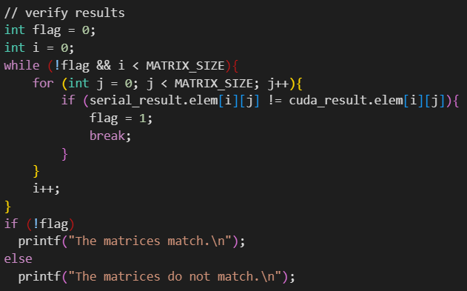
Proof of Concept
Results verification

Slide 21
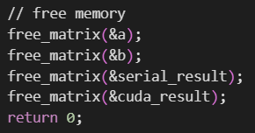

Proof of Concept
Free memory
Output

Slide 22
Code Demo

Slide 23
References
Cádenas-Montes, M., Vega-Rodríguez, M. A., Rodríguez-Vázquez, J. J., & Gómez-Iglesias, A. (2011). Accelerating Particle Swarm Algorithm with GPGPU. 19th International Euromicro Conference on Parallel, Distributed and Network-Based Processing. doi: 10.1109/PDP.2011.33
De Donno, D., Catarinucci, L., Tarricone, L., &amp; Esposito, A. (2010). Introduction to GPU Computing and CUDA Programming: A Case Study on FDTD. IEEE Antennas and Propagation Magazine, 52(3), 116–22. doi: 10.1109/MAP.2010.5586593
Ghorpade, J., Parande, J., Kulkarni, M., & Bawaskar, A. (2012). GPGPU Processing in CUDA Architecture. Advanced Computing: An International Journal ( ACIJ ), Vol. 3, No.1. doi: 10.48550/arXiv.1202.4347.
Levinas, M. (2020, November 25). GPU vs CPU Performance Comparison: What are the Key Differences? Cherry Servers. Retrieved from https://www.cherryservers.com/blog/gpu-vs-cpu-what-are-the-key-differences.
Wikimedia Foundation. (2023, October 27). CUDA. Wikipedia. Retrieved from https://en.wikipedia.org/wiki/CUDA.

