Slide 1

BRAND GUIDELINES
From Singapore to the World.
Version 1.0 · June 2026 · One company. One look. One voice.

Slide 2
01 · THE PURPOSE
02
Why this guide exists
We audited our own brand. We found four different blues, logos stretched to fit, and headlines that argued with each other. Nobody did anything wrong. This is just what eight years without a rulebook looks like.
Old PNG files
retired
Old icon files
retired
Website blues
retired
This guide is the rulebook. If a decision is written here, nobody has to debate it again.
THE OFFICIAL ONE

Slide 3


02 · THE NAME
03
Why we are called Zhenghe
In 1405, Admiral Zheng He led the largest fleet the world had ever seen through the Indonesian archipelago: Java, Sumatra, Palembang. Seven voyages over three decades.
Six hundred years later, we move cargo through the same waters. The name is a standard, not a story: know the route better than anyone, and run a disciplined fleet behind every shipment.
“The Trusted Route.”

Slide 4
03 · POSITIONING
04
Who we are
Zhenghe Logistics is the Indonesia door-to-door specialist for manufacturers, procurement managers, and business owners. Every client gets a dedicated account manager who owns the shipment end-to-end, unlike generalist forwarders who treat cargo as a batch number.
The test for everything we make: if it doesn’t serve this sentence, it isn’t on brand.

Slide 5
04 · THE TAGLINE
05
From Singapore to the World.
Our tagline, and the rule for using it: Indonesia first. Everywhere after.
1
Headlines & hero sections The Indonesia specialty always leads. Never “global” in a headline.
2
Second sentence “And when your supply chain goes beyond Indonesia, so do we.” Worldwide lanes, FCL & LCL.
3
Supporting details Lane lists, global coverage, compliance capabilities. Proof, never the headline.
The tagline travels with the logo everywhere. In sales headlines, the specialty leads. That is tier 1.

Slide 6


05 · THE PROMISE
06
What we promise, in order
1. Ownership-level accountability
2. Responsiveness
Every client gets a dedicated account manager: one name, one number, owning the shipment end-to-end. Per client, not per shipment. We promise what we can keep.
Quotes within one business day via the online estimator, often within the hour when rates are in hand. If we take longer, it’s because we’re hunting you a better rate, and we tell you so.

Slide 7



06 · VOICE
07
How we sound
The expert who tells you the truth before you’ve paid for it.
Lead with the answer. Then the reason. Clients are busy and anxious, so never bury the headline.
Bad news travels fastest. Delays and cost changes: the client hears it from us first, with the fix attached.
Plain words beat industry words. “Your shipment,” not “the consignment.” Jargon only when precise (FCL, HS code).
Banned: world-class · synergy · solutions provider · revolutionary · cheapest · guaranteed · “We are pleased to inform you…”

Slide 8
07 · VOICE IN PRACTICE
08
We say / we never say
WE SAY
WE NEVER SAY
“Here’s exactly what this quote covers, and what it doesn’t.”
“Best rates guaranteed!!”
“That routing will bite you at customs. Here’s the better way.”
“We are pleased to inform you of our wide range of solutions.”
“Your AM is Sarah. She owns this shipment end to end.”
“Your request has been forwarded to the relevant department.”
“You’ll have the quote within the business day. If we’re hunting a cheaper rate, we’ll tell you.”
“Cheapest and fastest in Singapore!”
“Delay at Tanjung Priok, two days. Here’s what we’re doing.”
(silence until the client asks)

Slide 9
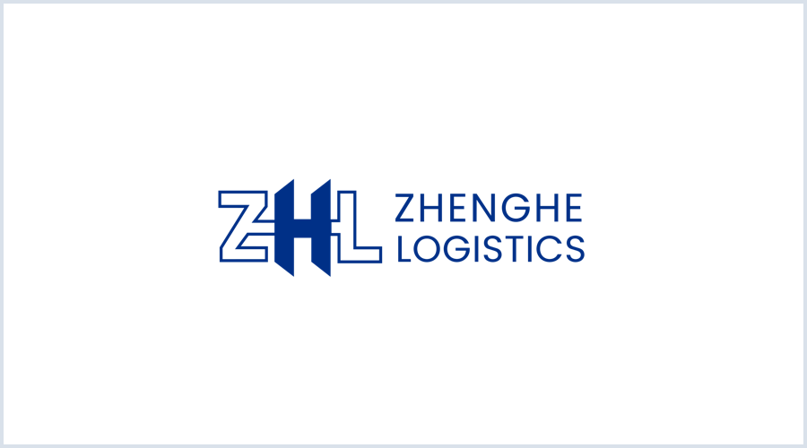
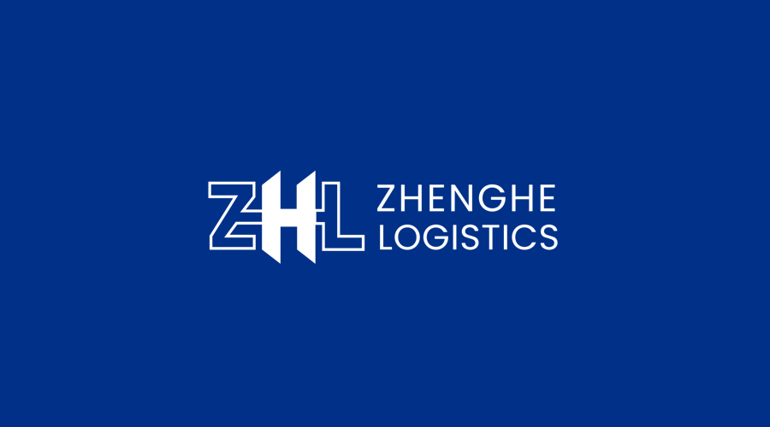


08 · LOGO
09
Our logo: four versions, two rules
Rule 1: Color
Navy logo on white. White logo on navy. No other combination exists.
Rule 2: Space and size
Clear space around the logo equals the height of the “Z”, on all sides. Below 120px wide, switch to the icon-only mark.
All approved files live in ZHL_Logo_Kit_v1. Use only those files.
Primary, navy on white
Reverse, white on navy
Icon, small spaces
Icon reverse, avatars

Slide 10
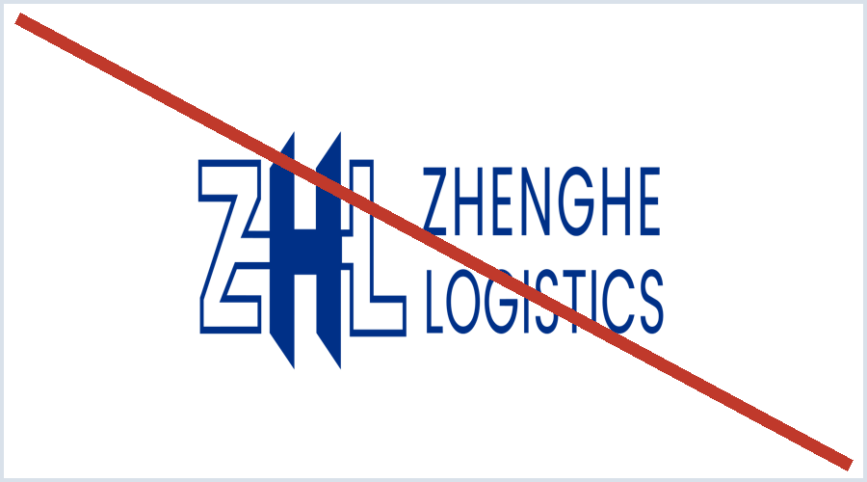
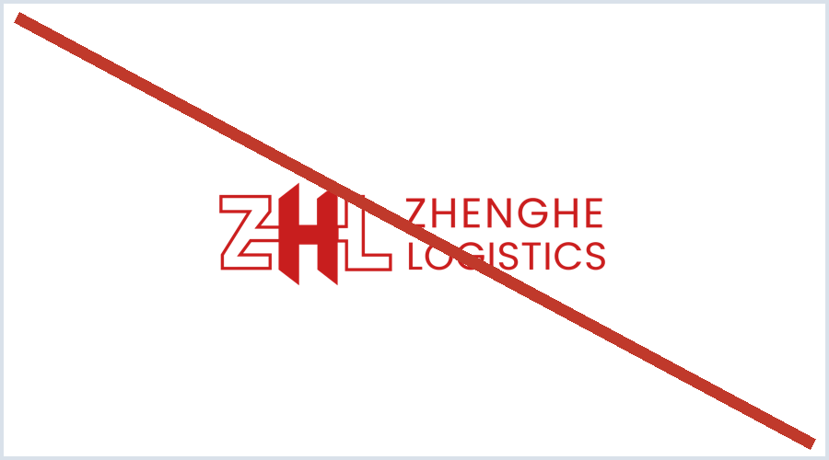
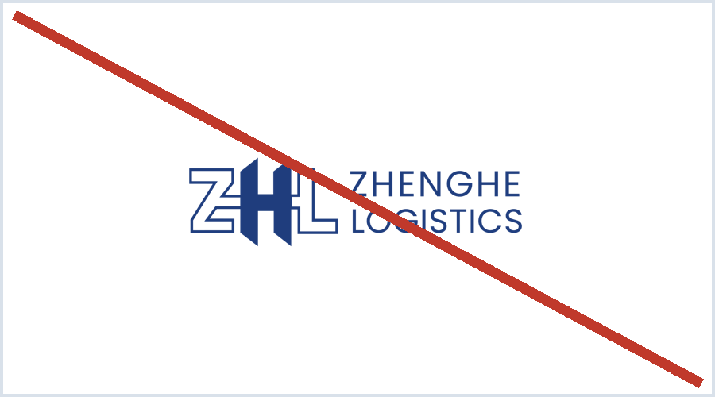
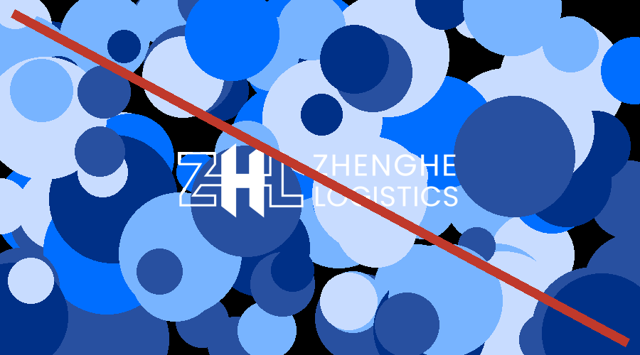
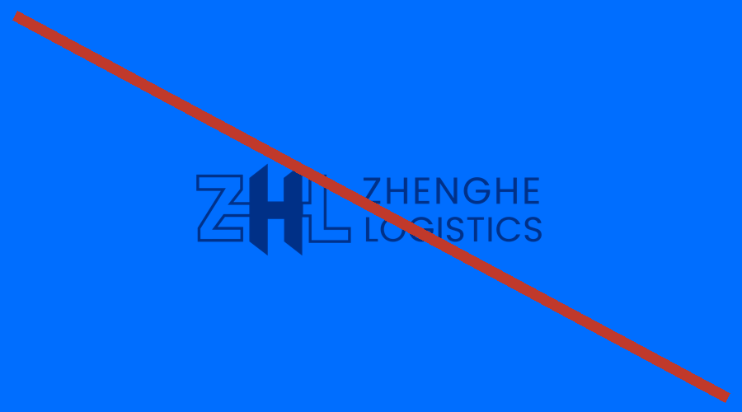
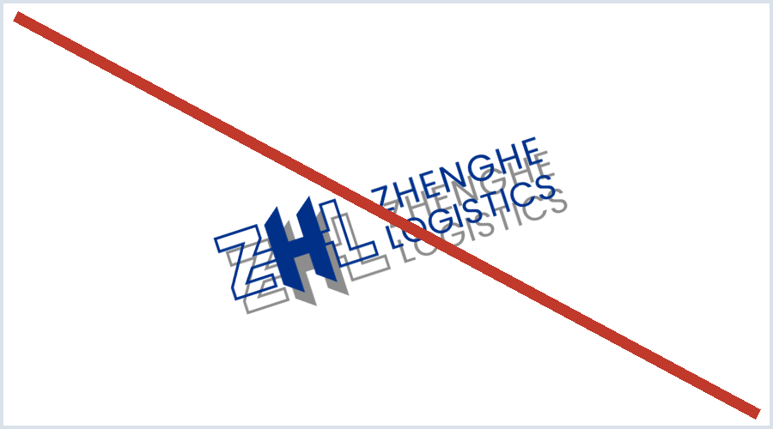
09 · LOGO MISUSE
10
Never do this to the logo
Don’t stretch or squish
Don’t recolor
Don’t use retired blues
Don’t place on busy backgrounds
Don’t use low-contrast pairings
Don’t rotate or add effects

Slide 11
10 · COLOR
11
Our colors
ZHL Navy
Pantone 287C · #003087
The brand. Logo, headers, heroes.
Horizon Blue
#006EFF (text: #0061E0)
The action. Buttons, links, highlights. Max 10%.
Pure White
#FFFFFF
Logo reverse, cards.
Sail White
#F5F8FC
Page & slide backgrounds.
Ink Navy
#11203A
Body text.
Harbor Gray
#5A6B80
Captions, secondary text.
60% white space
30% navy
10%
If everything is Horizon Blue, nothing is. Old blues (#042B52, #1F3D7D) are retired.

Slide 12
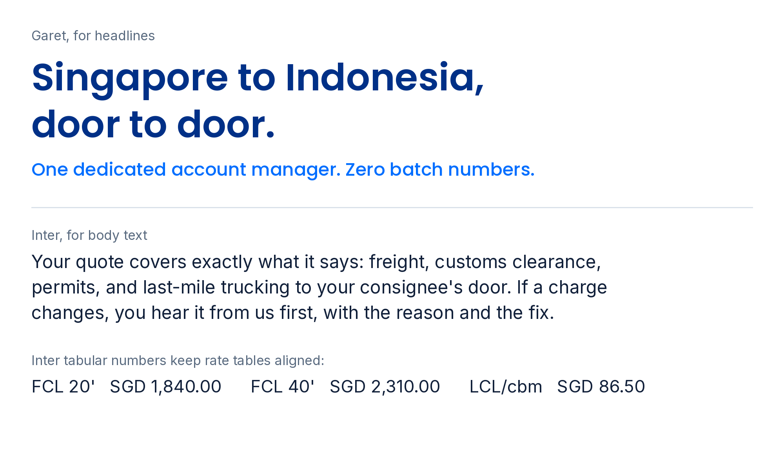
11 · TYPOGRAPHY
12
Our typography
Garet
Headlines in Canva and print. Semibold for H1, Medium for H2 and H3.
Inter
All body text, everywhere. Tabular numbers keep rate tables aligned.
Poppins
Web substitute wherever Garet can’t be served.
No italics for subtext. ALL-CAPS only for short headlines.

Slide 13



12 · THE SYSTEM
13
Icons, layout & imagery
Icons
Layout
Imagery
One family only: Lucide line icons. Navy on light, white on navy, Horizon Blue only when clickable. Never filled, never multicolor, never emoji in client documents.
12-column grid. Minimum 40px margins. One idea per slide. Left-align text; center only short hero lines. White space is a feature. It is 60% of the brand.
Real assets first: our trucks, our containers, our team. Stock only when it looks candid and operational, never staged handshake photos. (Full library coming in v1.1.)

